Slide 1


Enabling High-level SLOs on Shared Storage
Cake
Andrew Wang, Shivaram Venkataraman, Sara Alspaugh, Randy Katz, Ion Stoica

Slide 2


Slide 3





Slide 4
Trend toward consolidation of front-end and back-end storage systems

Slide 5

Front-end
Backend

Slide 6
Data
Users
Analysis
Front-end
Backend

Slide 7
forever
Minutes to hours
Data
Users
Analysis
Front-end
Backend

Slide 8
Users
Consolidated

Slide 9
Provisioning
Utilization
Analysis time
Users
Consolidated

Slide 10
Nope.

Slide 11
Cluster scheduling
Privacy
Failure domains
Performance isolation

Slide 12
Performance isolation

Slide 13
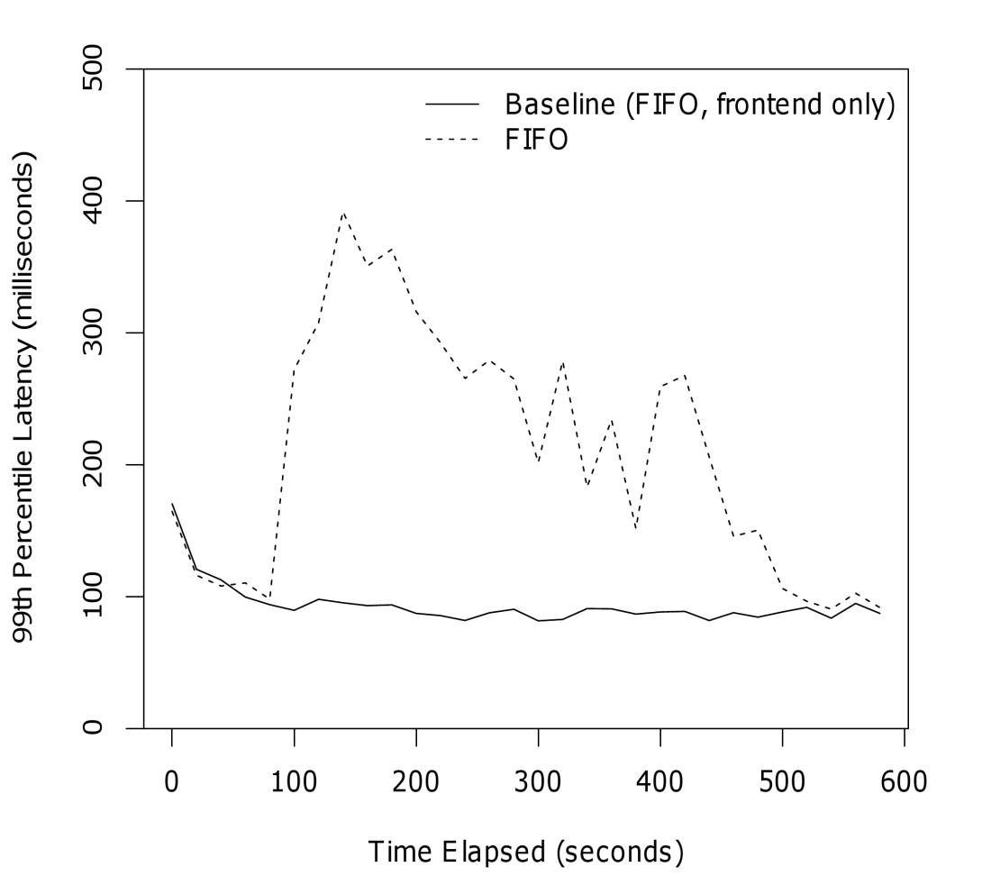
4x increase in latency
Notes:
Fix the legend: Separated & Consolidated

Slide 14
Objective
Combine two workloads
Meet front-end latency requirements
Then maximize batch throughput

Slide 15
Latency
vs.
Throughput

Slide 16
95th
High-percentile latency
99th

Slide 17
95th
“…purely targeted at controlling performance at the 99.9th percentile.”
99th

Slide 18
get
put
High-level operations
scan

Slide 19
service-level objective
performance metric
requirement
of
type of request
for

Slide 20
service-level objective
99th percentile latency
100 milliseconds
of
get requests
for

Slide 21
Approach
Coordinated, multi-resource scheduler for consolidated storage workloads
Add scheduling points within the system
Dynamically adjust allocations to meet SLO of front-end workload
Built on HBase/HDFS

Slide 22
Front-end web server
Client
HBase
HDFS
Batch MapReduce task

Slide 23
Index lookup
Client
HBase
HDFS

Slide 24
Read data
Client
HBase
HDFS

Slide 25
Process
Client
HBase
HDFS

Slide 26
Response
Client
HBase
HDFS

Slide 27

CPU usage
Client
HBase
HDFS

Slide 28

Disk usage
Client
HBase
HDFS

Slide 29
Clean RPC interfaces
Client
HBase
HDFS

Slide 30
1st-level schedulers
Client
1
HBase
1
HDFS

Slide 31
2^{nd-}level scheduler
2
Client
1
HBase
1
HDFS

Slide 32
1^{st-}level schedulers
2
Client
1
HBase
1
HDFS

Slide 33
1st-Level Schedulers
Provide effective control over access to the underlying hardware resource
Low latency
Expose scheduling knobs to the 2nd-level scheduler

Slide 34
Three Requirements
Differentiated Scheduling
Chunk Large Requests
Limit # Outstanding Requests

Slide 35

Differentiated Scheduling
Requests are handled by HBase threads
Threads wait in OS to be scheduled on a CPU
HBase
OS

Slide 36
Differentiated Scheduling
Unfairness with a single FIFO queue
Front-end requests get stuck behind batch
HBase
OS

Slide 37
Differentiated Scheduling
Separate queues for each client
Schedule based on allocations set by the 2nd-level scheduler
HBase
OS

Slide 38
Chunk Large Requests
Large requests tie up resources while being processed
Lack of preemption
HBase
OS

Slide 39
Chunk Large Requests
Split large requests into multiple smaller chunks
Only wait for a chunk, rather than an entire large request
HBase
OS

Slide 40
Limit # of Outstanding Requests
Long queues outside of Cake impact latency
Caused by too many outstanding requests
Need to determine level of overcommit
HBase
OS

Slide 41
Limit # of Outstanding Requests
TCP Vegas-like scheme
Latency as estimate of load on a resource
Dynamically adjust # of threads
HBase
OS

Slide 42
Limit # of Outstanding Requests
Upper and lower latency bounds
Additively increase # threads if underloaded
Multiplicatively decrease # threads if overloaded
Converges in the general case
HBase
OS

Slide 43
1st-level Schedulers
Separate queues enable scheduling at each resource
Chunk large requests for better preemption
Dynamically size thread pools to prevent long queues outside of Cake
More details in the paper

Slide 44
2nd-level Scheduler
2
Client
1
HBase
1
HDFS

Slide 45
2nd-level Scheduler
Coordinates allocation at 1st-level schedulers
Monitors and enforces front-end SLO
Two allocation phases
SLO compliance-based
Queue occupancy-based
Just a sketch, full details are in the paper

Slide 46
SLO compliance-based
Disk is the bottleneck in storage workloads
Improving performance requires increasing scheduling allocation at disk (HDFS)
Increase allocation when not meeting SLO
Decrease allocation when easily meeting SLO

Slide 47
Queue Occupancy-based
Want HBase/HDFS allocation to be balanced
HBase can incorrectly throttle HDFS
Look at queue occupancy
% of time a client’s request is waiting in the queue at a resource
Measure of queuing at a resource
Increase when more queuing at HBase
Decrease when more queuing at HDFS

Slide 48
Details
Using both proportional share and reservations at 1st-level schedulers
Linear performance model
Evaluation of convergence properties

Slide 49
Recap
1st-level schedulers
Effective control over resource consumption
HBase and HDFS
2nd-level scheduler
Decides allocation at 1st-level schedulers
Enforces front-end client’s high-level SLO

Slide 50
Evaluation
Consolidated workloads
Front-end YCSB client doing 1-row gets
Batch YCSB/MR client doing 500-row scans
c1.xlarge EC2 instances

Slide 51
Diurnal Workload
Front-end running web-serving workload
Batch YCSB client running at max throughput
Evaluate adaptation to dynamic workload
Evaluate latency vs. throughput tradeoff

Slide 52
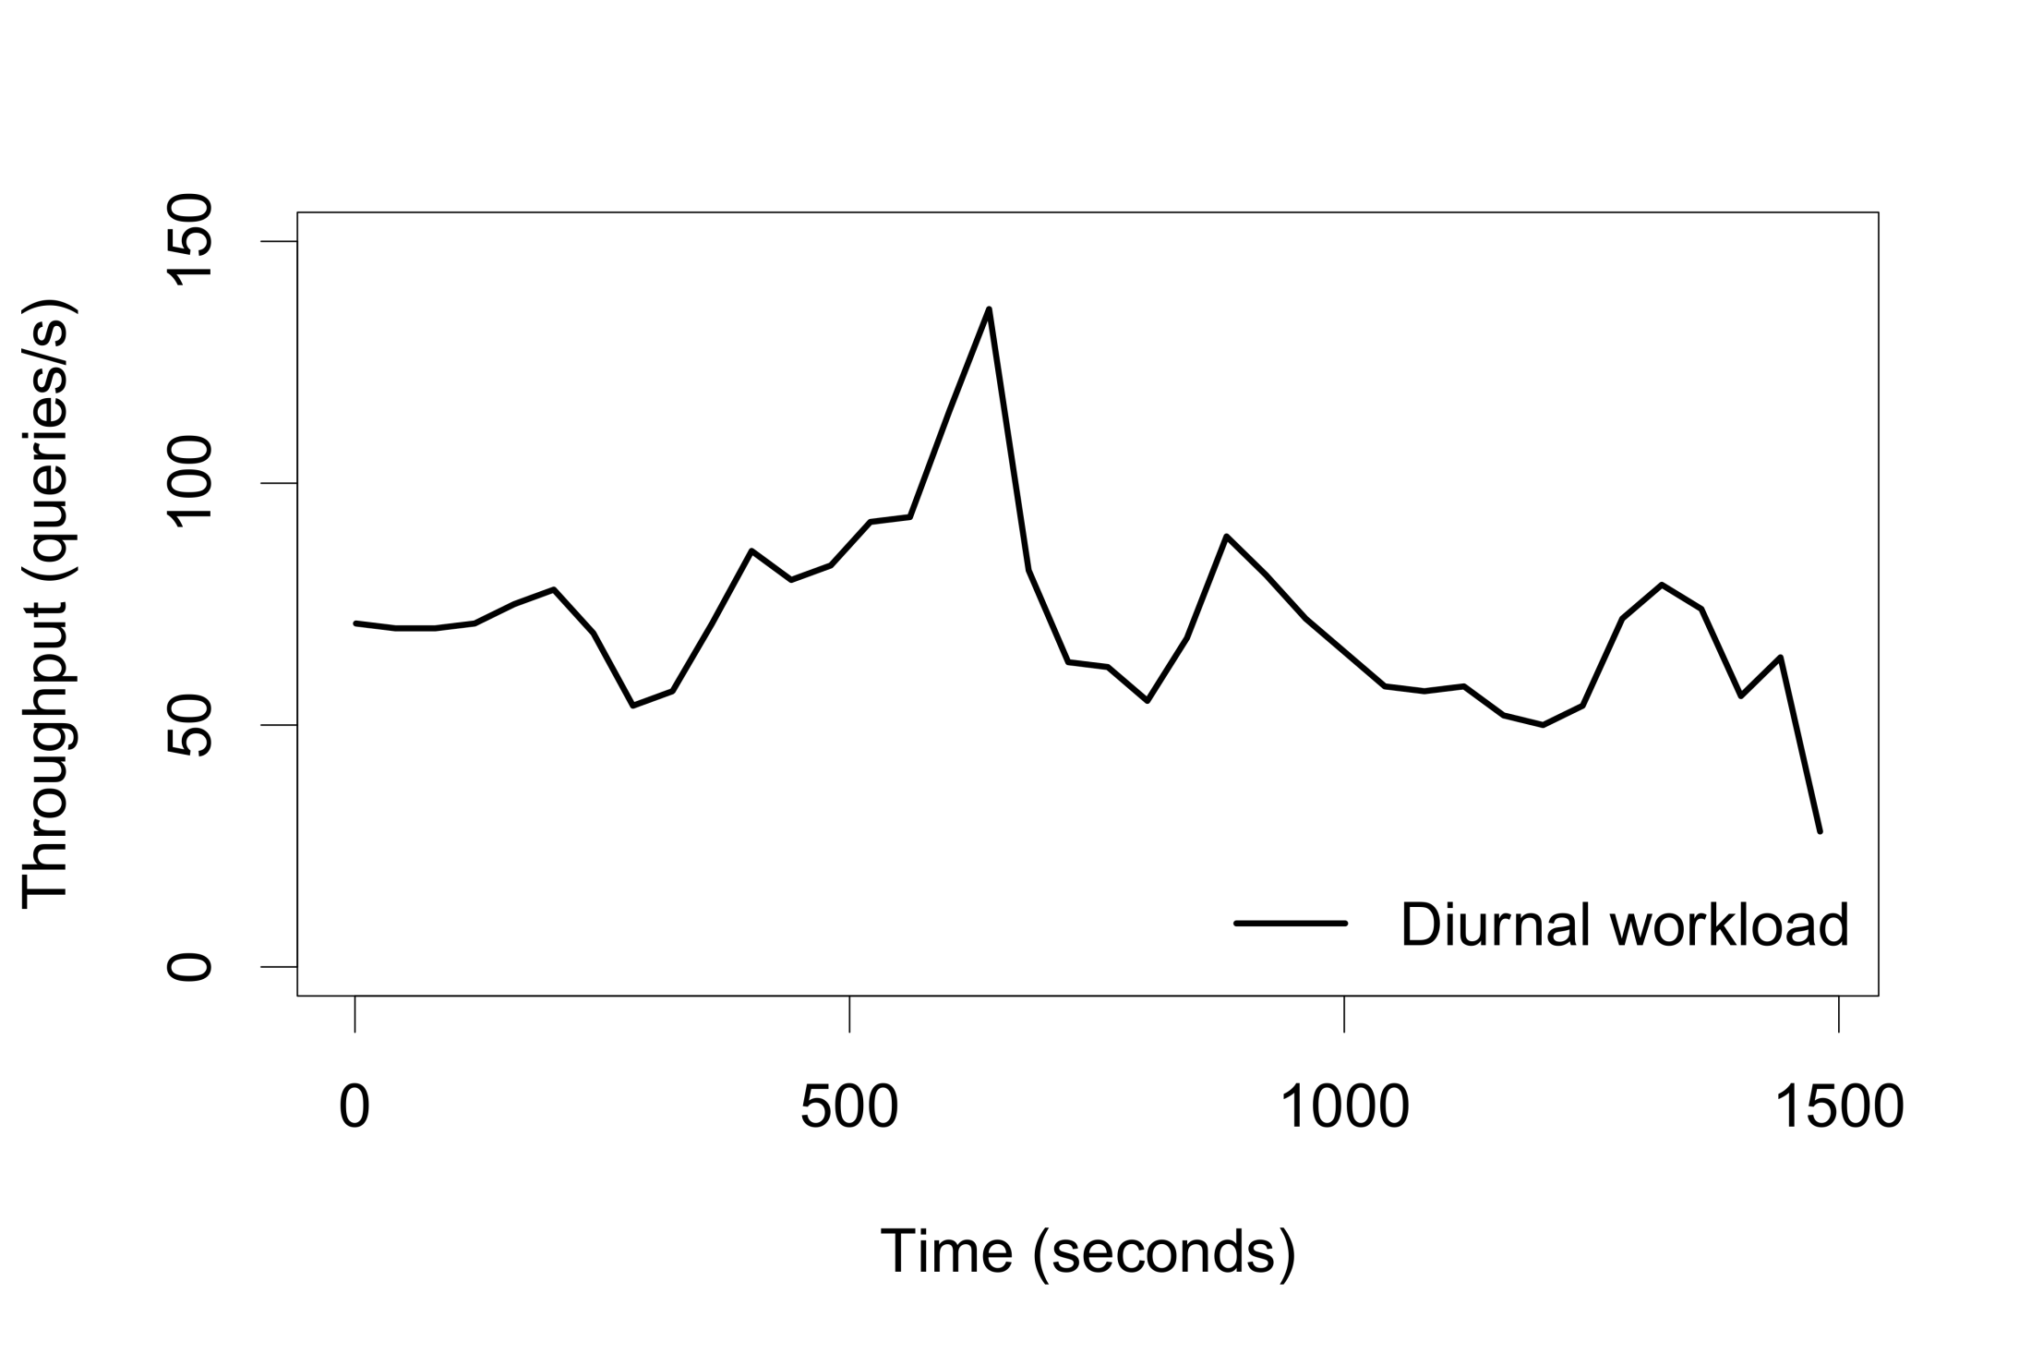
3x peak-to-trough

Slide 53
Front-end 99th SLO | % Meeting SLO | Batch Throughput
100ms | 98.77% | 23 req/s
150ms | 99.72% | 38 req/s
200ms | 99.88% | 45 req/s
Notes:
Baseline latency

Slide 54
Analysis Cycle
20-node cluster
Front-end YCSB client running diurnal pattern
Batch MapReduce scanning over 386GB data
Evaluate analytics time and provisioning cost
Evaluate SLO compliance

Slide 55
Scenario | Time | Speedup | Nodes
Unconsolidated | 1722s | 1.0x | 40
Consolidated | 1030s | 1.7x | 20
Notes:
386 GB of data

Slide 56
Front-end 99th SLO | % Requests Meeting SLO
100ms | 99.95%

Slide 57
Evaluation
Adapts to dynamic front-end workloads
Can set different SLOs to flexibly move within latency vs. throughput tradeoff
Significant gains from consolidation
1.7x speedup
50% provisioning cost

Slide 58
Conclusion
Coordinated, multi-resource scheduler for storage workloads
Directly enforce high-level SLOs
High-percentile latency
High-level storage system operations
Significant benefits from consolidation
Provisioning costs
Analytics time

Slide 60
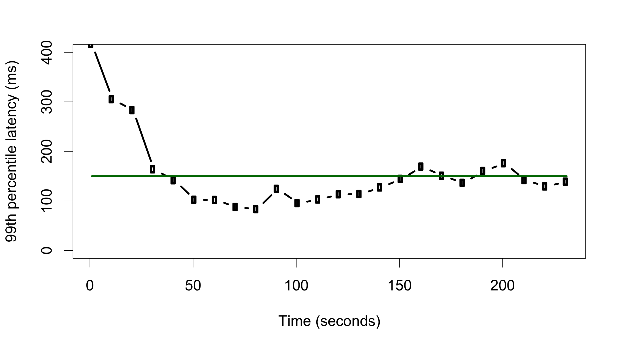

Slide 61
2nd-level Scheduling
SLO perf | Action | Justification
perf >> SLO | ↓ HDFS allocation | SLO safely met
perf < SLO | ↑ HDFS allocation | SLO is not met
Queue occ | Action | Justification
HBase > HDFS | ↑ HBase allocation | Bottlenecked on HBase
HBase << HDFS | ↓ HBase allocation | HBase is underutilized

Slide 62
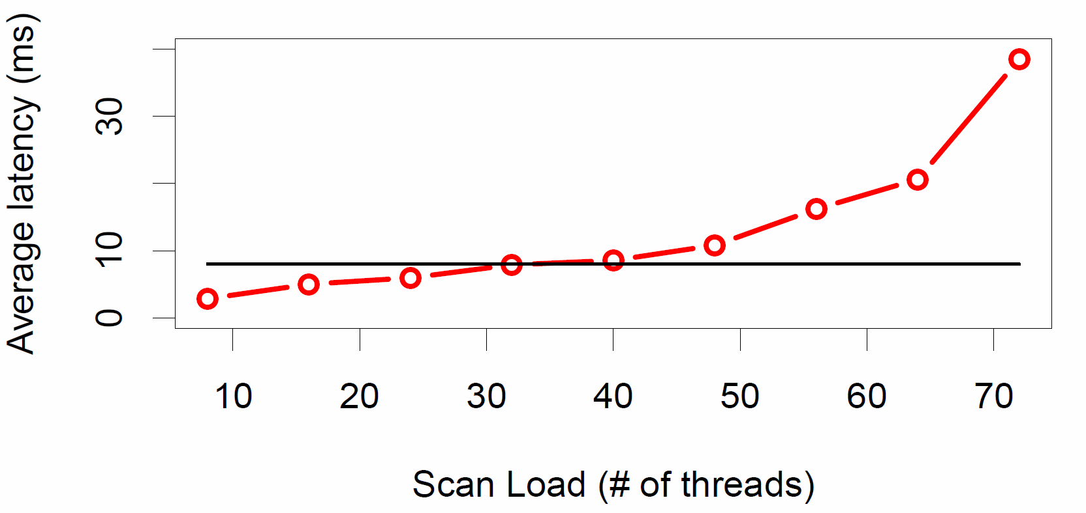
Limit Outstanding Requests

Slide 63
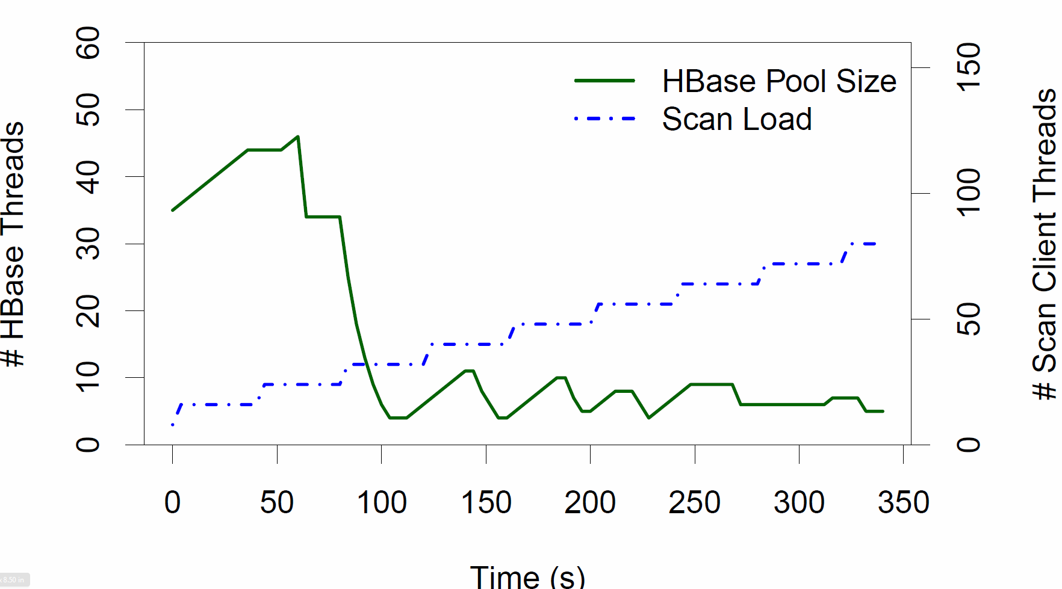
Limit Outstanding Requests

Slide 64





Search
Browse
Decide

Slide 65


Slide 66

News For You

Slide 67

Good
Better
Best
Top News
Personal
Real-time

Slide 68


Slide 69
We had the data
We had the content
We didn’t connect the dots

Slide 70
?

Slide 71
Half a second delay caused a 25% drop in traffic.
- Google
Notes:
Fix the legend: Separated & Consolidated

