Slide 1

JAYPEE UNIVERSITY OF INFORMATION TECHNOLOGY, WAKNAGHAT-173234
Major Project Part I (10B19CI791/10B29CI792 )
SAVE++
Prepared By
Apurva Dubey[181209]
Project Supervisor
Dr. Ruchi Verma
Assistant Professor(SG)

Slide 2
Problem Statement
Income tax is levied on the income earned after considering few deductions. With too many tax exemptions and deductions, calculating tax can be complicated.
Deciding which regime is better is also a tedious task
Exploring and doing research on all kinds of tax exemptions is time consuming

Slide 3
Project Objectives
Understand the income tax acts in Indian Constitution
Understand it’s calculation
Design a user friendly product
Keep the content minimal but useful
Save user’s time
Suggest tax benefits

Slide 4
Individual Contribution
Frontend
Designed and coded the SignUp and Login Page with form validation and error handling(frontend)
Navbar with logout feature
Login with Google feature(not deployed)
Testing of all components
Backend:
JWT authentication

Slide 5
Introduction to Project
Tax Calculation
Suggest which regime is better
Recommends tax saving ways
Enter your details once, and can calculate tax multiple times

Slide 6
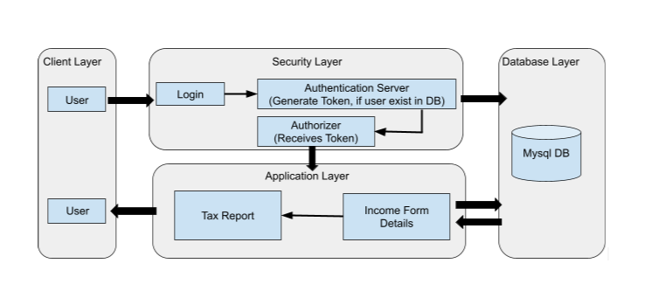
Methodology Used

Slide 7
Tools Platforms/Technology/Languages Used
Technology used
React Js
Spring Boot
Platforms used
Postman
GCP
Github
VsCode
InteliJ

Slide 8
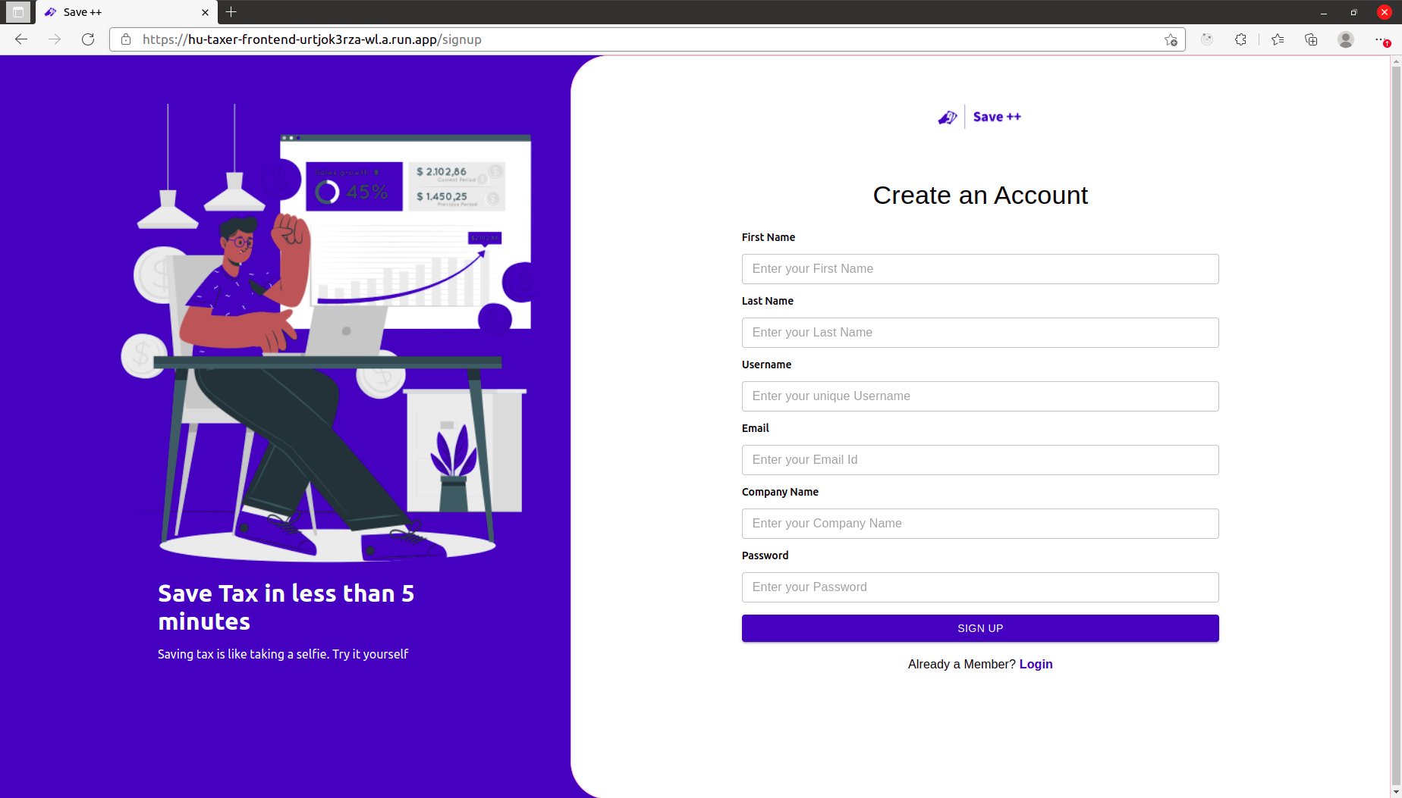
Implementation

Slide 9
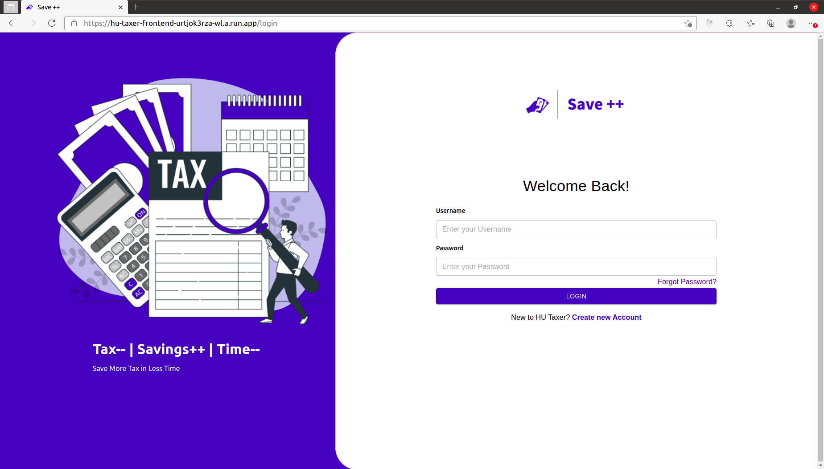
Implementation

Slide 10
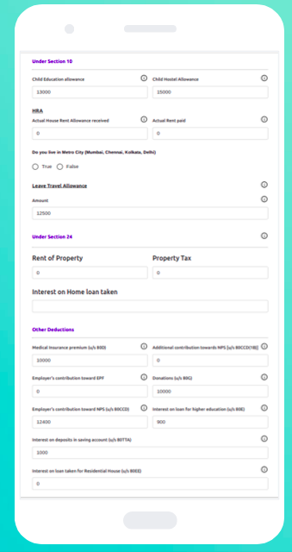
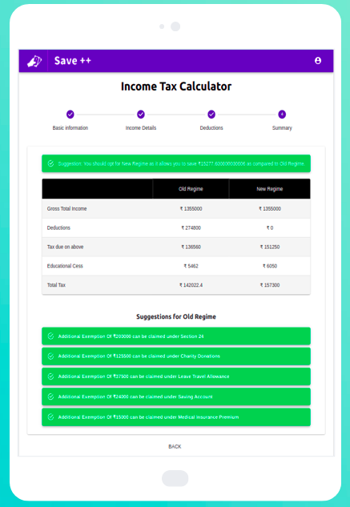
Implementation

Slide 11
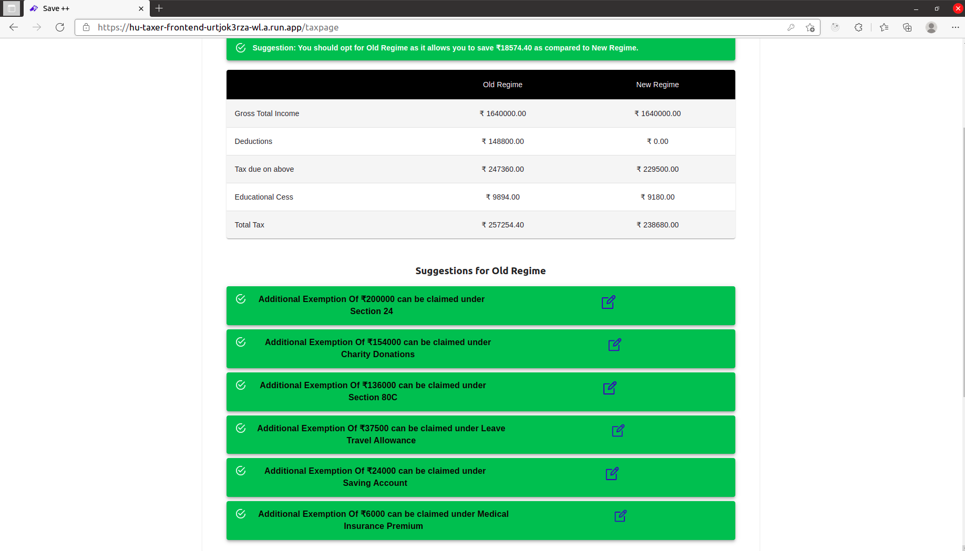
Implementation

Slide 12
Project Outcome(Most Imp)
OUTCOME | STATUS(Communicated/ Accepted/Published/App Hosted) | Journal Name/Patent Number | Platform Name where Website is Hosted
Website | Hosted | https://hu-taxer-frontend-urtjok3rza-wl.a.run.app/login | GCP

Slide 13
Future Innovations in the same Project
Dynamic React Js Form
Landing Page to describe more about our platform
Cover other categories of taxpayers

Slide 14
References
Income Tax Government Website, https://www.incometaxindia.gov.in/pages/tools/income-tax-calculator.aspx
Swagger Documentation, https://swagger.io/docs/
React Testing Documentation, https://testing-library.com/docs/react-testing-library/intro/
Spring Boot Testing Documentation, https://docs.spring.io/spring-boot/docs/1.5.2.RELEASE/reference/html/boot-features-testing.html
JWT Authentication Documentation, https://javatodev.com/spring-boot-jwt-authentication/

Slide 15
THANK YOU

