Slide 1
Chest X-Ray Image Retrieval Under Declining Target-Pathology Prevalence
Obed Appiah, Ezekiel Mensah Martey, Emmanuel Asante, Ernest Kwame Ampomah,
Ofei Obuobisah Bekoe, Henry Cobbinah, Boateng Kwedwo Amponsah, Grace Tsomemanya Tulasi
University of Energy and Natural Resources, Ghana
University of Mines and Technology, Tarkwa, Ghana
Presenter: Ofei Obuobisah Bekoe · ce-pobekoe1423@st.umat.edu.gh
Notes:
This study asks how chest X-ray retrieval changes when relevant cases become rare in a fixed-size gallery. The author list follows the manuscript. Presenter and presenter contact follow the supplied conference template.
Source: Chest_XRay_Retrieval_IEEE_Format.docx, supplied manuscript. Reference numbers follow the manuscript.

Slide 2
Outline
Problem and prior work
1
4
Experiments and results
Study objectives
2
5
Conclusion and future work
Evaluation protocol
3
Notes:
The talk covers the motivation and related work, study objectives, controlled evaluation protocol, findings, and limitations with future work.
Source: Chest_XRay_Retrieval_IEEE_Format.docx, supplied manuscript. Reference numbers follow the manuscript.

Slide 3
The study question
01
How does retrieval quality change
when relevant cases become rarer?
Notes:
The manipulated quantity is gallery prevalence: the proportion of gallery images carrying the target pathology. Gallery size, fitted model, query set, and retrieval depth remain fixed. This isolates prevalence at evaluation time rather than changing training-set balance.
Source: Chest_XRay_Retrieval_IEEE_Format.docx, supplied manuscript. Reference numbers follow the manuscript.

Slide 4
Background and Research Gap
Image retrieval returns similar prior cases for education and reference.
Existing work studies embeddings, rare diseases and imbalanced galleries.
Changing examples per class in a balanced index preserves prevalence.
This study fixes gallery size and reduces the target share from 5% to 0.5%.
Notes:
Related work motivates the protocol rather than providing directly comparable metric values. Denner et al. [1] compared representations and varied indexed support while keeping classes balanced. SISH [2] and volumetric retrieval [4] examine rare or imbalanced settings. The reviewed work did not isolate a controlled multi-level prevalence reduction while holding queries and representations fixed. This is a narrative, non-systematic review.
Source: Chest_XRay_Retrieval_IEEE_Format.docx, supplied manuscript. Reference numbers follow the manuscript.

Slide 5



Objectives and Contributions
Objective
Contribution
Implication
Measure retrieval loss as target prevalence decreases across three held-out pathologies.
Compare six ResNet-50 conditions with fixed queries, checkpoints and gallery size.
Report retrieval at multiple prevalence levels, alongside absolute quality and enrichment.
Notes:
The secondary question compares classification and supervised contrastive fine-tuning from the same SwAV initialization. Held out means the three target labels were absent from available fine-tuning annotations, not verified clinical absence in every training image.
Source: Chest_XRay_Retrieval_IEEE_Format.docx, supplied manuscript. Reference numbers follow the manuscript.

Slide 6
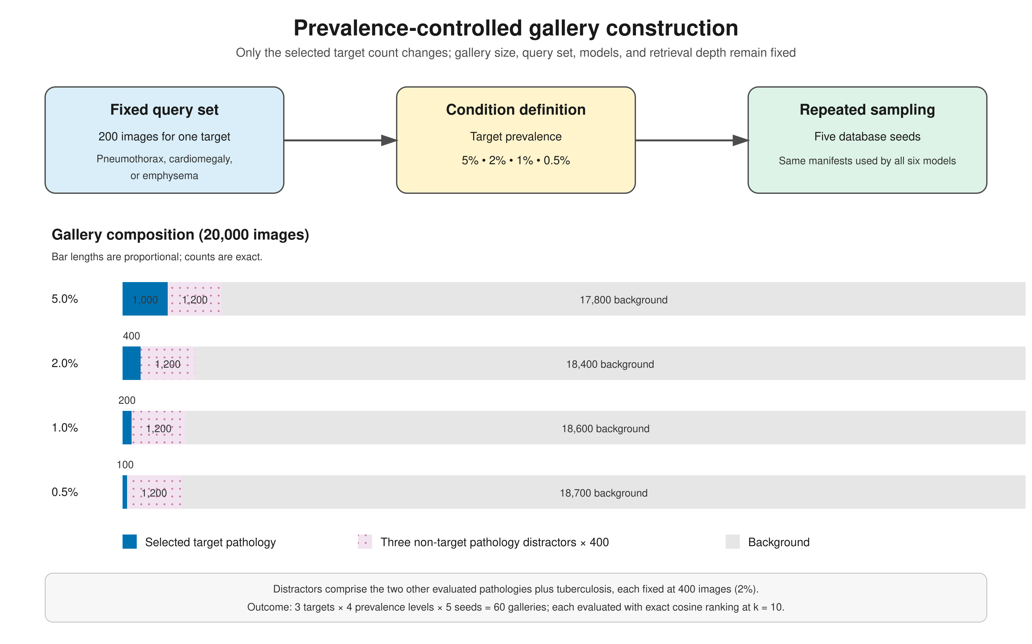
Prevalence-Controlled Evaluation
Data: source, size and how it was split
Model or system: main components
Training or design settings
Evaluation: metrics and baselines
Fig. 1. Replace with your framework or system diagram
Notes:
Original Figure 2 from the supplied manuscript. Three target pathologies: cardiomegaly, emphysema and pneumothorax. Each has 200 fixed queries. Every gallery contains 20,000 images with 1,000, 400, 200 or 100 relevant cases. Three non-target pathology distractors each contribute 400 images. Five seeds per target and prevalence yield 60 galleries. All six models use the same manifests. Tuberculosis was excluded as a target after a source-bias audit but remained a 2% distractor.
Source: Chest_XRay_Retrieval_IEEE_Format.docx, supplied manuscript. Reference numbers follow the manuscript.

Slide 7
Experimental Setup
Item | Details
Data and queries | NIH ChestX-ray14, SIIM-ACR and three external collections. 200 fixed queries per pathology.
Image preparation | 224 × 224, grayscale in 3 channels, ImageNet normalization. Duplicate audit and patient exclusions where identifiers permit.
Six representations | CNN-PT, CNN-Common, CNN-NIH, SwAV-PT, SwAV-CLS and SwAV-SupCon.
Retrieval and metrics | 2,048-D normalized embeddings, exact cosine ranking. Precision@10 primary, nDCG@10 secondary.
Training and inference | AdamW, learning rate 0.0001, up to 50 epochs. One training run per learned condition, five gallery seeds.
Notes:
CNN-PT: supervised ImageNet ResNet-50 without adaptation. CNN-Common: three-class normal/pneumonia/COVID-19 classification. CNN-NIH: NIH multi-label classification. SwAV-PT: self-supervised ImageNet ResNet-50 without adaptation. SwAV-CLS: NIH multi-label classification from SwAV. SwAV-SupCon: weighted multi-label supervised contrastive learning from SwAV. The projection head is discarded for retrieval. Common-class adaptation used 4,545 balanced images and an 80:20 source-class-stratified split. NIH adaptation used 48,280 training and 12,266 validation images after target-patient exclusions, with 10,620 background images. Training used PyTorch 2.10.0+cu128 and two Tesla T4 GPUs. The five gallery seeds are not independent training runs. Paired query tests use Holm correction, with 72 planned model comparisons.
Source: Chest_XRay_Retrieval_IEEE_Format.docx, supplied manuscript. Reference numbers follow the manuscript.

Slide 8
Precision Falls as Cases Become Rarer
All six models declined
P@10 fell by 83.4%–91.9% from 5% to 0.5% prevalence across the 18 model–pathology pairs.
Every paired decline remained significant after Holm correction.
At 0.5%, random P@10 = 0.005.
Notes:
Endpoint values come from manuscript Table 2. The chart shows SwAV-SupCon, the highest mean model at every pathology-prevalence condition. All 18 included model-pathology pairs declined significantly for both metrics, Holm-adjusted p ≤ 2.30 × 10^-26. Across all models, absolute P@10 loss ranged from 0.0959 to 0.3480. The larger absolute loss for a stronger model does not establish poorer rare-case retrieval: SwAV-SupCon remained highest at both endpoints. The chart presents means across five gallery samples without uncertainty bars. Seed variation measures gallery sampling, not retraining. Pneumothorax uses SIIM queries and an NIH relevant gallery and is a cross-source condition.
Source: Chest_XRay_Retrieval_IEEE_Format.docx, supplied manuscript. Reference numbers follow the manuscript.

Slide 9



SwAV-SupCon Leads Within This Study
12/12
10/12
3.26–13.20×
Highest mean P@10
Above SwAV-CLS
Random enrichment
All pathology–prevalence
conditions
Significant after global
Holm correction
At 0.5% prevalence,
P@10 = 0.0163–0.0660
Notes:
SwAV-SupCon ranked first in mean P@10 in all 12 conditions. Its advantage over SwAV-CLS survived global correction in 10 of 12 planned comparisons. The exceptions were cardiomegaly at 0.5% and 1%. At 0.5%, SupCon versus CLS P@10: cardiomegaly 0.0163 versus 0.0133 (adjusted p > 0.99), emphysema 0.0335 versus 0.0175 (p = 5.34 × 10^-7), pneumothorax 0.0660 versus 0.0446 (p = 3.17 × 10^-6). Enrichment factors 3.26, 6.70 and 13.20 divide the leading mean by the random expectation of 0.005. Low absolute precision limits practical interpretation. Results are conditional on one fitted checkpoint per learned condition and objective-specific checkpoint selection.
Source: Chest_XRay_Retrieval_IEEE_Format.docx, supplied manuscript. Reference numbers follow the manuscript.

Slide 10
Conclusion and Future Work
Conclusion
Lower target prevalence substantially reduces retrieval quality.
SwAV-SupCon leads here, but rare-case precision remains limited.
Limits
One training run, imperfect labels and cross-source confounding.
Future work
Repeat training, strengthen source controls and assess clinical relevance.
Notes:
Additional limitations: every model uses ResNet-50, external labels are not exhaustive, SIIM patient uniqueness cannot be verified, and no clinician assessed relevance. Pneumothorax source is aligned with query-gallery role, so the result is not a source-controlled estimate of pathology-specific similarity. The lowest prevalence still has 100 relevant images, and larger approximate indexes were not evaluated. No study measured diagnostic benefit. Future work should test additional architectures, lower relevant-case counts and clinically assessed relevance.
Source: Chest_XRay_Retrieval_IEEE_Format.docx, supplied manuscript. Reference numbers follow the manuscript.

Slide 11
Key References
[1] S. Denner et al., “Leveraging foundation models for content-based image retrieval in radiology,” Computers in Biology and Medicine, vol. 196, art. 110640, 2025. doi: 10.1016/j.compbiomed.2025.110640.
[9] X. Wang, Y. Peng, L. Lu, Z. Lu, M. Bagheri, and R. M. Summers, “ChestX-ray8: Hospital-scale chest X-ray database and benchmarks on weakly-supervised classification and localization of common thorax diseases,” in Proceedings of the IEEE Conference on Computer Vision and Pattern Recognition, 2017, pp. 3462–3471. doi: 10.1109/CVPR.2017.369.
[10] K. He, X. Zhang, S. Ren, and J. Sun, “Deep residual learning for image recognition,” in Proceedings of the IEEE Conference on Computer Vision and Pattern Recognition, 2016, pp. 770–778. doi: 10.1109/CVPR.2016.90.
[11] M. Caron et al., “Unsupervised learning of visual features by contrasting cluster assignments,” in Advances in Neural Information Processing Systems, vol. 33, 2020, pp. 9912–9924.
[12] P. Khosla et al., “Supervised contrastive learning,” in Advances in Neural Information Processing Systems, vol. 33, 2020, pp. 18661–18673.
Notes:
These references follow the manuscript bibliography. The remaining related-work and dataset references are in the paper.
Source: Chest_XRay_Retrieval_IEEE_Format.docx, supplied manuscript. Reference numbers follow the manuscript.

Slide 12
Thank You
Questions and discussion
Ofei Obuobisah Bekoe
ce-pobekoe1423@st.umat.edu.gh
University of Mines and Technology, Ghana
Notes:
Thank the audience and invite discussion about prevalence-aware benchmarking, representation adaptation and cross-source evaluation.
Source: Chest_XRay_Retrieval_IEEE_Format.docx, supplied manuscript. Reference numbers follow the manuscript.

