Slide 1
Evaluating and correcting for batch effects in RNA-seq data
Laura Dillon
BYO Bioinformatics
November 5, 2013

Slide 2
RNA-seq Data Analysis Pipeline
FastQC
assess quality
TopHat
align reads
identify splice junctions
Htseq-count
generate count table
Trimmomatic
remove low quality reads
remove genes with zero/low counts
quantile normalization
PCA/heatmap
assess batch effects
voom-limma
log2 transform counts
conduct differential expression analysis
GSEA/GOseq
identify enriched GO categories and KEGG pathways
ComBat
adjust data for batch effects

Slide 3
Assessment of batch effects is crucial when analyzing high-throughput data
Batch effects = non-biological sources of variability
person
processing date
reagent batch
flow cell/lane (minor source)
Account for batch effects to increase statistical power for detection of true biological effects
Normalization does not remove, and may even worsen
We use date as a surrogate to capture many of the sources of technical variability

Slide 4
Evaluate batch effects
Principal components analysis
Numerical association with batch
Plot principal components
(View distribution of samples across individual PCs)
Heatmap

Slide 5
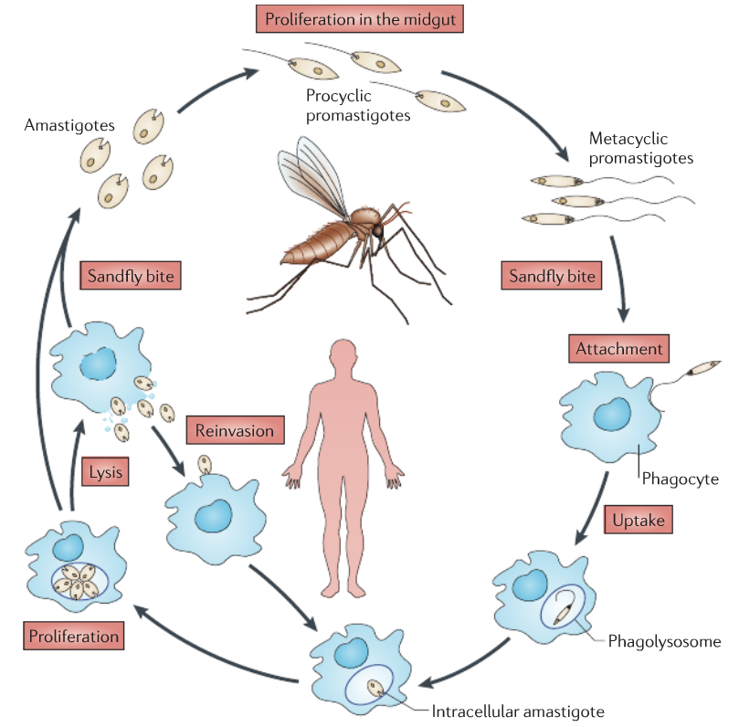
adapted from Kaye & Scott, 2011 Nature Rev Microbiol

Slide 6
Count Table and Design
> head(countsTable)
HPGL0075 HPGL0076 HPGL0096 HPGL0097 HPGL0098 HPGL0164 HPGL0165 HPGL0192 HPGL0193
exon_LmjF.01.0010-1 410 514 1056 1143 2151 1141 1582 1225 2134
exon_LmjF.01.0020-1 696 702 1350 838 1158 536 489 873 929
exon_LmjF.01.0030-1 892 833 1748 1168 1035 600 346 942 1127
exon_LmjF.01.0040-1 478 400 860 572 642 437 327 402 517
exon_LmjF.01.0050-1 885 1010 1760 1979 2708 1448 1993 1322 2999
exon_LmjF.01.0060-1 815 860 1215 669 741 327 342 652 598
HPGL0228 HPGL0229 HPGL0230
exon_LmjF.01.0010-1 1163 1948 1943
exon_LmjF.01.0020-1 1260 741 958
exon_LmjF.01.0030-1 1992 1156 1237
exon_LmjF.01.0040-1 664 400 447
exon_LmjF.01.0050-1 2633 2547 2728
exon_LmjF.01.0060-1 1138 587 637
> design
sampleID condition batch
1 HPGL0075 procyclic A
2 HPGL0076 metacyclic A
3 HPGL0096 procyclic B
4 HPGL0097 metacyclic B
5 HPGL0098 metacyclic B
6 HPGL0164 procyclic C
7 HPGL0165 metacyclic C
8 HPGL0192 procyclic D
9 HPGL0193 metacyclic D
10 HPGL0228 procyclic E
11 HPGL0229 metacyclic E
12 HPGL0230 metacyclic E
> dim(countsTable)
[1] 10156 12

Slide 7
Filtering, normalization, and computation of principal components

Slide 8
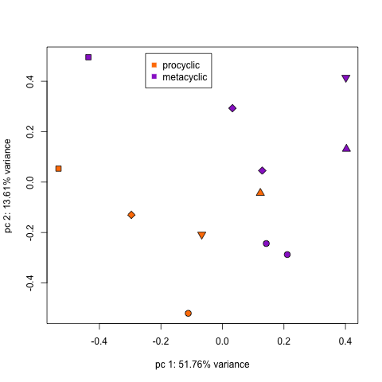
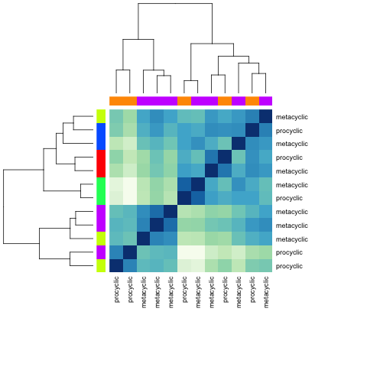
PCA Plot and Heatmap: no correction
condition
batch

Slide 9
So there are significant batch effects … now what?

Slide 10
Method 1: Use batch as a factor in the limma model

Slide 11
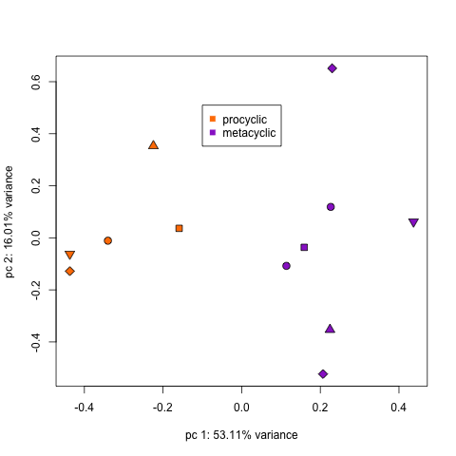
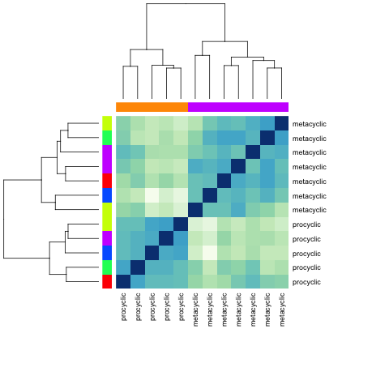
PCA Plot and Heatmap: limma model correction
condition
batch

Slide 12
Method 2: Combat correction

Slide 13
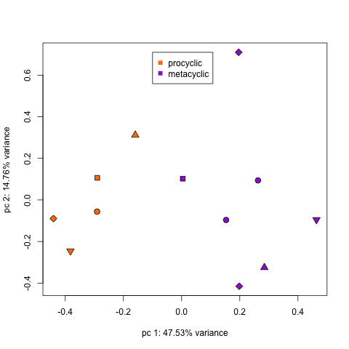
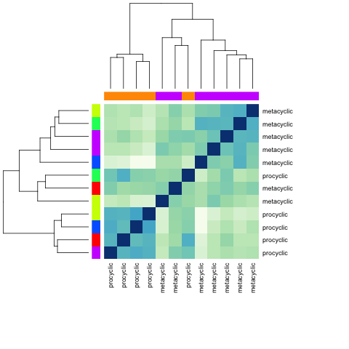
PCA Plot and Heatmap: Combat correction
condition
batch

Slide 14
Effect of adjusting for batch on DE analysis
 | # sig genes | # 2-fold+ genes
No correction | 0 | 0
limma model correction | 2821 | 108
Combat correction | 4017 | 68
Combat + limma model correction | 2793 | 95

