Slide 1
Unannotated RNA-Seq transcripts and long noncoding RNA detection: RNAcode and CPAT
BYOB - Oct. 8, 2013
Kevin Nyberg

Slide 2
Annotation of the D. pseudoobscura transcriptome
via Bowtie2/Tophat, Cufflinks (cuffmerge)
18982 transcripts
12407 loci
Exact reference matches
6499 transcripts
5478 loci
Unannotated, intergenic
17480 mapped transcripts
Exact reference matches
3424 mapped transcripts
Exact reference matches
16761 annotated protein-coding transcripts
719 annotated non-coding transcripts
(miRNAs, rRNAs, tRNAs, snRNAs, snoRNAs, only 4 long ncRNAs)

Slide 3
What do you do with unannotated transcripts?
Protein-coding or non-coding?
ORF length – ORF > 50 or 100 aa
Homology – blastx hits to protein databases (e.g. NCBI nr, Uniprot)
ORF + Homology – Coding Potential Calculator (web-based)
Alignment based ORF conservation – RNAcode, PhyloCSF
ORF + base/codon composition – Coding Potential Assessment Tool (CPAT)
Proteomics
Sequencing – Ribosomal profiling

Slide 4
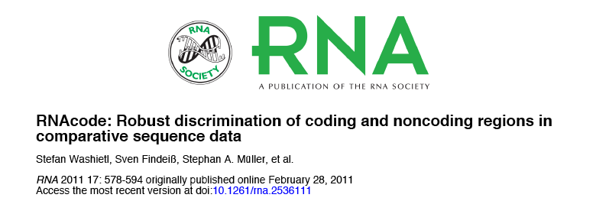
Looks for ORF conservation using multiple sequence alignments
Creates phylogenetic tree using alignment under neutral model
Calculates substitution score based on protein similarity
- synonymous vs. nonsynonymous changes
- short INDELs in multiples of 3
- stop codons
3) Calculates p-value based on randomized simulations

Slide 5
Alignment based ORF conservation – RNAcode
Input: multiple sequence alignments in clustal or MAF format (3 or more taxa)
Command: RNAcode –s –g –p 0.05 –n 500 transcript.aln
Output: High scoring segments with p-values
Run: bash RNAcode_BYOB.sh

Slide 6
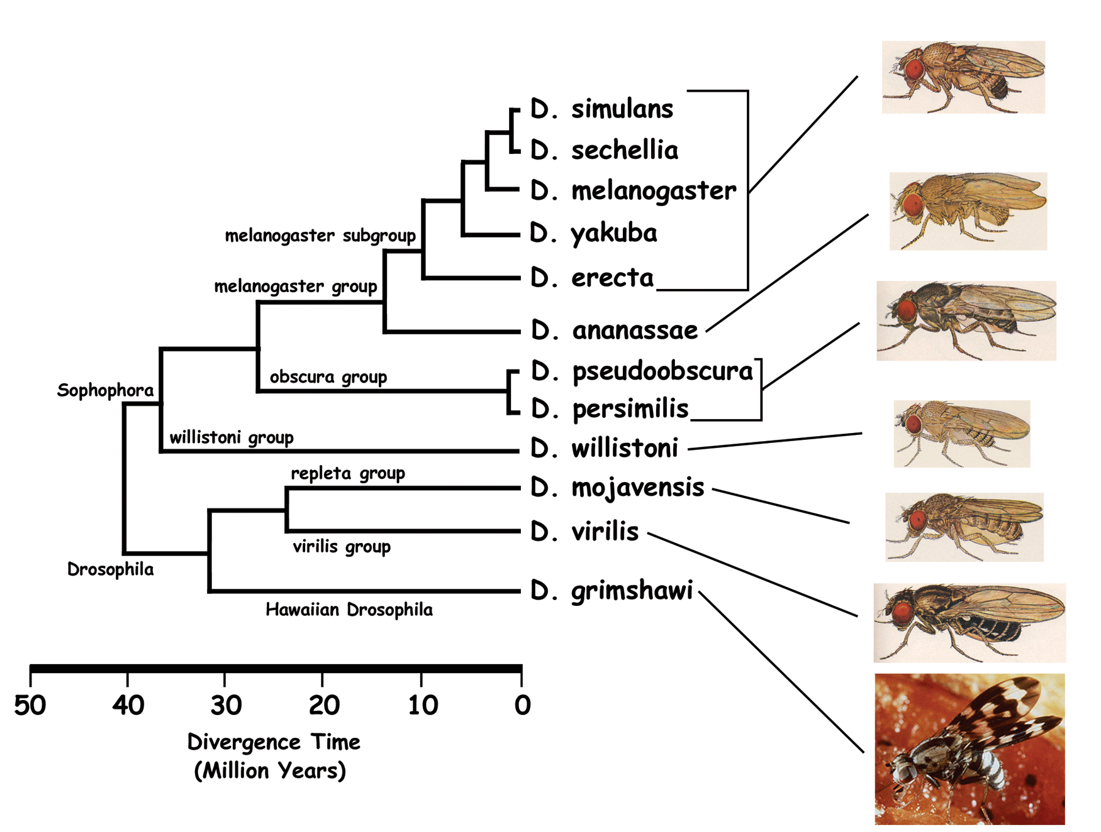
Alignment based ORF conservation – RNAcode
Use multiple genome of alignments of at least 3 taxa to look for features of ORF conservation (synonymous vs. nonsynonymous mutations, INDELs in multiples of 3, presence of stop codons)
Only ~50% of annotated D. pseudoobscura transcripts align to the D. melanogaster genome, and only 16% of unannotated transcripts.
protein RNAs = 9939
9790 (98.5% TP)
ncRNAs = 484
27 (5.4% FP)

Slide 7
Alignment based ORF conservation – RNAcode
Use multiple genome of alignments of at least 3 taxa to look for features of ORF conservation (synonymous vs. nonsynonymous mutations, INDELs in multiples of 3, presence of stop codons)
D. lowei (1)
D. miranda (2)
D. persimilis (3)
D. ps. pseudoobscura (11)
D. ps. bogotana (3)
protein RNAs = 16761
13028 (77.7% TP)
ncRNAs = 719
11 (1.5% FP)
Pseudobase Alignments – all lines of all taxa

Slide 8
Alignment based ORF conservation – RNAcode
Use multiple genome of alignments of at least 3 taxa to look for features of ORF conservation (synonymous vs. nonsynonymous mutations, INDELs in multiples of 3, presence of stop codons)
D. lowei
D. miranda
D. persimilis
D. ps. pseudoobscura
D. ps. bogotana
protein RNAs = 16761
13320 (79.5% TP)
ncRNAs = 719
7 (1.0% FP)
Pseudobase Alignments – 1 line of 4 taxa

Slide 9
Alignment based ORF conservation – RNAcode
PROS:
Pretty accurate
Can detect small peptides
No dataset training necessary
CONS
Memory intensive, so it’s slow
Not designed for high-throughput data
Only as good as your alignment (divergence data is best)
Unable to detect species-specific peptides

Slide 10
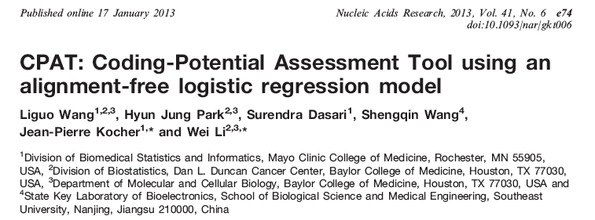
Logistic regression model to identify protein-coding transcripts
ORF length
ORF coverage (% transcript covered by ORF)
Fickett’s score – nucleotide composition and codon usage
Hexamer frequencies
CPAT is trained on a given set of protein and noncoding sequences

Slide 11
CPAT
Input: multi-fasta file of transcript sequences
If creating a training set, need multifasta files of protein-coding and noncoding transcripts
Command:
python cpat.py --gene input.fasta --outfile output.txt --hex Hexamer_frequencies.tab --logitModel training_data.RData
Output: Protein coding probability. Determine cutoff empirically using training data (sensitivity vs. specificity)
Run: python cpat.py --gene BYOB.fasta --outfile BYOB_CPAT_out --hex fly_Hexame.tab --logitModel fly_train.Rdata
Cutoff is 0.39 for D. melanogaster training set.

Slide 12
Coding Potential Assessment Tool (CPAT)
Using the D. melanogaster training set (provided by CPAT)
protein RNAs = 16761
ncRNAs = 719
Dmel lncRNAs = 1588
16169 (96.5% TP)
3 (0.4% FP)
62 (3.9% FP)

Slide 13
Coding Potential Assessment Tool (CPAT)
Using a D. pseudoobscura training set
Coding = 16761 protein RNAs
Noncoding = 719 ncRNAs
protein RNAs = 16761
ncRNAs = 719
Dmel lncRNAs = 1588
16736 (99.8% TP)
1 (0.1% FP)
1051 (66.2% FP)

Slide 14
Coding Potential Assessment Tool (CPAT)
Using a D. pseudoobscura training set
Coding = 16761 protein RNAs
Noncoding = 719 ncRNAs + all UTRs
protein RNAs = 16761
ncRNAs = 719
Dmel lncRNAs = 1588
16335 (97.4% TP)
0 (0.1% FP)
231 (14.5% FP)

Slide 15
Coding Potential Assessment Tool (CPAT)
PROS:
Very accurate
FAST. Great for high-throughput data.
Can detect novel peptides
CONS
Needs to be trained on protein-coding and noncoding datasets. Probably not great for species without annotations
Probably not great for detecting small peptides

Slide 16
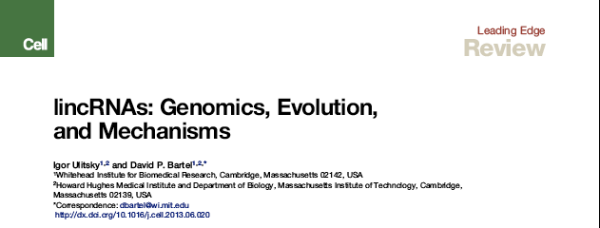
A great new review on lincRNA biology!

