Slide 1


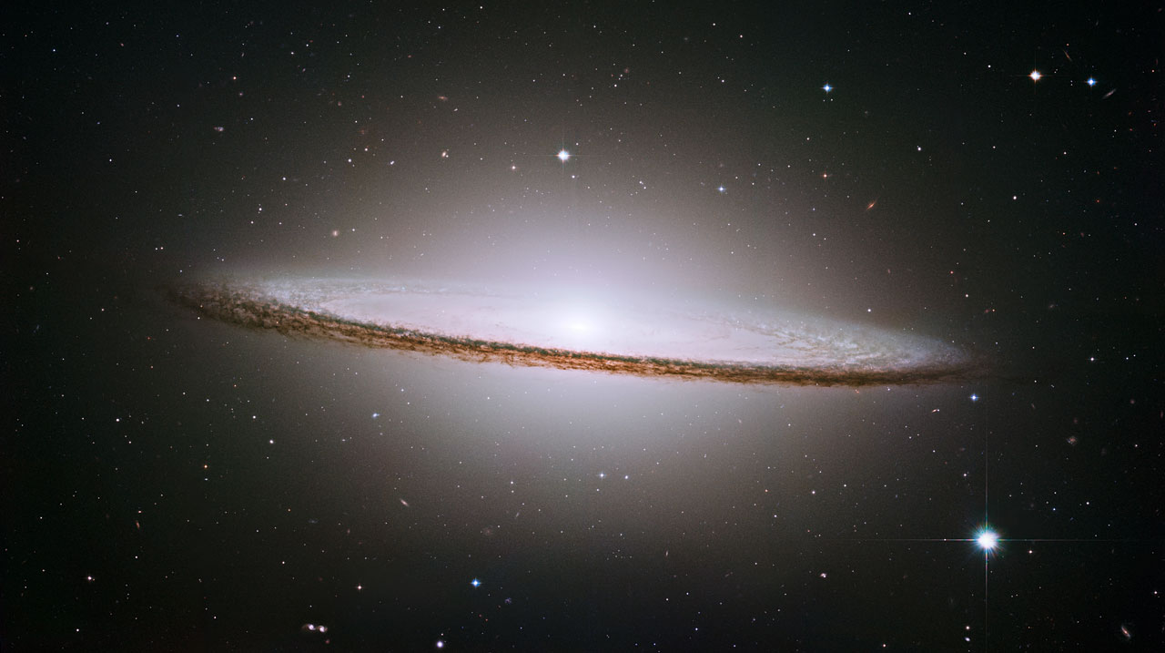
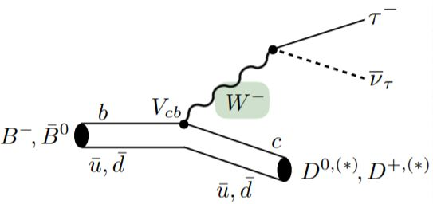
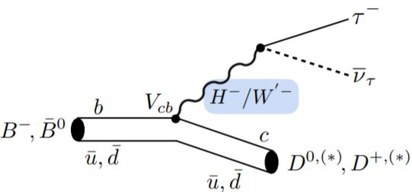
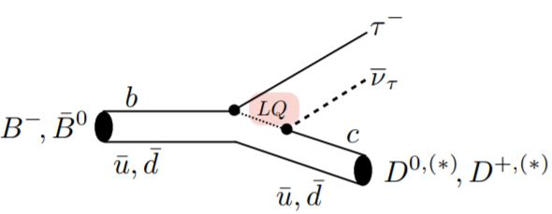
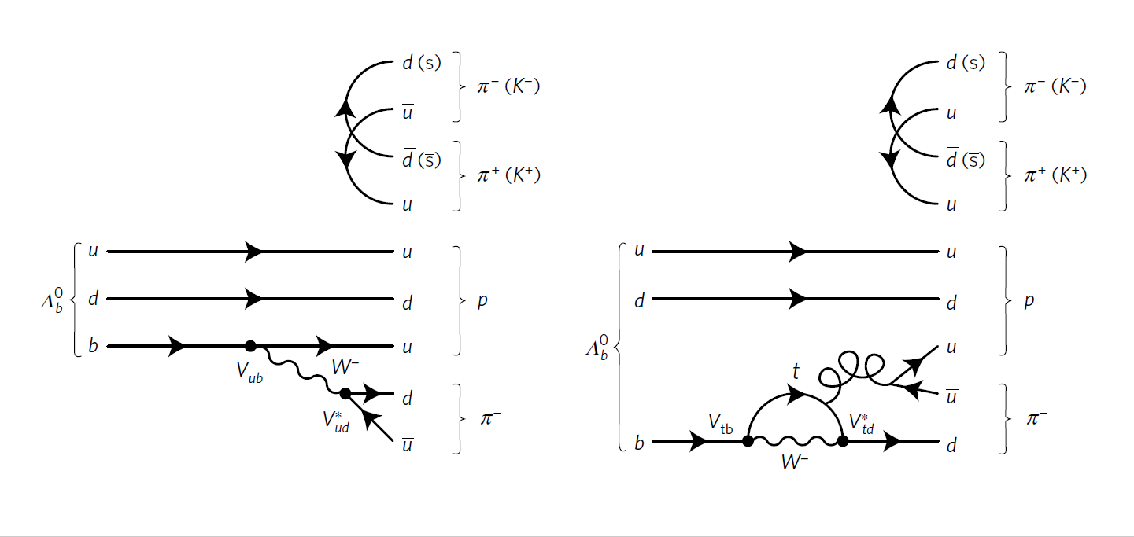
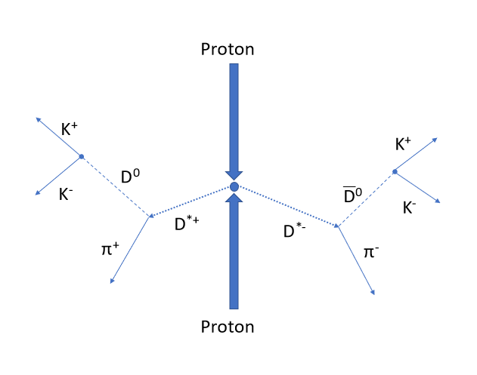
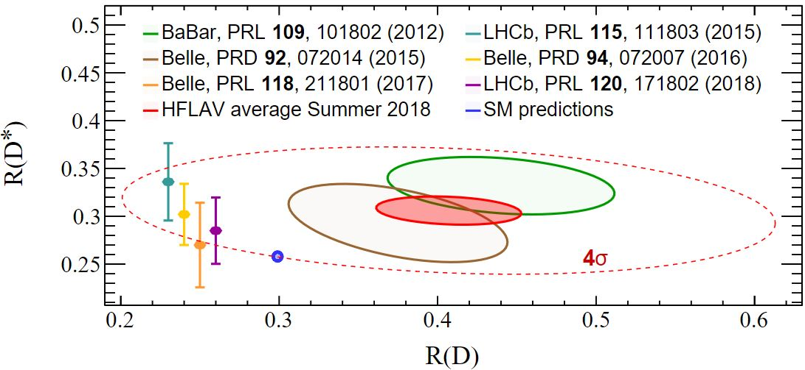

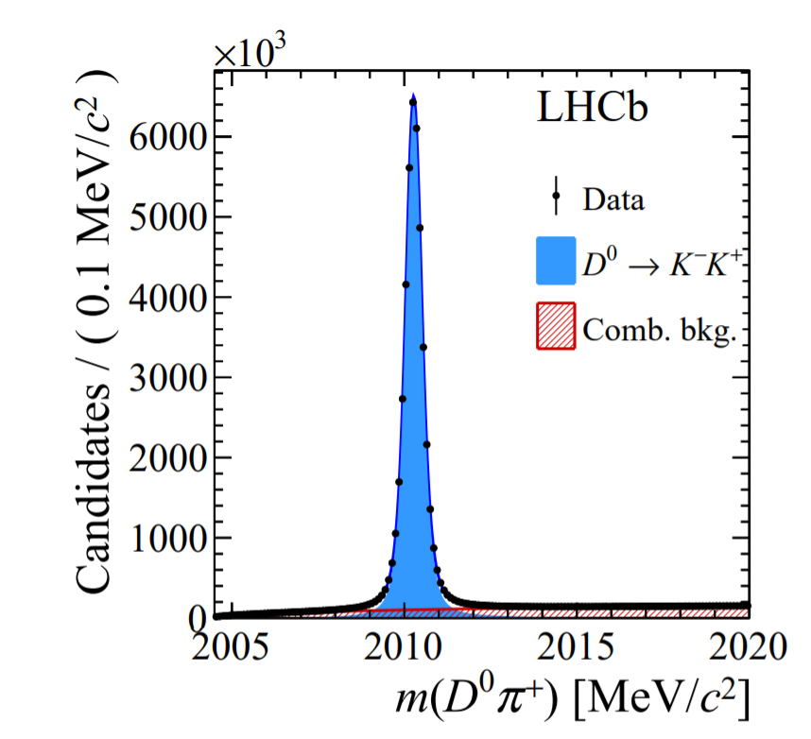
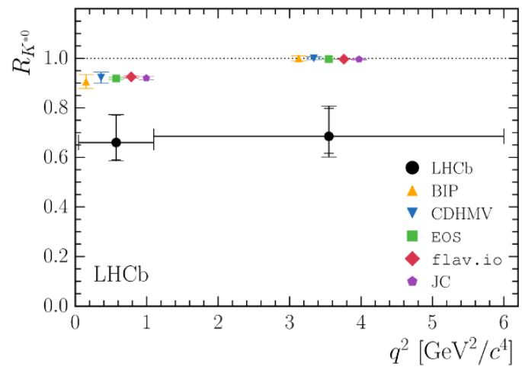
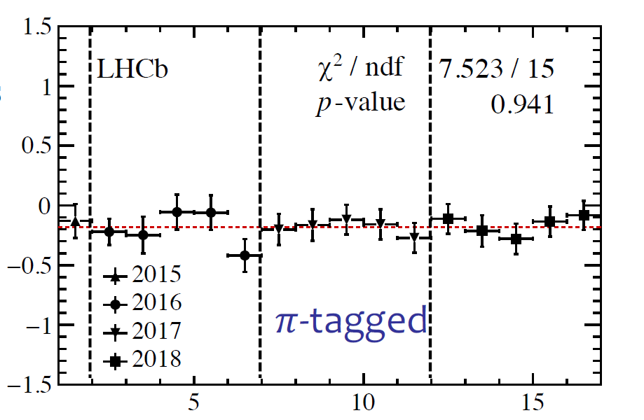
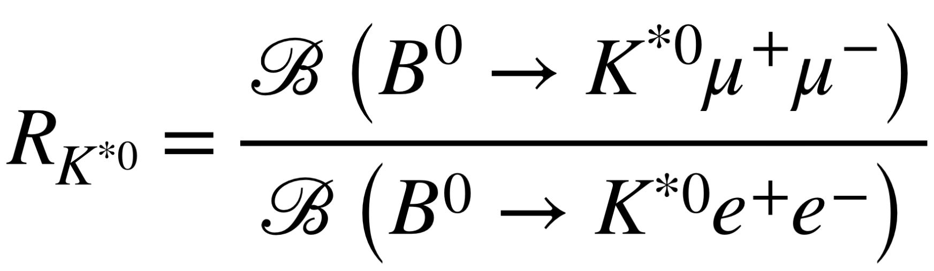
Using LHCb to Search for Violations of Fundamental Symmetries of the Standard Model
Ben Flaggs, Rohan Rajagopalan & Raymond Su
Advised by Professors Manuel Franco Sevilla & Hassan Jawahery
The LHCb experiment (Large Hadron Collider Beauty) is one of several particle detectors situated on the LHC, a world renown particle collider in Geneva Switzerland. This detector aims at understanding the nature of the birth of the universe. To accomplish this goal, LHCb has been specialized to study b-quarks and the physics behind them. Examples of this include measuring CP-violation in b-hadrons (heavy particles that contain a bottom quark), as well as examining the postulates of lepton flavor universality. These measurements primarily search for deviations from predictions based on our Standard Model of Physics, which could lead to the discovery of new physics and learning the secrets of our Universe.
Charge-Parity Violation (CPv)
Lepton Flavor Universality (LFU) Violation
We exist. This is a problem.
Humans, like the universe, are mostly made of matter; but as we understand the Standard Model, there should not be such an impressive imbalance of matter and antimatter as what we observe in the world today.
The study of CPv is integral to understanding this conundrum, with the LHCB playing a leading role, in the observation of high-energy decays.
Standard Model (SM) predicts that force carriers for particle decays interact with the same strength for ALL leptons (e⁻, μ⁻, 𝜏⁻)
Decays to lepton pair.
Pair could also be e⁻, 𝜈_{e} or μ⁻, 𝜈_{μ}
Force Carrier
(W Boson)
New exotic particles could violate lepton flavor universality!
LHCb and the Standard Model, with a dash of CPv
Charged Higgs/W’ Bosons
Lepto-Quarks
In 2017, the LHCb found evidence (above 3.3 σ) of CPv in the Lambda-Bottom Baryons; a first for spinning particles.
…But the big news involve D0 mesons; on March 21st the collaboration reported strong evidence (5.3 σ!) of CPv in charmed particles, a previously unobserved phenomena.
Previous experiments have shown a possible anomaly in B-meson decays to heavy leptons (𝜏⁻) and light leptons (e⁻, μ⁻)
Figure (1) – Lambda Baryon decays
Here 𝓁⁻ = e⁻ or μ⁻
Figure (2) – D(0) meson decays
LHCb measurements show a similar anomaly for B-meson decays involving only light leptons (e⁻, μ⁻)
Figure (3) – A(CP) of D meson results
More LHCb data needs to be taken to make further conclusions about this anomaly!
Figure (4) – Invariant mass of D(0), tagged with pion plus
LHCb collaboration, Test of lepton universality with B⁰→K*⁰𝓁⁺𝓁⁻ decays, JHEP 08 (2017) 055 [arXiv: 1705.05802]
Citations: (1) Aaij, R. et al. (LHCb collaboration) Nat. Phys. 13, 391–396 (2017), (2) Observation of CP violation in charm decays LHCb Collaboration (Roel Aaij (NIKHEF, Amsterdam) et al.). Mar 20, 2019. 18 pp

