Slide 1


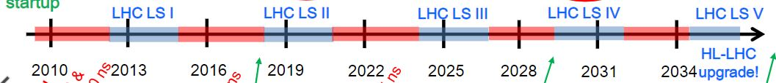
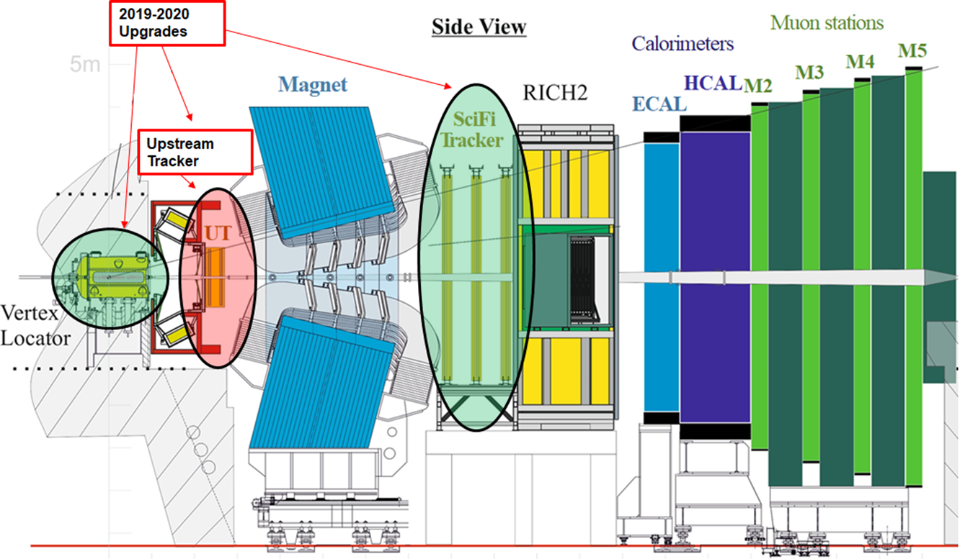
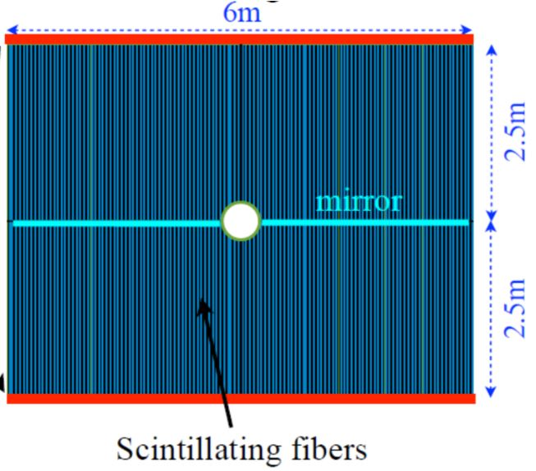
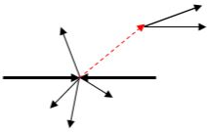
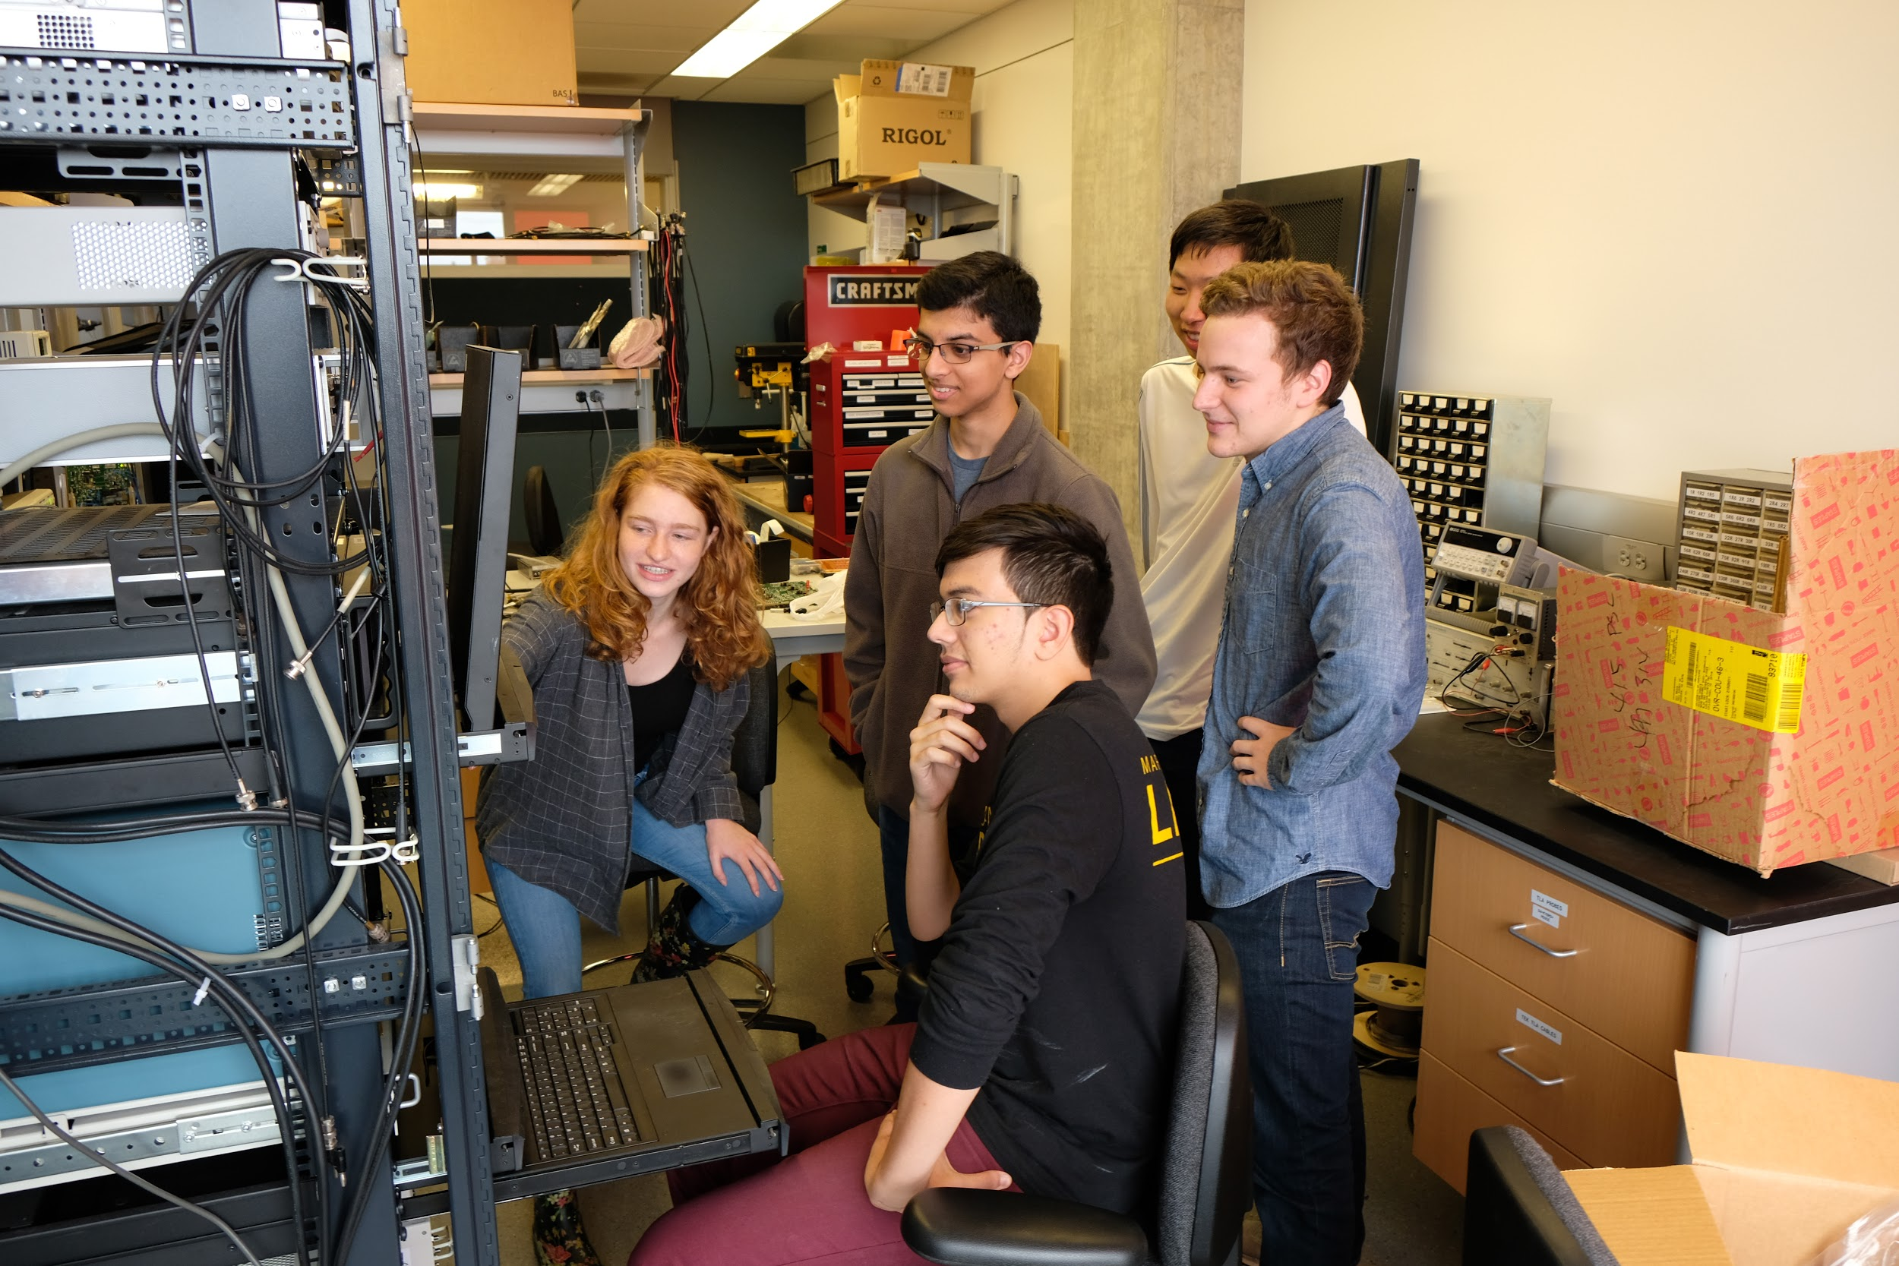
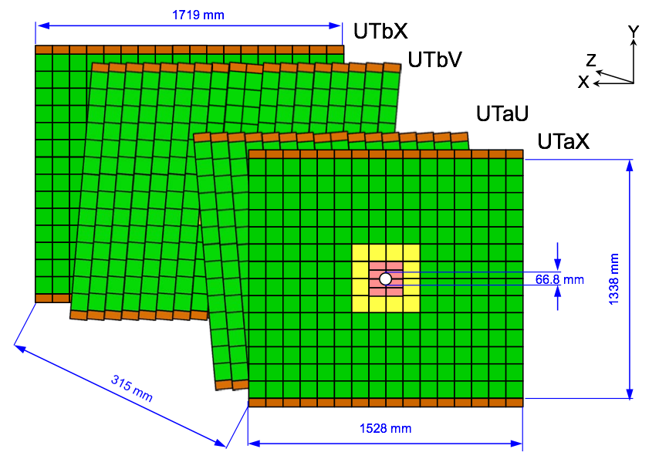
Phase-I Upgrade of the LHCb Detector
Ben Flaggs, Rohan Rajagopalan & Jorge Ramirez
Advised by Professors Manuel Franco Sevilla & Hassan Jawahery
Today
Intro
Currently LHCb is having its second long shutdown (LS II) during which upgrades are being made in order to ensure that data can be collected more rapidly in future runs
Two major upgrades are being carried out in LS II
Implementing the first software-only trigger in a hadron collider experiment
Increasing the data acquisition rate of LHCb by a factor of 5-10
Upgrades aim to collect approximately 10 times more overall data as well as 20 times more exclusive hadronic events
Scintillating Fiber (SciFi)
Completely new detector based on scintillating fibers
Will track the paths of particles which will lead to better position and momentum measurements
Each fiber has a length of 2.5 m and a diameter of 250 μm
Total width of detector will be 6 m
Vertex Locator (VELO)
Experiment will collide protons where the collision will result in a multitude of particles flying out in all directions
B mesons can be tracked because these mesons do not decay immediately after the proton-proton collision
Upgrade will move detectors closer to the point at which the B mesons decay
Will allow for improved resolution of the B meson decay points (i.e. better position and momentum measurements of the B meson decays)
Trigger and DAQ Upgrade
The trigger plays a key role in selecting signal events and rejecting background. It currently consists of two stages: a hardware trigger followed by a high-level trigger implemented in software.
With the most recent upgrade, this trigger will be converted completely to that of a software-based system.
Currently, the LHCb’s DAQ (Data acquisition) numbers range at approximately 0.5 GB/s. With the new trigger system in place, these DAQ numbers are expected to increase to 2-5 GB/s!
B
p
p
3.5 mm
Upstream Tracker (UT)
UMD work on UT upgrade
The University of Maryland is contributing to the LHCb upgrade with the design, construction, and installation of three electronic systems that will organize the flow of data from the sensors, package the data and convert it to an optical signal, and provide power to the detector.
We will undertake a large-scale production of these three electronic systems and then rigorously stress-test them in laboratory conditions to ensure their stability for use in the LHCb until the next long shutdown.
Expect to construct 260+ data control boards, 30+ backplanes, and 300+ LV regulators by 2020.
The Upstream Tracker is the second detector in line to detect particles from the proton collision.
The particles that pass through the detector deposit charge through four layers of silicon. These charge deposits are then analyzed and the particle’s trajectory can be deduced.
This upgrade focuses on improving the experiment’s ability to track the paths of charged particles following collisions, as well as multiply the electronics' ability to record data by a factor of 10.
Notes:
Bold important text. Use different colors for each Box/Title.
Put Box around diagram showing B decay.
Add 3.5mm label showing from proton beam to VELO detectors. Acceptance range for detections is 10-300 milliradians.
Add citations in a small text box at bottom of physics poster. Journal Name, Volume Number, DOI?
Change Physics poster final point because now it seems that there is a supposed anomaly and we want to measure the significance which is not the case.
Insert the Ratios for each decay. Possibly change the font size.

