Slide 1
CMSC424: Database Design Module: Transactions and ACID Properties
Overview
Instructor: Amol Deshpande
amol@umd.edu

Slide 2
Transactions: Overview
Book Chapters
14.1, 14.2, 14.3, 14.4, 14.5
Key topics:
Transactions and ACID Properties
Different states a transaction goes through
Notion of a ”Schedule”
Introduction to Serializability

Slide 3
Transaction Concept
A transaction is a unit of program execution that accesses and possibly updates various data items.
E.g. transaction to transfer $50 from account A to account B:
1. read(A)
2. A := A – 50
3. write(A)
4. read(B)
5. B := B + 50
6. write(B)
Two main issues to deal with:
Failures of various kinds, such as hardware failures and system crashes
Concurrent execution of multiple transactions

Slide 4
Overview
Transaction: A sequence of database actions enclosed within special tags
Properties:
Atomicity: Entire transaction or nothing
Consistency: Transaction, executed completely, takes database from one consistent state to another
Isolation: Concurrent transactions appear to run in isolation
Durability: Effects of committed transactions are not lost
Consistency: Transaction programmer needs to guarantee that
DBMS can do a few things, e.g., enforce constraints on the data
Rest: DBMS guarantees

Slide 5
How does..
.. this relate to queries that we discussed ?
Queries don’t update data, so durability and consistency not relevant
Would want concurrency
Consider a query computing total balance at the end of the day
Would want isolation
What if somebody makes a transfer while we are computing the balance
Typically not guaranteed for such long-running queries
TPC-C vs TPC-H

Slide 6
Assumptions and Goals
Assumptions:
The system can crash at any time
Similarly, the power can go out at any point
Contents of the main memory won’t survive a crash, or power outage
BUT… disks are durable. They might stop, but data is not lost.
For now.
Disks only guarantee atomic sector writes, nothing more
Transactions are by themselves consistent
Goals:
Guaranteed durability, atomicity
As much concurrency as possible, while not compromising isolation and/or consistency
Two transactions updating the same account balance… NO
Two transactions updating different account balances… YES

Slide 7
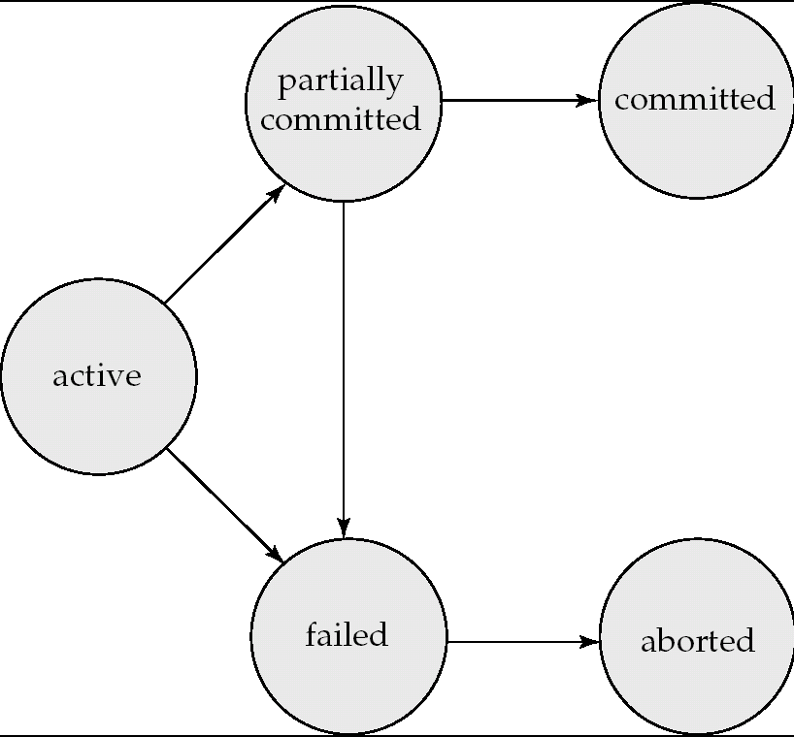
Transaction states
Successful Completion
Initial State – stays in this during execution
Any changes have been rolled back

Slide 8
Summary
Transactions is how we update data in databases
ACID properties: foundations on which high-performance transaction processing systems are built
From the beginning, consistency has been a key requirement
Although “relaxed” consistency is acceptable in many cases (originally laid out in 1975)
NoSQL systems originally eschewed ACID properties
MongoDB was famously bad at guaranteeing any of the properties
Lot of focus on what’s called “eventual consistency”
Recognition today that strict ACID is more important than that
Hard to build any business logic if you have no idea if your transactions are consistent

Slide 9
CMSC424: Database Design Module: Transactions and ACID Properties
Concurrency: Basics
Instructor: Amol Deshpande
amol@umd.edu

Slide 10
Concurrency: Basics
Book Chapters
14.5
Key topics:
Why Concurrency
Notion of a ”Schedule”
Introduction to Serializability

Slide 11
Next…
Concurrency: Why?
Increased processor and disk utilization
Reduced average response times
Concurrency control schemes
A CC scheme is used to guarantee that concurrency does not lead to problems
For now, we will assume durability is not a problem
So no crashes
Though transactions may still abort
Schedules
When is concurrency okay ?
Serial schedules
Serializability

Slide 12
A Schedule
Transactions:
T1: transfers $50 from A to B
T2: transfers 10% of A to B
Database constraint: A + B is constant (checking+saving accts)
T1
read(A)
A = A -50
write(A)
read(B)
B=B+50
write(B)
T2
read(A)
tmp = A*0.1
A = A – tmp
write(A)
read(B)
B = B+ tmp
write(B)
Effect: Before After
A 100 45
B 50 105
Each transaction obeys the constraint.
This schedule does too.

Slide 13
Schedules
A schedule is simply a (possibly interleaved) execution sequence of transaction instructions
Serial Schedule: A schedule in which transaction appear one after the other
ie., No interleaving
Serial schedules satisfy isolation and consistency
Since each transaction by itself does not introduce inconsistency

Slide 14
Example Schedule
Another “serial” schedule:
T1
read(A)
A = A -50
write(A)
read(B)
B=B+50
write(B)
T2
read(A)
tmp = A*0.1
A = A – tmp
write(A)
read(B)
B = B+ tmp
write(B)
Effect: Before After
A 100 40
B 50 110
Consistent ?
Constraint is satisfied.
Since each Xion is consistent, any
serial schedule must be consistent

Slide 15
Another schedule
T1
read(A)
A = A -50
write(A)
read(B)
B=B+50
write(B)
T2
read(A)
tmp = A*0.1
A = A – tmp
write(A)
read(B)
B = B + tmp
write(B)
Is this schedule okay ?
Lets look at the final effect…
Effect: Before After
A 100 45
B 50 105
Consistent.
So this schedule is okay too.

Slide 16
Another schedule
T1
read(A)
A = A -50
write(A)
read(B)
B=B+50
write(B)
T2
read(A)
tmp = A*0.1
A = A – tmp
write(A)
read(B)
B = B+ tmp
write(B)
Is this schedule okay ?
Lets look at the final effect…
Effect: Before After
A 100 45
B 50 105
Further, the effect same as the
serial schedule 1.
Called serializable

Slide 17
Example Schedules (Cont.)
A “bad” schedule
T1
read(A)
A = A -50
write(A)
read(B)
B=B+50
write(B)
T2
read(A)
tmp = A*0.1
A = A – tmp
write(A)
read(B)
B = B+ tmp
write(B)
Effect: Before After
A 100 50
B 50 60
Not consistent

Slide 18
Serializability
A schedule is called serializable if its final effect is the same as that of a serial schedule
Serializability → schedule is fine and doesn’t cause inconsistencies
Since serial schedules are fine
Non-serializable schedules unlikely to result in consistent databases
We will ensure serializability
Typically relaxed in real high-throughput environments
Not possible to look at all n! serial schedules to check if the effect is the same
Instead we ensure serializability by allowing or not allowing certain schedules

Slide 19
Example Schedule with More Transactions
T₁ T₂ T₃ T₄ T₅ read(X) read(Y) read(Z) read(V) read(W) read(W) read(Y) write(Y) write(Z) read(U) read(Y) write(Y) read(Z) write(Z)
read(U) write(U)

Slide 20
Summary
Transactions is how we update data in databases
ACID properties: foundations on which high-performance transaction processing systems are built
From the beginning, consistency has been a key requirement
Although “relaxed” consistency is acceptable in many cases (originally laid out in 1975)
NoSQL systems originally eschewed ACID properties
MongoDB was famously bad at guaranteeing any of the properties
Lot of focus on what’s called “eventual consistency”
Recognition today that strict ACID is more important than that
Hard to build any business logic if you have no idea if your transactions are consistent

Slide 21
CMSC424: Database Design Module: Transactions and ACID Properties
Concurrency: Serializability
Instructor: Amol Deshpande
amol@umd.edu

Slide 22
Transactions: Serializability
Book Chapters
14.6
Key topics:
Conflict equivalence of schedules
Conflict serializability and checking by drawing precedence graphs

Slide 23
An Interleaved schedule
T1
read(A)
A = A -50
write(A)
read(B)
B=B+50
write(B)
T2
read(A)
tmp = A*0.1
A = A – tmp
write(A)
read(B)
B = B+ tmp
write(B)
Is this schedule okay ?
Lets look at the final effect…
Effect: Before After
A 100 45
B 50 105
Further, the effect same as the
serial schedule 1 (T1 before T2)
Called serializable

Slide 24
Conflict Serializability
Two read/write instructions “conflict” if
They are by different transactions
They operate on the same data item
At least one is a “write” instruction
Why do we care ?
If two read/write instructions don’t conflict, they can be “swapped” without any change in the final effect
However, if they conflict they CAN’T be swapped without changing the final effect

Slide 25
Equivalence by Swapping
T1
read(A)
A = A -50
write(A)
read(B)
B=B+50
write(B)
T2
read(A)
tmp = A*0.1
A = A – tmp
write(A)
read(B)
B = B+ tmp
write(B)
T1
read(A)
A = A -50
write(A)
read(B)
B=B+50
write(B)
T2
read(A)
tmp = A*0.1
A = A – tmp
write(A)
read(B)
B = B+ tmp
write(B)
Effect: Before After
A 100 45
B 50 105
Effect: Before After
A 100 45
B 50 105
==

Slide 26
Equivalence by Swapping
T1
read(A)
A = A -50
write(A)
read(B)
B=B+50
write(B)
T2
read(A)
tmp = A*0.1
A = A – tmp
write(A)
read(B)
B = B+ tmp
write(B)
T1
read(A)
A = A -50
write(A)
read(B)
B=B+50
write(B)
T2
read(A)
tmp = A*0.1
A = A – tmp
write(A)
read(B)
B = B+ tmp
write(B)
Effect: Before After
A 100 45
B 50 105
Effect: Before After
A 100 45
B 50 55
! ==

Slide 27
Conflict Serializability
Conflict-equivalent schedules:
If S can be transformed into S’ through a series of swaps, S and S’ are called conflict-equivalent
conflict-equivalent guarantees same final effect on the database
A schedule S is conflict-serializable if it is conflict-equivalent to a serial schedule

Slide 28
Equivalence by Swapping
T1
read(A)
A = A -50
write(A)
read(B)
B=B+50
write(B)
T2
read(A)
tmp = A*0.1
A = A – tmp
write(A)
read(B)
B = B+ tmp
write(B)
T1
read(A)
A = A -50
write(A)
read(B)
B=B+50
write(B)
T2
read(A)
tmp = A*0.1
A = A – tmp
write(A)
read(B)
B = B+ tmp
write(B)
Effect: Before After
A 100 45
B 50 105
Effect: Before After
A 100 45
B 50 105
==

Slide 29
Equivalence by Swapping
T1
read(A)
A = A -50
write(A)
read(B)
B=B+50
write(B)
T2
read(A)
tmp = A*0.1
A = A – tmp
write(A)
read(B)
B = B+ tmp
write(B)
T1
read(A)
A = A -50
write(A)
read(B)
B=B+50
write(B)
T2
read(A)
tmp = A*0.1
A = A – tmp
write(A)
read(B)
B = B+ tmp
write(B)
Effect: Before After
A 100 45
B 50 105
Effect: Before After
A 100 45
B 50 105
==

Slide 30
Example Schedules (Cont.)
A “bad” schedule
T1
read(A)
A = A -50
write(A)
read(B)
B=B+50
write(B)
T2
read(A)
tmp = A*0.1
A = A – tmp
write(A)
read(B)
B = B+ tmp
write(B)
Y
Can’t move Y below X
read(B) and write(B) conflict
Other options don’t work either
X
So: Not Conflict Serializable

Slide 31
Testing for conflict-serializability
Given a schedule, determine if it is conflict-serializable
Draw a precedence-graph over the transactions
A directed edge from T1 and T2, if they have conflicting instructions, and T1’s conflicting instruction comes first
If there is a cycle in the graph, not conflict-serializable
Can be checked in at most O(n+e) time, where n is the number of vertices, and e is the number of edges
If there is none, conflict-serializable
Testing for view-serializability is NP-hard.

Slide 32
Example Schedule (Schedule A) + Precedence Graph
T₁ T₂ T₃ T₄ T₅ read(X) read(Y) read(Z) read(V) read(W) read(W) read(Y) write(Y) write(Z) read(U) read(Y) write(Y) read(Z) write(Z)
read(U) write(U)
T₁
T₂
T₄
T₃

Slide 33
CMSC424: Database Design Module: Transactions and ACID Properties
Concurrency: View Serializability; Recoverability
Instructor: Amol Deshpande
amol@umd.edu

Slide 34
View Serializability; Recoverability
Book Chapters
14.6 (last paragraph), 14.7
Key topics:
View serializability
Recoverability

Slide 35
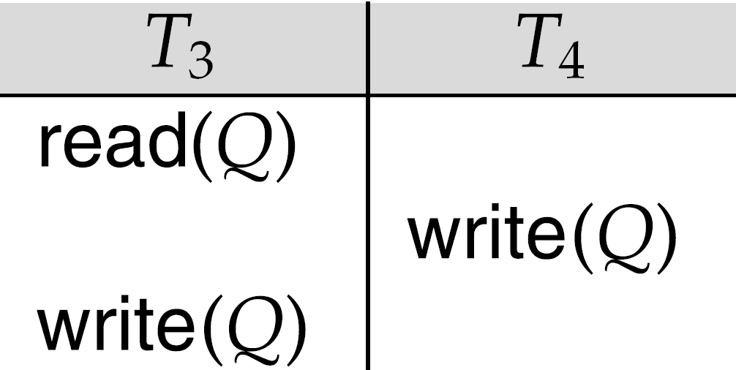
Conflict Serializability
In essence, following set of instructions is not conflict-serializable:

Slide 36
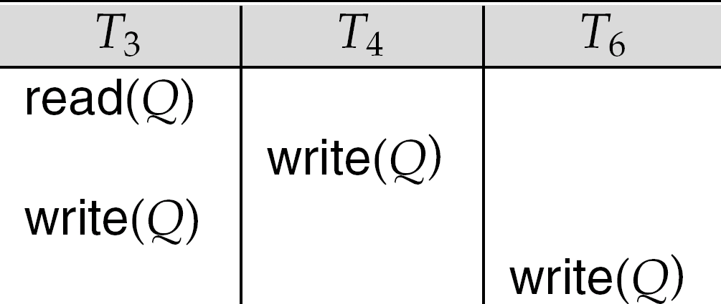
View-Serializability
Similarly, following not conflict-serializable
BUT, it is serializable
Intuitively, this is because the conflicting write instructions don’t matter
The final write is the only one that matters
View-serializability allows these
Read up

Slide 37
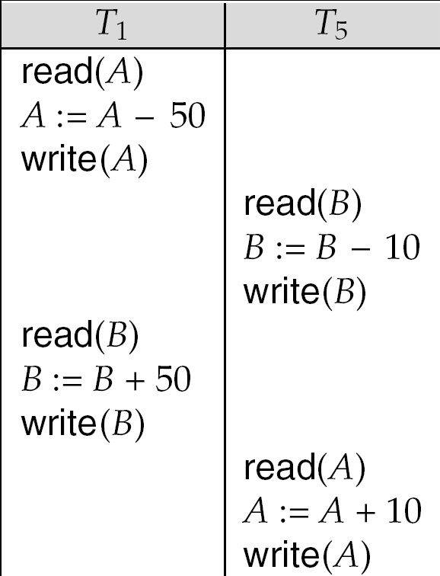
Other notions of serializability
Not conflict-serializable or view-serializable, but serializable
Mainly because of the +/- only operations
Requires analysis of the actual operations, not just read/write operations
Most high-performance transaction systems will allow these

Slide 38
Recoverability
Serializability is good for consistency
But what if transactions fail ?
T2 has already committed
A user might have been notified
Now T1 abort creates a problem
T2 has seen its effect, so just aborting T1 is not enough. T2 must be aborted as well (and possibly restarted)
But T2 is committed
T1
read(A)
A = A -50
write(A)
read(B)
B=B+50
write(B)
ABORT
T2
read(A)
tmp = A*0.1
A = A – tmp
write(A)
COMMIT

Slide 39
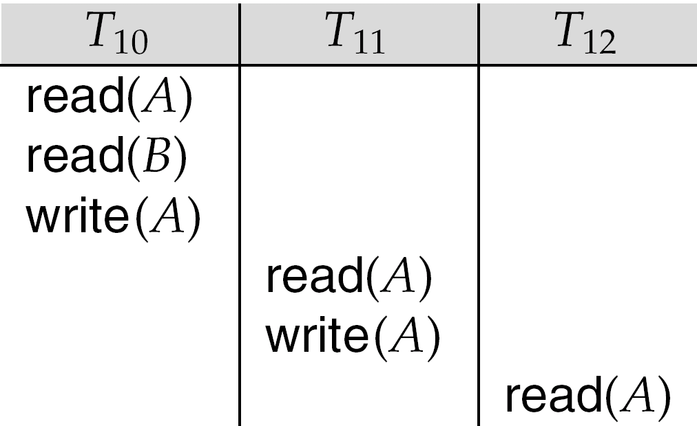
Recoverability
Recoverable schedule: If T1 has read something T2 has written, T2 must commit before T1
Otherwise, if T1 commits, and T2 aborts, we have a problem
Cascading rollbacks: If T10 aborts, T11 must abort, and hence T12 must abort and so on.

Slide 40
Recoverability
Dirty read: Reading a value written by a transaction that hasn’t committed yet
Cascadeless schedules:
A transaction only reads committed values.
So if T1 has written A, but not committed it, T2 can’t read it.
No dirty reads
Cascadeless → No cascading rollbacks
That’s good
We will try to guarantee that as well

Slide 41
Recap so far…
We discussed:
Serial schedules, serializability
Conflict-serializability, view-serializability
How to check for conflict-serializability
Recoverability, cascade-less schedules
We haven’t discussed:
How to guarantee serializability ?
Allowing transactions to run, and then aborting them if the schedules wasn’t serializable is clearly not the way to go
We instead use schemes to guarantee that the schedule will be conflict-serializable

Slide 42
CMSC424: Database Design Module: Transactions and ACID Properties
Concurrency Control: Locking - 1
Instructor: Amol Deshpande
amol@umd.edu

Slide 43
Locking - 1
Book Chapters
15.1.1-15.1.4
Key topics:
Using locking to guarantee concurrency
2-Phase Locking (2PL)
Implementation of locking

Slide 44
Approach, Assumptions etc..
Approach
Guarantee conflict-serializability by allowing certain types of concurrency
Lock-based
Assumptions:
Durability is not a problem
So no crashes
Though transactions may still abort
Goal:
Serializability
Minimize the bad effect of aborts (cascade-less schedules only)

Slide 45
Lock-based Protocols
A transaction must get a lock before operating on the data
Two types of locks:
Shared (S) locks (also called read locks)
Obtained if we want to only read an item – lock-S() instruction
Exclusive (X) locks (also called write locks)
Obtained for updating a data item – lock-X() instruction
T1
T2
T1
T2
lock-X(B)
read(B)
B ←B-50
write(B)
unlock(B)
lock-X(A)
read(A)
A ←A + 50
write(A)
unlock(A)
lock-S(A)
read(A)
unlock(A)
lock-S(B)
read(B)
unlock(B)
display(A+B)
read(B)
B ←B-50
write(B)
read(A)
A ←A + 50
write(A)
read(A)
read(B)
display(A+B)

Slide 46
Lock-based Protocols
Lock requests are made to the concurrency control manager
It decides whether to grant a lock request
T1 asks for a lock on data item A, and T2 currently has a lock on it ?
Depends
If compatible, grant the lock, otherwise T1 waits in a queue.
T2 lock type | T1 lock type | Should allow ?
Shared | Shared | YES
Shared | Exclusive | NO
Exclusive | - | NO

Slide 47
Lock-based Protocols
How do we actually use this to guarantee serializability/recoverability ?
Not enough just to take locks when you need to read/write something
T1
lock-X(B)
read(B)
B ←B-50
write(B)
unlock(B)
lock-X(A)
read(A)
A ←A + 50
write(A)
unlock(A)
lock-X(A), lock-X(B)
TMP = (A + B) * 0.1
A = A - TMP
B = B + TMP
unlock(A), unlock(B)
NOT SERIALIZABLE

Slide 48
2-Phase Locking Protocol (2PL)
Phase 1: Growing phase
Transaction may obtain locks
But may not release them
Phase 2: Shrinking phase
Transaction may only release locks
Can be shown that this achieves conflict-serializability
lock-point: the time at which a transaction acquired last lock
if lock-point(T1) < lock-point(T2), there can’t be an edge from T2 to T1 in the precedence graph
T1
lock-X(B)
read(B)
B ←B-50
write(B)
unlock(B)
lock-X(A)
read(A)
A ←A + 50
write(A)
unlock(A)

Slide 49
2 Phase Locking
Example: T1 in 2PL
T1
lock-X(B) read(B) B ← B - 50 write(B) lock-X(A) read(A) A ← A - 50 write(A) unlock(B) unlock(A)
Growing phase
Shrinking phase

Slide 50
2 Phase Locking
Guarantees conflict-serializability, but not cascade-less recoverability
T1 | T2 | T3
lock-X(A), lock-S(B) read(A) read(B) write(A) unlock(A), unlock(B) <xction fails> | lock-X(A) read(A) write(A) unlock(A) Commit | lock-S(A) read(A) Commit

Slide 51
2 Phase Locking
Guarantees conflict-serializability, but not cascade-less recoverability
Guaranteeing just recoverability:
If T2 reads a dirty data of T1 (ie, T1 has not committed), then T2 can’t commit unless T1 either commits or aborts
If T1 commits, T2 can proceed with committing
If T1 aborts, T2 must abort
So cascades still happen

Slide 52
Strict 2PL
Release exclusive locks only at the very end, just before commit or abort
T1 | T2 | T3
lock-X(A), lock-S(B) read(A) read(B) write(A) unlock(A), unlock(B) <xction fails> | lock-X(A) read(A) write(A) unlock(A) Commit | lock-S(A) read(A) Commit
Strict 2PL
will not
allow that
Works. Guarantees cascade-less and recoverable schedules.

Slide 53
Strict 2PL
Release exclusive locks only at the very end, just before commit or abort
Read locks are not important
Rigorous 2PL: Release both exclusive and read locks only at the very end
The serializability order === the commit order
More intuitive behavior for the users
No difference for the system
Lock conversion:
Transaction might not be sure what it needs a write lock on
Start with a S lock
Upgrade to an X lock later if needed
Doesn’t change any of the other properties of the protocol

Slide 54
Implementation of Locking
A separate process, or a separate module
Uses a lock table to keep track of currently assigned locks and the requests for locks

Slide 55
Lock Table
Black rectangles indicate granted locks, white ones indicate waiting requests
Lock table also records the type of lock granted or requested
New request is added to the end of the queue of requests for the data item, and granted if it is compatible with all earlier locks
Unlock requests result in the request being deleted, and later requests are checked to see if they can now be granted
If transaction aborts, all waiting or granted requests of the transaction are deleted
lock manager may keep a list of locks held by each transaction, to implement this efficiently

Slide 56
Recap so far…
Concurrency Control Scheme
A way to guarantee serializability, recoverability etc
Lock-based protocols
Use locks to prevent multiple transactions accessing the same data items
2 Phase Locking
Locks acquired during growing phase, released during shrinking phase
Strict 2PL, Rigorous 2PL

Slide 57
CMSC424: Database Design Module: Transactions and ACID Properties
Concurrency Control: Locking - 2
Instructor: Amol Deshpande
amol@umd.edu

Slide 58
Locking - 2
Book Chapters
15.2
Key topics:
Deadlocks and how 2PL doesn’t prevent them
Deadlock detection through precedence graphs
Deadlock avoidance/prevention schemes

Slide 59
More Locking Issues: Deadlocks
No xction proceeds:
Deadlock
- T1 waits for T2 to unlock A
- T2 waits for T1 to unlock B
2PL does not prevent deadlock
Strict doesn’t either
T1 | T2
lock-X(B) read(B) B ← B-50 write(B) lock-X(A) | lock-S(A) read(A) lock-S(B)
Rollback transactions
Can be costly...

Slide 60
Deadlock detection and recovery
Instead of trying to prevent deadlocks, let them happen and deal with them if they happen
How do you detect a deadlock?
Wait-for graph
Directed edge from Ti to Tj
Ti waiting for Tj
T2
T4
T1
T3
T1 | T2 | T3 | T4
S(V) | X(V) S(W) | X(Z) S(V) | X(W)
Suppose T4 requests lock-S(Z)....

Slide 61
Dealing with Deadlocks
Deadlock detected, now what ?
Will need to abort some transaction
Prefer to abort the one with the minimum work done so far
Possibility of starvation
If a transaction is aborted too many times, it may be given priority in continueing

Slide 62
Preventing deadlocks
Solution 1: A transaction must acquire all locks before it begins
Not acceptable in most cases
Still need some way to deal with deadlocks during lock acquisition
Solution 2: A transaction must acquire locks in a particular order over the data items
Also called graph-based protocols
The particular order used doesn’t matter (e.g., based on the value of some unique attribute)
Guarantees that there can never be a cycle in the precedence graph

Slide 63
Preventing deadlocks
Solution 3: Use time-stamps; say T1 is older than T2
wait-die scheme: T1 will wait for T2. T2 will not wait for T1; instead it will abort and restart
In the precedence graph, there can be an edge from old transaction to a new transaction, but never the other way
So there cannot be a cycle in precedence graph
wound-wait scheme: T1 will wound T2 (force it to abort) if it needs a lock that T2 currently has; T2 will wait for T1.
Similar to above: edges only from newer transactions to older transactions
May abort more transactions that needed
Solution 4: Timeout based
Transaction waits a certain time for a lock; aborts if it doesn’t get it by then
As above, may lead to unnecessary restarts, but very simple to implement

Slide 64
CMSC424: Database Design Module: Transactions and ACID Properties
Concurrency Control: Locking - 3
Instructor: Amol Deshpande
amol@umd.edu

Slide 65
Locking - 3
Book Chapters
15.3
Key topics:
What are we taking locks on
Multi-granularity locking
Intentional locks and compatibility

Slide 66
Locking granularity
Locking granularity
What are we taking locks on ? Tables, tuples, attributes ?
Coarse granularity
e.g. take locks on tables
less overhead (the number of tables is not that high)
very low concurrency
Fine granularity
e.g. take locks on tuples
much higher overhead
much higher concurrency
What if I want to lock 90% of the tuples of a table ?
Prefer to lock the whole table in that case

Slide 67
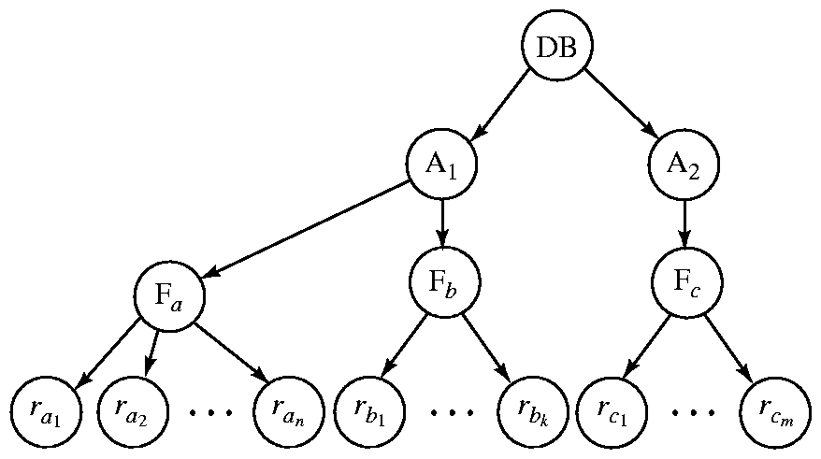
Granularity Hierarchy
The highest level in the example hierarchy is the entire database.
The levels below are of type area, file or relation and record in that order.
Can lock at any level in the hierarchy

Slide 68
Granularity Hierarchy
New lock mode, called intentional locks
Declare an intention to lock parts of the subtree below a node
IS: intention shared
The lower levels below may be locked in the shared mode
IX: intention exclusive
SIX: shared and intention-exclusive
The entire subtree is locked in the shared mode, but I might also want to get exclusive locks on the nodes below
Protocol:
If you want to acquire a lock on a data item, all the ancestors must be locked as well, at least in the intentional mode
So you always start at the top root node

Slide 69
Granularity Hierarchy
(1) Want to lock F_a in shared mode, DB and A1 must be locked in at least IS mode (but IX, SIX, S, X are okay too)
(2) Want to lock rc1 in exclusive mode, DB, A2,Fc must be locked in at least IX mode (SIX, X are okay too)

Slide 70
Multi-granularity Locking
Rules for Multi-granularity Locking
Always start with the root
Can lock Q in S or IS, only if parent is locked in IS or IX mode
Can lock Q in X, SIX, or IX only if parent is locked in IX or SIX mode
Must follow 2-phase locking protocol
Unlock Q only if locks on all children (if any) are released
i.e., unlock from the bottom up
However: it is not a problem to lock a child in, say S, if the parent is in SIX
It is redundant, but may happen because of “lock upgrades”
Depending on implementation, may release the child lock or not

Slide 71
Compatibility Matrix with Intention Lock Modes
The compatibility matrix (which locks can be present simultaneously on the same data item) for all lock modes is:
requestor
IS
IX
S
S IX
X
IS
✓
✓
✓
✓
×
IX
✓
✓
×
×
×
S
✓
×
✓
×
×
holder
S IX
✓
×
×
×
×
X
×
×
×
×
×

Slide 72
Example
T1(IS)
, T2(IX)
R1
t1
t4
t2
t3
T1(S)
T2(X)

Slide 73
Examples
T1(IX)
R
T1(IS)
R
T1(IX)
t1
t2
t3
t4
T1(S)
t1
t2
t3
t4
T1(X)
f2.1
f2.2
f4.2
f4.2
f2.1
f2.2
f4.2
f4.2
T1(SIX)
Can T2 access object f2.2 in X mode?
What locks will T2 get?
R
T1(IX)
t1
t2
t3
t4
T1(X)
f2.1
f2.2
f4.2
f4.2

Slide 74
Examples
T1 scans R, and updates a few tuples:
T1 gets an SIX lock on R, then occasionally upgrades to X on the specific tuples.
T2 uses an index to read only part of R:
T2 gets an IS lock on R, and repeatedly gets an S lock on tuples of R.
T3 reads all of R:
T3 gets an S lock on R.
OR, T3 could behave like T2; can
use lock escalation to decide which.
--
IS
IX
S
X
--
√
√
√
√
√
IS
√
√
√
√
IX
√
√
√
S
√
√
√
X
√

Slide 75
Recap: Locking-based CC
Key idea: Take locks as required to ensure conflict serializability
2-phase locking, and Strict and Rigorous 2PL
Deadlocks and how to prevent or detect them
Multi-granularity locking
Many commercial databases support locking-based CC, but increasingly multi-version concurrency control more common
Locking expensive in comparison, and supports lower concurrency than MVCC techniques (like Snapshot Isolation)

Slide 76
CMSC424: Database Design Module: Transactions and ACID Properties
Concurrency Control:
Other Schemes
Instructor: Amol Deshpande
amol@umd.edu

Slide 77
1. Time-stamp Based
Time-stamp based
Transactions are issued time-stamps when they enter the system
The time-stamps determine the serializability order
So if T1 entered before T2, then T1 should be before T2 in the serializability order
Say timestamp(T1) < timestamp(T2)
If T1 wants to read data item A
If any transaction with larger time-stamp wrote that data item, then this operation is not permitted, and T1 is aborted
If T1 wants to write data item A
If a transaction with larger time-stamp already read that data item or written it, then the write is rejected and T1 is aborted
Aborted transaction are restarted with a new timestamp
Possibility of starvation

Slide 78
1. Time-stamp Based
Maintain for each data Q, two timestamps:
W-timestamp(Q): largest time-stamp of any transaction that executed Write(Q) successfully
R-timestamp(Q): largest time-stamp of any transaction that executed Read(Q) successfully
Suppose Ti wants to read(Q):
If TS(T_i) < W-Timestamp(Q): Reject the operation and roll back T_i
Otherwise, allow the operation and modify:
R-timestamp(Q) = max(R-timestamp(Q)), TS(T_i))

Slide 79
1. Time-stamp Based
Maintain for each data Q, two timestamps:
W-timestamp(Q): largest time-stamp of any transaction that executed Write(Q) successfully
R-timestamp(Q): largest time-stamp of any transaction that executed Read(Q) successfully
Suppose Ti wants to write(Q):
1. If TS(T_{i}) < R-timestamp(Q): reject the write and roll back T_i
2. If TS(T_{i}) < W-timestamp(Q), then T_{i} is attempting to write an
obsolete value of Q.
Hence, this write operation is rejected, and T_{i} is rolled back.
3. Otherwise, execute write, and W-timestamp(Q) is set to TS(T_{i}).

Slide 80
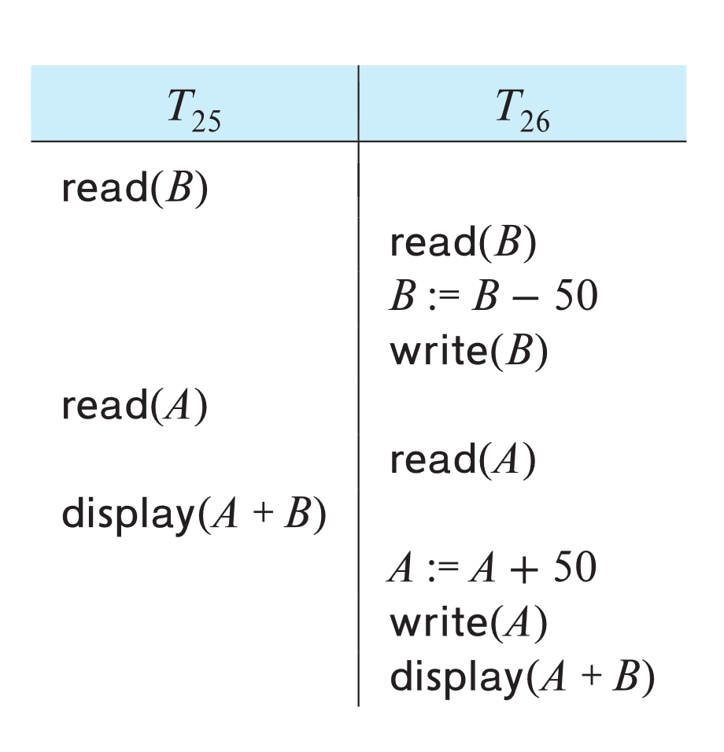
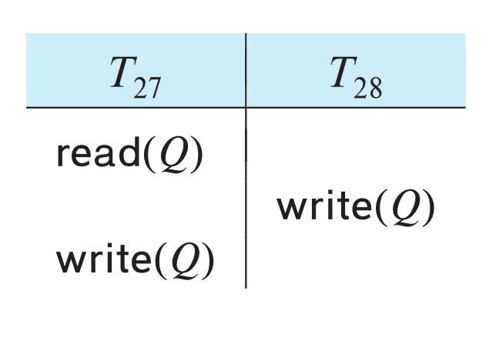
1. Example of Schedule Under TSO
Is this schedule valid under TSO?
Assume that initially:
R-TS(A) = W-TS(A) = 0
R-TS(B) = W-TS(B) = 0
Assume TS(T₂₅) = 25 and TS(T₂₆) = 26
How about this one, where initially R-TS(Q)=W-TS(Q)=0

Slide 81
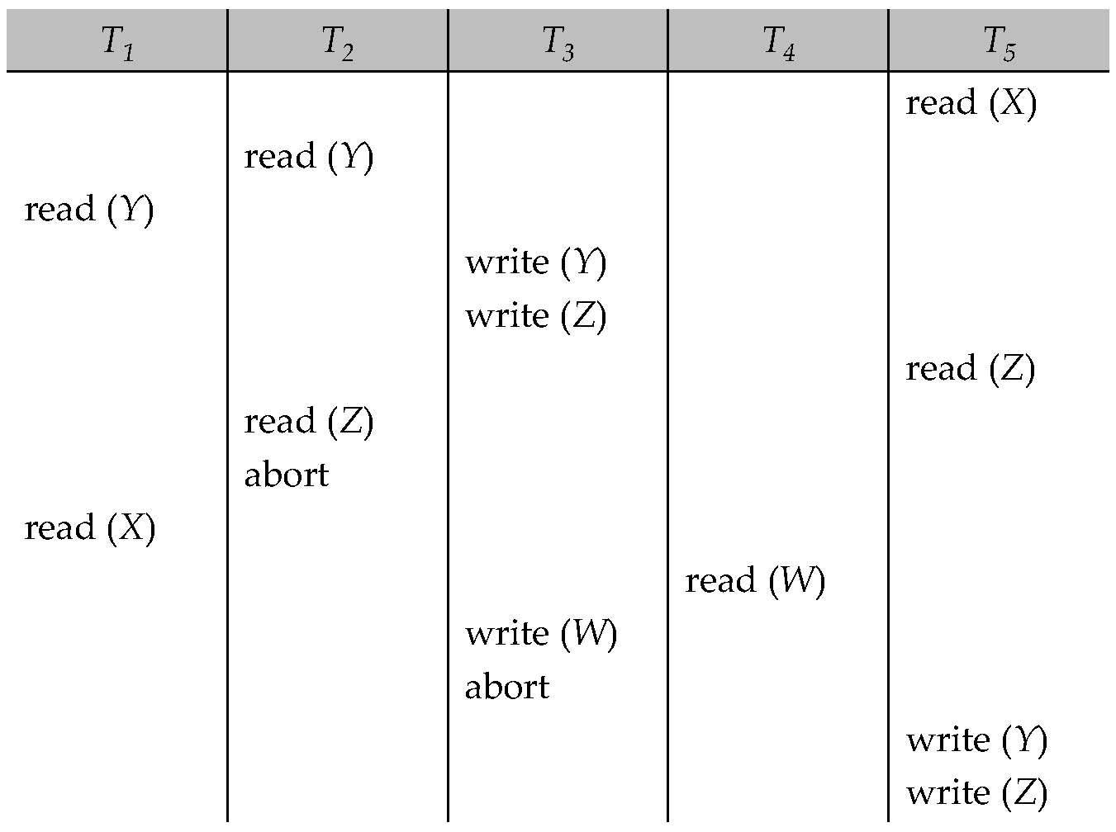
1. Another Example
Example

Slide 82
1. Recoverability and Cascade Freedom
Solution 1:
A transaction is structured such that its writes are all performed at the end of its processing
All writes of a transaction form an atomic action; no transaction may execute while a transaction is being written
A transaction that aborts is restarted with a new timestamp
Solution 2:
Limited form of locking: wait for data to be committed before reading it
Solution 3:
Use commit dependencies to ensure recoverability (i.e., require them to commit in some order)

Slide 83
1. Thomas’ Write Rule
Ignore obsolete write operations under certain circumstances
When T_{i} attempts to write data item Q, if TS(T_{i}) < W-timestamp(Q), then T_{i} is attempting to write an obsolete value of {Q}.
Rather than rolling back T_{i}, this {write} operation can be ignored.
Allows greater potential concurrency.
Allows some view-serializable schedules that are not conflict-serializable.

Slide 84
2. Optimistic Concurrency Control
Optimistic concurrency control
Also called validation-based
Intuition
Let the transactions execute as they wish
At the very end when they are about to commit, check if there might be any problems/conflicts etc
If no, let it commit
If yes, abort and restart
Optimistic: The hope is that there won’t be too many problems/aborts

Slide 85
2. Optimistic Concurrency Control
Each transaction T_{i} has 3 timestamps
Start(T_{i}) : the time when T_{i} started its execution
Validation(T_{i}): the time when T_{i} entered its validation phase
Finish(T_{i}) : the time when T_{i} finished its write phase
Serializability order is determined by timestamp given at validation time, to increase concurrency.
Thus TS(T_{i}) is given the value of Validation(T_{i}).
This protocol is useful and gives greater degree of concurrency if probability of conflicts is low.
because the serializability order is not pre-decided, and
relatively few transactions will have to be rolled back.

Slide 86
2. Optimistic Concurrency Control
If for all T_{i} with TS (T_{i}) < TS (T_{j}) either one of the following condition holds:
finish(T_{i}) < start(T_{j})
start(T_{j}) < finish(T_{i}) < validation(T_{j}) and the set of data items written by T_{i} does not intersect with the set of data items read by T_{j}.
then validation succeeds and T_{j} can be committed. Otherwise, validation fails and T_{j} is aborted.
Justification: Either the first condition is satisfied, and there is no overlapped execution, or the second condition is satisfied and
the writes of T_{j} do not affect reads of T_{i} since they occur after T_{i} has finished its reads.
the writes of T_{i} do not affect reads of T_{j} since T_{j} does not read any item written by T_{i}.

Slide 87
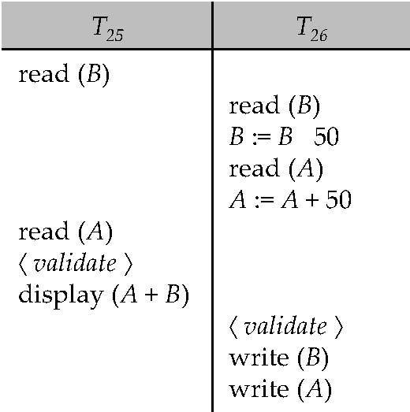
2. Optimistic Concurrency Control
Example of schedule produced using validation

Slide 88
3. Snapshot Isolation
Very popular scheme, used as the primary scheme by many systems including Oracle, PostgreSQL etc…
Several others support this in addition to locking-based protocol
A type of “multi-version concurrency control”
Also similar to optimistic concurrency control in many ways
Key idea:
For each object, maintain past “versions” of the data along with timestamps
Every update to an object causes a new version to be generated

Slide 89
3. Snapshot Isolation
Read queries:
Let “t” be the “time-stamp” of the query, i.e., the time at which it entered the system
When the query asks for a data item, provide a version of the data item that was latest as of “t”
Even if the data changed in between, provide an old version
No locks needed, no waiting for any other transactions or queries
The query executes on a consistent snapshot of the database
Update queries (transactions):
Reads processed as above on a snapshot
Writes are done in private storage
At commit time, for each object that was written, check if some other transaction updated the data item since this transaction started
If yes, then abort and restart
If no, make all the writes public simultaneously (by making new versions)

Slide 90
3. Snapshot Isolation
A transaction T1 executing with Snapshot Isolation
takes snapshot of committed data at start
always reads/modifies data in its own snapshot
updates of concurrent transactions are not visible to T1
writes of T1 complete when it commits
First-committer-wins rule:
Commits only if no other concurrent transaction has already written data that T1 intends to write.
T1 | T2 | T3
W(Y := 1) Commit
 | Start R(X) → 0 R(Y)→ 1
 |  | W(X:=2) W(Z:=3) Commit
 | R(Z) → 0 R(Y) → 1 W(X:=3) Commit-Req Abort
Concurrent updates not visible
Own updates are visible
Not first-committer of X
Serialization error, T2 is rolled back

Slide 91
3. Snapshot Isolation
Advantages:
Read query don’t block at all, and run very fast
As long as conflicts are rare, update transactions don’t abort either
Overall better performance than locking-based protocols
Major disadvantage:
Not serializable
Inconsistencies may be introduced
See the wikipedia article for more details and an example
http://en.wikipedia.org/wiki/Snapshot_isolation

Slide 92
3. Snapshot Isolation
Example of problem with SI
T1: x:=y
T2: y:= x
Initially x = 3 and y = 17
Serial execution: x = ??, y = ??
if both transactions start at the same time, with snapshot isolation: x = ?? , y = ??
Called skew write
Skew also occurs with inserts
E.g:
Find max order number among all orders
Create a new order with order number = previous max + 1

Slide 93
3. SI In Oracle and PostgreSQL
Warning: SI used when isolation level is set to serializable, by Oracle, and PostgreSQL versions prior to 9.1
PostgreSQL’s implementation of SI (versions prior to 9.1) described in Section 26.4.1.3
Oracle implements “first updater wins” rule (variant of “first committer wins”)
concurrent writer check is done at time of write, not at commit time
Allows transactions to be rolled back earlier
Oracle and PostgreSQL < 9.1 do not support true serializable execution
PostgreSQL 9.1 introduced new protocol called “Serializable Snapshot Isolation” (SSI)
Which guarantees true serializabilty including handling predicate reads (coming up)

Slide 94
CMSC424: Database Design Module: Transactions and ACID Properties
Concurrency Control:
Phantom Problem; Weak Levels of Isolations
Instructor: Amol Deshpande
amol@umd.edu

Slide 95
Phantom Phenomenon
Example of phantom phenomenon.
A transaction T1 that performs predicate read (or scan) of a relation
select count(*) from instructor where dept_name = 'Physics'
and a transaction T2 that inserts a tuple while T1 is active but after predicate read
insert into instructor values ('11111', 'Feynman', 'Physics', 94000)
(conceptually) conflict in spite of not accessing any tuple in common.
If only tuple locks are used, non-serializable schedules can result
E.g. the scan transaction does not see the new instructor, but may read some other tuple written by the update transaction
Can also occur with updates
E.g. update Wu’s department from Finance to Physics

Slide 96
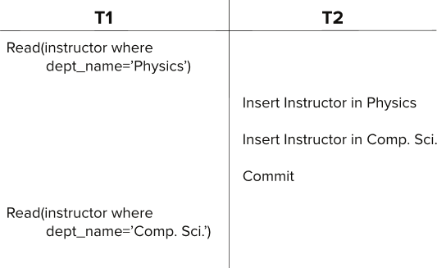
Insert/Delete Operations and Predicate Reads
Another Example Schedule with a problem
T1 saw a partial update of T2, but not the full update
So not serializable

Slide 97
Insert/Delete Operations and Predicate Reads
Another Example: T1 and T2 both find maximum instructor ID in parallel, and create new instructors with ID = maximum ID + 1
Both instructors get same ID, not possible in serializable schedule

Slide 98
Index Locking To Prevent Phantoms
Index locking protocol to prevent phantoms
Every relation must have at least one index.
A transaction can access tuples only after finding them through one or more indices on the relation
A transaction T_{i} that performs a lookup must lock all the index leaf nodes that it accesses, in S-mode
Even if the leaf node does not contain any tuple satisfying the index lookup (e.g. for a range query, no tuple in a leaf is in the range)
A transaction T_{i} that inserts, updates or deletes a tuple t_{i} in a relation r
Must update all indices to r
Must obtain exclusive locks on all index leaf nodes affected by the insert/update/delete
The rules of the two-phase locking protocol must be observed
Guarantees that phantom phenomenon won’t occur

Slide 99
Weak Levels of Consistency
Degree-two consistency: differs from two-phase locking in that S-locks may be released at any time, and locks may be acquired at any time
X-locks must be held till end of transaction
Guarantees no “dirty reads” (so no recoverability issues)
Serializability is not guaranteed, programmer must ensure that no erroneous database state will occur]
Cursor stability:
For reads, each tuple is locked, read, and lock is immediately released
X-locks are held till end of transaction
Special case of degree-two consistency

Slide 100
Weak Levels of Consistency

Slide 101
The “Phantom” problem
An interesting problem that comes up for dynamic databases
Schema: accounts(acct_no, balance, zipcode, …)
Transaction 1: Find the number of accounts in zipcode = 20742, and divide $1,000,000 between them
Transaction 2: Insert <acctX, …, 20742, …>
Execution sequence:
T1 locks all tuples corresponding to “zipcode = 20742”, finds the total number of accounts (= num_accounts)
T2 does the insert
T1 computes 1,000,000/num_accounts
When T1 accesses the relation again to update the balances, it finds one new (“phantom”) tuples (the new tuple that T2 inserted)
Not serializable

Slide 102
Weak Levels of Consistency
Degree-two consistency: differs from two-phase locking in that S-locks may be released at any time, and locks may be acquired at any time
X-locks must be held till end of transaction
Serializability is not guaranteed, programmer must ensure that no erroneous database state will occur]
Cursor stability:
For reads, each tuple is locked, read, and lock is immediately released
X-locks are held till end of transaction
Special case of degree-two consistency

Slide 103
Weak Levels of Consistency in SQL
SQL allows non-serializable executions
Serializable: is the default
Repeatable read: allows only committed records to be read, and repeating a read should return the same value (so read locks should be retained)
However, the phantom phenomenon need not be prevented
T1 may see some records inserted by T2, but may not see others inserted by T2
Read committed: same as degree two consistency, but most systems implement it as cursor-stability
Read uncommitted: allows even uncommitted data to be read
In many database systems, read committed is the default consistency level
has to be explicitly changed to serializable when required
set isolation level serializable

Slide 104
Summary
Concurrency control schemes help guarantee isolation while allowing for concurrent transactions
Many different schemes developed over the years
Lock-based, Timestamp-based, Snapshot Isolation, Optimistic
Lot of new work in the recent years because of shifting hardware trends
E.g., locking performance overheads quite significant
Many NoSQL systems still have limited concurrency
Important to consider recovery schemes at the same time

Slide 105
CMSC424: Database Design Module: Transactions and ACID Properties
Recovery: Overview; Terminology; Steal and Force
Instructor: Amol Deshpande
amol@umd.edu

Slide 106
Transactions: Recovery
Book Chapters
16.1, 16.2, 16.3.2
Key topics:
Challenges in guaranteeing Atomicity and Durability
Basics of how disks and memory interact
New operations: Output() and Input()
STEAL and NO FORCE: Why those are desirable
Terminology used in the book: Immediate vs Deferred Modifications

Slide 107
Context
ACID properties:
We have talked about Isolation and Consistency
How do we guarantee Atomicity and Durability ?
Atomicity: Two problems
Part of the transaction is done, but we want to cancel it
ABORT/ROLLBACK
System crashes during the transaction. Some changes made it to the disk, some didn’t.
Durability:
Transaction finished. User notified. But changes not sent to disk yet (for performance reasons). System crashed.
Essentially similar solutions

Slide 108
Reasons for crashes
Transaction failures
Logical errors: transaction cannot complete due to some internal error condition
System errors: the database system must terminate an active transaction due to an error condition (e.g., deadlock)
System crash
Power failures, operating system bugs etc
Fail-stop assumption: non-volatile storage contents are assumed to not be corrupted by system crash
Database systems have numerous integrity checks to prevent corruption of disk data
Disk failure
Head crashes; for now we will assume
STABLE STORAGE: Data never lost. Can approximate by using RAID and maintaining geographically distant copies of the data

Slide 109
Approach, Assumptions etc..
Approach:
Guarantee A and D:
by controlling how the disk and memory interact,
by storing enough information during normal processing to recover from failures
by developing algorithms to recover the database state
Assumptions:
System may crash, but the disk is durable
The only atomicity guarantee is that a disk block write is atomic
Once again, obvious naïve solutions exist that work, but that are too expensive.
E.g. The shadow copy solution
Make a copy of the database; do the changes on the copy; do an atomic switch of the dbpointer at commit time
Goal is to do this as efficiently as possible

Slide 110
Data Access
Physical blocks are those blocks residing on the disk.
Buffer blocks are the blocks residing temporarily in main memory.
Block movements between disk and main memory are initiated through the following two operations:
input(B) transfers the physical block B to main memory.
output(B) transfers the buffer block B to the disk, and replaces the appropriate physical block there.
We assume, for simplicity, that each data item fits in, and is stored inside, a single block.

Slide 111
Example of Data Access
buffer
Buffer Block A
input(A)
X
A
Buffer Block B
Y
B
output(B)
read(X)
write(Y)
x₂
x₁
y₁
work area
of T₁
work area
of T₂
memory
disk

Slide 112
Data Access (Cont.)
Each transaction T_{i} has its private work-area in which local copies of all data items accessed and updated by it are kept.
T_{i}'s local copy of a data item X is called x_{i}.
Transferring data items between system buffer blocks and its private work-area done by:
read(X) assigns the value of data item X to the local variable x_{i}.
write(X) assigns the value of local variable x_{i} to data item {X} in the buffer block.
Note: output(B_{X}) need not immediately follow write(X). System can perform the output operation when it deems fit.
Transactions
Must perform read(X) before accessing X for the first time (subsequent reads can be from local copy)
write(X) can be executed at any time before the transaction commits

Slide 113
STEAL vs NO STEAL, FORCE vs NO FORCE
STEAL:
The buffer manager can steal a (memory) page from the database
ie., it can write an arbitrary page to the disk and use that page for something else from the disk
In other words, the database system doesn’t control the buffer replacement policy
Why a problem ?
The page might contain dirty writes, ie., writes/updates by a transaction that hasn’t committed
But, we must allow steal for performance reasons.
NO STEAL:
Not allowed. More control, but less flexibility for the buffer manager.

Slide 114
STEAL vs NO STEAL, FORCE vs NO FORCE
FORCE:
The database system forces all the updates of a transaction to disk before committing
Why ?
To make its updates permanent before committing
Why a problem ?
Most probably random I/Os, so poor response time and throughput
Interferes with the disk controlling policies
NO FORCE:
Don’t do the above. Desired.
Problem:
Guaranteeing durability becomes hard
We might still have to force some pages to disk, but minimal.

Slide 115
STEAL vs NO STEAL, FORCE vs NO FORCE: Recovery implications
Desired
No Force
Trivial
Force
No Steal
Steal

Slide 116
STEAL vs NO STEAL, FORCE vs NO FORCE: Recovery implications
How to implement A and D when No Steal and Force ?
Only updates from committed transaction are written to disk (since no steal)
Updates from a transaction are forced to disk before commit (since force)
A minor problem: how do you guarantee that all updates from a transaction make it to the disk atomically ?
Remember we are only guaranteed an atomic block write
What if some updates make it to disk, and other don’t ?
Can use something like shadow copying/shadow paging
No atomicity/durability problem arise.

Slide 117
Terminology
Deferred Database Modification:
Similar to NO STEAL, NO FORCE
Not identical
Only need redos, no undos
We won’t cover this in detail
Immediate Database Modification:
Similar to STEAL, NO FORCE
Need both redos, and undos

Slide 118
CMSC424: Database Design Module: Transactions and ACID Properties
Recovery: Basics of Logging and UNDO
Instructor: Amol Deshpande
amol@umd.edu

Slide 119
Transactions: Recovery
Book Chapters
16.3.1, 16.3.5
Key topics:
Generating log records
Using log records to support UNDO/Rollback

Slide 120
Log-based Recovery
Most commonly used recovery method
Intuitively, a log is a record of everything the database system does
For every operation done by the database, a log record is generated and stored typically on a different (log) disk
<T1, START>
<T2, COMMIT>
<T2, ABORT>
<T1, A, 100, 200>
T1 modified A; old value = 100, new value = 200

Slide 121
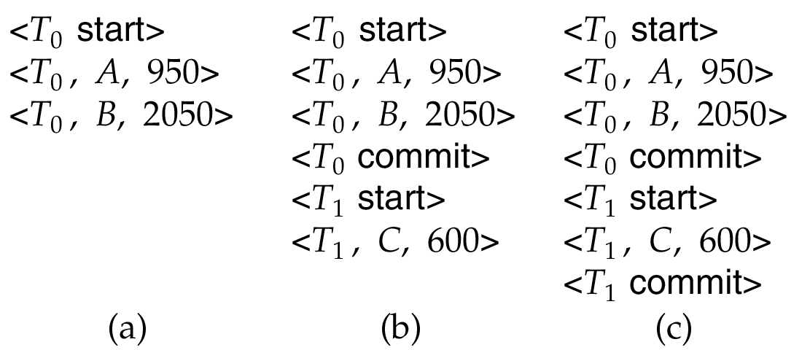
Log
Example transactionsT₀ and T₁ (T₀ executes before T₁):
T₀: read (A) T₁ : read (C)
A: - A - 50 C:- C- 100
write (A) write (C)
read (B)
B:- B + 50
write (B)
Log:

Slide 122
Log-based Recovery
Assumptions:
Log records are immediately pushed to the disk as soon as they are generated
Log records are written to disk in the order generated
A log record is generated before the actual data value is updated
Strict two-phase locking
The first assumption can be relaxed
As a special case, a transaction is considered committed only after the <T1, COMMIT> has been pushed to the disk
But, this seems like exactly what we are trying to avoid ??
Log writes are sequential
They are also typically on a different disk
Aside: LFS == log-structured file system

Slide 123
Log-based Recovery
Assumptions:
Log records are immediately pushed to the disk as soon as they are generated
Log records are written to disk in the order generated
A log record is generated before the actual data value is updated
Strict two-phase locking
The first assumption can be relaxed
As a special case, a transaction is considered committed only after the <T1, COMMIT> has been pushed to the disk
NOTE: As a result of assumptions 1 and 2, if data item A is updated, the log record corresponding to the update is always forced to the disk before data item A is written to the disk
This is actually the only property we need; assumption 1 can be relaxed to just guarantee this (called write-ahead logging)

Slide 124
Using the log to abort/rollback
STEAL is allowed, so changes of a transaction may have made it to the disk
UNDO(T1):
Procedure executed to rollback/undo the effects of a transaction
E.g.
<T1, START>
<T1, A, 200, 300>
<T1, B, 400, 300>
<T1, A, 300, 200> [[ note: second update of A ]]
T1 decides to abort
Any of the changes might have made it to the disk

Slide 125
Using the log to abort/rollback
UNDO(T1):
Go backwards in the log looking for log records belonging to T1
Restore the values to the old values
NOTE: Going backwards is important.
A was updated twice
In the example, we simply:
Restore A to 300
Restore B to 400
Restore A to 200
Write a log record <T_{i} , X_{j}, V₁>
such log records are called compensation log records
<T1, A, 300>, <T1, B, 400>, <T1, A, 200>
Note: No other transaction better have changed A or B in the meantime
Strict two-phase locking

Slide 126
CMSC424: Database Design Module: Transactions and ACID Properties
Recovery: Log-based Restart Recovery
Instructor: Amol Deshpande
amol@umd.edu

Slide 127
Using Logs for Recovery
Book Chapters
16.4
Key topics:
How to use logs for REDO
Idempotency of log records
Restart recovery after a failure

Slide 128
Using the log to recover
We don’t require FORCE, so a change made by the committed transaction may not have made it to the disk before the system crashed
BUT, the log record did (recall our assumptions)
REDO(T1):
Procedure executed to recover a committed transaction
E.g.
<T1, START>
<T1, A, 200, 300>
<T1, B, 400, 300>
<T1, A, 300, 200> [[ note: second update of A ]]
<T1, COMMIT>
By our assumptions, all the log records made it to the disk (since the transaction committed)
But any or none of the changes to A or B might have made it to disk

Slide 129
Using the log to recover
REDO(T1):
Go forwards in the log looking for log records belonging to T1
Set the values to the new values
NOTE: Going forwards is important.
In the example, we simply:
Set A to 300
Set B to 300
Set A to 200

Slide 130
Idempotency
Both redo and undo are required to idempotent
F is idempotent, if F(x) = F(F(x)) = F(F(F(F(…F(x)))))
Multiple applications shouldn’t change the effect
This is important because we don’t know exactly what made it to the disk, and we can’t keep track of that
E.g. consider a log record of the type
<T1, A, incremented by 100>
Old value was 200, and so new value was 300
But the on disk value might be 200 or 300 (since we have no control over the buffer manager)
So we have no idea whether to apply this log record or not
Hence, value based logging is used (also called physical), not operation based (also called logical)

Slide 131
Log-based recovery
Log is maintained
If during the normal processing, a transaction needs to abort
UNDO() is used for that purpose
If the system crashes, then we need to do recovery using both UNDO() and REDO()
Some transactions that were going on at the time of crash may not have completed, and must be aborted/undone
Some transaction may have committed, but their changes didn’t make it to disk, so they must be redone
Called restart recovery

Slide 132
Recovery Algorithm (Cont.)
Recovery from failure: Two phases
Redo phase: replay updates of all transactions, whether they committed, aborted, or are incomplete
Undo phase: undo all incomplete transactions
Redo phase:
Set undo-list to {} (empty).
Scan forward from first log record
Whenever a record <T_{i}, X_{j}, V₁, V₂> is found, redo it by writing V₂ to X_{j}
Whenever a log record <T_{i} start> is found, add T_{i} to undo-list
Whenever a log record <T_{i} commit> or <T_{i} abort> is found, remove T_{i} from undo-list

Slide 133
Recovery Algorithm (Cont.)
Undo phase:
Scan log backwards from end
Whenever a log record <T_{i}, X_{j}, V₁, V₂> is found where T_{i} is in undo-list perform same actions as for transaction rollback:
perform undo by writing V₁ to X_{j}.
write a log record <T_{i} , X_{j}, V₁>
Whenever a log record <T_{i} start> is found where T_{i} is in undo-list,
Write a log record <T_{i} abort>
Remove T_{i} from undo-list
Stop when undo-list is empty
i.e. <T_{i} start> has been found for every transaction in undo-list
After undo phase completes, normal transaction processing can commence

Slide 134
Example of Recovery

Slide 135
CMSC424: Database Design Module: Transactions and ACID Properties
Checkpointing; Write-ahead Logging; Recap
Instructor: Amol Deshpande
amol@umd.edu

Slide 136
Recovery: Recap
Book Chapters
16.3.6, 16.5
Key topics:
Checkpointing
Write-ahead logging
Recap

Slide 137
Checkpointing
How far should we go back in the log while constructing redo and undo lists ??
It is possible that a transaction made an update at the very beginning of the system, and that update never made it to disk
very very unlikely, but possible (because we don’t do force)
For correctness, we have to go back all the way to the beginning of the log
Bad idea !!
Checkpointing is a mechanism to reduce this

Slide 138
Checkpointing
Periodically, the database system writes out everything in the memory to disk
Goal is to get the database in a state that we know (not necessarily consistent state)
Steps:
Stop all other activity in the database system
Write out the entire contents of the memory to the disk
Only need to write updated pages, so not so bad
Entire === all updates, whether committed or not
Write out all the log records to the disk
Write out a special log record to disk
<CHECKPOINT LIST_OF_ACTIVE_TRANSACTIONS>
The second component is the list of all active transactions in the system right now
Continue with the transactions again

Slide 139
Recovery Algorithm (Cont.)
Recovery from failure: Two phases
Redo phase: replay updates of all transactions, whether they committed, aborted, or are incomplete
Undo phase: undo all incomplete transactions
Redo phase (No difference for Undo phase):
Find last <checkpoint L> record, and set undo-list to L.
- If no checkpoint record, start at the beginning
Scan forward from above <checkpoint L> record
Whenever a record <T_{i}, X_{j}, V₁, V₂> is found, redo it by writing V₂ to X_{j}
Whenever a log record <T_{i} start> is found, add T_{i} to undo-list
Whenever a log record <T_{i} commit> or <T_{i} abort> is found, remove T_{i} from undo-list

Slide 140
Recap so far …
Log-based recovery
Uses a log to aid during recovery
UNDO()
Used for normal transaction abort/rollback, as well as during restart recovery
REDO()
Used during restart recovery
Checkpoints
Used to reduce the restart recovery time

Slide 141
Write-ahead logging
We assumed that log records are written to disk as soon as generated
Too restrictive
Write-ahead logging:
Before an update on a data item (say A) makes it to disk, the log records referring to the update must be forced to disk
How ?
Each log record has a log sequence number (LSN)
Monotonically increasing
For each page in the memory, we maintain the LSN of the last log record that updated a record on this page
pageLSN
If a page P is to be written to disk, all the log records till pageLSN(P) are forced to disk

Slide 142
Write-ahead logging
Write-ahead logging (WAL) is sufficient for all our purposes
All the algorithms discussed before work
Note the special case:
A transaction is not considered committed, unless the <T, commit> record is on disk

Slide 143
Other issues
The system halts during checkpointing
Not acceptable
Advanced recovery techniques allow the system to continue processing while checkpointing is going on
System may crash during recovery
Our simple protocol is actually fine
In general, this can be painful to handle
B+-Tree and other indexing techniques
Strict 2PL is typically not followed (we didn’t cover this)
So physical logging is not sufficient; must have logical logging

Slide 144
Other issues
ARIES: Considered the canonical description of log-based recovery
Used in most systems
Has many other types of log records that simplify recovery significantly
Loss of disk:
Can use a scheme similar to checkpoining to periodically dump the database onto tapes or optical storage
Techniques exist for doing this while the transactions are executing (called fuzzy dumps)
Shadow paging:
Read up

Slide 145
Recap
STEAL vs NO STEAL, FORCE vs NO FORCE
We studied how to do STEAL and NO FORCE through log-based recovery scheme
Desired
REDO
NO UNDO
REDO
UNDO
No Force
No Force
Trivial
NO REDO
NO UNDO
NO REDO
UNDO
Force
Force
No Steal
Steal
No Steal
Steal

Slide 146
Recap
ACID Properties
Atomicity and Durability :
Logs, undo(), redo(), WAL etc
Consistency and Isolation:
Concurrency schemes
Strong interactions:
We had to assume Strict 2PL for proving correctness of recovery

Slide 147
CMSC424: Database Design Module: Transactions and ACID Properties
Distributed Transactions
Instructor: Amol Deshpande
amol@umd.edu

Slide 148
Distributed Transactions
Book Chapters
19.1-19.4, 19.6: at a fairly high level
Key topics:
Distributed databases and replication
Transaction processing in distributed databases
2-Phase Commit
Brief discussion of other protocols including Paxos

Slide 149
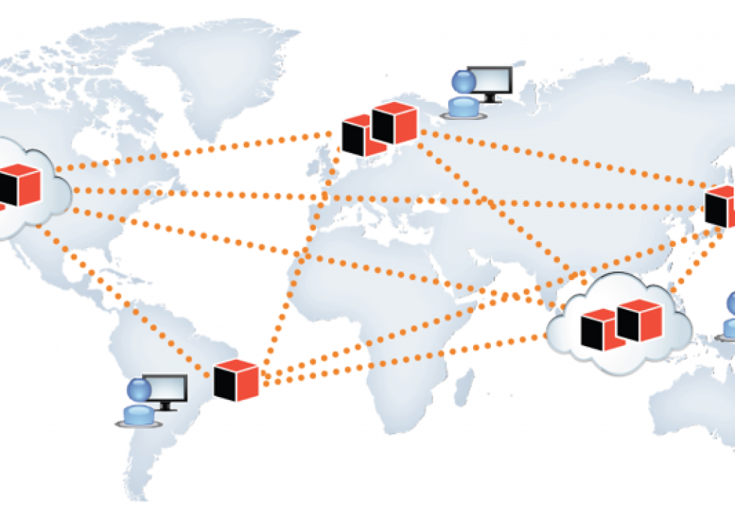
Distributed Database System
A distributed database system consists of loosely coupled sites that share no physical component
Database systems that run on each site are independent of each other
Or not – lot of variations here
Transactions may access data at one or more sites
Because of replication, even updating a single data item involves a “distributed transaction” (to keep all replicas up to date)

Slide 150
Data Replication
A relation or fragment of a relation is replicated if it is stored redundantly in two or more sites
Advantages:
Availability: failures can be handled through replicas
Parallelism: queries can be run on any replica
Reduced data transfer: queries can go to the “closest” replica
Disadvantages:
Increased cost of updates: both computation as well as latency
Increased complexity of concurrency control: need to update all copies of a data item/tuple
Typically we use the term “data items”, which may be tuples or relations or relation partitions

Slide 151
Distributed Transactions
Transaction may access data at several sites
As noted, single data item update is also a distributed transaction
Each site has a local transaction manager responsible for:
Maintaining a log for recovery purposes
Coordinating the concurrent execution of the transactions
Each site has a transaction coordinator, which is responsible for:
Starting the execution of transactions that originate at the site.
Distributing sub-transactions at appropriate sites for execution.
Coordinating the termination of each transaction that originates at the site -- transaction may commit at all sites or abort at all sites.

Slide 152
System Failure Modes
Failures unique to distributed systems:
Failure of a site.
Loss of massages
Handled by network transmission control protocols such as TCP-IP
Failure of a communication link
Handled by network protocols, by routing messages via alternative links
Network partition
A network is said to be partitioned when it has been split into two or more subsystems that lack any connection between them
Note: a subsystem may consist of a single node
Network partitioning and site failures are generally indistinguishable.

Slide 153
Commit Protocols
Commit protocols are used to ensure atomicity across sites
a transaction which executes at multiple sites must either be committed at all the sites, or aborted at all the sites.
not acceptable to have a transaction committed at one site and aborted at another
Two-phase commit (2PC) protocol is widely used
Three-phase commit (3PC) protocol
Handles some situations that 2PC doesn’t
Not widely used
Paxos
Robust alternative to 2PC that handles more situations as well
Was considered too expensive at one point, but widely used today
RAFT: Alternative to Paxos

Slide 154
Two Phase Commit Protocol (2PC)
Assumes fail-stop model – failed sites simply stop working, and do not cause any other harm, such as sending incorrect messages to other sites.
Execution of the protocol is initiated by the coordinator after the last step of the transaction has been reached.
The protocol involves all the local sites at which the transaction executed
Let T be a transaction initiated at site S_{i}, and let the transaction coordinator at S_{i} be C_{i}

Slide 155
Two Phase Commit Protocol (2PC)
Goal: Make sure all ”sites” commit or abort
Assumption: Some log records can be “forced” (denote * above)

Slide 156
Phase 1: Obtaining a Decision
Coordinator asks all participants to prepare to commit transaction T_{i}.
C_{i} adds the records <prepare T> to the log and forces log to stable storage
sends prepare T messages to all sites at which T executed
Upon receiving message, transaction manager at site determines if it can commit the transaction
if not, add a record <no T> to the log and send abort T message to C_{i}
if the transaction can be committed, then:
add the record <ready T> to the log
force all records for T to stable storage
send ready T message to C_{i}

Slide 157
Phase 2: Recording the Decision
T can be committed of C_{i} received a ready T message from all the participating sites: otherwise T must be aborted.
Coordinator adds a decision record, <commit T> or <abort T>, to the log and forces record onto stable storage. Once the record stable storage it is irrevocable (even if failures occur)
Coordinator sends a message to each participant informing it of the decision (commit or abort)
Participants take appropriate action locally.

Slide 158
Handling of Failures - Site Failure
When site S_{i} recovers, it examines its log to determine the fate of
transactions active at the time of the failure.
Log contain <commit T> record: txn had completed, nothing to be done
Log contains <abort T> record: txn had completed, nothing to be done
Log contains <ready T> record: site must consult C_{i} to determine the fate of T.
If T committed, redo (T); write <commit T> record
If T aborted, undo (T)
The log contains no log records concerning T:
Implies that S_{k} failed before responding to the prepare T message from C_{i}
since the failure of S_{k} precludes the sending of such a response, coordinator C₁ must abort T
S_{k} must execute undo (T)

Slide 159
Handling of Failures- Coordinator Failure
If coordinator fails while the commit protocol for T is executing then participating sites must decide on T’s fate:
If an active site contains a <commit T> record in its log, then T must be committed.
If an active site contains an <abort T> record in its log, then T must be aborted.
If some active participating site does not contain a <ready T> record in its log, then the failed coordinator C_{i} cannot have decided to commit T.
Can therefore abort T; however, such a site must reject any subsequent <prepare T> message from C_{i}
If none of the above cases holds, then all active sites must have a <ready T> record in their logs, but no additional control records (such as <abort T> of <commit T>).
In this case active sites must wait for C_{i} to recover, to find decision.
Blocking problem: active sites may have to wait for failed coordinator to recover.

Slide 160
Handling of Failures - Network Partition
If the coordinator and all its participants remain in one partition, the failure has no effect on the commit protocol.
If the coordinator and its participants belong to several partitions:
Sites that are not in the partition containing the coordinator think the coordinator has failed, and execute the protocol to deal with failure of the coordinator.
No harm results, but sites may still have to wait for decision from coordinator.
The coordinator and the sites are in the same partition as the coordinator think that the sites in the other partition have failed, and follow the usual commit protocol.
Again, no harm results

Slide 161
More…
Three-phase Commit
2PC can’t handle failure of a coordinator well – everything halts waiting for the coordinator to come back up
Three-phase commit handles that through another phase
Paxos and RAFT
Solutions for the “consensus problem”: get a collection of distributed entities to ”choose” a single value
In case of transaction, you are choosing abort/commit
Fairly complex, but well-understood today
Widely used in most distributed systems today
See the Wikipedia pages
A nice recent paper: Paxos vs Raft: Have we reached consensus on distributed consensus? – Heidi Howard, 2020

Slide 162
More…
Bitcoin (and other cryptocurrencies)
Fundamental problem is the same one, of obtaining “consensus”
But need to support a large number of entities, 1000s or more
Can’t assume full one-to-one communication
Instead:
Choose a “leader” based on ”proof of work”
Whoever solves a hard puzzle first becomes the “leader”
The ”leader” chooses the next “block” in the blockchain
A block is basically a list of transactions to accept
Reward the puzzle solvers with money (“bitcoins”)
So they have an incentive to keep solving puzzles
Blockchain?
Blockchain is a small part of bitcoin
A cryptographically designed chain of blocks that are immutable

