Slide 1
Today
Part 1: Syllabus, Final, Any other questions on that
Part 2: Miscellaneous Topics
Part 3: Other Topics, Industry Stuff, Research, 724 and 624

Slide 2
CMSC424: Database Design Module: Miscellaneous Topics
Instructor: Amol Deshpande
amol@umd.edu

Slide 3
Miscellaneous Topics
Goals:
Briefly introduce some ”traditional” concepts in data management systems at a fairly high level
Enough coverage to know where to go next
This field is moving very rapidly
Lot of ongoing work in the industry on data analytics, visualization, collaborative data science, ML, and much more
Many other topics we don’t cover, e.g., streaming systems
Not on syllabus for the Final

Slide 4
CMSC424: Database Design Module: Miscellaneous Topics
1. OLAP and Data Cubes
Instructor: Amol Deshpande
amol@umd.edu

Slide 5
OLAP and Data Cubes
Book Chapters
5.7
Key topics:
Data Warehouses
Star and Snowflake Schemas
Data Cubes

Slide 6
Data Warehouses
A repository of integrated information for querying and analysis purposes
A (usually) stand-alone system that integrates data from everywhere
Read-only, typically not kept up-to-date with the real data
Geared toward business analytics, data mining etc…
HUGE market today
Heavily optimized
Specialized query processing and indexing techniques are used
High emphasis on pre-computed data structures like summary tables, data cubes
Analysis cycle:
Extract data from databases with queries, visualize/analyze with desktop tools
E.g., Tableau

Slide 7
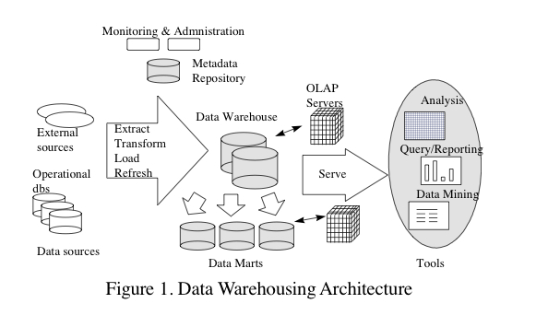
Data Warehouses

Slide 8
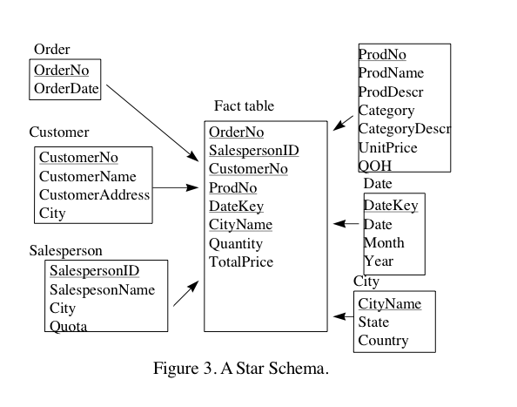
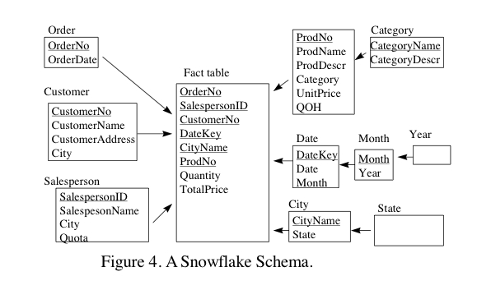
Data Warehouses
Query processing algorithms heavily
optimized for these types of schemas
Many queries of the type:
Selections on dimension tables
(e.g., state = ‘MD’)
Join fact table with dimension tables
Aggregate on a “measure” attribute
(e.g., Quantity, TotalPrice)
For example:
select c_city, o_year, SUM(quantity)
from Fact, Customer, Product
where p_category = ‘Tablet’;

Slide 9
OLAP
On-line Analytical Processing
Why ?
Exploratory analysis
Interactive
Different queries than typical SPJ SQL queries
Data CUBE
A summary structure used for this purpose
E.g. give me total sales by zipcode; now show me total sales by customer employment category
Much much faster than using SQL queries against the raw data
The tables are huge
Applications:
Sales reporting, Marketing, Forecasting etc etc

Slide 10
Data Analysis and OLAP
Online Analytical Processing (OLAP)
Interactive analysis of data, allowing data to be summarized and viewed in different ways in an online fashion (with negligible delay)
Data that can be modeled as dimension attributes and measure attributes are called multidimensional data.
Measure attributes
measure some value
can be aggregated upon
e.g., the attribute number of the sales relation
Dimension attributes
define the dimensions on which measure attributes (or aggregates thereof) are viewed
e.g., attributes item_name, color, and size of the sales relation

Slide 11
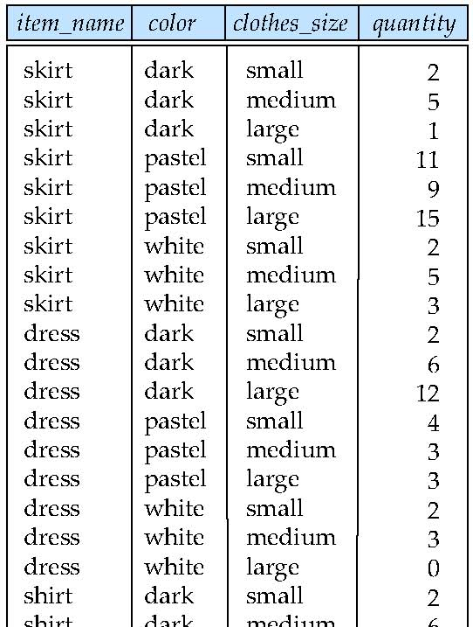
Example sales relation
...
...
...
...
...
...
...
...

Slide 12
Cross Tabulation of sales by item_name and color
Example of a cross-tabulation (cross-tab), or a pivot-table.
Values for one of the dimension attributes form the row headers
Values for another dimension attribute form the column headers
Other dimension attributes are listed on top
Values in individual cells are (aggregates of) the values of the dimension attributes that specify the cell.

Slide 13
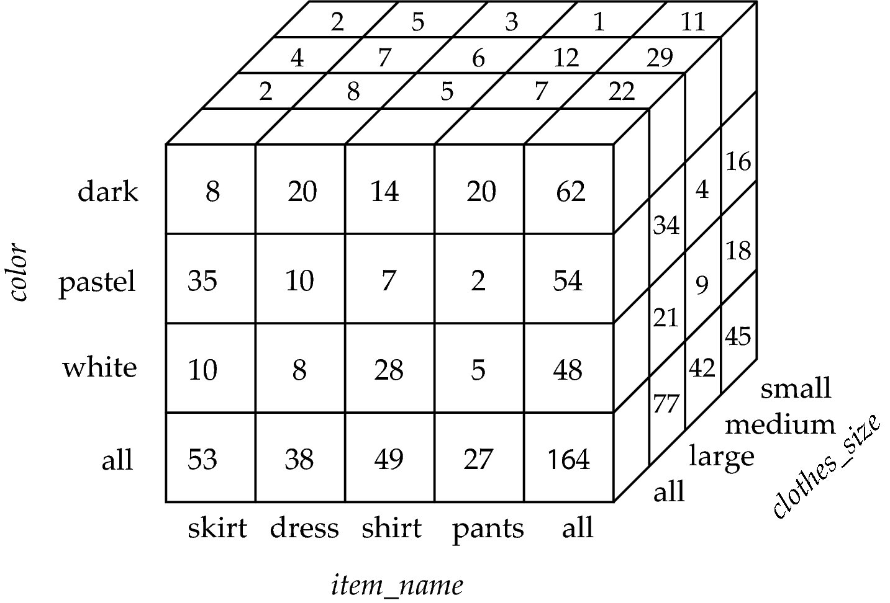
Data Cube
A data cube is a multidimensional generalization of a cross-tab
Can have n dimensions; we show 3 below
Cross-tabs can be used as views on a data cube

Slide 14
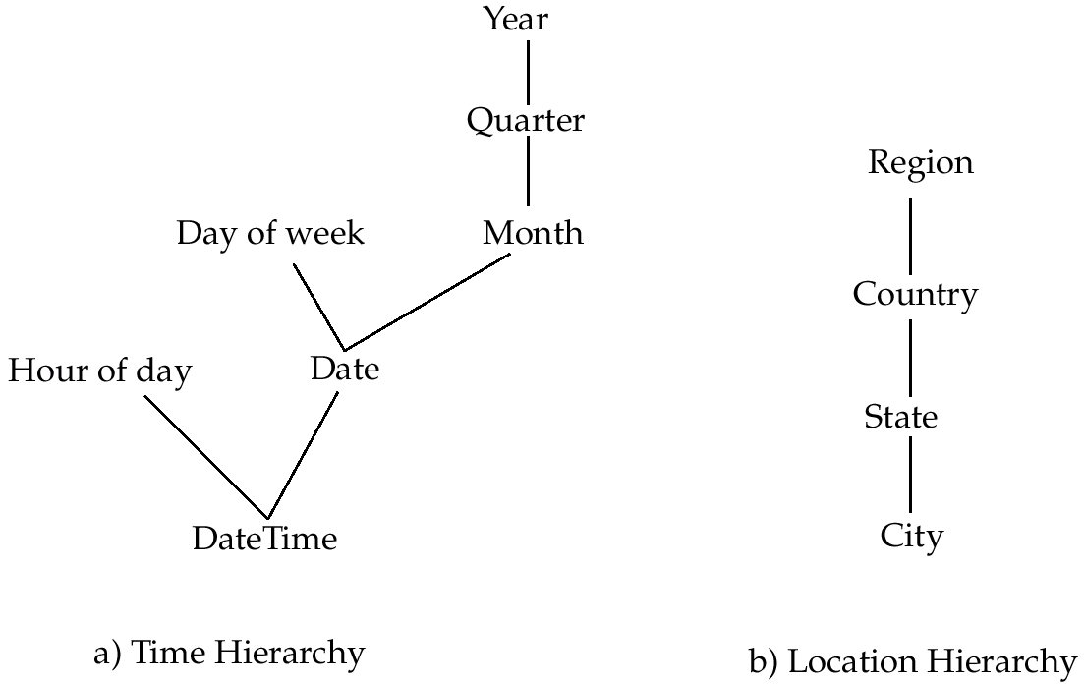
Hierarchies on Dimensions
Hierarchy on dimension attributes: lets dimensions to be viewed at different levels of detail
E.g., the dimension DateTime can be used to aggregate by hour of day, date, day of week, month, quarter or year

Slide 15
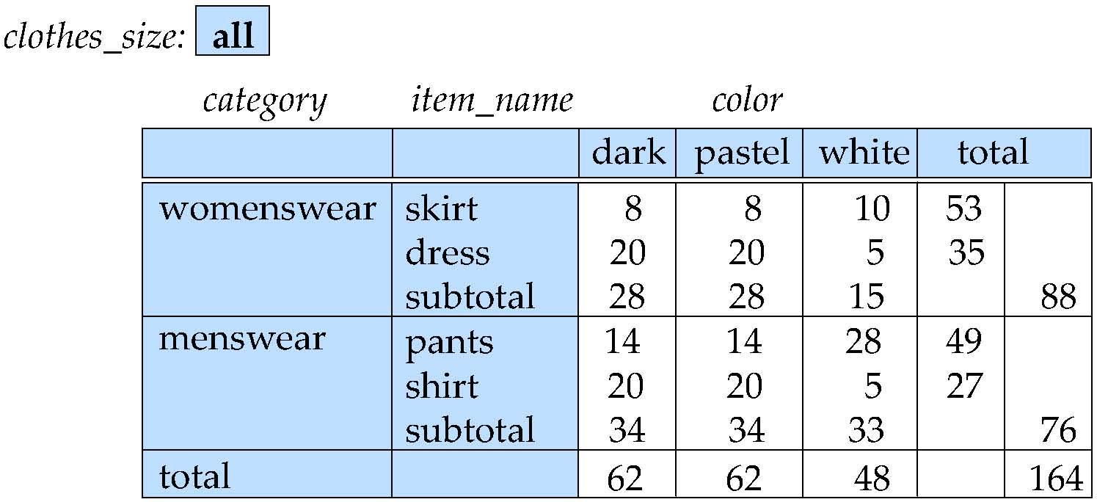
Cross Tabulation With Hierarchy
Cross-tabs can be easily extended to deal with hierarchies
Can drill down or roll up on a hierarchy

Slide 16
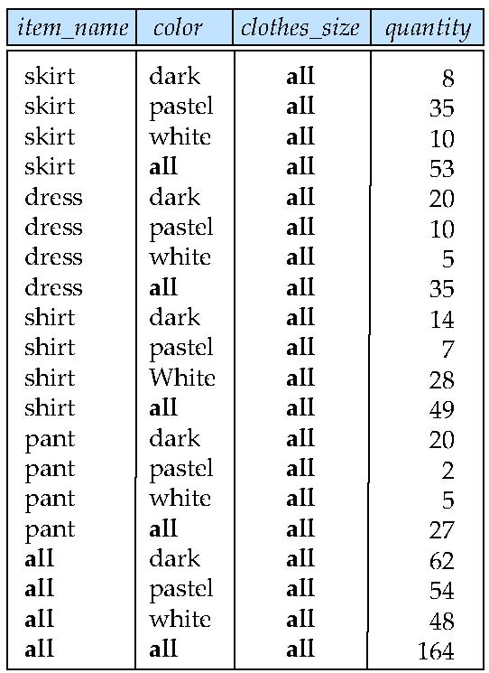
Relational Representation of Cross-tabs
Cross-tabs can be represented as relations
We use the value all is used to represent aggregates.
The SQL standard actually uses null values in place of all despite confusion with regular null values.

Slide 17
Extended Aggregation to Support OLAP
The cube operation computes union of group by’s on every subset of the specified attributes sales(item_name, color, clothes_size, quantity)
Consider the query
select item_name, color, size, sum(number) from sales group by cube(item_name, color, size)
Computers a union of eight different groupings of the sales relation:
{ (item_name, color, size), (item_name, color), (item_name, size), (color, size), (item_name), (color), (size), ( ) }
where ( ) denotes an empty group by list.
Notes:
17

Slide 18
Extended Aggregation (Cont.)
The rollup construct generates union on every prefix of specified list of attributes
E.g.,
select item_name, color, size, sum(number) from sales group by rollup(item_name, color, size)
Generates union of four groupings:
{ (item_name, color, size), (item_name, color), (item_name), ( ) }
Notes:
18

Slide 19
Extended Aggregation (Cont.)
Multiple rollups and cubes can be used in a single group by clause
Each generates set of group by lists, cross product of sets gives overall set of group by lists
E.g.,
select item_name, color, size, sum(number) from sales group by rollup(item_name), rollup(color, size)
generates the groupings
{item_name, ()} X {(color, size), (color), ()}
= { (item_name, color, size), (item_name, color), (item_name), (color, size), (color), ( ) }
Notes:
19

Slide 20
Online Analytical Processing Operations
Pivoting: changing the dimensions used in a cross-tab is called
Slicing: creating a cross-tab for fixed values only
Sometimes called dicing, particularly when values for multiple dimensions are fixed.
Rollup: moving from finer-granularity data to a coarser granularity
Drill down: The opposite operation - that of moving from coarser-granularity data to finer-granularity data

Slide 21
OLAP Implementation
The earliest OLAP systems used multidimensional arrays in memory to store data cubes, and are referred to as multidimensional OLAP (MOLAP) systems.
OLAP implementations using only relational database features are called relational OLAP (ROLAP) systems
Hybrid systems, which store some summaries in memory and store the base data and other summaries in a relational database, are called hybrid OLAP (HOLAP) systems.

Slide 22
Data Mining
Searching for patterns in data
Typically done in data warehouses
Association Rules:
When a customer buys X, she also typically buys Y
Use ?
Move X and Y together in supermarkets
A customer buys a lot of shirts
Send him a catalogue of shirts
Patterns are not always obvious
Classic example: It was observed that men tend to buy beer and diapers together (may be an urban legend)
Other types of mining
Classification
Decision Trees

Slide 23
Summary
Data analytics a major industry right now, and likely to grow in near future
BIG Data !!
Extracting (actionable) knowledge from data really critical
Especially in real-time
Some key technologies:
Parallelism – pretty much required
Column-oriented design
Lay out the data column-by-column, rather than row-by-row
Heavy pre-computation (like Cubes)
New types of indexes
Focusing on bitmap representations
Heavy compression
Map-reduce??

Slide 24
CMSC424: Database Design Module: Miscellaneous Topics
2. Information Retrieval
Instructor: Amol Deshpande
amol@umd.edu

Slide 25
Information Retrieval
Book Chapters
Chapter 21 – at a fairly high level
Key topics:
What is Information Retrieval?
IF-TDF
Web crawling and searching

Slide 26
Information Retrieval Systems
Information retrieval (IR) systems use a simpler data model than database systems
Information organized as a collection of documents
Documents are unstructured, no schema
Information retrieval locates relevant documents, on the basis of user input such as keywords or example documents
e.g., find documents containing the words “database systems”
Can be used even on textual descriptions provided with non-textual data such as images
Web search engines are the most familiar example of IR systems

Slide 27
Information Retrieval Systems (Cont.)
Differences from database systems
IR systems don’t deal with transactional updates (including concurrency control and recovery)
Database systems deal with structured data, with schemas that define the data organization
IR systems deal with some querying issues not generally addressed by database systems
Approximate searching by keywords
Ranking of retrieved answers by estimated degree of relevance

Slide 28
Keyword Search
In full text retrieval, all the words in each document are considered to be keywords.
We use the word term to refer to the words in a document
Information-retrieval systems typically allow query expressions formed using keywords and the logical connectives and, or, and not
Ands are implicit, even if not explicitly specified
Ranking of documents on the basis of estimated relevance to a query is critical
Relevance ranking is based on factors such as
Term frequency
Frequency of occurrence of query keyword in document
Inverse document frequency
How many documents the query keyword occurs in
Fewer ➔ give more importance to keyword
Hyperlinks to documents
More links to a document ➔ document is more important

Slide 29
Relevance Ranking Using Terms
n(d, t)
TF (d, t) = log
1 +
n(d)
∑
TF (d, t)
r (d, Q) =
t∈Q
n(t)
TF-IDF (Term frequency/Inverse Document frequency) ranking:
Let n(d) = number of terms in the document d
n(d, t) = number of occurrences of term t in the document d.
Relevance of a document d to a term t
The log factor is to avoid excessive weight to frequent terms
Relevance of document to query Q

Slide 30
Relevance Ranking Using Terms (Cont.)
Most systems add to the above model
Words that occur in title, author list, section headings, etc. are given greater importance
Words whose first occurrence is late in the document are given lower importance
Very common words such as “a”, “an”, “the”, “it” etc. are eliminated
Called stop words
Proximity: if keywords in query occur close together in the document, the document has higher importance than if they occur far apart
Documents are returned in decreasing order of relevance score
Usually only top few documents are returned, not all

Slide 31
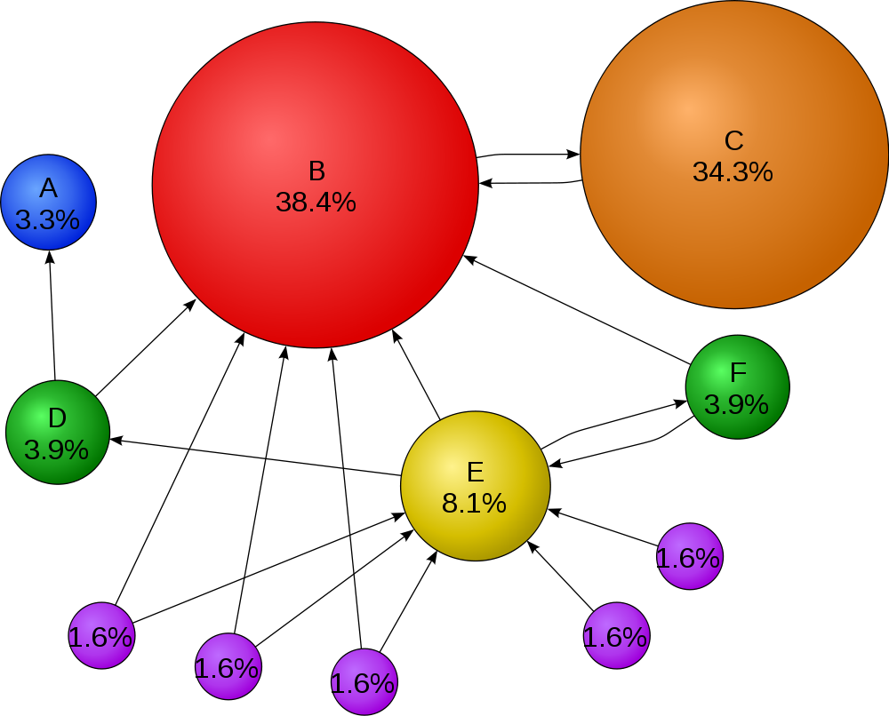
PageRank: Ranking based on hyperlinks
The probability that a random surfer (who follows links randomly) will end up at a particular page
Intuitively: Higher the probability, the more important the page
Surfer model:
Choose a random page to visit with probability “alpha”
If the number of outgoing edges = n, then visit one of those pages with probability (1 – alpha)/n

Slide 32
Indexing of Documents
An inverted index maps each keyword K_{i} to a set of documents S_{i} that contain the keyword
Documents identified by identifiers
Inverted index may record
Keyword locations within document to allow proximity based ranking
Counts of number of occurrences of keyword to compute TF
and operation: Finds documents that contain all of K₁, K₂, ..., K_{n}.
Intersection S₁∩ S₂ ∩..... ∩ S_{n}
or operation: documents that contain at least one of K₁, K₂, …, K_{n}
union, S₁∩ S₂ ∩..... ∩ S_{n},.
Each S_{i} is kept sorted to allow efficient intersection/union by merging
“not” can also be efficiently implemented by merging of sorted lists

Slide 33
Measuring Retrieval Effectiveness
Information-retrieval systems save space by using index structures that support only approximate retrieval. May result in:
false negative (false drop) - some relevant documents may not be retrieved.
false positive - some irrelevant documents may be retrieved.
For many applications a good index should not permit any false drops, but may permit a few false positives.
Relevant performance metrics:
precision - what percentage of the retrieved documents are relevant to the query.
recall - what percentage of the documents relevant to the query were retrieved.

Slide 34
Measuring Retrieval Effectiveness
Recall vs. precision tradeoff:
Can increase recall by retrieving many documents (down to a low level of relevance ranking), but many irrelevant documents would be fetched, reducing precision
Measures of retrieval effectiveness:
Recall as a function of number of documents fetched, or
Precision as a function of recall
Equivalently, as a function of number of documents fetched
E.g., “precision of 75% at recall of 50%, and 60% at a recall of 75%”
Problem: which documents are actually relevant, and which are not

Slide 35
Web Search Engines
Web crawlers are programs that locate and gather information on the Web
Recursively follow hyperlinks present in known documents, to find other documents
Starting from a seed set of documents
Fetched documents
Handed over to an indexing system
Can be discarded after indexing, or store as a cached copy
Crawling the entire Web would take a very large amount of time
Search engines typically cover only a part of the Web, not all of it
Take months to perform a single crawl

Slide 36
Summary and More
Information retrieval a very mature field, that developed largely in parallel to databases
Much work on:
similarity search (to find similar documents)
better search and ranking algorithms
natural language question/answering
answer diversification (imagine searching for “apple”)
… and so on
SIGKDD, SIGIR, WWW the main research conferences
Vs SIGMOD, VLDB, ICDE for databases

Slide 37
CMSC424: Database Design Module: Miscellaneous Topics
3. Object-oriented and Object-relational Databases
Instructor: Amol Deshpande
amol@umd.edu

Slide 38
Object-oriented and Object-relational
Book Chapters
Chapter 22: at a fairly high level
Key topics:
Why Objects?
Object-oriented
Object-relational

Slide 39
Motivation
Relational model:
Clean and simple
Great for much enterprise data
But lot of applications where not sufficiently rich
Multimedia, CAD, for storing set data etc
Object-oriented models in programming languages
Complicated, but very useful
Smalltalk, C++, now Java
Allow
Complex data types
Inheritance
Encapsulation
People wanted to manage objects in databases.

Slide 40
History
In the 1980’s and 90’s, DB researchers recognized benefits of objects.
Two research thrusts:
OODBMS: extend C++ with transactionally persistent objects
Used to be a niche Market
CAD etc.
More recently, made a comeback as a JSON, Graph Databases
But those usually have a query language and look more like ORDBMS
ORDBMS: extend Relational DBs with object features
Much more common
Efficiency + Extensibility
SQL:99 support
Postgres – First ORDBMS
Berkeley research project
Became Illustra, became Informix, bought by IBM

Slide 41
Object-Relational Data Models
Extend the relational data model by including object orientation and constructs to deal with added data types.
Allow attributes of tuples to have complex types, including non-atomic values such as nested relations.
Preserve relational foundations, in particular the declarative access to data, while extending modeling power.
Upward compatibility with existing relational languages.

Slide 42
Structured Types and Inheritance in SQL
Structured types (a.k.a. user-defined types) can be declared and used in SQL
create type Name as (firstname varchar(20), lastname varchar(20)) final
create type Address as (street varchar(20), city varchar(20), zipcode varchar(20))
not final
Note: final and not final indicate whether subtypes can be created
Structured types can be used to create tables with composite attributes
create table person (
name Name,
address Address,
dateOfBirth date)
Dot notation used to reference components: name.firstname

Slide 43
Structured Types (cont.)
User-defined row types
create type PersonType as ( name Name, address Address, dateOfBirth date) not final
Can then create a table whose rows are a user-defined type create table customer of CustomerType
Alternative using unnamed row types.
create table person_r(
name row(firstname varchar(20),
lastname varchar(20)),
address row(street varchar(20),
city varchar(20),
zipcode varchar(20)),
dateOfBirth date)

Slide 44
Methods
Can add a method declaration with a structured type.
method ageOnDate (onDate date)
returns interval year
Method body is given separately.
create instance method ageOnDate (onDate date)
returns interval year
for CustomerType
begin
return onDate - self.dateOfBirth;
end
We can now find the age of each customer:
select name.lastname, ageOnDate (current_date)
from customer

Slide 45
Type Inheritance
Suppose that we have the following type definition for people:
create type Person (name varchar(20), address varchar(20))
Using inheritance to define the student and teacher types create type Student under Person (degree varchar(20), department varchar(20))
create type Teacher under Person (salary integer, department varchar(20))
Subtypes can redefine methods by using overriding method in place of method in the method declaration

Slide 46
Array and Multiset Types in SQL
Example of array and multiset declaration:
create type Publisher as (name varchar(20), branch varchar(20));
create type Book as (title varchar(20), author_array varchar(20) array [10], pub_date date, publisher Publisher, keyword-set varchar(20) multiset);
create table books of Book;

Slide 47
Creation of Collection Values
Array construction
array [‘Silberschatz’,`Korth’,`Sudarshan’]
Multisets
multiset [‘computer’, ‘database’, ‘SQL’]
To create a tuple of the type defined by the books relation: (‘Compilers’, array[`Smith’,`Jones’], new Publisher (`McGraw-Hill’,`New York’), multiset [`parsing’,`analysis’ ])
To insert the preceding tuple into the relation books
insert into books values (‘Compilers’, array[`Smith’,`Jones’], new Publisher (`McGraw-Hill’,`New York’), multiset [`parsing’,`analysis’ ]);

Slide 48
Querying Collection-Valued Attributes
To find all books that have the word “database” as a keyword,
select title from books where ‘database’ in (unnest(keyword-set ))
We can access individual elements of an array by using indices
E.g.: If we know that a particular book has three authors, we could write:
select author_array[1], author_array[2], author_array[3] from books where title = `Database System Concepts’
To get a relation containing pairs of the form “title, author_name” for each book and each author of the book
select B.title, A.author
from books as B, unnest (B.author_array) as A (author )
To retain ordering information we add a with ordinality clause
select B.title, A.author, A.position
from books as B, unnest (B.author_array) with ordinality as
A (author, position )

Slide 49
Path Expressions
Find the names and addresses of the heads of all departments:
select head –>name, head –>address from departments
An expression such as “head–>name” is called a path expression
Path expressions help avoid explicit joins
If department head were not a reference, a join of departments with people would be required to get at the address
Makes expressing the query much easier for the user

Slide 50
An Alternative: OODBMS
Persistent OO programming
Imagine declaring a Java object to be “persistent”
Everything reachable from that object will also be persistent
You then write plain old Java code, and all changes to the persistent objects are stored in a database
When you run the program again, those persistent objects have the same values they used to have!
Solves the “impedance mismatch” between programming languages and query languages
E.g. converting between Java and SQL types, handling rowsets, etc.
But this programming style doesn’t support declarative queries
For this reason (??), OODBMSs haven’t proven popular
OQL: A declarative language for OODBMSs
Was only implemented by one vendor in France (Altair)

Slide 51
OODBMS
Currently a Niche Market
Engineering, spatial databases, physics etc…
Main issues:
Navigational access
Programs specify go to this object, follow this pointer
Not declarative
Though advantageous when you know exactly what you want, not a good idea in general
Kinda similar argument as network databases vs relational databases

Slide 52
Comparison of O-O and O-R Databases
Relational systems
simple data types, powerful query languages, high protection.
Persistent-programming-language-based OODBs
complex data types, integration with programming language, high performance.
Object-relational systems
complex data types, powerful query languages, high protection.
Object-relational mapping systems
complex data types integrated with programming language, but built as a layer on top of a relational database system
Note: Many real systems blur these boundaries
E.g. persistent programming language built as a wrapper on a relational database offers first two benefits, but may have poor performance.

