Slide 1


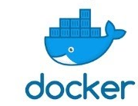

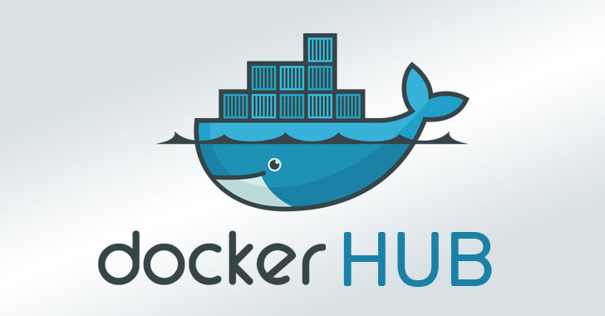

Software Production Engineering
Mini Project Example Demo

Slide 2
Dockerfile
FROM ubuntu:latest
COPY calculator.sh /app/calculator.sh
FROM ubuntu:latest: This line specifies the base image for the Docker container. In this case, it is using the latest version of the official Ubuntu image from Docker Hub. This image serves as the foundation for building your application.
COPY calculator.sh /app/calculator.sh: This line copies the file calculator.sh from the local file system into the Docker image. It places the file in the /app/ directory inside the image. This assumes that the calculator.sh script is located in the same directory as the Dockerfile.
Command to Build the Docker Image: docker build -t calculator .
docker build: This command is used to build a Docker image from a Dockerfile.
-t calculator: The -t flag allows you to tag your image with a name. In this case, the image is tagged with the name "calculator."
.: The dot represents the build context, indicating that the Docker build process should use the current directory as the build context. This assumes that both the Dockerfile and the calculator.sh script are in the current directory.
After running the docker build command, Docker will read the Dockerfile, execute each instruction, and create a Docker image named "calculator" based on the Ubuntu image with the calculator.sh script copied into the /app/ directory. The resulting image is ready to be deployed and run as a Docker container.

Slide 3
calculator.sh
# !/bin/bash
# A simple calculator shell program
echo "1. Addition"
echo "2. Subtraction"
echo "3. Multiplication"
echo "4. Division"
echo -n "Enter First Number: "
read a
echo -n "Enter Second Number: "
read b
echo -n "Enter the Choice: "
read ch
case $ch in
1) res=`expr $a + $b`
;;
2) res=`expr $a - $b`
;;
3) res=`expr $a \* $b`
;;
4) res=`expr $a / $b`
;;
esac
echo "Result : $res"

Slide 4
Ansible Key Components
Ansible consists of several key components and modules that work together to enable automation and configuration management. These components collectively facilitate the creation of playbooks and the execution of tasks on managed nodes.
1. Modules: Ansible modules are standalone units of code responsible for performing specific tasks on managed nodes. Modules can manage system components, deploy applications, interact with cloud services, and more. There are over a thousand built-in modules that cover a wide range of operations. Some common module categories include:
• System modules (e.g., user, file, service), Package management modules (e.g., yum, apt, pip), Cloud modules (e.g., AWS, Azure, GCP), Network modules (e.g., ios_command, nxos_command), Database modules (e.g., postgresql_user, mysql_db).
2. Playbooks: Playbooks are YAML files that define a series of tasks, along with the desired state and conditions. Playbooks combine modules to automate complex workflows and configurations. They provide a structured way to describe the steps required to achieve a specific outcome.
3. Tasks: Tasks are individual actions or operations performed by modules. Tasks within a playbook define what needs to be accomplished, such as installing a package, restarting a service, or copying a file.
4. Inventories: Inventories are files that list the hosts (managed nodes) and group them into categories. This categorization allows for easier management of resources and targeted execution of tasks on specific groups.
These components work in harmony to facilitate the creation, execution, and management of automation tasks in Ansible, enabling organizations to achieve efficient and consistent configuration management and automation across their IT infrastructure.

Slide 5
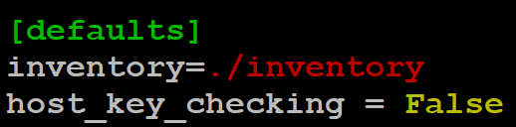
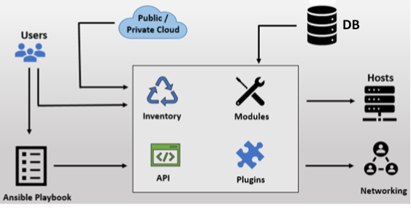
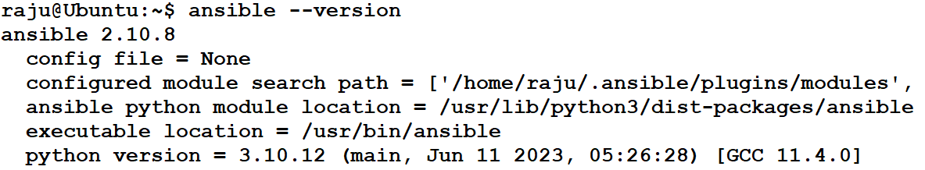
Ansible
sudo vim /etc/ansible/ansible.cfg
Ansible Installation:
Installing Ansible on a Linux system is a straightforward process. Execute the following command.
• sudo apt update
• sudo apt install Ansible
After the installation is complete, you can verify it by checking the Ansible version:

Slide 6

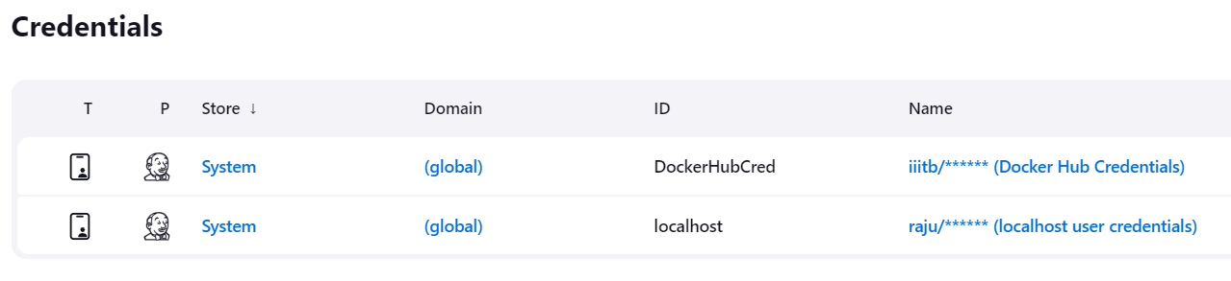
Integrate with Jenkins

Slide 7
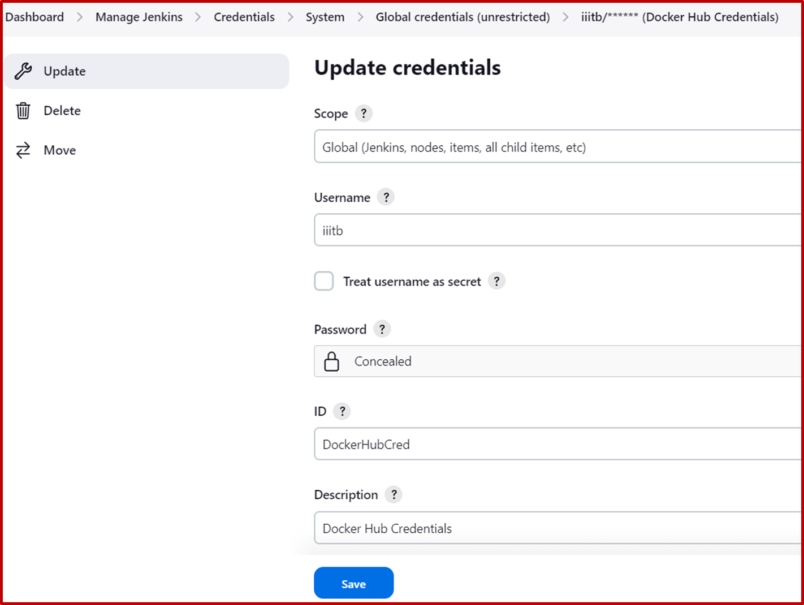
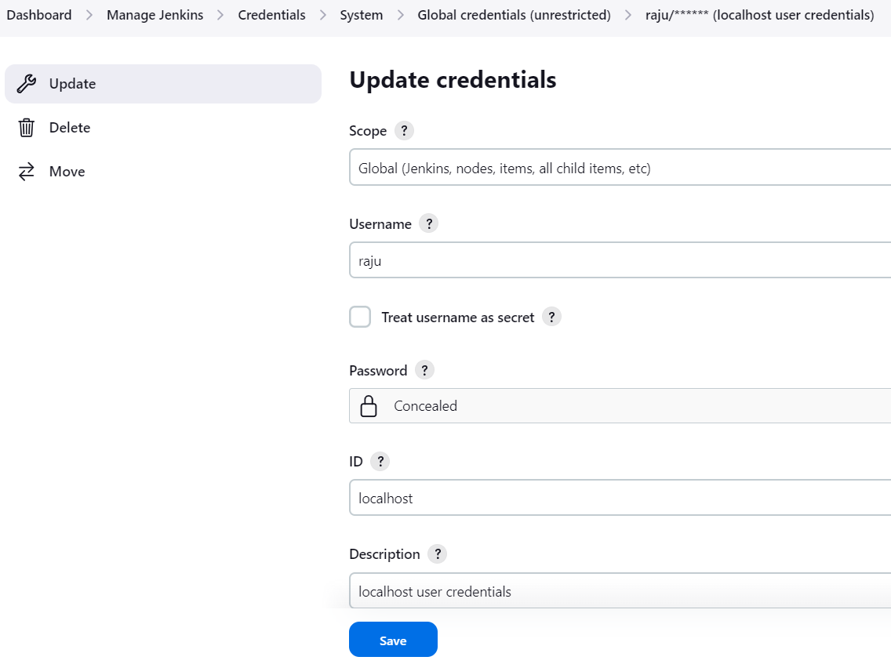
Integrate with Jenkins
Docker Hub Credentials
Ansible Credentials

Slide 8
deploy.yml
---
- name: Pull Docker Image from Docker Hub
hosts: localhost
remote_user: raju
become: false
tasks:
- name: Pull Docker Image
docker_image:
name: "iiitb/calculator"
source: pull
register: docker_pull_result
- name: Display Docker Pull Result
debug:
var: docker_pull_result
- name: Start Docker service
service:
name: docker
state: started
- name: Running container
shell: docker run -it -d --name calculator iiitb/calculator
This Ansible playbook performs several tasks related to Docker:
Pull Docker Image from Docker Hub: The playbook starts by defining a task to pull a Docker image from Docker Hub. The specified image is "iiitb/calculator.“ The result of the Docker image pull operation is stored in the variable docker_pull_result for later reference.
Display Docker Pull Result: This task utilizes the Ansible debug module to display the result of the Docker image pull operation. It helps provide insights into whether the image was successfully pulled or if there were any errors.
Start Docker Service: The playbook includes a task to ensure that the Docker service on the localhost is in the "started" state. This ensures that Docker is running and ready to manage containers.
Run Docker Container: The final task runs a Docker container named "calculator" based on the previously pulled image ("iiitb/calculator"). The container is started in detached mode (-d), ensuring it runs in the background.
Overall, this Ansible playbook automates the process of pulling a Docker image, displays the result of the pull operation, ensures the Docker service is running, and starts a Docker container based on the pulled image. It is designed to be executed on the localhost with the specified remote user "raju."

Slide 9
inventory
localhost ansible_user=raju ansible_ssh_pass=raju
The Ansible Inventory file contains information about a single host, "localhost," and includes specific connection details using Ansible variables.
localhost: This is the name or IP address of the host that Ansible will manage. In this case, it is set to "localhost," indicating that Ansible will be interacting with the local machine.
ansible_user=raju: This variable specifies the remote user that Ansible should use when connecting to the host. In this example, the remote user is set to "raju." Ansible will use this username to establish the SSH connection to the specified host.
ansible_ssh_pass=raju: This variable sets the SSH password for the specified remote user ("raju"). It is used for authentication when connecting to the host. However, note that specifying passwords directly in the inventory file is not recommended for security reasons. It's preferable to use SSH keys for authentication.

Slide 10
jenkinsfile
This Jenkinsfile is a Declarative Pipeline script for Jenkins, which orchestrates the build and deployment process.
pipeline {
agent any
environment {
DOCKER_IMAGE_NAME = 'calculator'
GITHUB_REPO_URL = 'https://github.com/BThangaraju/calculator.git'
}
}
The pipeline block initiates the pipeline definition, indicating that the pipeline can run on any available agent (Jenkins executor).
The environment block defines environment variables used throughout the pipeline. DOCKER_IMAGE_NAME is set to 'calculator,' and GITHUB_REPO_URL is set to the GitHub repository URL.
The stages block contains individual stages of the pipeline. Each stage represents a phase in the build and deployment process.

Slide 11
jenkinsfile
stages {
stage('Checkout') {
steps {
script {
// Checkout the code from the GitHub repository
git branch: 'main', url: "${GITHUB_REPO_URL}"
}
}
}
The first stage is 'Checkout,' which uses the Git plugin to clone the code from the specified GitHub repository (GITHUB_REPO_URL) and branch ('main').

Slide 12
jenkinsfile
stage('Build Docker Image') {
steps {
script {
// Build Docker image
docker.build("${DOCKER_IMAGE_NAME}", '.')
}
}
}
The second stage is 'Build Docker Image,' where a Docker image named 'calculator' is built from the code in the current directory ('.').

Slide 13
jenkinsfile
stage('Push Docker Images') {
steps {
script{
docker.withRegistry('', 'DockerHubCred') {
sh 'docker tag calculator iiitb/calculator:latest'
sh 'docker push iiitb/calculator'
}
}
}
}
The third stage is 'Push Docker Images,' responsible for tagging the built Docker image and pushing it to a Docker registry (in this case, Docker Hub). It utilizes Docker credentials ('DockerHubCred') for authentication.

Slide 14
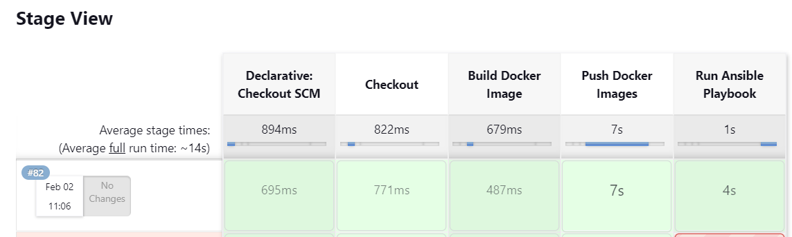
jenkinsfile
stage('Run Ansible Playbook') {
steps {
script {
ansiblePlaybook(
playbook: 'deploy.yml',
inventory: 'inventory'
)
}
}
}
The final stage, 'Run Ansible Playbook,' executes an Ansible playbook ('deploy.yml') using an inventory file ('inventory').

Slide 15
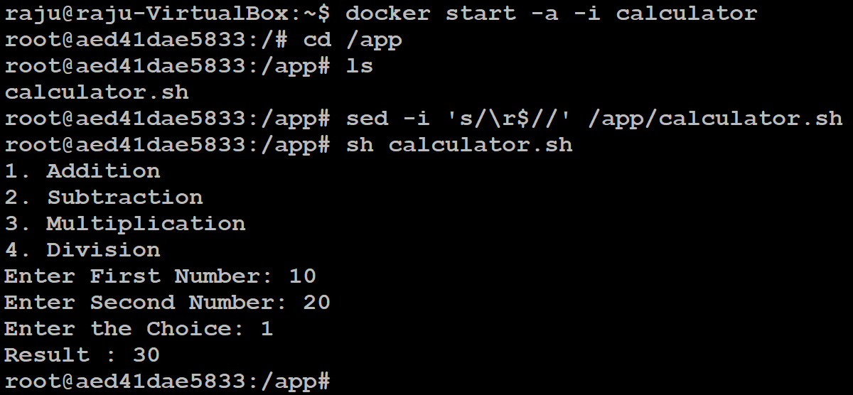
Running Application

Slide 16
Thank You

