Slide 1
Software Design
and Architecture
Final project
Ume-Kalsoom Waheed & Samurah Shafique
DDP-FA14-BSE(B)-017 & DDP-FA14-BSE(B)-092

Slide 2

Introduction
The project focuses on applying the concepts learned in the course.
The primary purpose of the project is to extract the
Components
Connectors
Interactions
from the descriptive architecture of a software.
The tool will then depict the architecture in form of class diagram.
The language we have used is

Slide 3
System Architecture
The class diagram

Slide 4
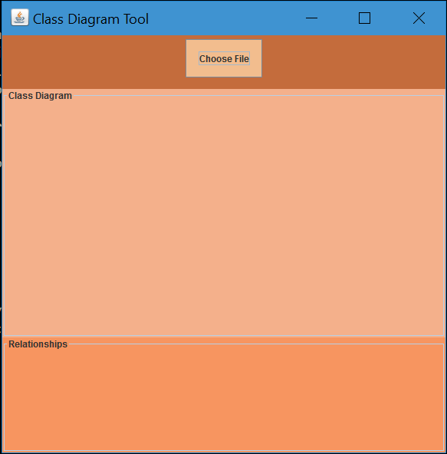
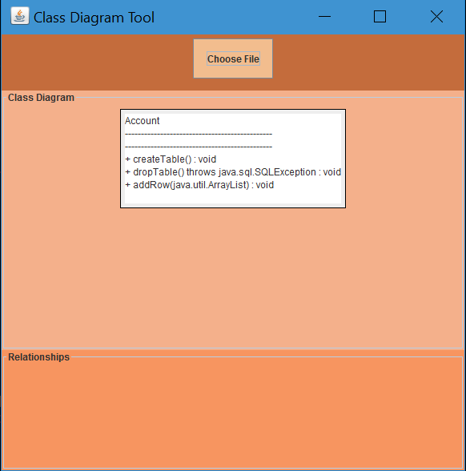
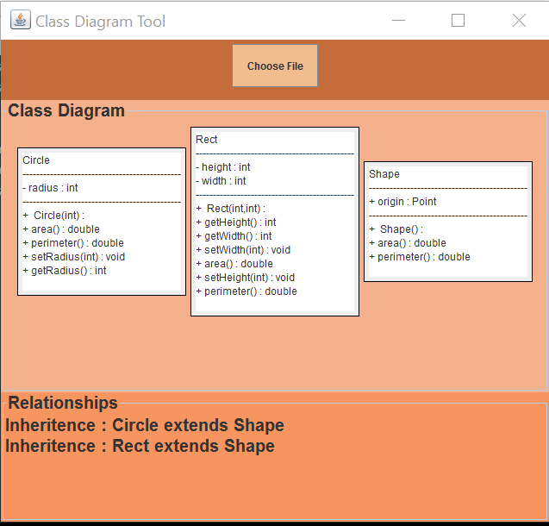
Screenshots
Single class
Multiple classes

Slide 5
Limitations
The tool cannot work with .java files that are not compiled (don’t have .class file)
The .java files whose .class files are in another destination (not in the same folder)
The relationships cannot be shown with a line in diagram
The dependency relationship is not shown

Slide 6
Any Questions?

