Slide 1
CSE 2015- Data Analysis and Visualization
Module 1-Introduction to Data Analysis
Module 1: Introduction to Data Visualization [12 Hrs] [Bloom’s Level Selected: Understand]
Data collection, Data Preparation Basic Models- Overview of data visualization - Data Abstraction - Task Abstraction - Analysis: Four Levels for Validation, Interacting with Databases, Data Cleaning and Preparation, Handling Missing Data, Data Transformation.
Python Libraries: NumPy, pandas, matplotlib, GGplot, Introduction to pandas Data Structures .

Slide 2
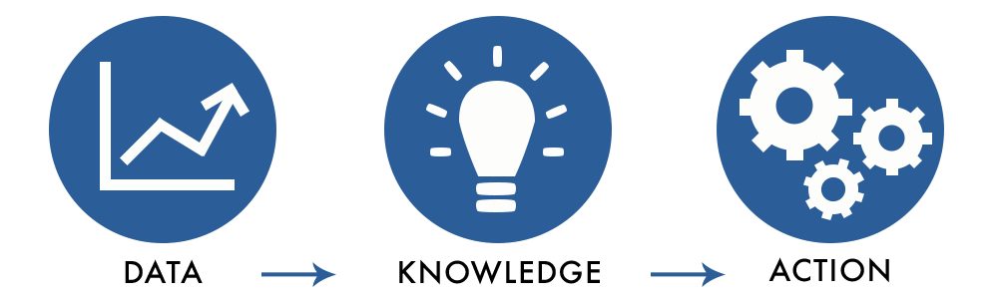
Introducing Data
Facts and statistics collected together for reference or analysis
Data has to be transformed into a form that is efficient for movement or processing.

Slide 3
Over view of Data Analysis

Slide 4
Data analysis is defined as a process of cleaning, transforming, and modeling data to discover useful information for business decision-making.
The purpose of Data Analysis is to extract useful information from data and taking the decision based upon the data analysis.
A simple example of Data analysis is whenever we take any decision in our day-to-day life is by thinking about what happened last time or what will happen by choosing that particular decision.

Slide 5
This is nothing but analyzing our past or future and making decisions based on it.
For that, we gather memories of our past or dreams of our future.
So that is nothing but data analysis. Now same thing analyst does for business purposes, is called Data Analysis.

Slide 6
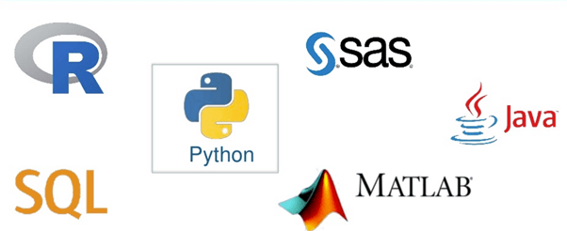
Data Analysis Tools

Slide 7
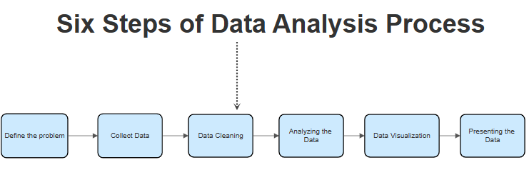

Slide 8
The Data Analysis Process
Step 1: Defining objectives and questions
Define the objectives and formulate clear, specific questions that your analysis aims to answer
Step 2: Data collection
Collect the relevant data through various methods such as surveys, interviews, observations, or extracting from existing databases
Step 3: Data cleaning
It involves checking the data for errors and inconsistencies, and correcting or removing them.
Step 4: Data analysis
applying statistical or mathematical techniques to the data to discover patterns, relationships, or trends

Slide 9
Step 5: Data interpretation and visualization
interpret the results and visualize them in a way that is easy to understand. This could involve creating charts, graphs, or other visual representations of the data.
Step 6: Data Publishing (storytelling)
presenting the findings of the analysis in a narrative form that is engaging and easy to understand- communicating the results to non-technical audiences and for making data-driven decisions.

Slide 10
Types of Data Analysis
The four types of data analysis are:
Descriptive Analysis
Diagnostic Analysis
Predictive Analysis
Prescriptive Analysis

Slide 11
Descriptive Analysis: Descriptive analysis involves summarizing and presenting data in a meaningful way to understand what has happened in the past or what is currently happening. It focuses on describing the characteristics of the data set, such as its central tendency, dispersion, and distribution.
Example: Suppose a retail company wants to understand its sales performance over the past year. By conducting descriptive analysis, they can generate reports showing total sales revenue by month, bestselling products, average transaction value, and geographic distribution of customers

Slide 12
Diagnostic Analysis:
Diagnostic analysis goes beyond describing data to understand why certain events or patterns occur. It involves identifying relationships, correlations, or causality between variables to uncover insights into the underlying factors driving observed outcomes.
Example:
In healthcare, diagnostic analysis may be used to investigate the reasons for a sudden increase in patient readmissions to a hospital. By analyzing patient records, demographics, treatment protocols, and discharge summaries, healthcare analysts can identify potential factors contributing to readmissions, such as medication non-compliance, inadequate follow-up care, or complications during treatment.

Slide 13
Predictive Analysis:
Predictive analysis leverages historical data and statistical algorithms to forecast future outcomes or trends. It involves building predictive models that use past observations to make educated predictions about future events or behaviors.
Example:
A credit card company may employ predictive analysis to assess the risk of default for individual cardholders. By analyzing customers' payment history, credit scores, spending patterns, and other relevant factors, the company can develop predictive models to estimate the likelihood of a cardholder defaulting on payments in the future.

Slide 14
Prescriptive Analysis:
Prescriptive analysis takes predictive insights a step further by recommending actions or interventions to optimize outcomes or achieve specific objectives. It involves using advanced analytics techniques, optimization algorithms, and business rules to prescribe the best course of action based on predicted scenarios.
Example:
An e-commerce platform may use prescriptive analysis to optimize its pricing strategy. By integrating predictive models that forecast demand fluctuations with optimization algorithms, the platform can dynamically adjust prices in real-time to maximize revenue or profit margins

Slide 15
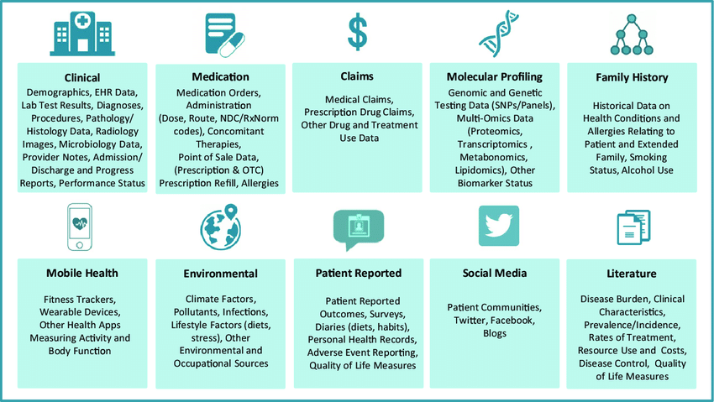
Data in the Real World

Slide 17
Data Collection
Data collection is the process of gathering and collecting information from various sources to analyse and make informed decisions based on the data collected. This can involve various methods, such as surveys, interviews, experiments, and observation.

Slide 18
Types of Data Collection
Primary Data Collection
Primary data collection is the process of gathering original and firsthand information directly from the source or target population.
Secondary Data Collection
Secondary data collection is the process of gathering information from existing sources that have already been collected and analyzed by someone else, rather than conducting new research to collect primary data.
Qualitative Data Collection
Qualitative data collection is used to gather non-numerical data such as opinions, experiences, perceptions, and feelings, through techniques such as interviews, focus groups, observations, and document analysis.
Quantitative Data Collection
Quantitative data collection is a used to gather numerical data that can be analyzed using statistical methods. This data is typically collected through surveys, experiments, and other structured data collection methods.

Slide 19
Data Collection Strategies
Multiple ways: decision depends on:
What you need to know: numbers or stories
Where the data reside: environment, files, people
Resources and time available
Complexity of the data to be collected
Frequency of data collection
Intended forms of data analysis

Slide 20
Rules for Collecting Data
Use multiple data collection methods
Use available data, but need to know
how the measures were defined
how the data were collected and cleaned
the extent of missing data
how accuracy of the data was ensured

Slide 21
Rules for Collecting Data
Collect original data
establish procedures and follow them (protocol)
maintain accurate records of definitions and coding
verify accuracy of coding, data input
Notes:
What is pre test data?
Pre-testing is the administration of the data collection instrument with a small set of respondents from the population for the full scale survey. If problems occur in the pre-test, it is likely that similar problems will arise in full-scale administration.
Data coding is any process that assigns a numerical value to a response. Coding is often automated, however, more complex decisions usually require human intervention (coders).

Slide 22
Data Collection Methods
Surveys
Surveys involve asking questions to a sample of individuals or organizations to collect data. Surveys can be conducted in person, over the phone, or online.
Interviews
Interviews involve a one-on-one conversation between the interviewer and the respondent. Interviews can be structured or unstructured and can be conducted in person or over the phone.
Focus Groups
Focus groups are group discussions that are moderated by a facilitator. Focus groups are used to collect qualitative data on a specific topic.

Slide 23
Observation
Observation involves watching and recording the behavior of people, objects, or events in their natural setting. Observation can be done overtly or covertly, depending on the research question.
Experiments
Experiments involve manipulating one or more variables and observing the effect on another variable. Experiments are commonly used in scientific research.
Case Studies
Case studies involve in-depth analysis of a single individual, organization, or event. Case studies are used to gain detailed information about a specific phenomenon.

Slide 24
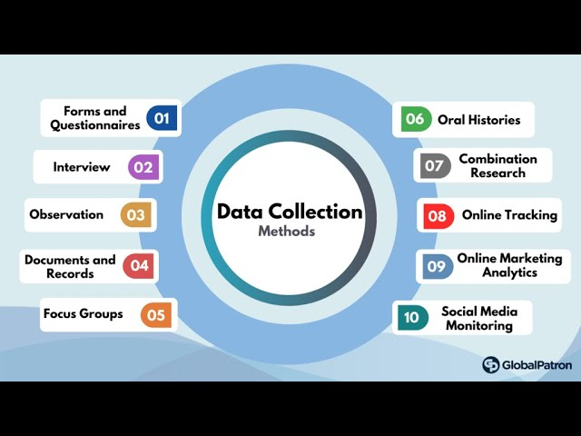

Slide 25
Data Preparation
Data preparation is the process of gathering, combining, structuring and organizing data so it can be used in business intelligence (BI), analytics and data visualization applications.

Slide 26
Benefits of Data Preparation
Ensure the data used in analytics applications produces reliable results
Identify and fix data issues that otherwise might not be detected
Enable more informed decision-making by business executives and operational workers
Reduce data management and analytics costs
Avoid duplication of effort in preparing data for use in multiple applications
Get a higher ROI from BI and analytics initiatives.

Slide 27
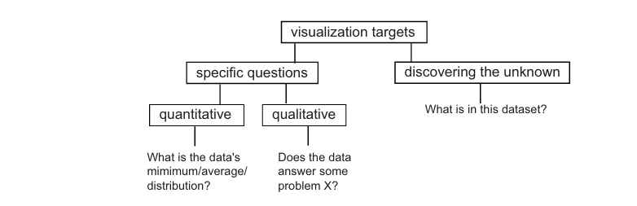
Overview of Data Visualization
The purpose of visualization is to get insight, by means of interactive graphics, into various aspects related to some process we are interested in, such as a scientific simulation or some real-world process.
Questions Targeted by the Visualization process

Slide 28
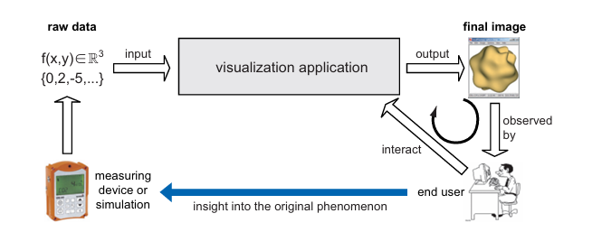
Conceptual View of Visualization Process

Slide 29
Challenges with Data Abstraction
Understanding Data Complexity
Data abstraction requires an understanding of both complex data structures and logical rules. Although abstracting data can involve simplifying it for easier management purposes, this doesn’t necessarily mean less complexity.
Hiding Details while Remaining Accurate
Data abstraction is also a way to hide certain details from view without compromising accuracy or security.
Limitations of Schemas and Abstraction Layers
When it comes to documenting large datasets, predefined schemas are often used as an easy way to structuralize the data correctly.

Slide 30
What is Data Validation?
Data validation refers to the process of ensuring the accuracy and quality of data. It is implemented by building several checks into a system or report to ensure the logical consistency of input and stored data.

Slide 31
Types of Data Validation
1. Data Type Check
A data type check confirms that the data entered has the correct data type. For example, a field might only accept numeric data. If this is the case, then any data containing other characters such as letters or special symbols should be rejected by the system.
2. Code Check
A code check ensures that a field is selected from a valid list of values or follows certain formatting rules. For example, it is easier to verify that a postal code is valid by checking it against a list of valid codes. The same concept can be applied to other items such as country codes and NAICS industry codes.

Slide 32
3. Range Check
A range check will verify whether input data falls within a predefined range. For example, latitude and longitude are commonly used in geographic data. A latitude value should be between -90 and 90, while a longitude value must be between -180 and 180. Any values out of this range are invalid.
4. Format Check
Many data types follow a certain predefined format. A common use case is date columns that are stored in a fixed format like “YYYY-MM-DD” or “DD-MM-YYYY.” A data validation procedure that ensures dates are in the proper format helps maintain consistency across data and through time.

Slide 33
5. Consistency Check
A consistency check is a type of logical check that confirms the data’s been entered in a logically consistent way. An example is checking if the delivery date is after the shipping date for a parcel.
6. Uniqueness Check
Some data like IDs or e-mail addresses are unique by nature. A database should likely have unique entries on these fields. A uniqueness check ensures that an item is not entered multiple times into a database.

Slide 34
What is Data Cleaning?
Data cleaning is the process of fixing or removing incorrect, corrupted, incorrectly formatted, duplicate, or incomplete data within a dataset. When combining multiple data sources, there are many opportunities for data to be duplicated or mislabeled.
If data is incorrect, outcomes and algorithms are unreliable, even though they may look correct.

Slide 35
Data Cleaning Steps
Step 1: Remove duplicate or irrelevant observations
Step 2: Fix structural errors
Structural errors are when you measure or transfer data and notice strange naming conventions, typos, or incorrect capitalization. These inconsistencies can cause mislabelled categories or classes.
Step 3: Filter unwanted outliers

Slide 36
Step 4: Handle missing data
You can’t ignore missing data because many algorithms will not accept missing values.
Step 5: Validate and QA
At the end of the data cleaning process, you should be able to answer these questions as a part of basic validation:
Does the data make sense?
Does the data follow the appropriate rules for its field?
Does it prove or disprove your working theory, or bring any insight to light?
Can you find trends in the data to help you form your next theory?
If not, is that because of a data quality issue?

Slide 37
Data Cleaning
Data in the Real World Is Dirty: Lots of potentially incorrect data, e.g., instrument faulty, human or computer error, transmission error
incomplete: lacking attribute values, lacking certain attributes of interest, or containing only aggregate data
e.g., Occupation=“ ” (missing data)
noisy: containing noise, errors, or outliers
e.g., Salary=“−10” (an error)
inconsistent: containing discrepancies in codes or names, e.g.,
Age=“42”, Birthday=“03/07/2010”
Was rating “1, 2, 3”, now rating “A, B, C”
discrepancy between duplicate records
Intentional (e.g., disguised missing data)
Jan. 1 as everyone’s birthday?

Slide 38
How to Handle Missing Data?
Ignore the tuple: usually done when class label is missing (when doing classification)—not effective when the % of missing values per attribute varies considerably
Fill in the missing value manually: tedious + infeasible?
Fill in it automatically with
a global constant : e.g., “unknown”, a new class?!
the attribute mean
the attribute mean for all samples belonging to the same class: smarter
the most probable value: inference-based such as Bayesian formula or decision tree

Slide 39
What is the difference between Data Cleaning and Data Transformation?
Data cleaning is the process that removes data that does not belong in your dataset. Data transformation is the process of converting data from one format or structure into another.
Transformation processes can also be referred to as data wrangling, or data munging, transforming and mapping data from one "raw" data form into another format for warehousing and analyzing.

Slide 40
Data Transformation
Data transformation in data analysis refers to the process of converting or modifying data from its original format into a format that is suitable for analysis or better suited for the requirements of a particular analytical technique or model.
Data transformation can involve various operations such as cleaning, normalization, scaling, aggregation, encoding, or restructuring of data.
The goal of data transformation is to prepare the data in such a way that it can be effectively analyzed to derive insights, make predictions, or perform other analytical tasks.
Notes:
40

Slide 41
Here are some common types of data transformations used in data analysis:
Cleaning: This involves identifying and handling missing or erroneous data, removing duplicates, and correcting inconsistencies in the data.
Normalization: Normalizing data involves scaling numerical variables to a standard range, typically between 0 and 1 or -1 and 1, to ensure that all variables have the same scale and are directly comparable.
Standardization: Similar to normalization, standardization scales numerical variables to have a mean of 0 and a standard deviation of 1. This is useful for algorithms that assume normally distributed data.

Slide 42
4. Aggregation: Aggregating data involves combining multiple data points into summary statistics, such as calculating means, sums, counts, or other aggregate measures for subsets of data.
5. Encoding: Encoding categorical variables involves converting them into numerical format, either through one-hot encoding, label encoding, or other methods, to make them compatible with machine learning algorithms.
6. Feature engineering: This involves creating new features from existing ones, such as combining or transforming variables to capture additional information or patterns in the data.
7. Dimensionality reduction: Techniques like principal component analysis (PCA) or feature selection methods can be used to reduce the dimensionality of the data by transforming it into a lower-dimensional space while retaining most of the important information.

