Slide 1


Horizon United Mavericks
VEHICLE PARKING MANAGEMENT SYSTEM
A Smart and Efficient Vehicle Parking Management System
BY:
Umer Khan 22I-0780
Hamza Imran 22I-0865
Abdul Munhim 22I-1021

Slide 2

Horizon United Mavericks
Introduction
Architecture & UML Diagrams
Project Planning
User Stories
Black Box Testing
White Box Testing
Further Improvements
Conclusion
OVERVIEW

Slide 3

Horizon United Mavericks
INTRODUCTION
Goal
Target Users
Efficiently manage parking spaces in public and private facilities.
Vehicle owners and parking administrators.
Benefits
Key Features
Minimize human error in parking operations
Maximize space utilization
Seamless reservation and booking experience
Real-time slot availability updates
Vehicle Registration
Parking Space Booking
Admin Management
Vehicle Owner Handling
Cost Calculation
Notification Handling

Slide 4


Horizon United Mavericks
ARCHITECTURE DIAGRAMS

Slide 5


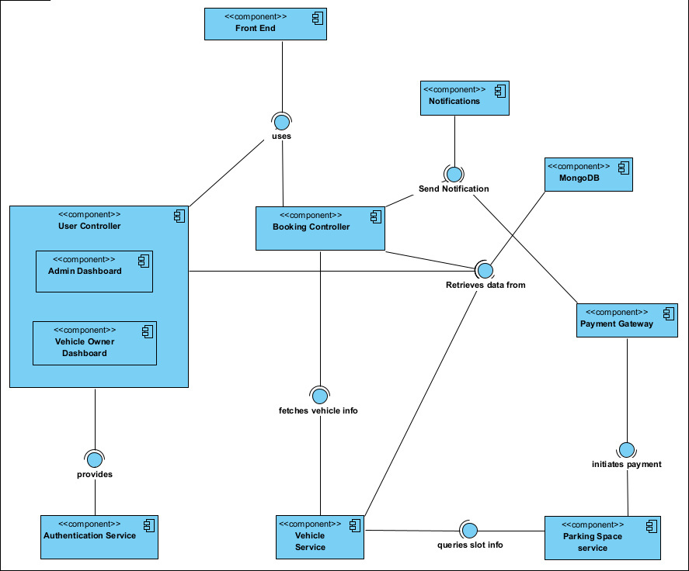
Horizon United Mavericks
COMPONENT DIAGARM

Slide 6
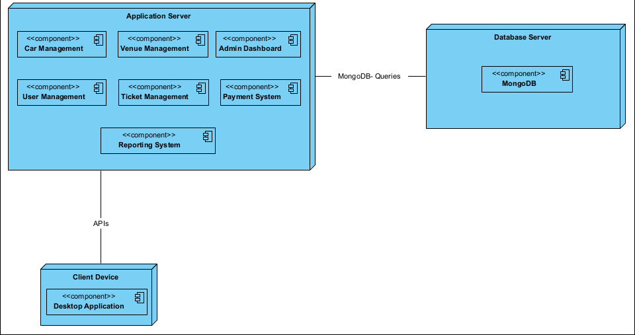
Horizon United Mavericks
DEPLOYMENT DIAGRAM

Slide 7
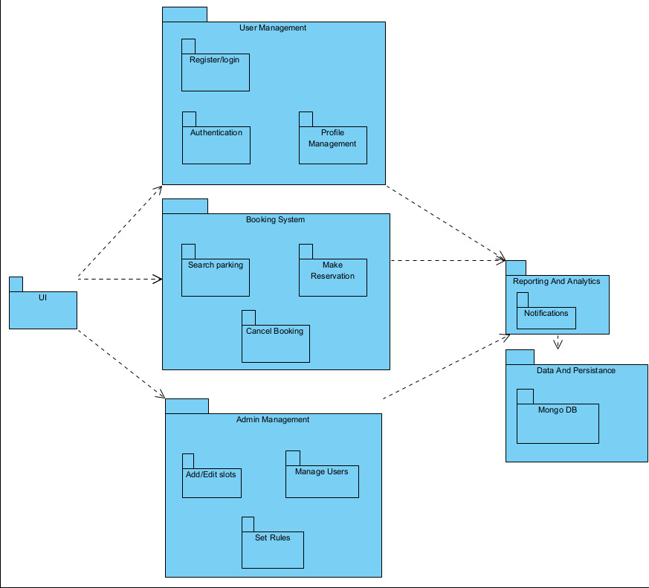
Horizon United Mavericks
PACKAGE DIAGRAM

Slide 8

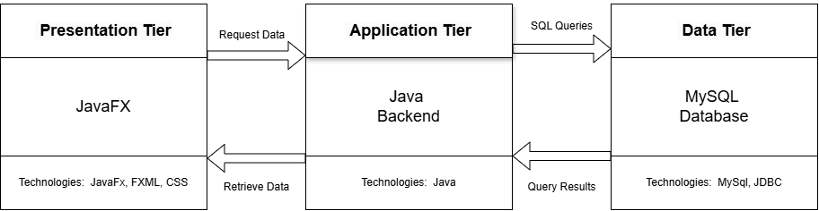
Horizon United Mavericks
ARCHITECTURE STYLE
3-Tier Architechture
Presentation Layer
Application Layer
Data Layer
Web Browsers on Client Devices
Node.js Backend (Controllers and Services)
MongoDB Database
Technologies : HTML5, CSS3, JavaScript
Technologies : Node.js, Express.js
Technologies : MongoDB, Mongoose ORM

Slide 9

Horizon United Mavericks
PROJECT PLANNING

Slide 10
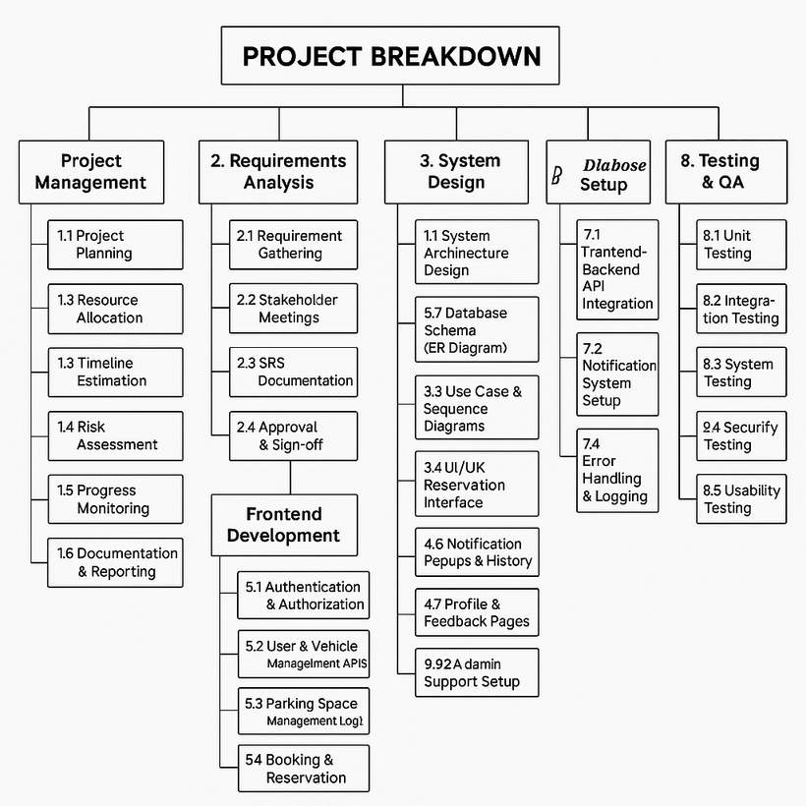

Horizon United Mavericks
WORK BREAKDOWN STRUCTURE
4. Database Setup

Slide 11
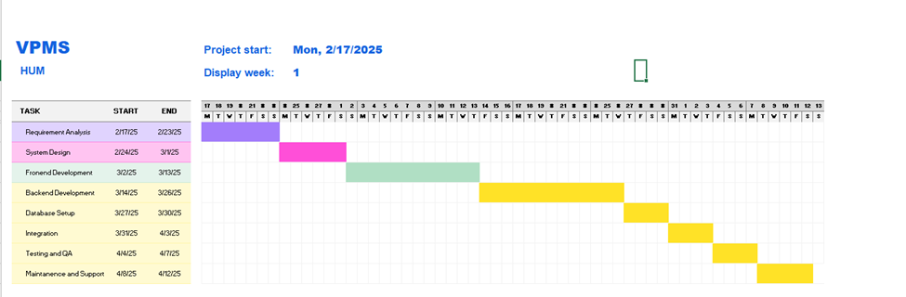

Horizon United Mavericks
GANTT CHART

Slide 12
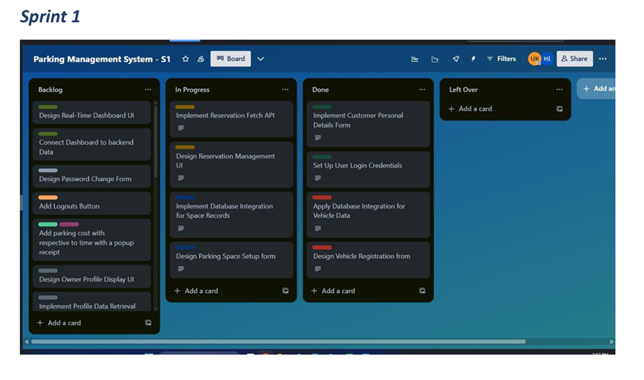
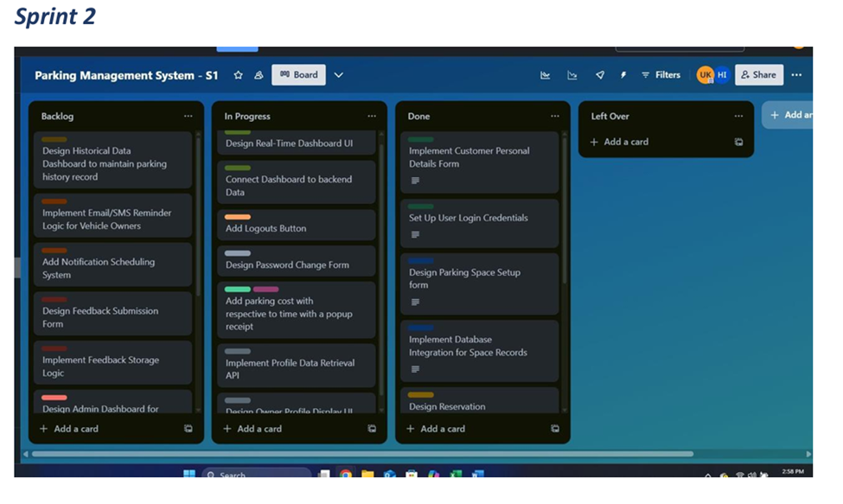
Horizon United Mavericks
SPRINT PLANNING

Slide 13

Horizon United Mavericks
USER STORIES

Slide 14
Horizon United Mavericks
MAIN USER STORIES
ID | As a | I want to | So that
1 | Vehicle owner | Register my account | I can manage my vehicle and parking space bookings
2 | Vehicle owner | Book a parking space | I can park my vehicle
3 | Admin | Monitor parking space availability in real-time | I can ensure optimal space allocation and prevent overcrowding
4 | Admin | Set rules for parking duration | I can ensure space turnover

Slide 15
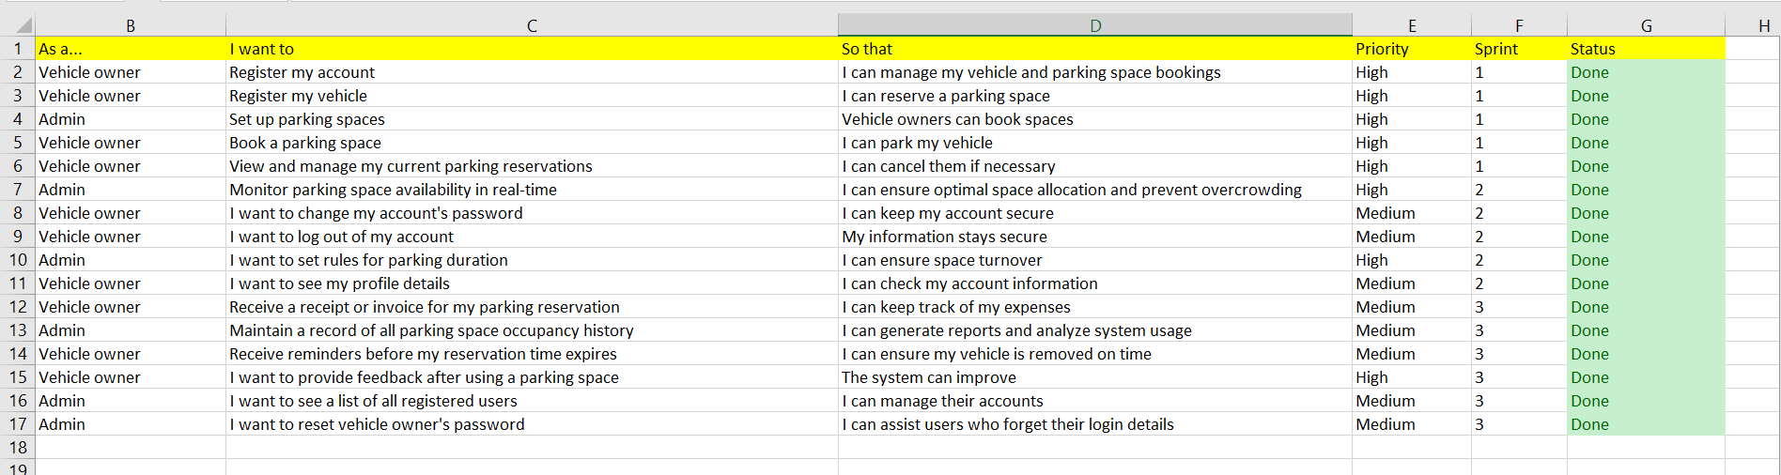
Horizon United Mavericks
PRODUCT BACKLOG

Slide 16

Horizon United Mavericks
BLACK BOX TESTING

Slide 17
Horizon United Mavericks
EQUIVALENCE CLASS PARTITIONING
Valid Equivalence Classes | Conditions
1. User Registration | UR1 — Name : { 1 ≤ length(name) AND matches [A-Z]+ | [a-z]+ } UR2 — Username : { 1 ≤ length(name) } UR3 — Password : { 5 ≤ length(password) } UR3 — Contact : { length(Contact) = 11 }
2. Vehicle Registration | VR1 — License Plate: { matches /^[A-Z]{3}\d{4}$/ (e.g. “ABC1234”) }
3. Booking a spot | PS1 — Search Date : { date ∈ [today, today + 365 days] } PS2 — Start Time : { time ∈ {00:00, 00:15, …, 23:45} } PS3 — End Time : { endTime > startTime }
4. Admin Parking‐Lot Setup | AS1 — Spot Count : { 1 ≤ numberOfSpots } AS2 — Type : { 1 ≤ length(Type) AND matches [A-Z]+ | [a-z]+ } AS3 — Hourly Rate : { matches [0-9]+ | [0-9]+ }
5. Feedback | FB1 — Rating : { integer ∈ {1,2,3,4,5} } FB2 — Comment : { length(comment) ≤ 256 characters }

Slide 18
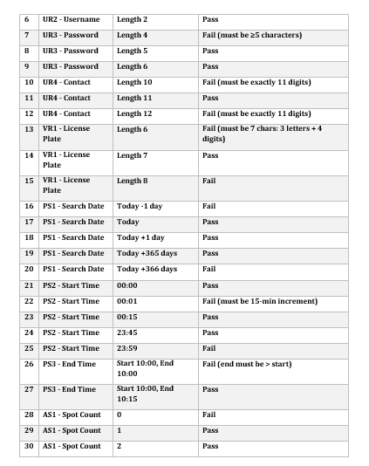

Horizon United Mavericks
BOUNDARY VALUE ANALYSIS

Slide 19

Horizon United Mavericks
WHITE BOX TESTING

Slide 20
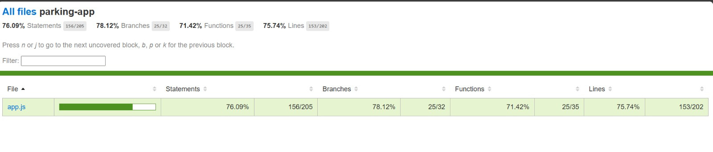
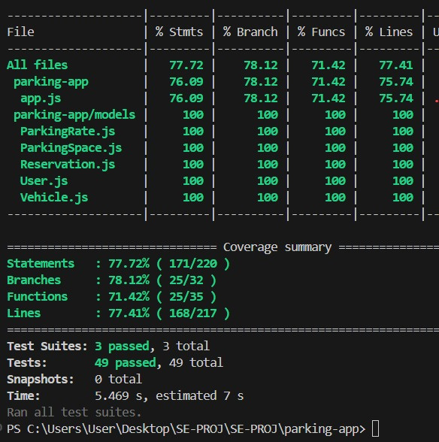
Horizon United Mavericks

Slide 21

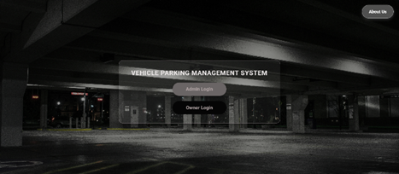
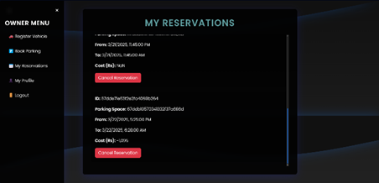
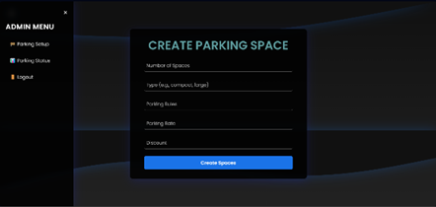
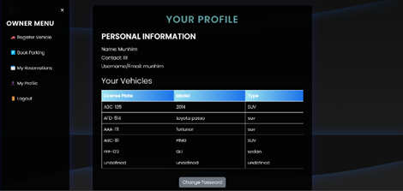
Horizon United Mavericks
IMPLEMENTATION

Slide 22

Horizon United Mavericks
FURTHER IMPROVEMENTS
Provide more specific error feedback (e.g., show missing special characters in passwords).
Implement real-time front-end validation (live password strength meters, contact number formatting).
Expand testing to include:
SQL Injection and XSS attacks on all text inputs.
API timeout, failure, and retry handling for bookings and vehicle registration.
Perform load testing (simulate 1000+ concurrent users searching for parking spots).
Conduct multi-device and cross-browser compatibility testing to ensure full accessibility compliance.
Improve test modularity for better reusability in future regression testing cycles.

Slide 23
Horizon United Mavericks
CONCLUSION
Lessons Learned
Importance of defining clear input boundaries and enforcing strong validation rules.
Black-box testing using equivalence classes and boundary value analysis helped catch hidden edge cases early.
Team Reflections
Collaborative testing improved communication and systematic planning of test cases.
Learned to focus test design based on real user behavior instead of assumptions.
Final Thoughts
Proud of building a scalable, secure VPMS foundation.
Realized that continuous testing and improvements are essential for long-term quality.
Future goal: Expand automation, strengthen security testing, and improve user accessibility.

Slide 24

Horizon United Mavericks
THANK YOU

