Slide 1
Pattern segmentation using skipping layer architecture
Presented By:
Muhammad Umer Ishfaq (2216336)
Khadija Ishaq (2314022)
Affiliation:
University of Eastern Finland

Slide 2
Outline
Introduction Background
●
●
–
Problem Statement
Literature Review Methodology Results Conclusion
●
●
●
●

Slide 3
Introduction
What is segmentation
Semantic vs Instance Segmentation
How medical images are different from normal images
Why there is a need of segmentation instead of classification
What techniques are used till now for medical images
●
●
●
●
●

Slide 4
Problem Statement
●
Stacked architecture are not good enough for images segmentation
The pixel range of medical images can range from -3000 to 3000
The objects are present in a dense background
The simple U-Net architecture not providing good results
●
●
●

Slide 5
Literature Review
Paper | Methodology | Year | Dataset | Dice Score
[1] | GAN’s + UNet | 29 May 2020 | Aortic Valve | 93
[2] | DenseNet | 19 May 2019 | Chest Radiography | 75
[3] | EUnet | 19 Nov 2019 | Skin Lesion | 83
[4] | ACNN-Seg | 26 Sept 2017 | Cardiac MR | 93
[5] | 2D-FCN | 23 Jan 2019 | Cardiac MR | 82
[6] | S-UNet | 17 Sept 2019 | Retinal Data | Not mentioned
[7] | Nas-Unet | 4 April 2019 | Bladder | 94.5
[8] | SMCRNet | 2 July 2019 | Brain Tumour | 63
[9] | U- Net+localization | 27 Aug 2020 | Heart MR | 93
[10] | P-Net | 26 Jan 2018 | Fetal MRI | 83
5

Slide 6
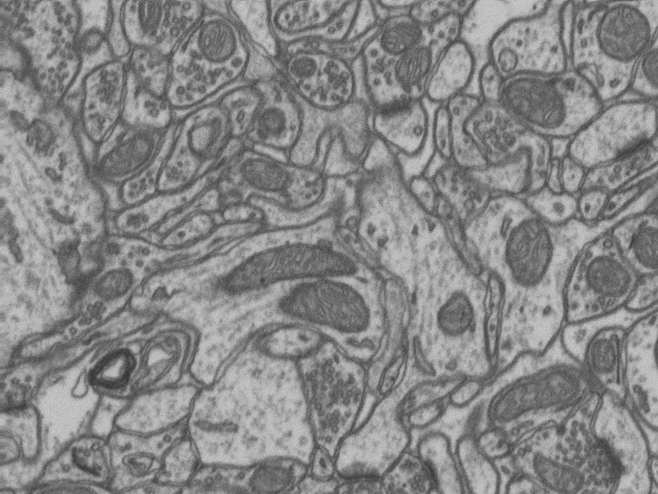
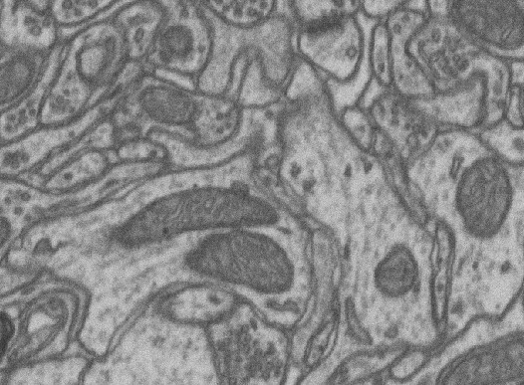
Methodology (1/3)
●
In pre-processing images were first converted from TIFF files to png and brightness was applied
Data augmentation has been done by Albumentation
●
Random Crop Rotation Center Crop
–
–
–
Raw image vs random crop

Slide 7
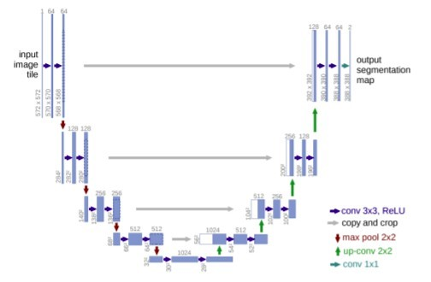
Methodology (2/3)
●
Architecture that we have used is U-Net along with the Efficient Net as the shared backbone.
Efficient Net is used to enhance feature before subjecting to U-Net
●

Slide 8
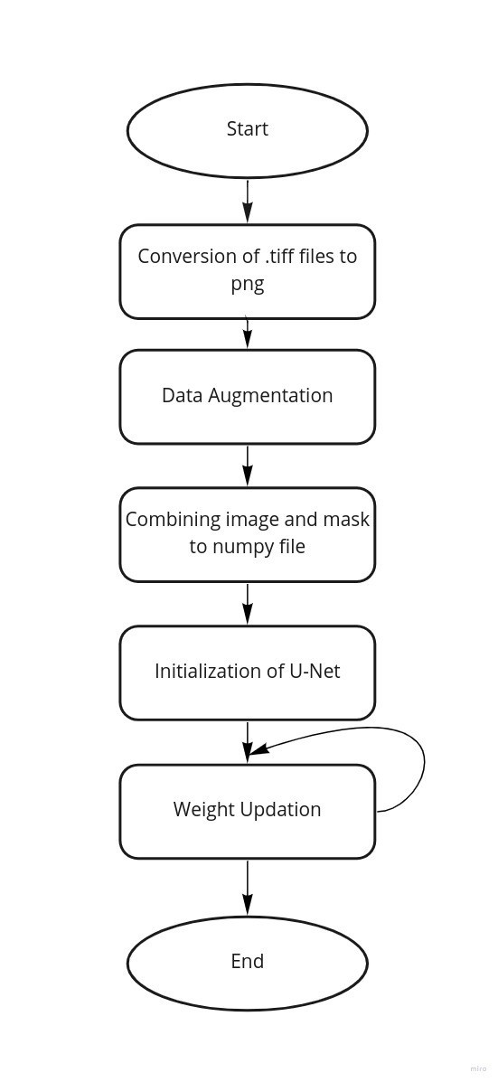
Methodology (3/3)
●
Flow Diagram

Slide 9
Results(1/2)
Paper | Architecture | Dice Score
A Semi-Automatic Method To Segment The Left Atrium in MR Volumes With Varying Slice Numbers | U-Net with semi automated localization | 93
A Stacked Multi-Connection Simple Reducing Net for Brain Tumor Segmentation | Stacked R-Unet | 60
Our Methodology | U-Net with Efficient Net as backbone | 96

Slide 10
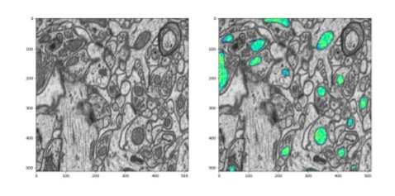
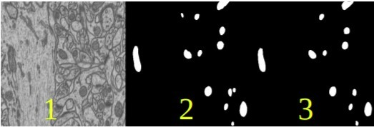
Results(2/2)
●
The visual representation of results are following:

Slide 11
Conclusion
●
The problem that we want to solve is predicting pretty good. The results on testing data are good enough by taking in consideration of the amount of data we have. For achieving a good accuracy we must have a good variety of data to increase the performance. In this problem we did not provide the validation data set as we dont have much data. By adding validation data we can increase the performance on testing data significantly.

Slide 12
References(1/1)
●
H. Asma-Ull, I. D. Yun and D. Han, "Data Efficient Segmentation of Various 3D Medical Images Using Guided Generative Adversarial Networks," in IEEE Access, vol. 8, pp. 102022-102031, 2020, doi: 10.1109/ACCESS.2020.2998735.
●
E. Sogancioglu, K. Murphy, E. Calli, E. T. Scholten, S. Schalekamp and B. Van Ginneken, "Cardiomegaly Detection on Chest Radiographs: Segmentation Versus Classification," in IEEE Access, vol. 8, pp. 94631-94642, 2020, doi: 10.1109/ACCESS.2020.2995567.
●
R. Zhao, W. Chen and G. Cao, "Edge-Boosted U-Net for 2D Medical Image Segmentation," in IEEE Access, vol. 7, pp. 171214-171222, 2019, doi: 10.1109/ACCESS.2019.2953727.
●
Y. Weng, T. Zhou, Y. Li and X. Qiu, "NAS-Unet: Neural Architecture Search for Medical Image Segmentation," in IEEE Access, vol. 7, pp. 44247-44257, 2019, doi: 10.1109/ACCESS.2019.2908991.
●
G. Wang et al., "Interactive Medical Image Segmentation Using Deep Learning With Image-Specific Fine Tuning," in IEEE Transactions on Medical Imaging, vol. 37, no. 7, pp. 1562-1573, July 2018, doi: 10.1109/TMI.2018.2791721.

Slide 13


