Slide 1
Simple NLP Tasks

Slide 2
Bag of Words
A simple method to find Topics in a text
  Generate tokens
  Convert all tokens to lower case
  Count frequency of each token in the text
  The characters with highest frequency are the most significant words

Slide 3
Simple Preprocessing Steps
Convert text into tokens
Changing tokens to lowercase
Removing numbers and punctuation signs
Removing stop words
  A built-in library has been provided in Python
Lemmatization/stemming: Shorten words to their root stems, i.e. converting plurals to singular forms

Slide 4
Gensim
Widely used open source vector-space modeling and topic modeling library
Classes and functions to easily realise complex NLP tasks
It is built on top of NumPy and SciPy
Gensim includes implementations of tf-idf, random projections, word2vec and document2vec algorithms, hierarchical Dirichlet processes (HDP), latent semantic analysis (LSA) and latent Dirichlet allocation (LDA), including distributed parallel versions.

Slide 5
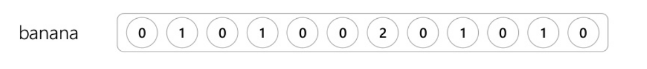
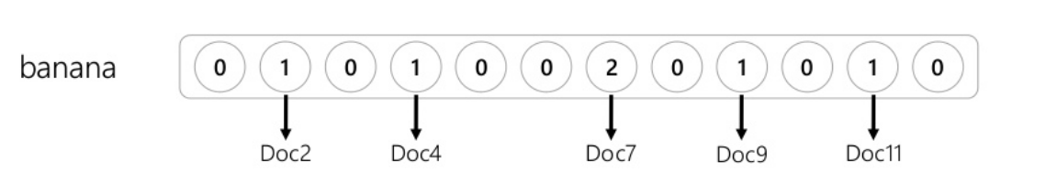
Word Vector-Space Models
Represent an item (such as word) as a vector of numbers
The vector can represents the documents in which the word appear

Slide 6
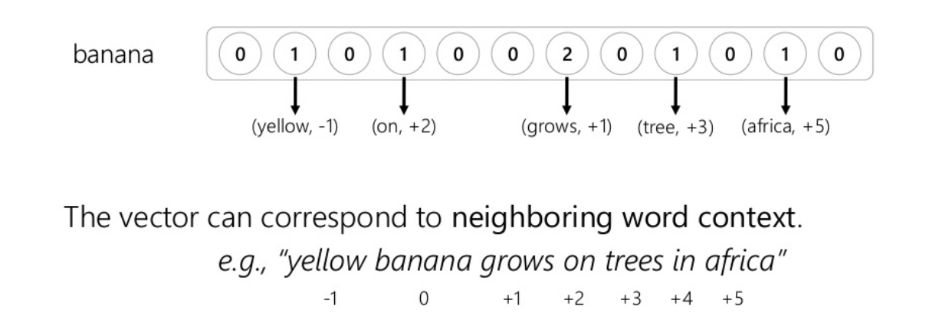
Word Vector-Space Models

Slide 7
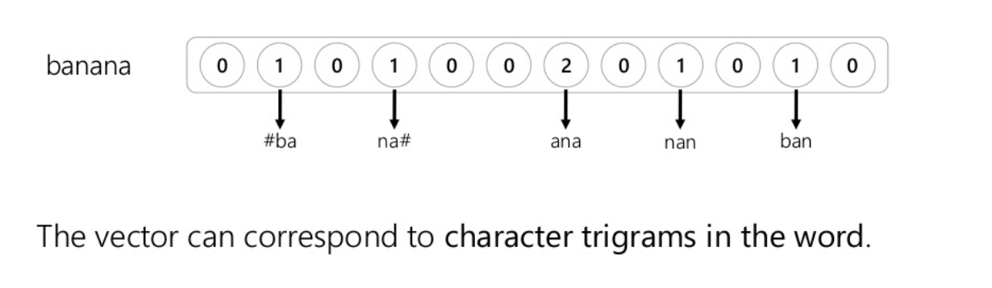
Word Vector-Space Models

Slide 8
Measure of Similarity
Comparing two vectors estimates how similar the two words are
What is the meaning of similarity here?
  Depends on the vector representation

Slide 9
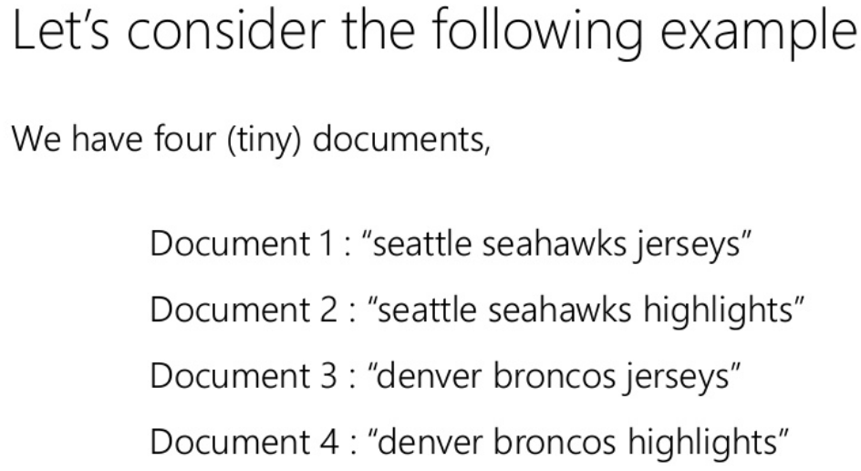
Measure of Similarity

Slide 10
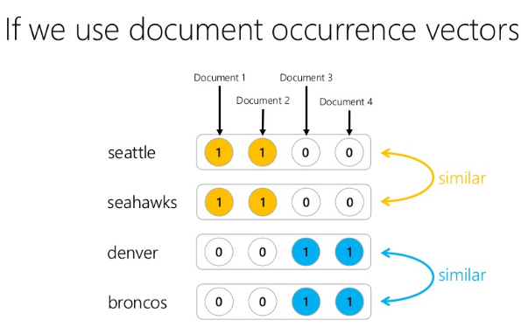
Topical Similarity

Slide 11
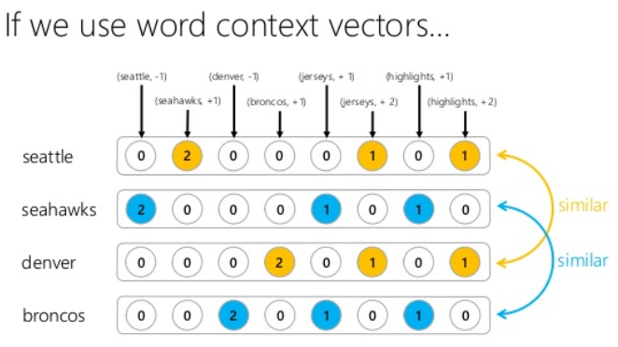
Typical (by Type) Similarity

Slide 12
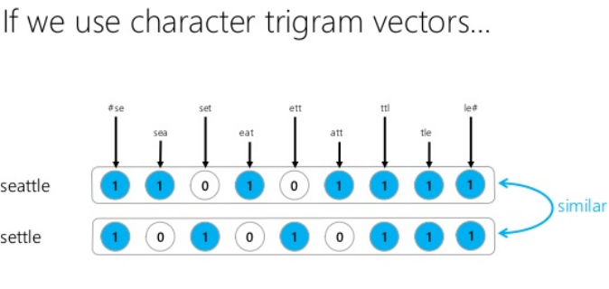
Similar to Edit-Distance

Slide 13
Creating Dictionary in Gensim
Corpus (pl. Corpora)
  a collection of written texts, especially the entire works of a particular author or a body of writing on a particular subject.
  a collection of written or spoken material in machine-readable form, assembled for the purpose of linguistic research.

Slide 14
Creating Dictionary in Gensim
Lab Session

