Slide 1
Algorithms In Data Science

Slide 2
Algorithms in Data Science
An algorithm is a procedure or set of steps or rules to accomplish a task.
Three classes of Algorithms in Data Science
  Data munging, preparation, and processing algorithms, such as sorting, MapReduce, or Pregel.
  Optimization algorithms
  Machine Learning Algorithms

Slide 3
Machine Learning Algorithms
Used for
  Prediction
  Classification
  Clustering
We can use the terms Statisitcal Modeling (focus on Inference) and Machine Learning Algorithms (focus on classification and prediction) interchangeably

Slide 4
Basic Algorithms
Most of data related real world problems are either classification or prediction problems
As a Data Scientist your job is to choose the BEST algorithm depending upon
  The problem and its parameters
  Underlying assumptions

Slide 5
Linear Regression
Most commonly used to express linear relationship between two variables
  Outcome variable (response variable, dependent variable, label)
  Predictor (Independent variable, explanatory variable, feature)
Can also be used when there is a linear relationship between one variable and several other variables

Slide 6
Good starting point for many problems (first assumption)

Slide 7
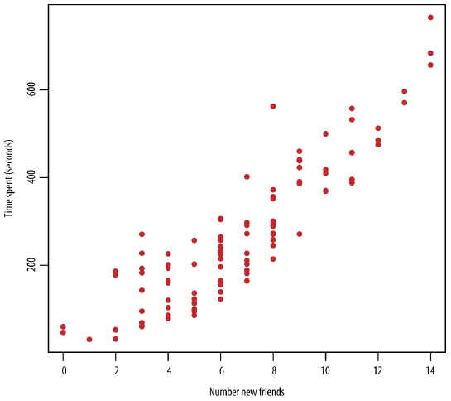
Writing Model
There is no deterministic relation here BUT
It is obvious there is some association between
the two variables.
There are two important things we
want to capture in a model:
TREND and VARIATION

Slide 8
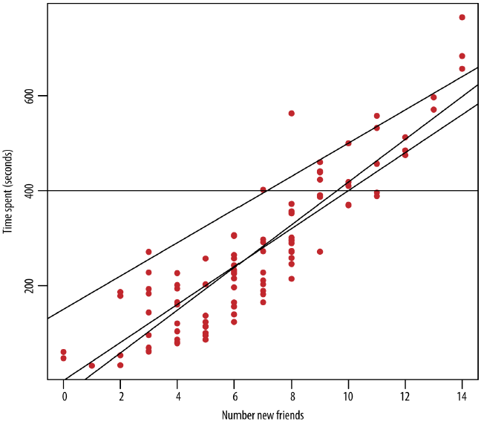
Writing Model
Which line is the BEST fit?
y = β₀ +β₁x
Now your job is to find
best values of
β₀ and β₁ -> MODEL FITTING

Slide 9
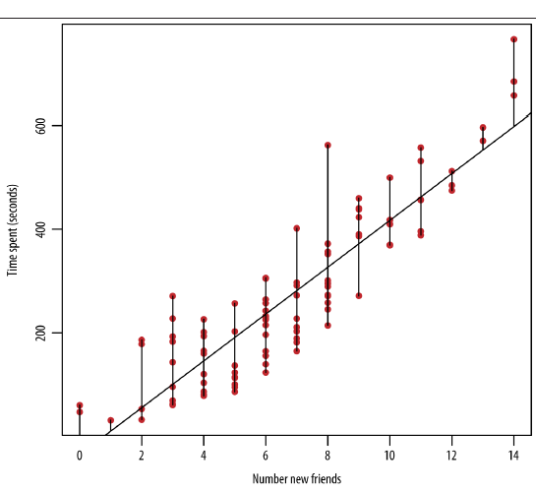
Fitting the Model
You have to find the optimal line.
  But what is the meaning of optimal?
LEAST SQUARE ESTIMATION:
Minimizes the sum of squares of differences
between approximated y’ and actual y

Slide 10
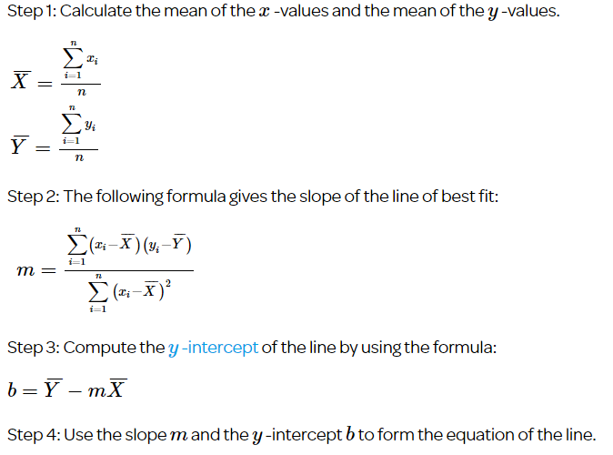

Slide 11
Extending beyond Least Squares
1. Adding in modeling assumptions about the errors
2. Adding in more predictors
3. Transforming the predictors

Slide 12
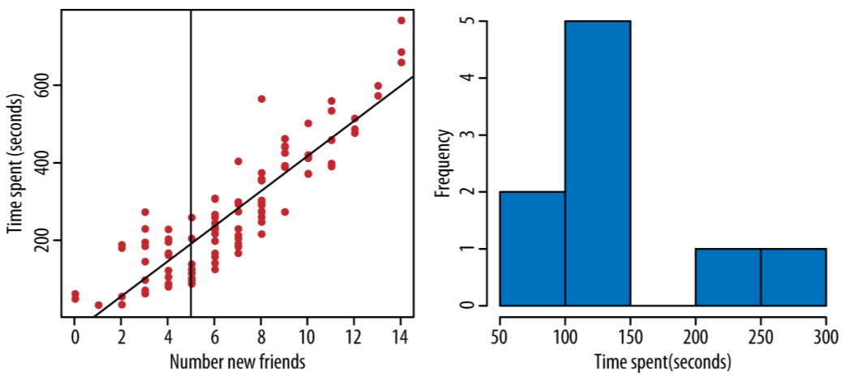
1. Error Consideration
For x=5, y=195.7
How confident you are about this result?
So far we have captured the trend
but not Variation
Extend your model to:
y=β₀+β₁x+ϵ
ϵ is called error term OR noise

Slide 13
Estimating ϵ
One common assumption is Noise is normally distributed ϵ∼N(0,σ²)
Thus, we can say the conditional distribution of y given x is
p(y/x) ∼N(β₀+β₁x,σ²)
How to find values of these parameters: β₀,β₁,σ² ?

Slide 14
Estimating ϵ
σ²=∑_{i} e_{i}² /(n−2)
Where e_{i} = y_{i}−y’_{i}

Slide 15
Cross Validation
Divide data into training set (80%) and test set (20%)
Find values of parameters by using training set and calculate MSE
Calculate MSE for TEST set as well
If both values of MSE are approximately the same, then it is a good model

Slide 16
K – Nearest Neighbors (K-NN)
To automatically classify a collection of objects based on the classification ALREADY DONE on similar objects
The output of the algorithm is categorical label
K-NN Philosphy
  Each object has attributes
  Consider most similar other items defined in terms of attributes
  Give the unassinged object Majority vote

Slide 17
Two Important Considerations
How do you define similarity or closeness?
  The similarity criteria would be used choose more similar objects and call them neighbors
  Each neighbor has a vote
How many neighbors to choose for voting?
  This value is k
  To be determined by data scientist

Slide 18
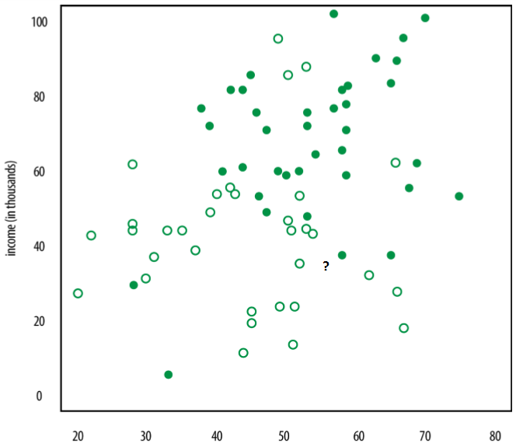
An Example

Slide 19
k-NN Process
Decide on your similarity or distance metric.
Split the original labeled dataset into training and test data.
Pick an evaluation metric.
Run k-NN a few times, changing k and checking the evaluation measure.
Optimize k by picking the one with the best evaluation measure.
Once you’ve chosen k, use the same training set and now create a new test set with the people’s ages and incomes that you have no labels for, and want to predict

Slide 20
Similarity or Distance Metrics
It depends on the problem
Must be decided with great care
In our example, we can choose Euclidean distance as distance metrics
  Reperesenting salaries in Dollars (34,40000,715) VS representing salaries in thousand of dollars (34,40,715)
  THE WAY YOU SCALE YOUR VARIABLES HAS A GREAT EFFECT ON THE OUTPUT

Slide 21

Closeness Metrics
Euclidean Distance
  Good for attributes that are real valued and can be plotted on x-dimensional space
Cosine similarity
  Can be used between two real value vectors
  Interpretation: -1 (completely opposite), 1 (exactly the same), 0 (independent)

Slide 22
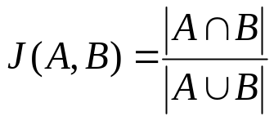

Closeness Metrics
Jaccard Distance or Similarity
  Calculate distance between set of objects
Mahalanobis Distance
  More useful than Euclidean distance as it is scale-invariant
  Where is S is covariance matrics

Slide 23
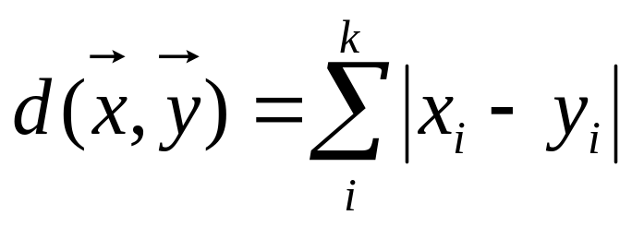
Closeness Metrics
Hamming distance
  Can be used to find distance between two strings or two sequences
  The distance between HOT and NOT is 1, while the distance between HOT and NET is 2
Manhattan
  Used to find distance between real valued vectors

Slide 24
Training and Test Sets
Machine learning algorithm
  Training phase: create a model and train it
  Testing phase: test the accuracy of the model
What is the training data for our example?
What is the testing data for our example?

Slide 25
Choosing an Evaluation Metrics
How do you evaluate the result of your model?
Some misclassifications are worse than others
  False negatives may be worse than false positive
A domain expert can decide the evaluation metrics

Slide 26
Choosing an Evaluation Metrics
To evaluate the efficiency of your model
  Needs domain expertise
It is a tradeoff between sensitivity and specificity
Sensitivity (true positive rate OR recall)
  Correctly marking a positive as positive
Specificity (true negative rate)
  Correctly marking a negative as negative

Slide 27
Choosing an Evaluation Metrics
One possibility is accuracy: which is the ratio of number of correct labels to the total number of labels
Misclassification rate = 1 – accuracy
How to determine value of k?
  The one which gives minimum misclassification rate

Slide 28
When K-NN can be used?
Similarity of objects can be measured
Training data has been classified in two or more classes
The observed features and labels have some association

Slide 29
QUESTIONS

