Slide 1
Statistical Inference, Exploratory Data Analysis, and the Data Science Process

Slide 2
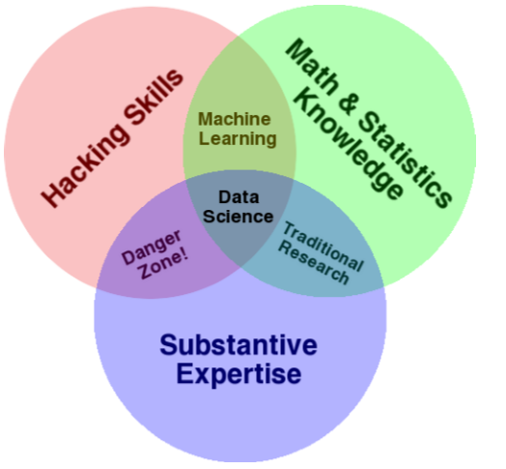
Introduction to Data Science

Slide 3
Introduction to Data Science
Data is everywhere in our world
To solve real world problems we must be able to collect, process and analyze data
Data Scientist: turns Real World -> Data
Main problem
  Randomness and uncertainity
    Process itself
    Data collection methods

Slide 4
Introduction to Data Science
Real world processes generate HUGE amount of data
  For decision making, we must simplify the data into something more meaningful (a concise representation of data)
    Mathematical model (Statistical estimators)

Slide 5
Statistical Inference
Statistical inference
  Real world -> data
  Data -> Real world
«statistical inference is the discipline that concerns itself with the development of procedures, methods, and theorems that allow us to extract meaning and information from data that has been generated by stochastic (random) processes»

Slide 6
Basic Terminology
Population: the entire set of objects, facts, events, etc. under consideration
  N is used to represent total number of observations of population
Sample: a subset of the units of size n in order to examine the observations to draw conclusions and make inferences about the population
  SAMPLING MECHANISM MUST BE CHOSEN WITH GREAT CARE

Slide 7
Population and Samples in Big Data
Is there any need of Sampling in Big data world? (Ans: depends upon the problem)
  For inference we need not to process all the data (do Sampling)
  For displaying contents of particular product we need all the data concerning that product (population)
For proper sampling and analysis, you must understand the context. (choose correct representation of the population)

Slide 8
Types of Data in Data Sciences
Traditional: numerical, categorial, binary
Text: tweets, news article, facebook posts
Records: timestamped event data, JSON log files
Geo-based location: map data
Sensor data
Images

Slide 9
Big Data
Volume
Variety
Velocity

Slide 10
Data is NOT Objective
Data is not objective
  The inference drawn pretty much depend upon the process and skills of data scientist
You must understand the underlying cause before arriving at some conclusion
In a Big data there is a tendency of ignoring the cause resulting in

Slide 11
Modeling
Humans try to understand the world around them by representing it in different ways. -> MODEL
Statisticians and data scientists capture the uncertainity and randomness of data-generating processes with mathematical functions that express the structure of the data

Slide 12
Modeling
We build model so that it contains only information of our interest and ignore any extra details (Abstraction)
  Be careful, you might remove something useful if you are not careful enough
Data model vs Mathematical Model vs Statistical Model

Slide 13
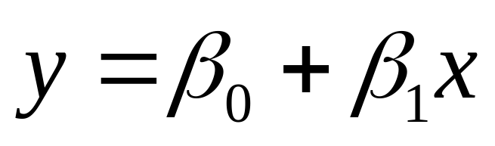
Statistical Modeling
Mathematical representation of real world processes usually have both VARIABLES and PARAMETERS
  The value of a parameter is NOT known in advance and it is determined from the data set
How do you know the form of mathematical equation that describes the real world process?
  Its half SCIENCE half ART

Slide 14
Statistical Modeling
Constructing correct model is the MOST important thing for a data scientist yet it is the MOST difficult art to master
One way is to start with Exploratory Data Analysis (EDA)
  Generate plots to get a feel of your dataset, such as Histograms, scatter plots
Another way is trial and error

Slide 15
Model Building Philosophy
Practice as much as possible
Start simply and build in complexity
  First try writing down a linear function
    Check whether it serves the purpose?
    How can it be improved?
  Use as much details as you can (natural language phrases) to describe your processes

Slide 16
Simplicity vs Accuracy
Simpler are easier to interpret but MAY be inaccurate
Simpler model takes less time to build
Sometimes the accuracy provided by a simple model may be acceptable

Slide 17
Probability Distributions
If we measure and plot various real world processes, certain shapes appear again and again
These shapes can be approximated by mathematical functions with few parameters
We can use these shapes as building blocks of our models

Slide 18
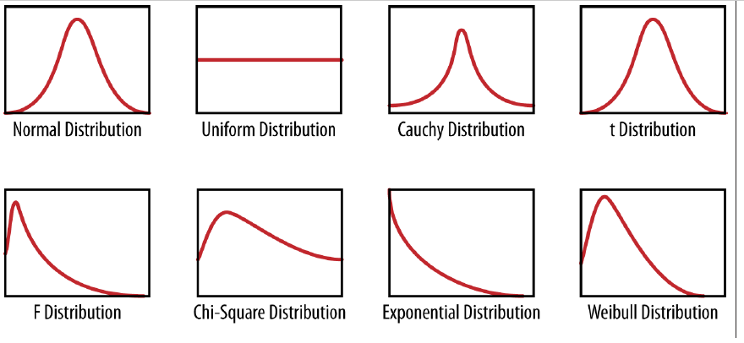
Probability Distributions

Slide 19
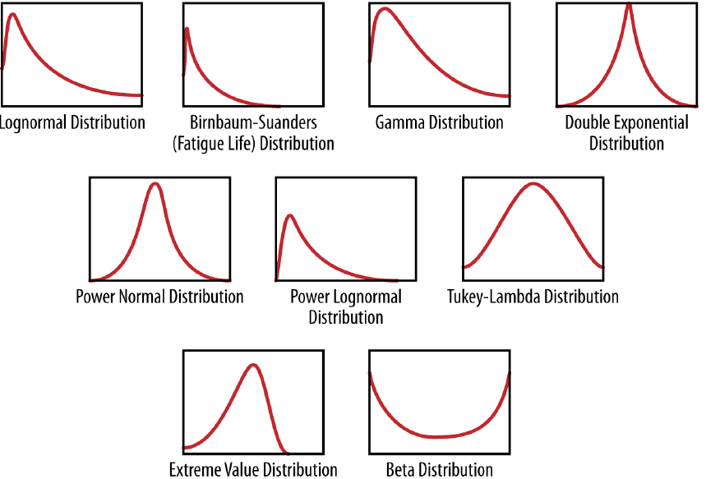
Probability Distributions

Slide 20
Probability Distributions
Probability distribution is foundation of statistical modeling
These shapes can often be approximated by mathematical functions
We can use these shapes as building blocks of our models
“A Probability distribution assigns a probability to a subset of possible outcomes”

Slide 21
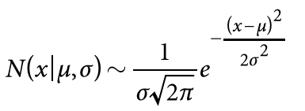
Probability Distributions
We say random variable x has probability distribution N(x), which assigns it to a positive number between 0 and 1.
If we integrate N(x) over all possible outcomes, the answer is always 1.
In case of Joint distribution with two variables, its double integral over the whole plane is 1.

Slide 22
Conditional Probability Distribution
P(x/y) is density function of x given a particular value of y.
Conditioning → Choosing a subset

Slide 23
Model Fitting
To estimate values of parameters by using observed data
Often involves optimization methods to estimate parameter values
R and Python languages provide built-in optimization methods to give the most likely values of the parameters
Be aware of Overfitting (wrong estimated values of parameters)

Slide 24
Exploratory Data Analysis
The basic tools of EDA are plots, graphs and summary statisitics.
  Plotting distribution of variables
  Plotting time series of data
  Looking at pairwise relationships by using scatter plots.
  Computing mean, minimum, maximum, the upper and lower quartiles and finding the OUTLIERS

Slide 25
Why We Do EDA?
To get a feel of the data shape and structure
To make comparisons between distributions
To make sure data is on expected scale and format
To find missing data
To find outliers
Notes:
Be careful when analyzing log data. The patterns you find could be something wrong with the Logging process

Slide 26
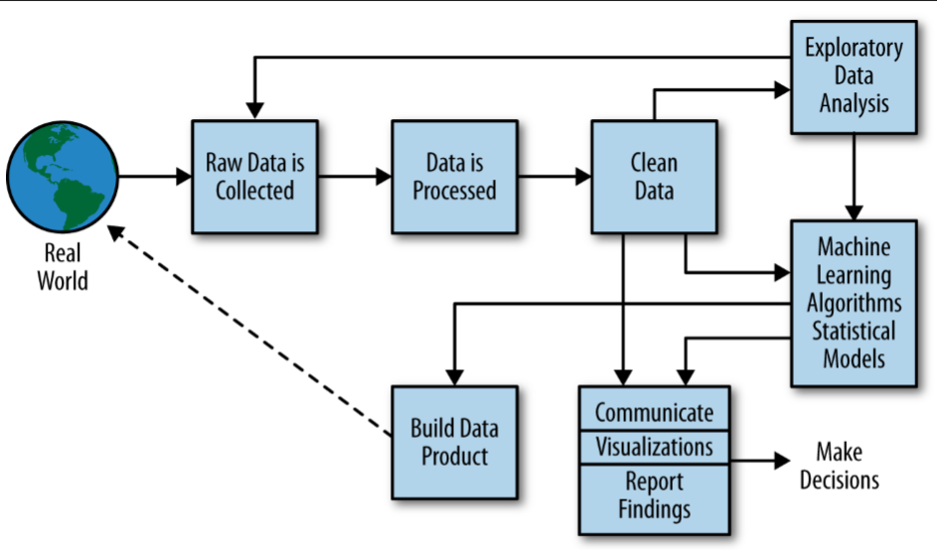
The Data Science Process
During EDA we may realize some data is missing or not clean
K-NN, Linear Regression,
Naive Bayes
Not Required if our Goal is just
Data Visualization
A product creates a
feedback loop that creates
even more data

Slide 27
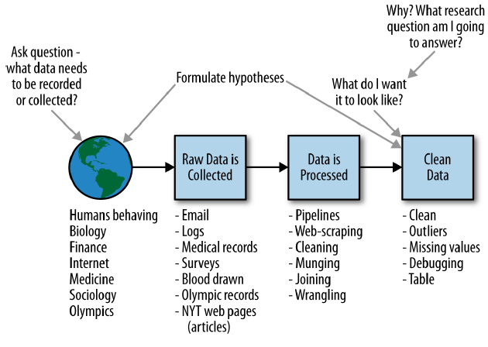
A Data Scientist Role

Slide 28
Main Tasks of Data Scientist
Decide what do to collect? Why?
Formulate questions and hypotheses
Making a plan on how to attack the problem
Data analytics
Product building

Slide 29
Data Science vs Scientific Method
Ask a question
Do background research
Construct a hypothesis
Test your hypothesis by doing an experiment
Analyze your data and draw a conclusion
Communicate your results

Slide 30
QUESTIONS

