Slide 1
Dimensionality Reduction

Slide 2
Principal Component Analysis – An Introduction
PCA finds the principal components of data
  It is often useful to measure data in terms of its principal components rather than on a normal x-y axis
Principal components are the underlying structure in the data.
  They are the directions where there is the most variance, the directions where the data is most spread out.

Slide 3
Principal Component Analysis – An Introduction
A set of data points can be represented into eigenvectors and eigenvalues.
  WHY?
Eigenvectors and values exist in pairs
  An eigenvector is a direction
  An eigenvalue is a number, telling you how much variance there is in the data in that direction

Slide 4
Principal Component Analysis – An Introduction
The eigenvector with the highest eigenvalue is therefore the principal component.
The number of eigenvectors/values that exist equals the number of dimensions the data set has

Slide 5
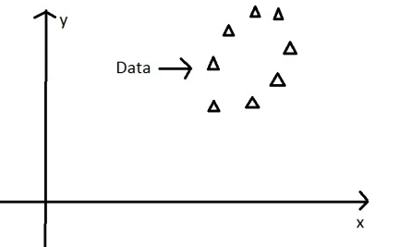
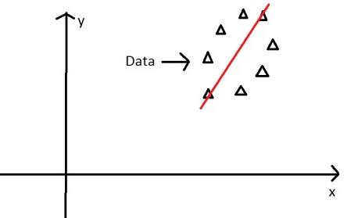
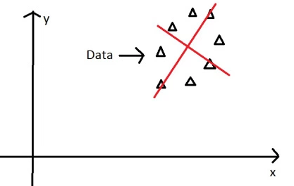
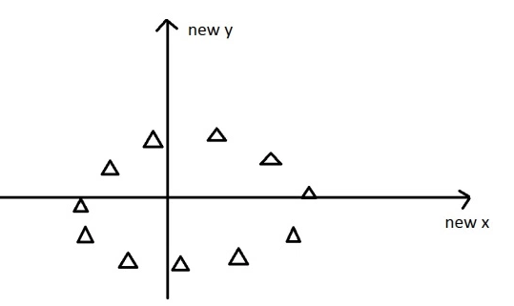
Principal Component Analysis – An Introduction
There is often a good reason why these axes represent the data better, but maths won’t tell you why, that’s for you to work out
Nothing has been done to data itself: The eigenvectors gets you from one set of axes to another

Slide 6
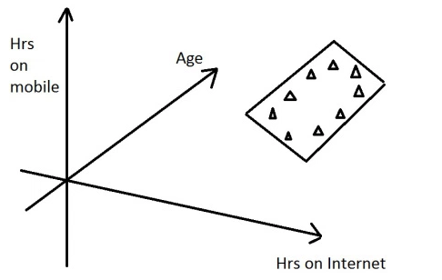
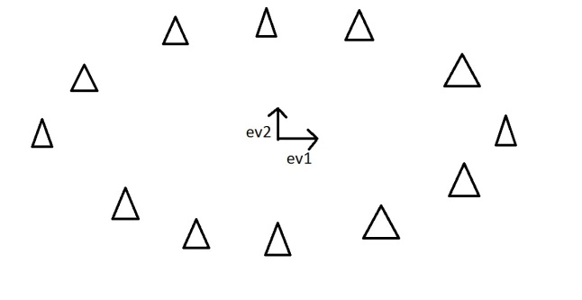
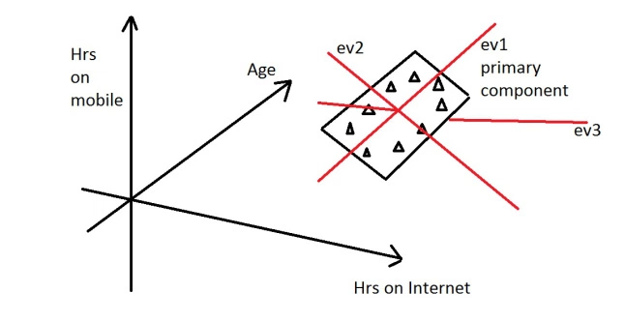
Dimension Reduction using PCA
It reduces the data down into it’s basic components, stripping away any unnecessary parts.

Slide 7
Dimension Reduction using PCA
This is dimension reduction. We have reduced the problem from a 3D to a 2D problem, getting rid of a dimension. Reducing dimensions helps to simplify the data and makes it easier to visualise.

Slide 8
Dimension Reduction – An Example
Let’s say in a survey we asked each person 50 questions. There are therefore 50 variables, making it a 50-dimension data set. There will then be 50 eigenvectors/values that will come out of that data set. Let’s say the eigenvalues of that data set were (in descending order): 50, 29, 17, 10, 2, 1, 1, 0.4, 0.2….. There are lots of eigenvalues, but there are only 4 which have big values – indicating along those four directions there is alot of information. These are then identified as the four principal components of the data set

