Slide 1
Kmeans and Naive Bayes

Slide 2
K-Means
Unsupervised learning → where we dont provide the algorithm WHAT is the RIGHT answer?
The goal is to segment or categorize data automatically
K-means make K groups of data points in d-dimensions
  Where d is the number of parameters

Slide 3
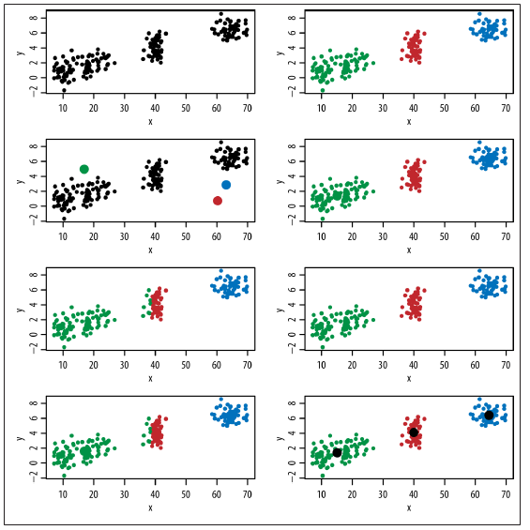
If data has many parameters it is not possible to identify groups like this

Slide 4
K-Means Algorithm
We may need to try different values for k before we arrive at a natural grouping
1. Initially, randomly pick k centroids (or points that will be the center of your clusters). Try to make them near the data but different from one another.
2. Then assign each data point to the closest centroid.
3. Move the centroids to the average location of the data points assigned to it.
4. Repeat the preceding two steps until the assignments don’t change, or change very little.

Slide 5
Issues with K-Means
Choosing k is more an art than a science
A single unique solution can fail to exist
Sometimes the classification makes no sense (This is the BIGGEST problem)

Slide 6

Naive Bayes
Let’s start with an even simpler example than the spam filter to get a
feel for how Naive Bayes works. Let’s say we’re testing for a rare disease,
where 1% of the population is infected. We have a highly sensitive and
specific test, which is not quite perfect:
• 99% of sick patients test positive.
• 99% of healthy patients test negative.
Given that a patient tests positive, what is the probability that the patient
is actually sick?
p(x) is implicitly computed and it is called NORMALIZATION FACTOR
Bayes Law
  p(y\x) p(x) = p (x,y) = p(x\y) p(y)
  p(y\x) = p(x\y) p(y) / p (x)

Slide 7

Spam Filter Using Naive Bayes
One word at a time
Each email can be represented by a binary vector
  Whose ith entry is either 0 or 1

Slide 8
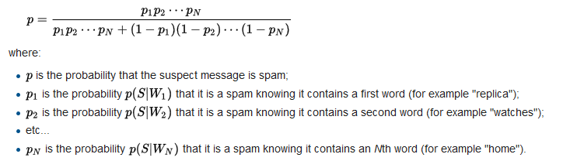
Spam Filter Using Naive Bayes

Slide 9
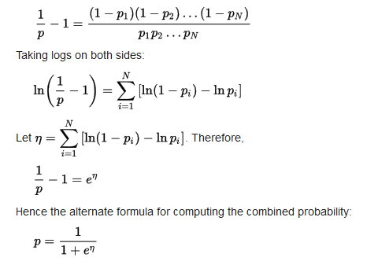
Spam Filter Using Naive Bayes

