Slide 1
Covariance and Correlations

Slide 2
Correlation
The term "correlation" refers to a mutual relationship or association between quantities.
In almost any business, it is useful to express one quantity in terms of its relationship with others. For example:
  sales might increase when the marketing department spends more on TV advertisements,
  a customer's average purchase amount on an e-commerce website might depend on customer’s income.

Slide 3
Correlation
Often, correlation is the first step to understanding these relationships and subsequently building better business and statistical models.
More formally, correlation is a statistical measure that describes the association between random variables.

Slide 4
Usefulness of Correlation
Correlation can help in predicting one quantity from another
Correlation can (but often does not) indicate the presence of a causal relationship
Correlation is used as a basic quantity and foundation for many other modeling techniques

Slide 5
Covariance
Covariance is a statistical measure of association between two variables X and Y.
Covariance and correlation describe how two variables are related.
  Variables are positively related if they move in the same direction.
  Variables are inversely related if they move in opposite directions.
Correlation also tells you the degree to which the variables tend to move together.

Slide 6
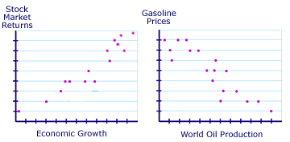
Covariance

Slide 7
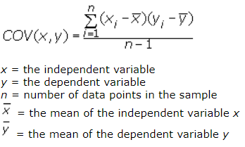
Covariance

Slide 8
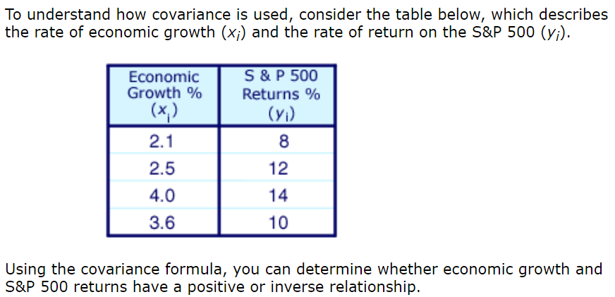
Covariance
Cov(x,y) = 1.53
means x and y are positively related

Slide 9
Correlation
In addition to telling you whether variables are positively or inversely related, correlation also tells you the degree to which the variables tend to move together.
The correlation measurement, called a correlation coefficient, will always take on a value between 1 and -1
  If the correlation coefficient is 1, the variables have a perfect positive correlation. This means that if one variable moves a given amount, the second moves proportionally in the same direction. A positive correlation coefficient less than one indicates a less than perfect positive correlation, with the strength of the correlation growing as the number approaches one.

Slide 10
Correlation
  If correlation coefficient is zero, no relationship exists between the variables. If one variable moves, you can make no predictions about the movement of the other variable; they are uncorrelated.
  If correlation coefficient is -1, the variables are perfectly negatively correlated (or inversely correlated) and move in opposition to each other. If one variable increases, the other variable decreases proportionally. A negative correlation coefficient greater than –1 indicates a less than perfect negative correlation, with the strength of the correlation growing as the number approaches –1.

Slide 11
Pearson Correlation Coefficient
Pearson is the most widely used correlation coefficient.
Pearson correlation measures the linear association between continuous variables.
In other words, this coefficient quantifies the degree to which a relationship between two variables can be described by a line
Remarkably, while correlation can have many interpretations, the same formula developed by Karl Pearson over 120 years ago is still the most widely used today.

Slide 12
Pearson Correlation Coefficient
Pearson correlation relies on means and standard deviations,
  it is only defined for distributions where those statistics are finite,
  It makes the coefficient sensitive to outliers.

Slide 13
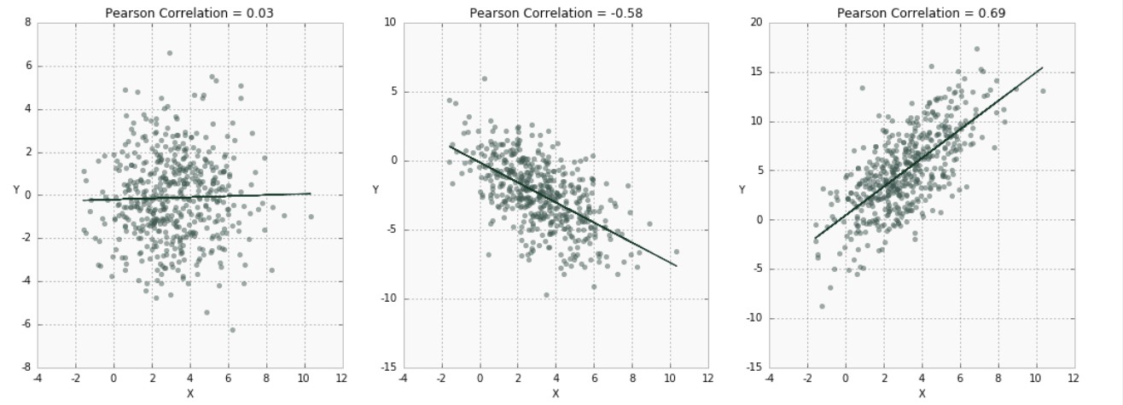
Pearson Correlation Coefficient

Slide 14
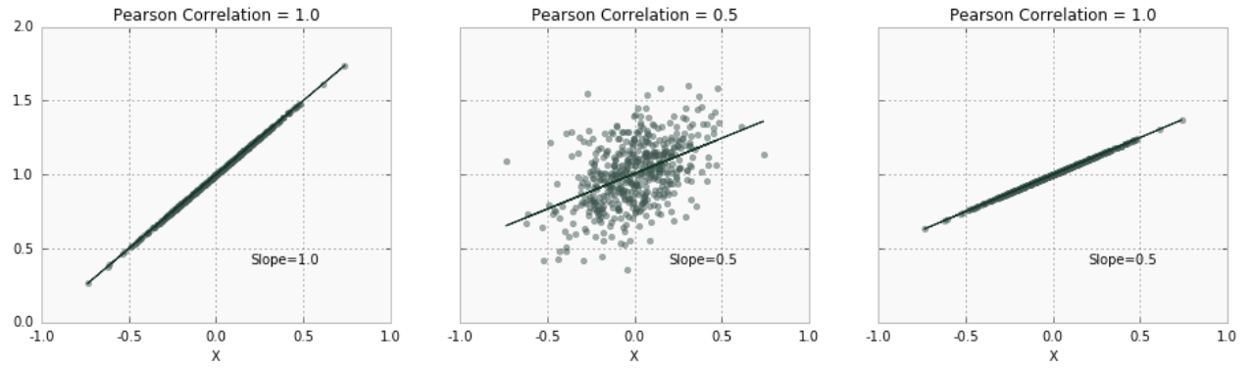
Pearson Correlation Coefficient
There is a clear connection between Pearson correlation and the slope of a regression line.
  corr(x,y) = m * (s_{x}/s_{y})
  In other words, correlation reflects the association and amount of variability between the two variables.
it is possible to have a very small magnitude of slope but large correlations between variables

Slide 15
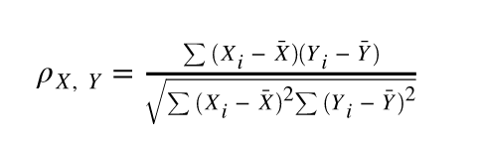
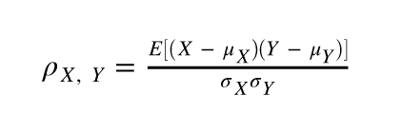
Pearson Correlation Coefficient

Slide 16
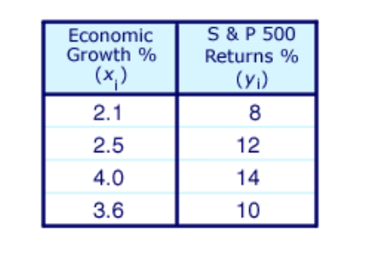
Pearson Correlation Coefficient
r(x,y) = 0.66
- Because the correlation coefficient is a positive
number, returns on the S&P 500 and economic
growth are postively related.
- Because .66 is relatively far from indicating
no correlation, the strength of the correlation
between returns on the S&P 500
and economic growth is strong.

Slide 17
Coefficient of Determination (R²)
It is another way to interpret Pearson correlation
While ρ is unitless, its square is interpreted at the proportion of variance of Y explained by X.
In the above example, ρ = 0.66 implies that (0.66)²*100 = 42% of variation in Y can be explained by X.

Slide 18
Spearman's Correlation
Spearman's rank correlation coefficient can be defined as a special case of Pearson ρ applied to ranked (sorted) variables.
Unlike Pearson, Spearman's correlation is not restricted to linear relationships.
it measures monotonic association (only strictly increasing or decreasing, but not mixed) between two variables and relies on the rank order of values.

Slide 19
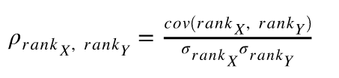
Spearman's Correlation
Spearman's coefficient looks at the relative order of values for each variable.
It is appropriate for both discrete and continuous values

Slide 20
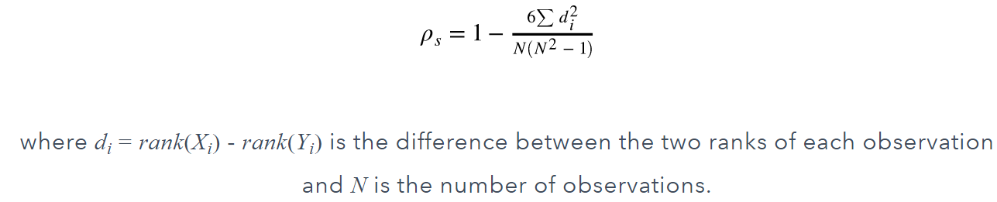
Spearman's Correlation
If all ranks are unique (i.e. there are no ties in ranks), a simplified version can be used.

Slide 21
Spearman's Correlation – Example
To calculate a Spearman rank-order correlation on data without any ties we will use the following data:
Exam | Marks
English | 56 | 75 | 45 | 71 | 62 | 64 | 58 | 80 | 76 | 61
Maths | 66 | 70 | 40 | 60 | 65 | 56 | 59 | 77 | 67 | 63

Slide 22
Spearman's Correlation – Example
English (mark) | Maths (mark) | Rank (English) | Rank (maths) | d | d²
56 | 66 | 9 | 4 | 5 | 25
75 | 70 | 3 | 2 | 1 | 1
45 | 40 | 10 | 10 | 0 | 0
71 | 60 | 4 | 7 | 3 | 9
62 | 65 | 6 | 5 | 1 | 1
64 | 56 | 5 | 9 | 4 | 16
58 | 59 | 8 | 8 | 0 | 0
80 | 77 | 1 | 1 | 0 | 0
76 | 67 | 2 | 3 | 1 | 1
61 | 63 | 7 | 6 | 1 | 1

Slide 23

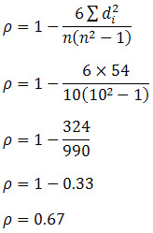
Spearman's Correlation – Example
We then substitute this into the main equation with the other information as follows:
Hence, we have a ρ (or r_{s}) of 0.67. This indicates a strong positive relationship between the ranks individuals obtained in the maths and English exam. That is, the higher you ranked in maths, the higher you ranked in English also, and vice versa.

Slide 24
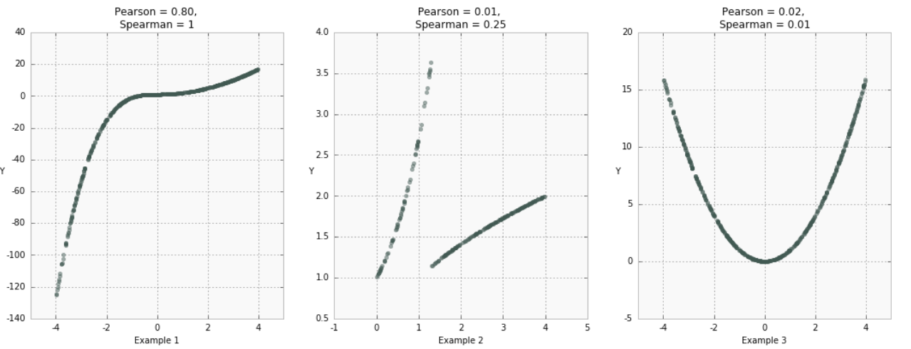
Pearson Coefficient vs Spearman Coefficient

Slide 25
Pearson Coefficient vs Spearman Coefficient
Weak or no correlation does not imply lack of association, as seen in Example 3,
and even a strong correlation coefficient might not fully capture the nature of the relationship.
It is always a good idea to use visualization techniques and multiple statistical data summaries to get a better pictures of how variables relate to each other.

Slide 26
Kendall's Tau
The third correlation coefficient we will discuss is also based on variable ranks.
However, unlike Spearman's coefficient, Kendalls' τ does not take into account the difference between ranks — only directional agreement.
  Therefore, this coefficient is more appropriate for discrete data.

Slide 27
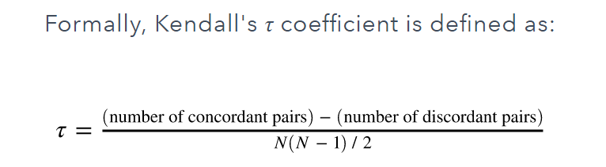
Kendall’s Tau

Slide 28
Kendall’s Tau Example
 | x | y
a | 1 | 7
b | 2 | 5
c | 3 | 1
d | 4 | 6
e | 5 | 9
Concordant Pairs:
(1,7) and (5,9)
(2,5) and (4,6)
(2,5) and (5,9)
(3,1) and (4,6)
(3,1) and (5,9)
(4,6) and (5,9)
and discordant pairs:
(1,7) and (2,5)
(1,7) and (3,1)
(1,7) and (4,6)
(2,5) and (3,1)
τ = (6-4) / 10 = 0.2

Slide 29
Correlation and Causation
Most of the data scientists when working with big data assume that correlation directly implies causation.
However, always using “cause and effect” analogy might render false predictions and unproductive decisions.
Correlation means X and Y tend to be observed at the same time whereas Causality means X causes Y.

Slide 30
Correlation and Causation
A lesson every data scientist must learn is that- “Correlation is not Causation in data science”. If two items appear to be related to each other, it does not mean that one causes the other.
Often, a relationship may appear to be causal through high correlation due to some unobserved variables. For example, the number of grocery stores in a city can be strongly correlated with the number of ice cream creameries. However, there is an obvious hidden variable here — the population size of the city
The example show how correlation is only one data summary statistic that by no means tells the complete story of relationships in the data.

Slide 31
Linear Regression
Most commonly used to express linear relationship between two variables
  Outcome variable (response variable, dependent variable, label)
  Predictor (Independent variable, explanatory variable, feature)
Can also be used when there is a linear relationship between one variable and several other variables

Slide 32
Good starting point for many problems (first assumption)

Slide 33
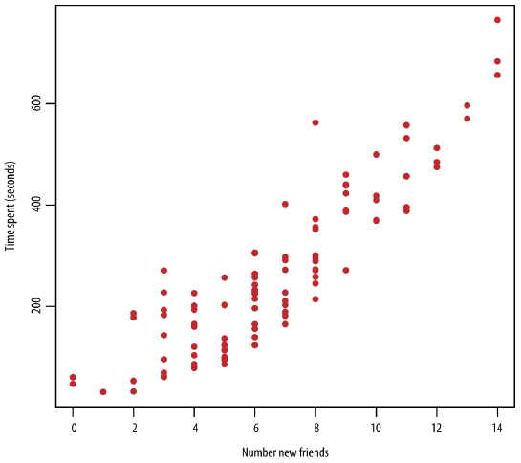
Writing Model
There is no deterministic relation here BUT
It is obvious there is some association between
the two variables.
There are two important things we
want to capture in a model:
TREND and VARIATION

Slide 34
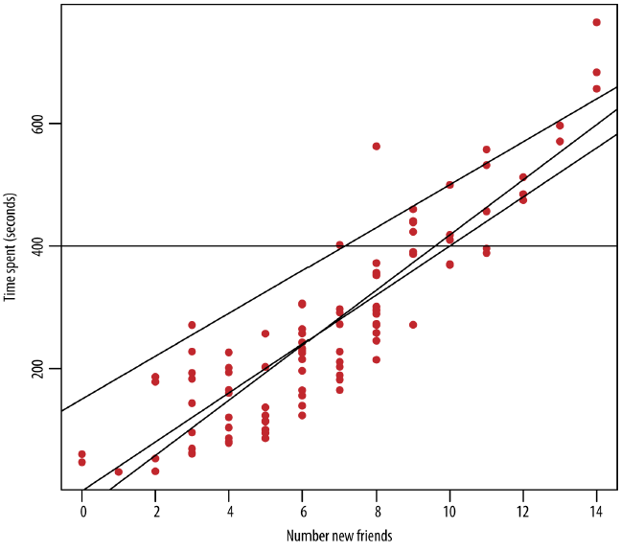
Writing Model
Which line is the BEST fit?
y = β₀ +β₁x
Now your job is to find
best values of
β₀ and β₁ -> MODEL FITTING

Slide 35
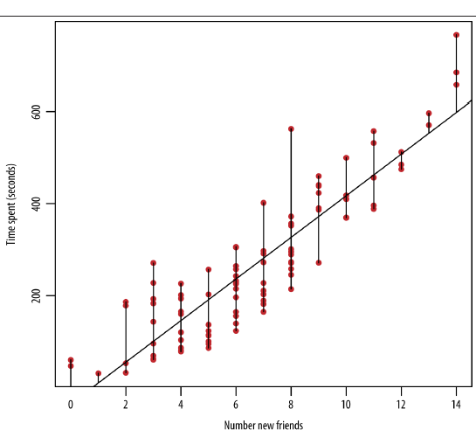
Fitting the Model
You have to find the optimal line.
  But what is the meaning of optimal?
LEAST SQUARE ESTIMATION:
Minimizes the sum of squares of differences
between approximated y’ and actual y

Slide 36
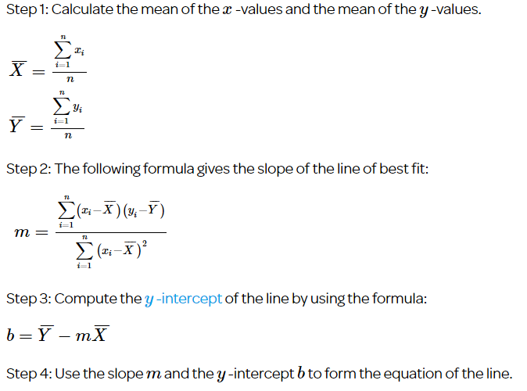

Slide 37
Extending beyond Least Squares
1. Adding in modeling assumptions about the errors
2. Adding in more predictors
3. Transforming the predictors

Slide 38
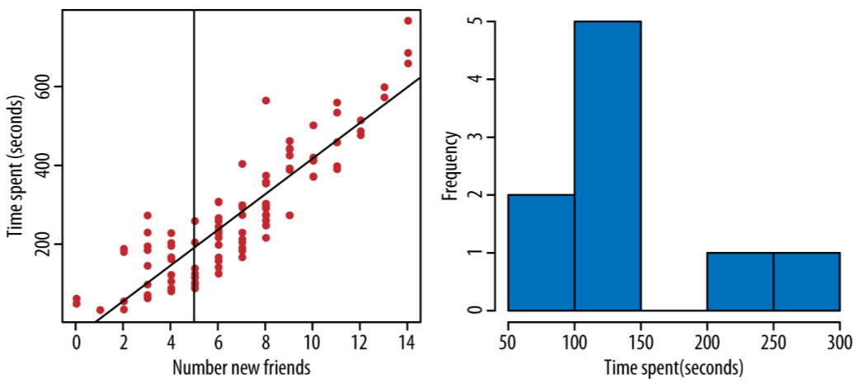
1. Error Consideration
For x=5, y=195.7
How confident you are about this result?
So far we have captured the trend
but not Variation
Extend your model to:
y=β₀+β₁x+ϵ
ϵ is called error term OR noise

Slide 39
Estimating ϵ
One common assumption is Noise is normally distributed ϵ∼N(0,σ²)
Thus, we can say the conditional distribution of y given x is
p(y/x) ∼N(β₀+β₁x,σ²)
How to find values of these parameters: β₀,β₁,σ² ?

Slide 40
Estimating ϵ
σ²=∑_{i} e_{i}² /(n−2)
Where e_{i} = y_{i}−y’_{i}

