Slide 1
Demographics Multipliers and Municipality Public Finance
Umer Farooq
Rutgers Center for Urban Policy Research
Dec 16, 2024

Slide 2

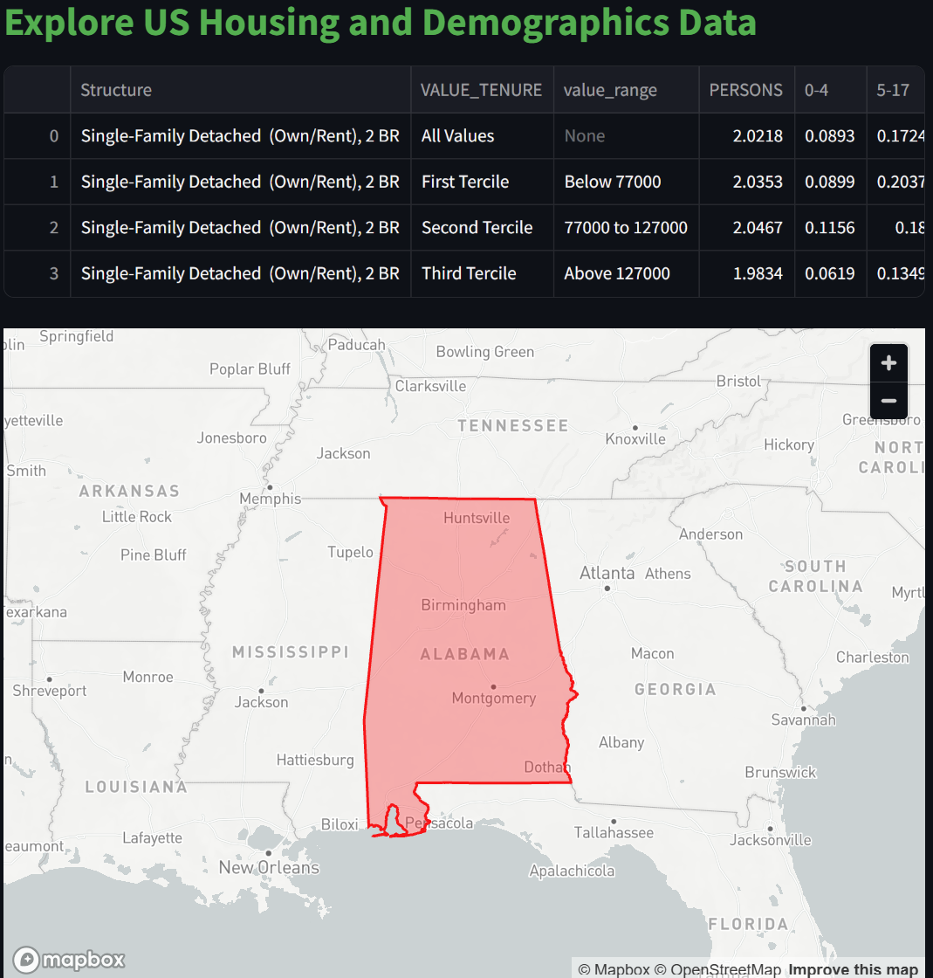
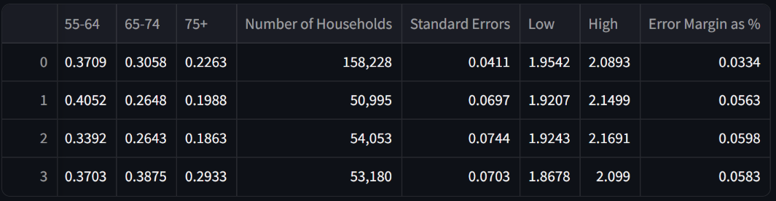
Interface

Slide 3
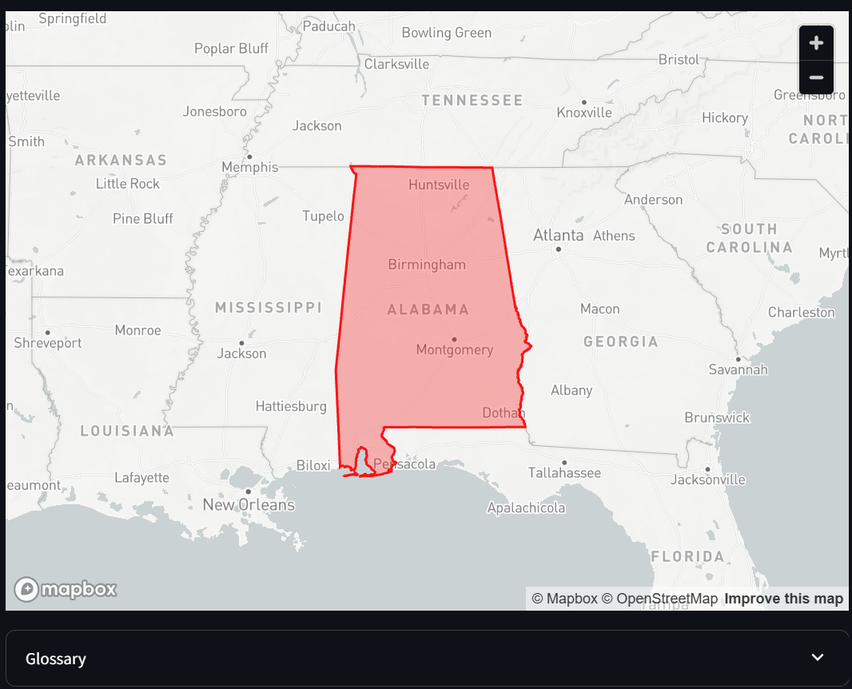
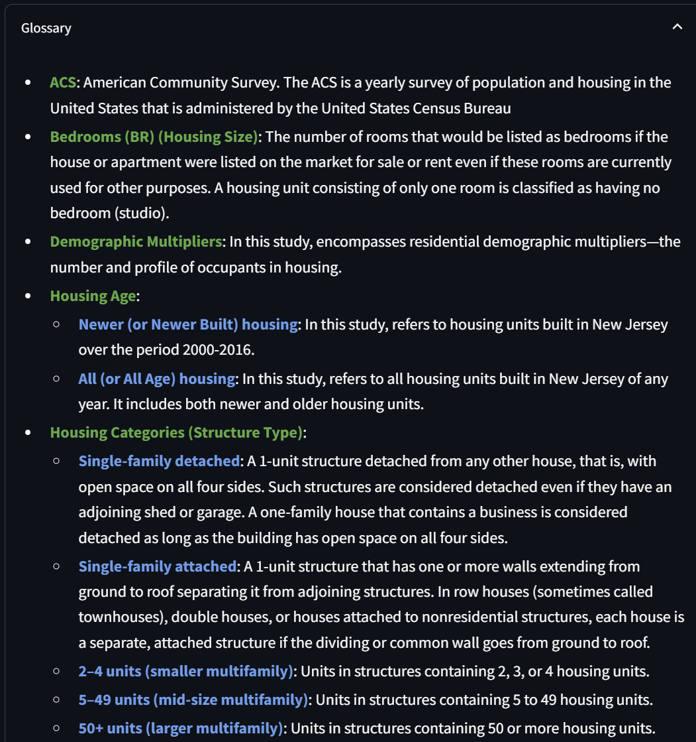
Interface
https://demographics-rutgers.streamlit.app/

Slide 4
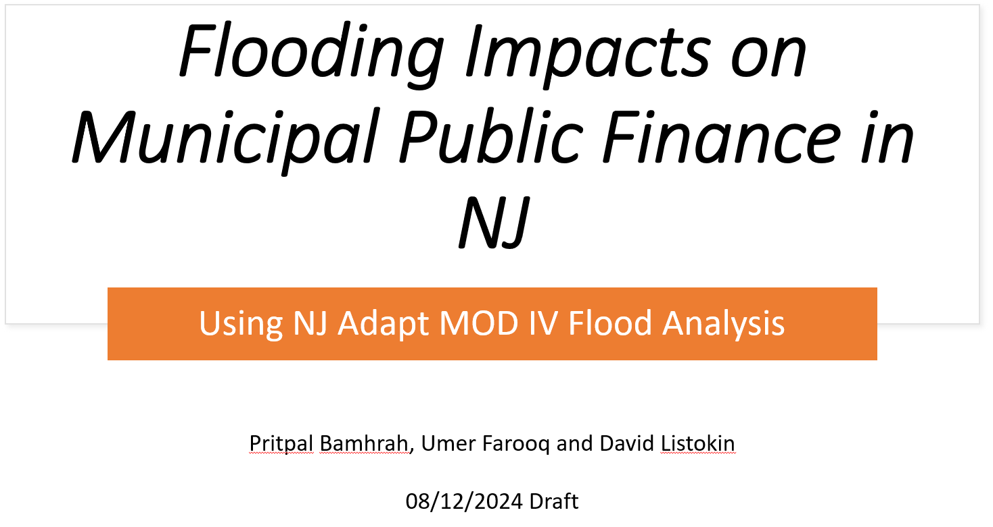
Flooding Impacts and ongoing research

Slide 5
Flooding Impacts and Ongoing Research
1. Environmental challenges + Buyouts – Map (
2. Env Challenge + Real Estate Activity – Map ()
3. Per capita impact on Market value and Property tax revenue - Bar graphs (same format as State and County Totals
4. Percentage property tax impact and Moody's Municipal Bond Ratings (table)

Slide 6
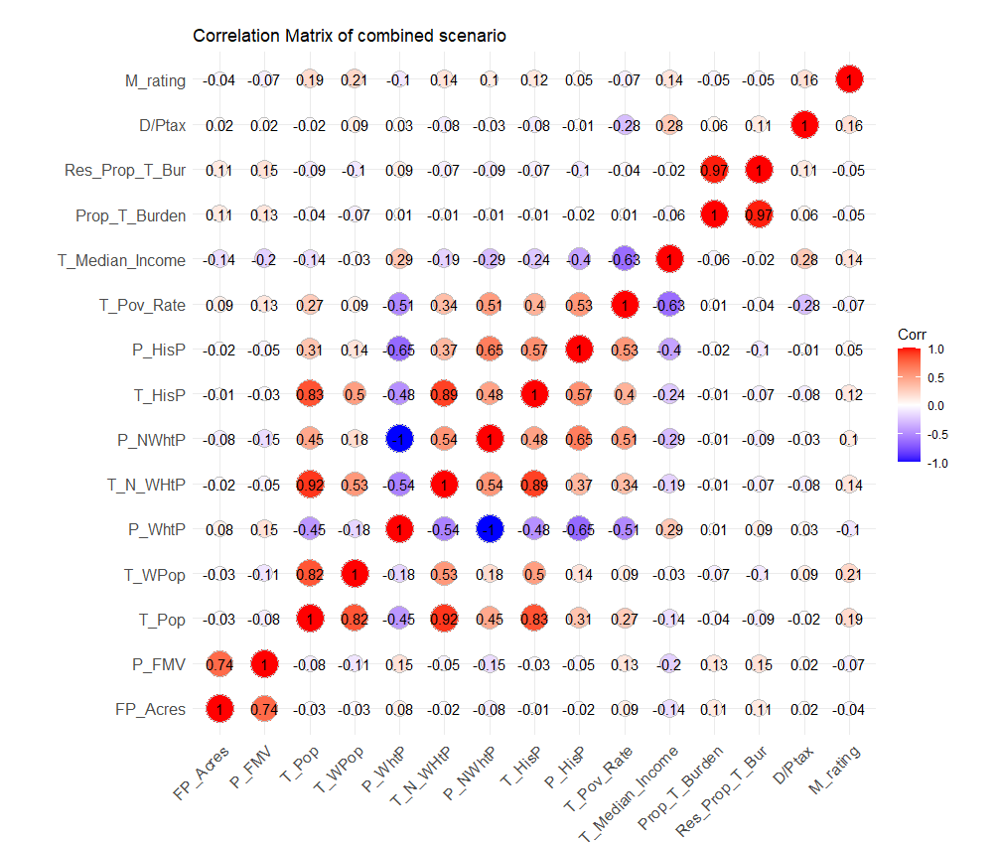
Flooding Impacts and Future Research
Total Valuation Loss
Fiscal Loss
3. Acreages Loss
4. GDP
5. Age, Health, Income
6. Property Type

