Slide 1
The Varying Data Frequency and Short Run Inflationary Impact of Oil Price Shocks in US Inflation Forecasts
Farooq, Umer and MPI
Date: 09-Oct-2024

Slide 2
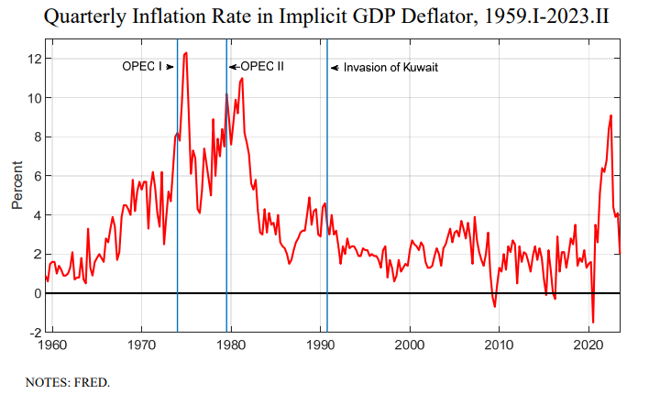
Introduction
Inflation forecasting is critical for economic policymaking and business planning. However, there is extreme volatility in data.
This paper examines the short-run effects of oil price shocks on US inflation forecasts using ARIMA and VAR models during volatile supply shocks.
A brief history of Oil Shocks

Slide 3

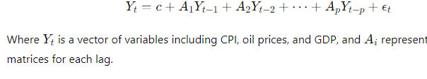
Data and Models
Data:
Key Data: CPI, Oil Prices, GDP, Inflation Expectations
CPI: Monthly, from Bureau of Labor Statistics (BLS)
Oil Prices: Daily, aggregated to monthly from Energy Information Administration (EIA)
GDP: Quarterly, interpolated to monthly from World Bank & FRED
Inflation Expectations: FED
Models:
ARIMA and VAR Models
ARIMA Equation:
VAR Equation:

Slide 4
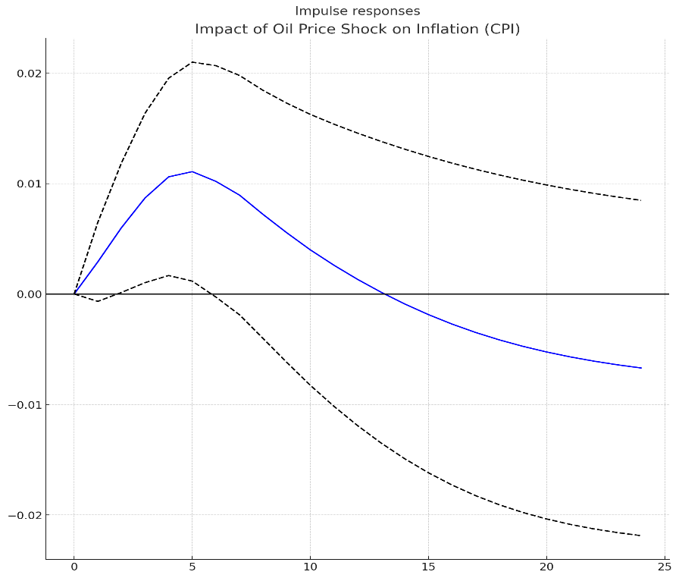
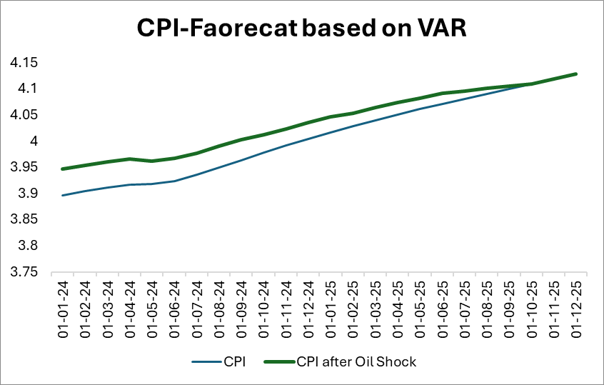
Results
ARIMA Model Results: Good performance under stable conditions but struggled with oil price shocks.
VAR Model Results: More accurate in capturing the dynamic relationship between oil prices, GDP, and inflation.
Impulse Response Functions (IRFs) show how oil price shocks lead to short-term inflation spikes, which dissipate over 12 months.
Variable | Coefficient | t-value | p-value
Constant | c | 1.35 | 0.022
Oil Prices (lag 1) | A1 | 0.52 | 0.004
Oil Prices (lag 2) | A2 | 0.33 | 0.016
GDP (lag 1) | A3 | 0.27 | 0.021
GDP (lag 2) | A4 | 0.12 | 0.033
R-squared | 0.93

Slide 5
Conclusion and Future Research
1. VAR model outperformed ARIMA in forecasting inflation during periods of oil price volatility.
2. Nowcasting uses real-time data to predict current economic activity and inflation trends
3.This includes real-time trading information, interest rates, and bond yields along with high-frequency commodity prices, oil, metals, and agricultural prices data on a daily or weekly basis.
4. Future Research: Explore hybrid models combining ARIMA, VAR, and Machine Learning techniques for more responsive inflation forecasts.

