Slide 1
Communication Skills
the ability to convey or share ideas and feelings effectively.

Slide 2
Group Members
Hamza Sadiq (BCSF15M008)
Umer Farooq (BCSF15M025)
Maryam Liaqat (BCSF15M032)
Hira Tahir (BCSF15M041)
Sikandar Nadeem (BCSF15M043)
Maida Tayyab (BCSF15M051)

Slide 3
Why Communication Skills?
Being able to communicate effectively is the most important of all life skills.Communication is simply the act of transferring information from one place to another and express emotions.
An essential life skill. The importance of having good communication skills cannot be stressed enough. It is the key to a person's happiness and success both as a child and ultimately as an adult. The ability to communicate well is not only an essential life skill, but arguably the most importantone.

Slide 4
Why Communication Skills?
Workplace communication is very important to companies because it allows companies to be productive and operate effectively. Employees can experience an increase in morale, productivity and commitment if they are able to communicate up and down the communication chain in an organization.
Communication in a relationship is extremely important because it acts as the judge, jury and executioner who has the final say on whether any relationship lives or dies. Being able to communicate effectively can also stop needless arguments which occur regularly in your relationships.

Slide 5
Goals of Communication Skills
To get and give information
To persuade
To ensure understanding
To get action
To change behavior

Slide 6
Ways of Communications
Verbal Communication is the use of sounds and words to express yourself, especially in contrast to using gestures or mannerisms (non-verbal communication). An example of verbal communication is saying “No” when someone asks you to do something you don't want to do.
Written communication involves any type of message that makes use of the written word. Written communication is the most important and the most effective of any mode of business communication. Some of the various forms of written communications that are used internally for business operations include: ... Instant messages.

Slide 7
Ways of Communication
Nonverbal communication includes gestures, facial expressions, and body positions (known collectively as “body language”), as well as unspoken understandings and presuppositions, and cultural and environmental conditions that may affect any encounter between people.

Slide 8
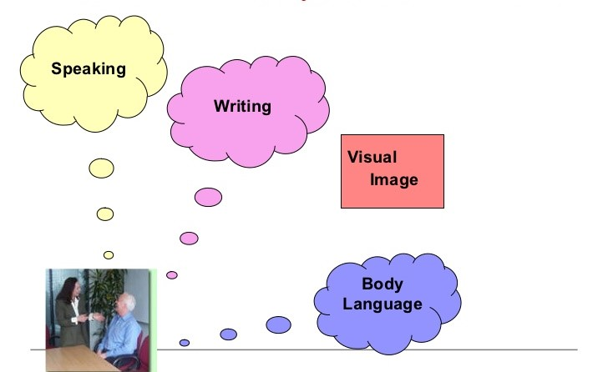
Most Common Ways of Communication

Slide 9
Communication Barriers
Semantic
Emotional and psychological
Organizational
Superior

Slide 10
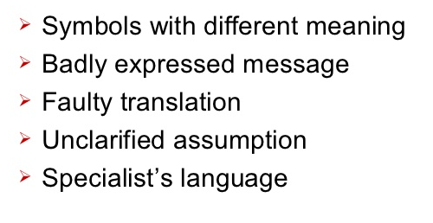
Communication Barriers
Semantical barriers

Slide 11
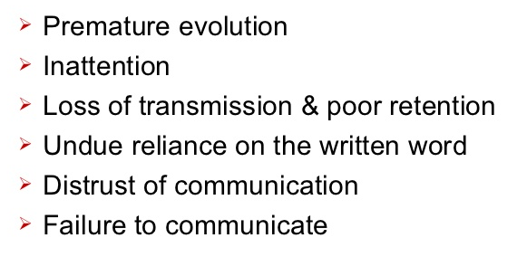
Communication Barriers
Emotional or Psychological

Slide 12
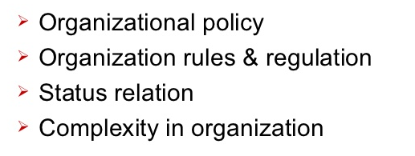
Communication Barriers
Organizational

Slide 13
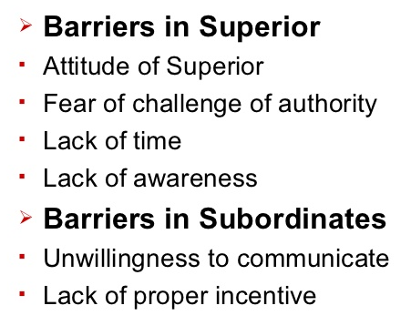
Communication Barriers
Personal Barriers

Slide 14
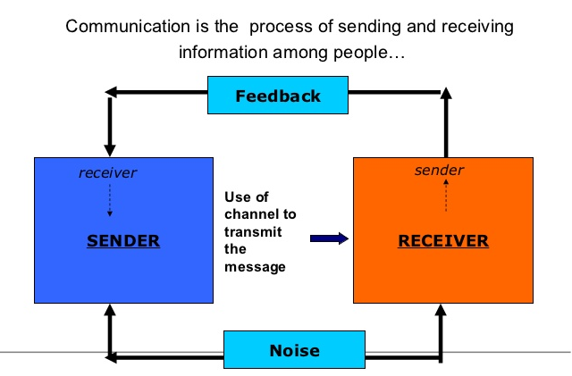
Communication Process

Slide 15
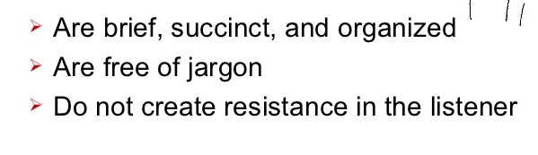
Sending Message
Effective verbal message

Slide 16
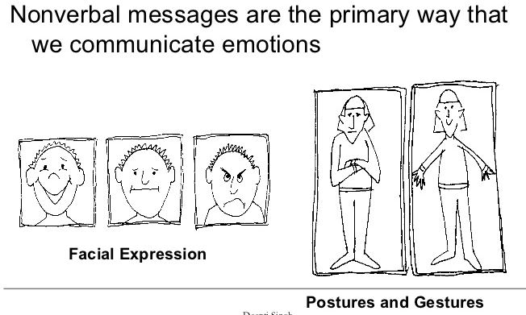
Nonverbal Message

Slide 17
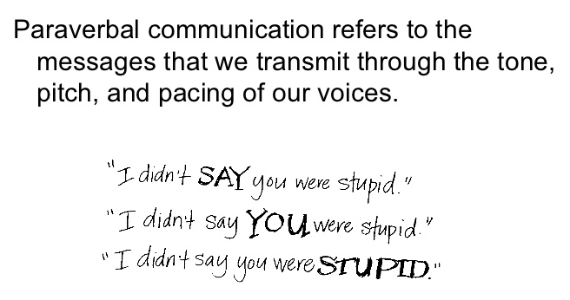
Paraverbal Messages

Slide 18
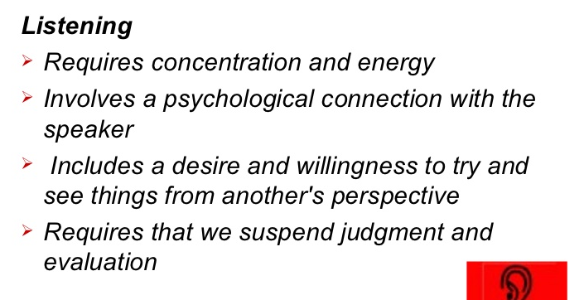
Receiving Message

Slide 19
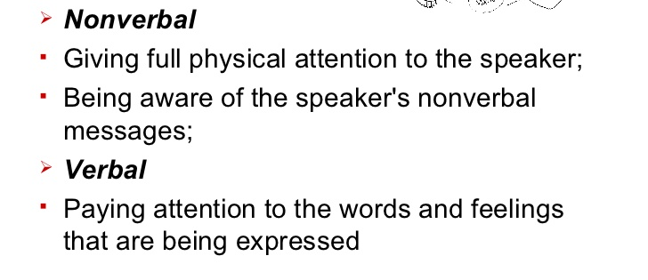
Key Listening Skills

Slide 20
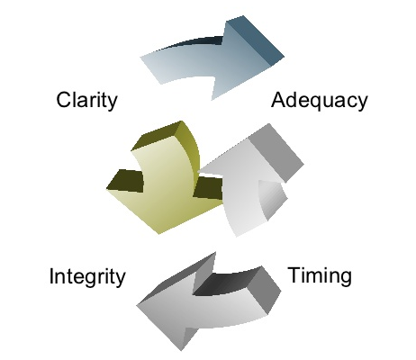
Good Communication

Slide 21
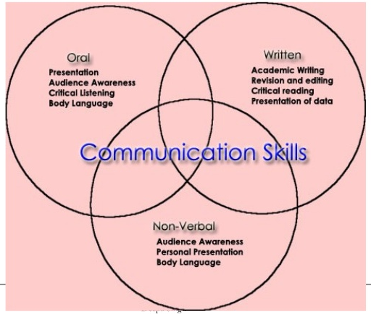
How to improve communication skills

Slide 22
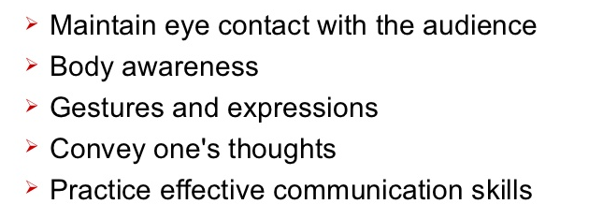
How to improve communication skills
Tips for effective communication

Slide 23
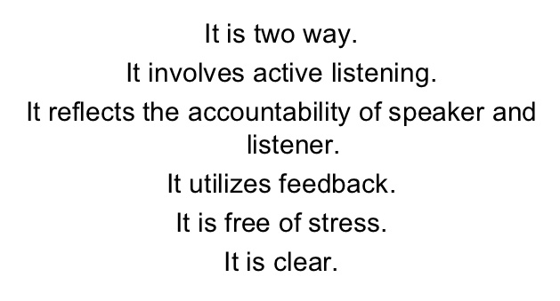
Effective communication

