Slide 1
TestFlow
Assignment 2: SaaS Landing Page and Prototype
Test management for QA teams: write tests, run them and track bugs in one place.
Presented by Umer Hassan
October 2026
Notes:
Introduce yourself: "I am Umer Hassan, and this is TestFlow." TestFlow is a SaaS tool that helps QA teams manage test cases, record test runs and report bugs in one place. I will show the product concept, the landing page and a working prototype, the technologies used and the business model.

Slide 2
Agenda
01
Problem and product concept
04
Prototype and live demo
02
Target users and key features
05
Design decisions and technologies
03
Landing page
06
Business model and roadmap
Notes:
Here is the flow of today's presentation: the problem and product concept, target users and features, a live demo of the landing page and prototype, then design decisions, technologies, the business model and the roadmap.

Slide 3
The problem
Scattered tools
No clear status
Slow reporting
Test cases live in spreadsheets, results in chats and bugs in emails.
Managers can't see what passed, what failed or whether a release is ready.
Testers spend hours copying steps into bug reports and status updates.
Small and mid-sized software teams need one simple, affordable place to manage testing.
Notes:
Explain the pain from a tester's point of view. Test cases are in Excel, results are shared on WhatsApp or Slack, and bugs are reported by email. It is hard to know the real status of a release, and testers waste time on manual reporting.

Slide 4
The solution: TestFlow
A cloud-based SaaS tool that follows the way QA teams already work, from writing a test case to closing a bug.
1
2
3
4
Write
Run
Report
Track
Test cases with steps and expected results
Mark each case passed, failed or blocked
Turn a failed case into a bug in one click
See pass rate, open bugs and release status
Notes:
TestFlow brings the whole testing cycle into one tool: write test cases, run them, report bugs from failures, and track release health on the dashboard. This flow is based on my experience as a QA automation engineer.

Slide 5
Target users
User | What they need | Plan
QA engineers and testers | Write and run test cases, report bugs quickly | Pro
QA leads and managers | See pass rates and decide if a release is ready | Pro / Team
Software houses and startups | One affordable tool for the whole team | Team
Students and freelance testers | Practice and manage small projects for free | Free
Notes:
Main users: QA engineers, QA leads, and software houses or startups in Pakistan and abroad. Students and freelancers can start on the Free plan, which also helps grow the user base.

Slide 6
Key features
Test case management
Test runs
Bug reporting
Steps, expected results, modules and priority
Pass, fail or block each case with live progress
Bugs created from failed cases, with severity and status
Dashboard
Reports and export
Plans and billing
Pass rate, open bugs and recent runs at a glance
Release status per project and CSV export
Free, Pro and Team plans with plan limits
Notes:
Go through the six core features. All six are implemented in the prototype, so I will show them live in the demo.

Slide 7
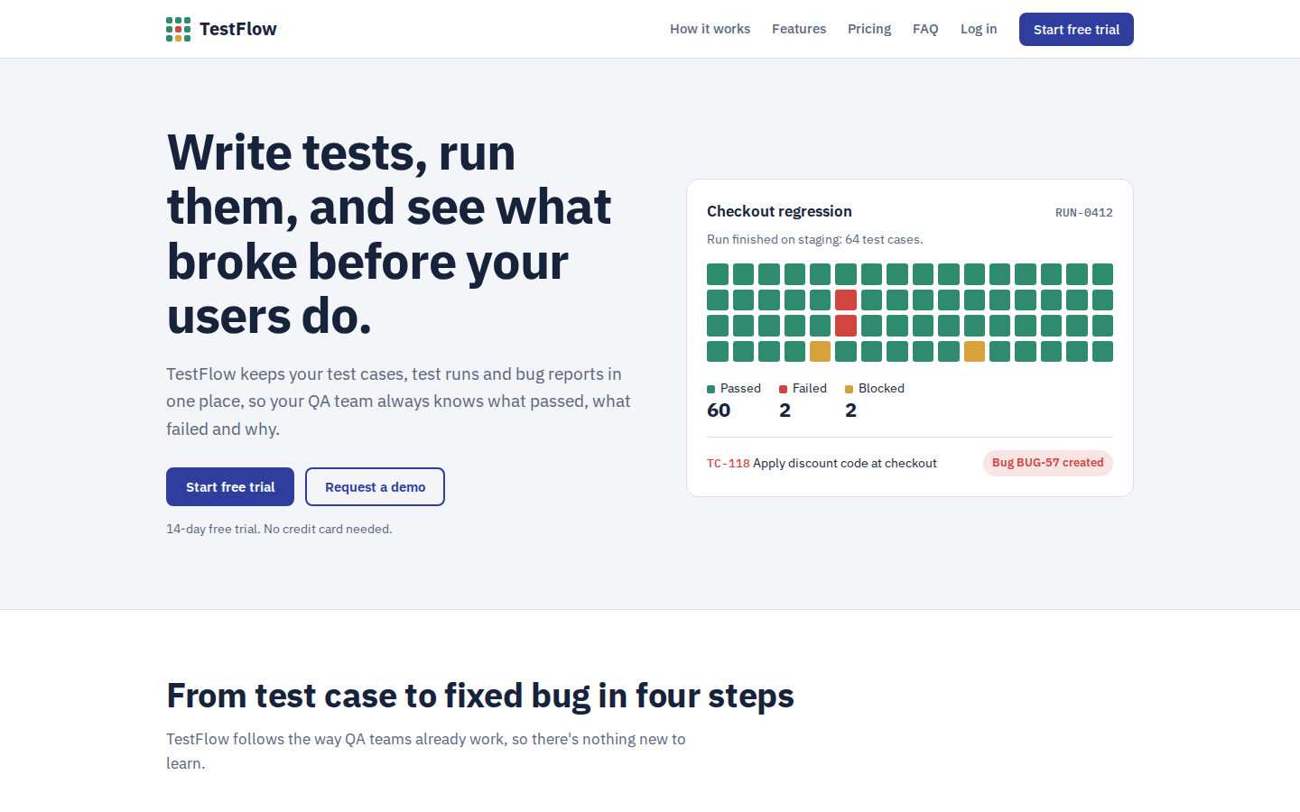
Landing page
Hero with a live test-run animation
Four-step workflow and six features
Pricing with monthly and yearly toggle
Start free trial, Sign up, Request a demo
Demo form with validation and FAQ
Responsive, with light and dark mode
Notes:
Open index.html live. Show the hero animation, scroll through how it works, features and pricing. Toggle monthly and yearly pricing, open Request a demo and show the form validation. Shrink the browser to show it is responsive.

Slide 8
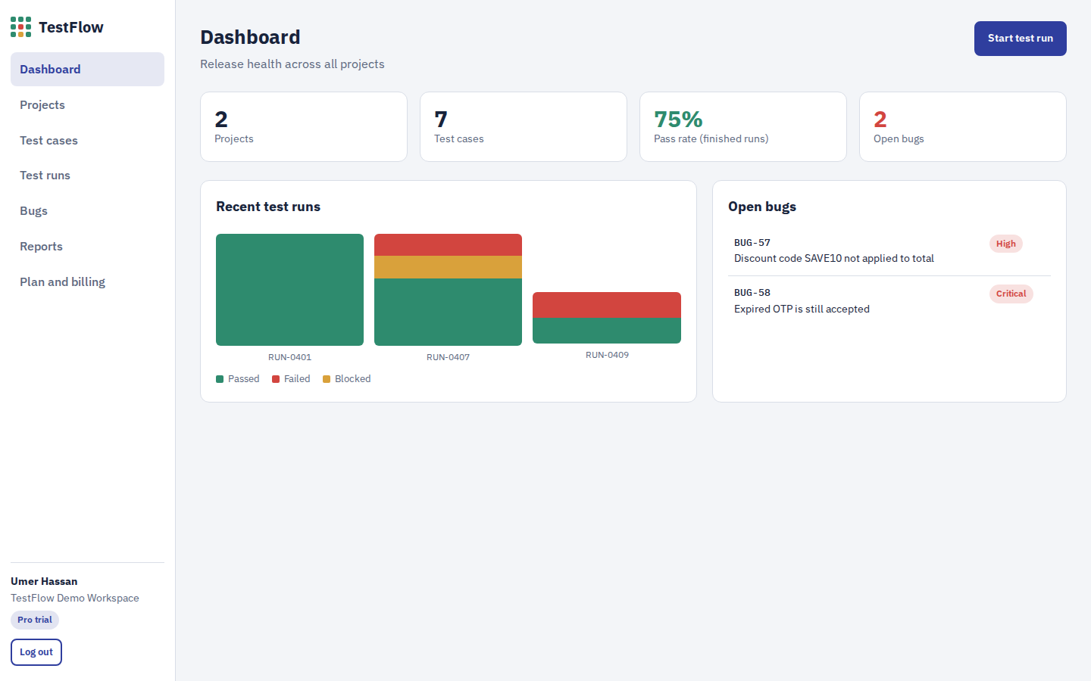
Prototype
Sign up, log in and demo account
Dashboard with live stats and chart
Projects and test cases (add, edit, delete)
Test runs and bug reports
Reports and plan switching
Notes:
Open app.html and click Use demo account (Umer Hassan). Show the dashboard: projects, test cases, pass rate, open bugs and the recent runs chart.

Slide 9
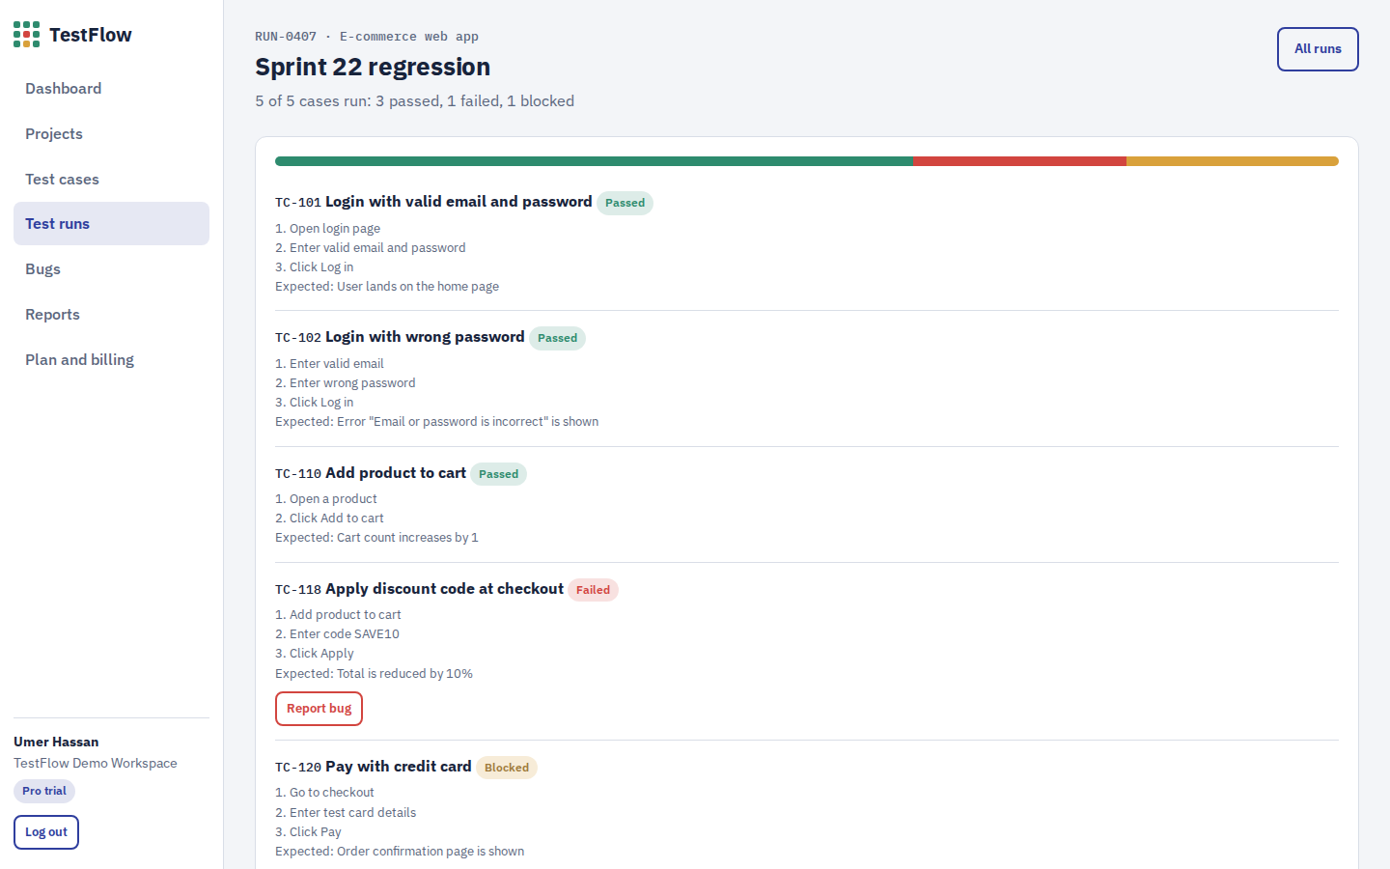
Core workflow demo
1
Add a new test case
2
Start a test run
3
Mark cases pass, fail or blocked
4
Report a bug from a failed case
5
Finish the run and check reports
Notes:
Live demo: add a test case, then start a test run and mark results. Fail one case and click Report bug: the steps are filled in automatically. Finish the run, change a bug status, and show Reports with release status and CSV export. Finally, Plan and billing: on the Free plan, limits apply.

Slide 10
Design decisions
Colors with meaning
Familiar workflow
Plain language
Green for passed, red for failed, amber for blocked, used the same way everywhere
Screens follow the real QA cycle: write, run, report, track
Buttons say exactly what they do, and errors explain how to fix them
Responsive and accessible
Built-in validation
No-setup prototype
Mobile and desktop, dark mode, keyboard focus and good contrast
Required fields, email format and plan limits are checked
Runs in any browser and saves data locally for the demo
Notes:
Explain the main design choices: consistent status colors, navigation that follows the QA workflow, simple action-based text, a responsive and accessible interface, validated forms, and a prototype that needs no installation, which makes the live demo reliable.

Slide 11
Technologies used
Layer | Prototype | Proposed production
Frontend | HTML5, CSS3, JavaScript | React + Tailwind CSS
Backend | Simulated in the browser | Node.js + Express REST API
Data | Browser localStorage | PostgreSQL, one workspace per company
Auth and payments | Mock login and plan switch | JWT authentication, Stripe subscriptions
Hosting | Static files | AWS or Vercel with a CI/CD pipeline
Notes:
The prototype uses plain HTML, CSS and JavaScript so it runs in any browser, with data in localStorage. In production: React frontend, Node.js API, PostgreSQL with a separate workspace per company (multi-tenant SaaS), Stripe for subscriptions, and cloud hosting.

Slide 12
Business model: freemium subscription
Free
Pro
Team
$0
$15 / user / month
$39 / user / month
1 project, 2 users, 100 test cases
Unlimited projects, reports, export, automation import
Integrations, roles and priority support
14-day Pro trial and 20% off yearly plans. Revenue grows with team size because pricing is per user.
Notes:
Users start free or with a 14-day Pro trial, then upgrade. Pricing is per user per month, with 20% off for yearly billing. Revenue comes from Pro and Team subscriptions; the Free plan attracts students and small teams.

Slide 13
Future enhancements
CI/CD integration
AI test case suggestions
Import Selenium, Playwright and Cypress results automatically
Generate test cases from requirements or user stories
Jira and Slack
Mobile app
Sync bugs to Jira and send run results to Slack
Record test results on the go
Notes:
Roadmap: automation and CI/CD integration, AI-generated test cases, Jira and Slack integration, and a mobile app.

Slide 14
Thank you
TestFlow
Questions and feedback are welcome.
Designed and developed by Umer Hassan
Notes:
Thank the audience and invite questions. Be ready to explain the design choices: status colors, simple navigation, and why the prototype uses localStorage.

