Slide 1

SOEN 6441 : Advance Programming Practices (Winter-2016)
Tower Defense Game Supervisor: Dr. Joey Paquet
Submitted by: TEAM-2
Alaa Sabah - 27835647 Lokesh Parappurath - 27299680 Iftikhar Ahmad - 26854605 Muhammad Umer - 40015021

Slide 2
INTRODUCTION
The basic idea of Tower Defense Game is to destroy moving critters in a specific path using some towers. The game consist of a map which has a start point and end point and also has a path connecting both. There is a map editor to create new maps or edit existing maps. The game starts by selecting the map and user can place towers anywhere on the scenery.
The game is developed as a desktop application using the MVC architecture implemented using Observer pattern design. The game has 2 views:
MapEditor: For creating and editing maps for the game.
GameWindow: For playing the game.
The business logic of the game is handled by the model classes.

Slide 3
Functional Requirements
The functional requirements for 1st deliverable includes:
User driven interactive creation of a map as a grid of user-defined dimension.
User-driven allocation of grid elements such as scenery, path, entry point and exit point.
Saving a map to a file.
Loading a map from an existing file, then editing the map.
Verification of map correctness before saving.
Game starts by selecting a saved map, then loads the map
User-driven placing of towers on the map, following the game’s restrictions
Implementation of currency and cost to buy or sell a tower
Implementation of towers’ level-dependent characteristics such as level, cost to increase level, refund rate, range, power, rate of fire, special effects, etc.
Tower inspection window that shows its current characteristics.
Tower inspection window allows to sell the tower.
Tower inspection window allows to increase the level of a tower, changing its characteristics.

Slide 4
Architectural Design
The project is developed using the MVC architecture and is implemented using the object pattern design. This model has been selected because of its decoupling advantage and its allows development of the business logic and the view separately and independently. Further, it provides flexibility in feature addition and maintenance.
The project is developed such that it has a view which extends the observable class and has a model which implements the observer class.
The view registers itself with the model so that any changes is the model which changes the state of the model gets notified to the view which is then updated accordingly.
The user interactions with the view are transferred to a separate controller class which handles all the user events and accordingly update the model objects.

Slide 5
The view is the face of the application that interacts with the user. The view is updated by the model by triggering an event every time its state gets updated. The view invokes methods in the controller class for handling user interactions. The view reads data from the model classes using direct invocation.
invocation
events
User
Controller
View implements Observer
Model extends
Observable

Slide 6
The controller is invoked by the event handlers in the view which handles the user`s input. It is responsible for the implementing the application behavior towards user interactions. It updates the model classes based on the user interactions.
The model classes implement the business logic and handles the data associated with the application. It is an extension of the observable class. The view or the controller classes updates the model depending on the user interaction with the user provided input. If it is a valid change and the state of the model is updated, the model sets its state and update all observers of the model. Thus, the registered view gets the update trigger event and the view is updated accordingly.

Slide 7
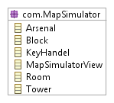
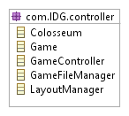
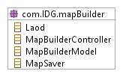

Subsystems Design
These are the packages in the system and their related classes

Slide 8
UML Class diagram for MVC Architecture
package: com.IDG.mapSimulator

Slide 9
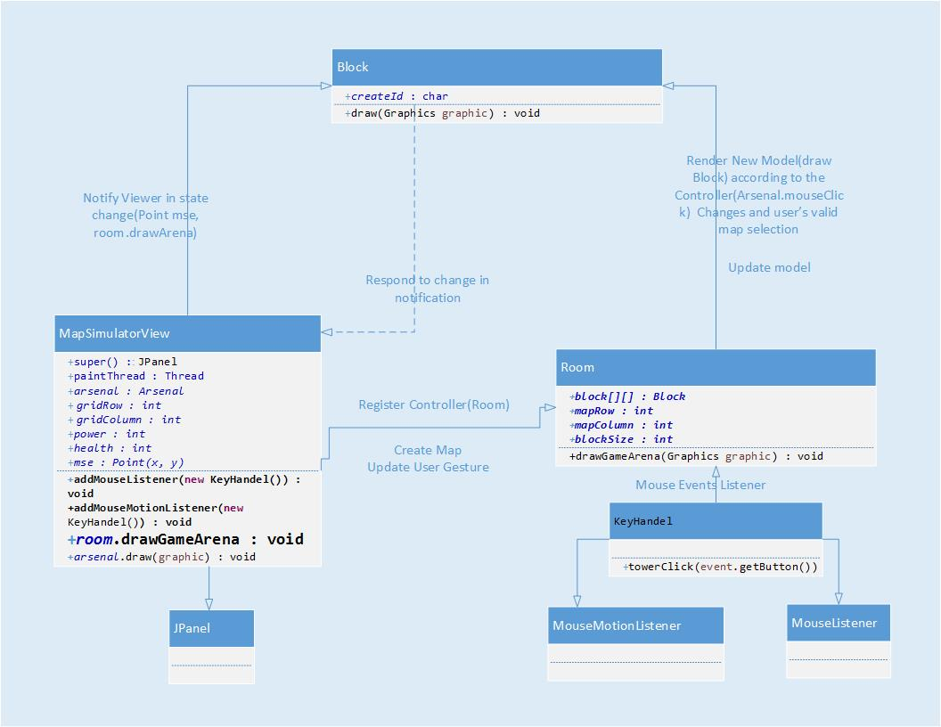
UML Class diagram for MVC Architecture

Slide 10
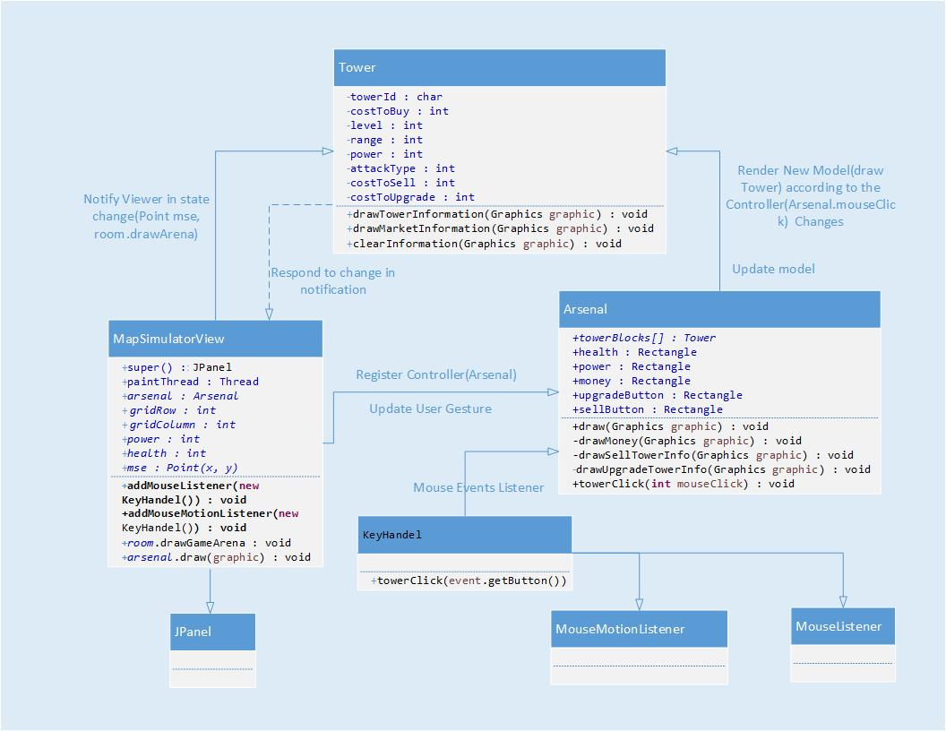
UML Class diagram for MVC Architecture

Slide 11
Testing
Unit testing applied to our system is the JUnit Framework for the Java Programming Language. Since its time consuming to test all the methods in the system as the large number of methods in our system is large, only selected sets of methods were tested and the method chosen test the most important aspects of the code.

Slide 12
Agile Methodology
Agile methodologies embrace iterations.
Small teams work together with stakeholders
Proof of concepts, or the problem to be solved.
The team defines the requirements for the iteration, develops the code, and runs integrated test scripts.
The users verify the results.
Two agile software development methodologies
1) XP
Extreme programming concentrates on the development rather than managerial aspects of software project
It start with a release planning phase, followed by several iterations.
When the product has enough features to satisfy users, the team terminates iteration
and releases the software.
2) Scrum development
The Scrum development process concentrates on managing sprints. Before each sprint begins, the team plans the sprint, identifying the backlog items and assigning teams to these items. Teams develop, wrap, review, and adjust each of the backlog items

