Slide 1
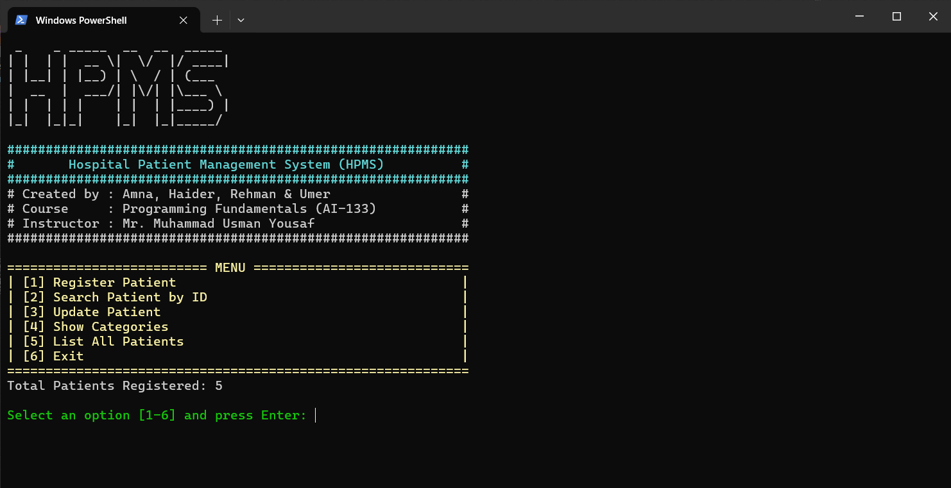
Hospital Patient Management System
Programming Fundamentals – AI-133 Group Members: Amna, Haider, Rehman, Umer Instructor: Mr. Muhammad Usman Yousaf Semester: Spring 2025

Slide 2
What is the HPMS?
A simple C++ console application for managing hospital patients.
Allows registering, searching, updating, and categorizing patients.
Designed with beginner-level programming concepts.
Uses arrays, functions, loops, and validation techniques.

Slide 3
Project Approach
Implemented using C++ with a Console-based Interface
Modular structure: each function handles one module
Used arrays for storing patient data temporarily in memory
Functions used for input validation, search, update, and display
Designed with user-friendly output using colors and formatting

Slide 4
Who Did What?
Name | Contribution
Amna | Responsible for patient registration functionality.
Haider | Worked on searching patients by ID functionality.
Rehman | Handled updating patient records.
Umer | Created the categories display based on symptoms.
👥 Teamwork makes the dream work! 🤝

Slide 5
User Interface – The Main Menu
Designed a colorful and intuitive menu using SetConsoleTextAttribute().
Displayed ASCII title banner for better CLI branding.
Showed real-time total patients and all options.
🎨 CLI can be colorful too! 🌈🖥️

Slide 6
User Interaction Overview
Inputs:
Basic Info (Name, Age, Gender, Contact, Symptom)
Patient ID (for search/update)
Symptom (for diagnosis)
Outputs:
Profile, Diagnosis, Status Messages
Menu:
Register, Search, Update, Diagnose, List All

Slide 7
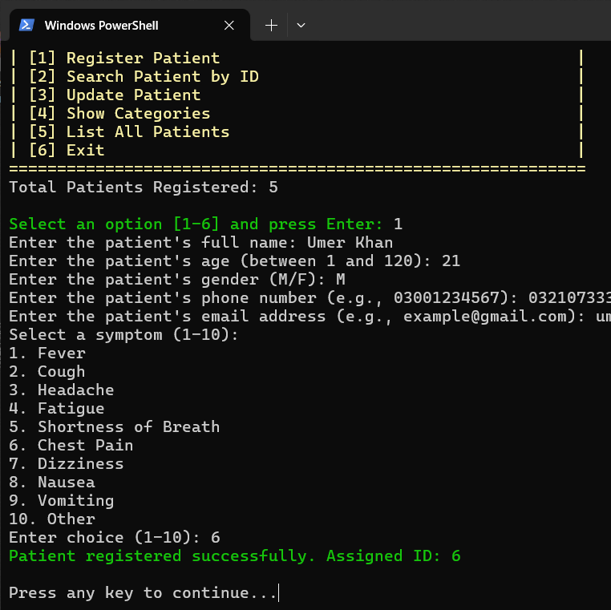
Module 1 – Registering a New Patient
Inputs first name, last name, age, gender, phone, email, and symptom.
Validates age (1–120) and gender (M/F).
Automatically assigns a unique ID.

Slide 8
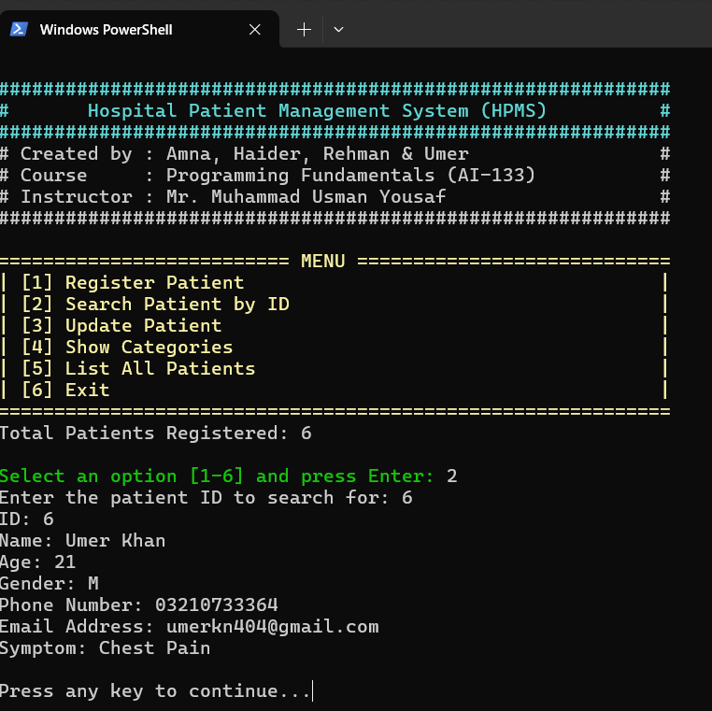
Module 2 – Searching for Patients
Linear search on patient ID array.
Displays full patient profile if found.
Shows “not found” error with red text if ID doesn't exist.

Slide 9
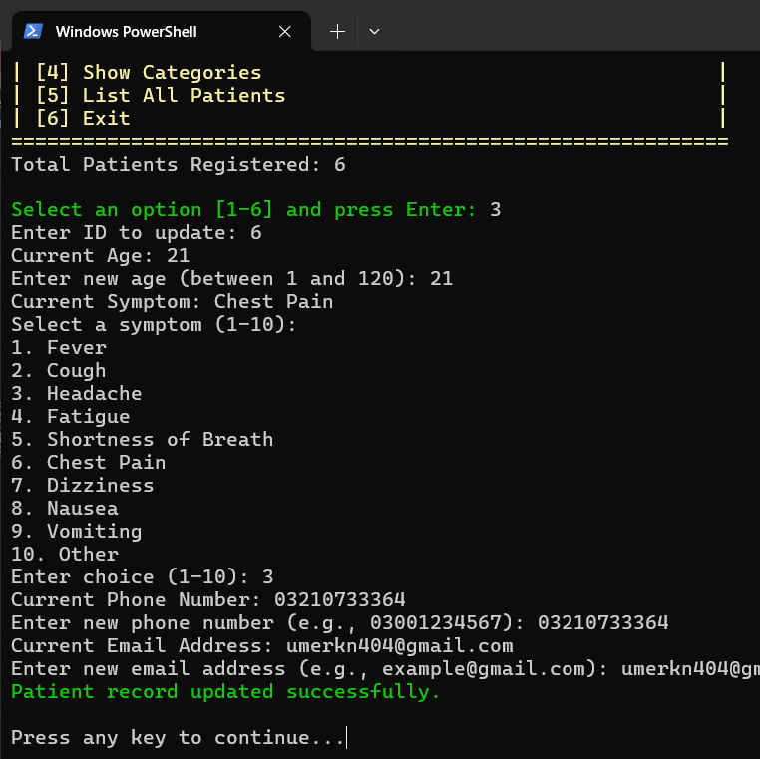
Module 3 – Updating Patient Info
Searches by ID.
Allows modifying age, symptom, phone, and email.
Reflects changes immediately in memory.

Slide 10
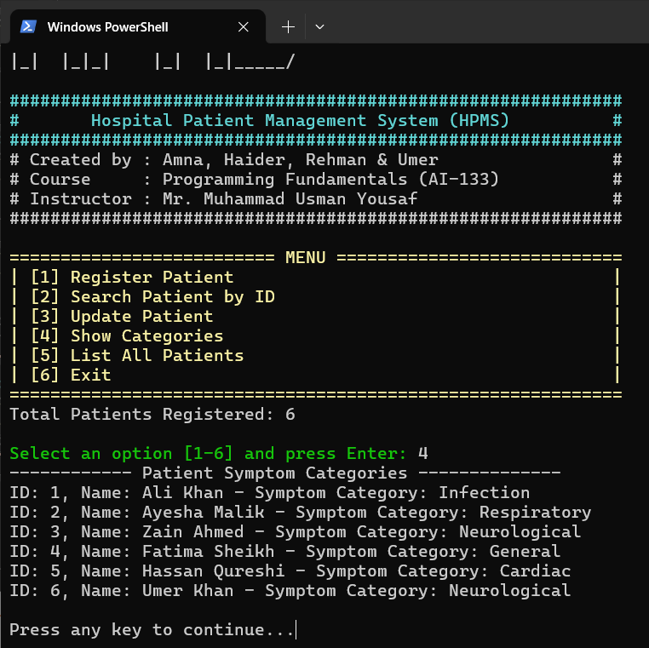
Module 4 – Diagnosing by Symptom
Algorithm Logic: Symptom-Based Categorization
Categories based on symptom input:
Fever → Infection
Cough, Shortness of Breath → Respiratory
Headache → Neurological
Fatigue → General
🔍 Categorization logic uses simple if-else statements.

Slide 11
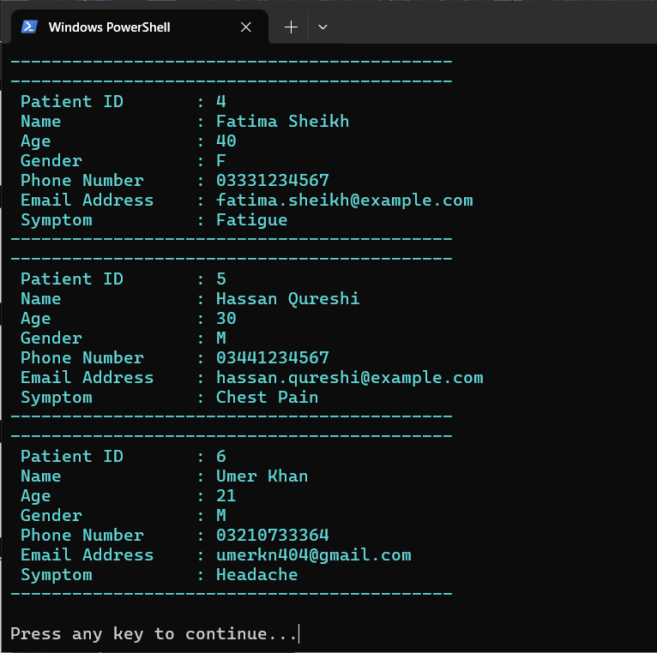
Module 5 – Admin View: List All
Displays all patient records in a formatted block.
Includes ID, full name, age, contact info, and symptom.
Uses color to enhance readability.

Slide 12
Code Structure & Design
Used arrays for simple data storage.
Employed functions for modularity and clarity.
Used validation for input accuracy.
Color-coded feedback to improve UX.
📈 Future Improvement Ideas:
Replace arrays with structs or classes.
Add file I/O for persistent data.
GUI version using frameworks like Qt or C#.

Slide 13
System Flow & UI Sketch
Start
Main Menu
Register | Search | Update | Diagnose | List
Output

Slide 14
Conclusion & Future Work
Function-based design improves maintainability.
Input validation is crucial for real-world applications.
Console-based UIs can be made friendly with small touches.
Collaborating and debugging as a team built strong skills.
We plan to enhance the system using structs, file storage, and a GUI in future versions.
👥 Soft Skills: Teamwork, problem-solving, and time management.

Slide 15
Thank You for Listening!
We’re grateful for the opportunity to learn through this project.
Special thanks to Sir Usman for guidance and support.
Open to questions!
🙏 Thanks for your time, we’re all ears for your feedback! 🗣️🎤

