Slide 1
Agenda
Introduction.
Knowledge discovery and data mining.
Visualisations.
Technologies used in project.
Demonstration.
Umer Iqbal

Slide 2
Introduction to Project
The aim of this project is to predict prices of London and Dublin houses.
Is prices of houses is rising at sharper rate in Dublin and London cities?
What would be the price of house if we have 4 bedrooms and 2000 square feet area.
In our analysis, property prices of London and Dublin datasets have been taken from Kaggle and property price register.
Data mining techniques helped to predict prices of houses of London and Dublin and came up with decision for buying property in Dublin and London. Datasets has been prepared and analyze through R programming language in RStudio
Umer Iqbal

Slide 3
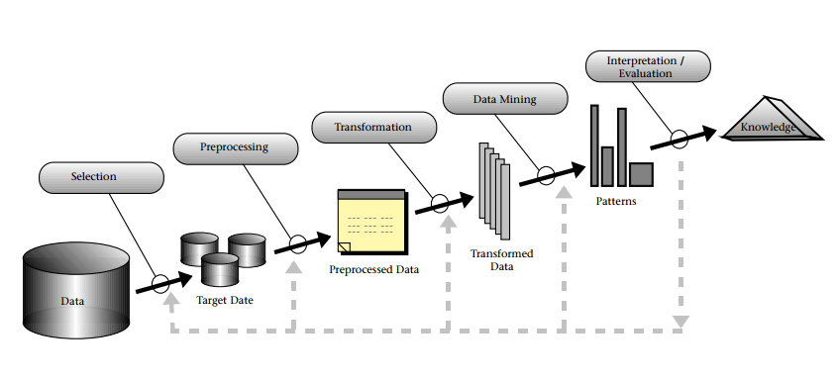
Knowledge discovery and data mining.
Umer Iqbal

Slide 4
Visualisations
Bar Graph
Line Graph
Scatter plot
Ggplot2
Heatmap graph
Surface graph
Umer Iqbal

Slide 5
Demonstration
Umer Iqbal

Slide 6

Thank You For Listening
Do you have any questions?
Umer Iqbal

