Slide 1
Car race in Minecraft
Group E
Mark O’Kelly x17742461
Muhammad Abu Bakar Sani x17112044
Umer Iqbal x17111854
Jason Smith x17702485
Aviendha O’Brion x17500536

Slide 2
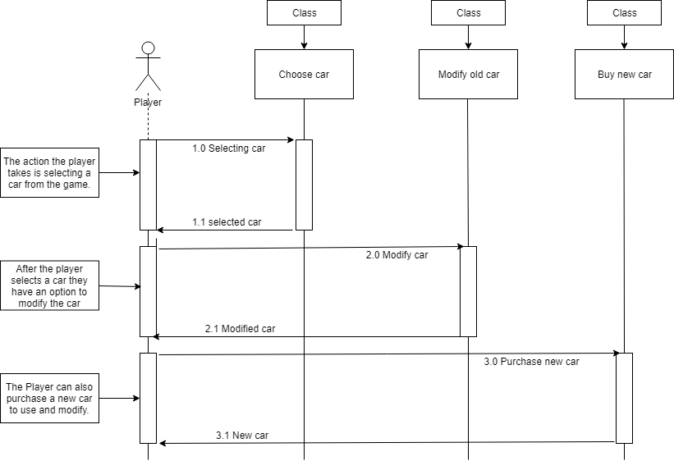
Choose Car
Mark O’Kelly

Slide 3
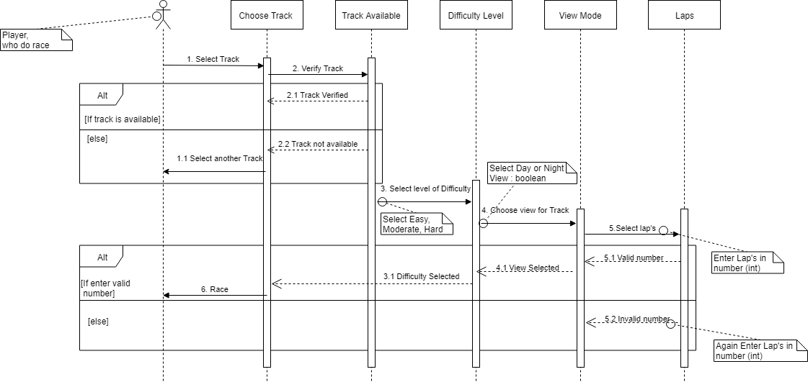
Choose Track
Muhammad Abu Bakar Sani

Slide 4
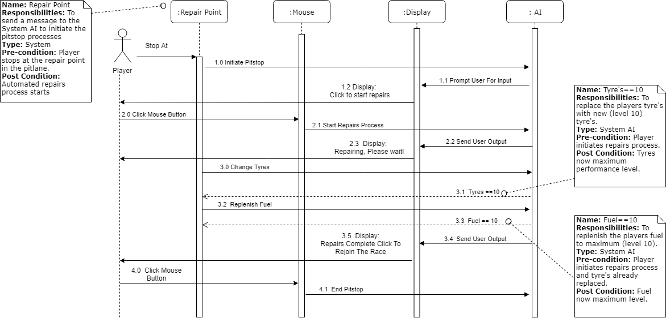
Pit Stop
Jason Smith

Slide 5
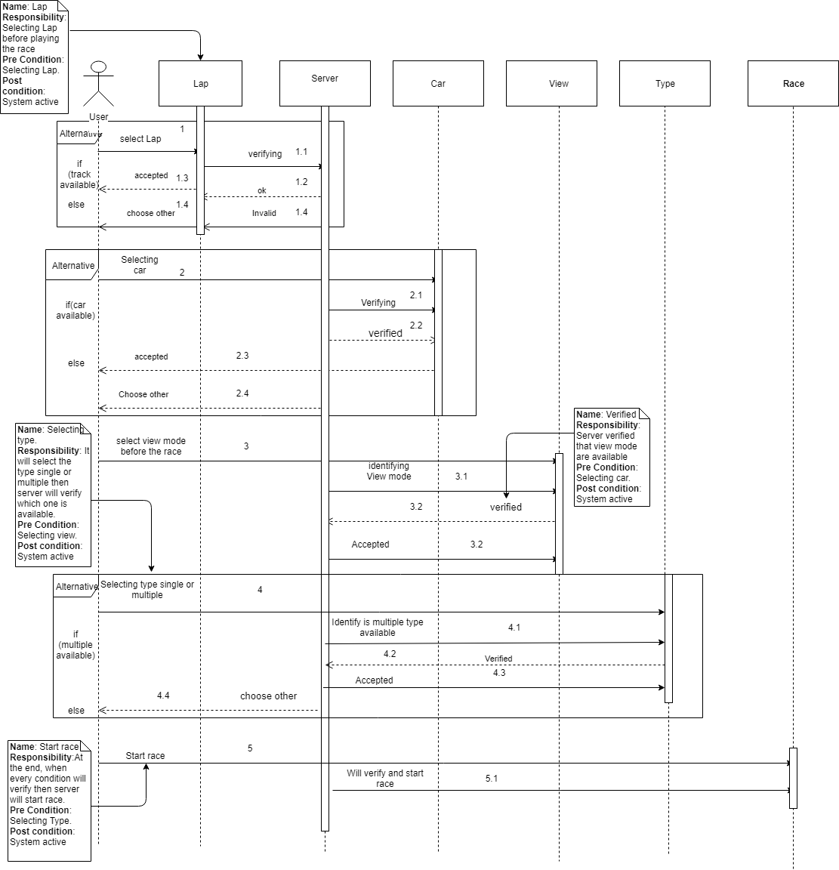
Race
Umer Iqbal

Slide 6

Any Questions?

