Slide 1
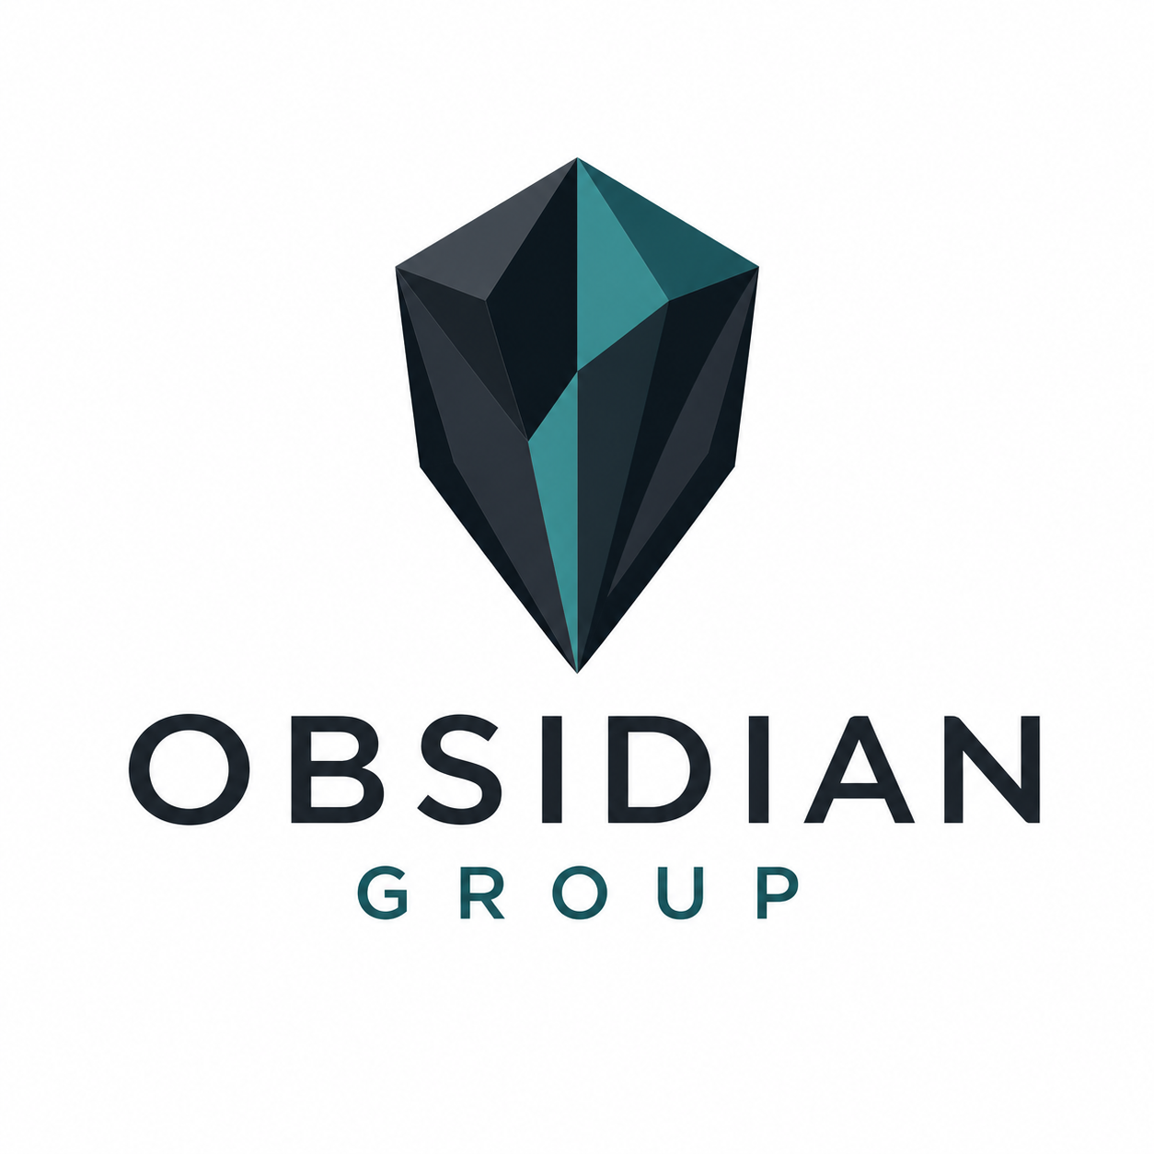
OBSIDIAN GROUP
BRAND CARD · V1
Visual identity
Logo, colour palette, and typography reference for Obsidian Group communications.
LOGO
COLOUR PALETTE
PRIMARY
SECONDARY
ACCENT
Obsidian
Slate
Teal
#0D171E
#2C343C
#3A8C91
RGB 13 / 23 / 30
RGB 44 / 52 / 60
RGB 58 / 140 / 145
Stone
Hairline
Fog
White
#6B7280
#D9DEE3
#EEF1F3
#FFFFFF
USAGE Obsidian dominates (60–70% of the visual area). Slate carries body content. Teal is reserved for emphasis, links, and a single accent per page.
Primary mark
Crystal mark + wordmark, stacked.
TYPOGRAPHY
Aa
Aptos Display
Headings · 36–44 pt bold
Aa
Aptos
Body · 11–14 pt regular
Sampled from the Obsidian Group identity assets · 17 April 2026

