Slide 1

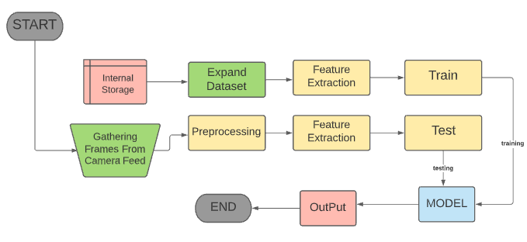
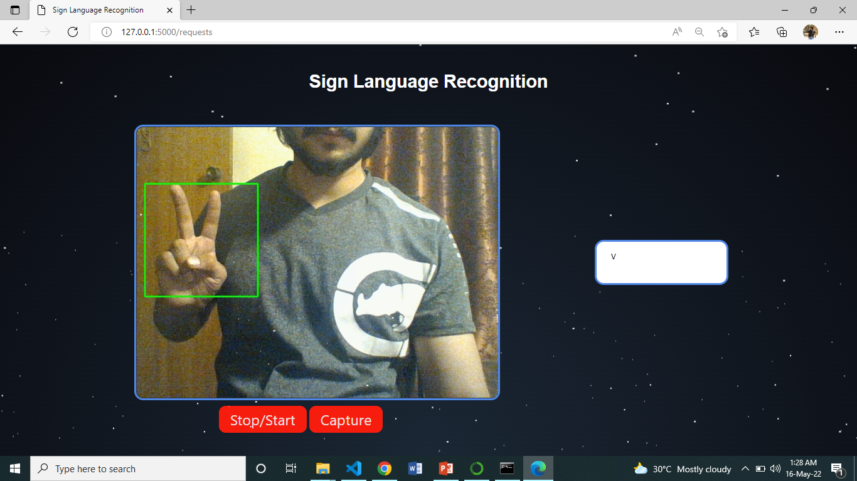
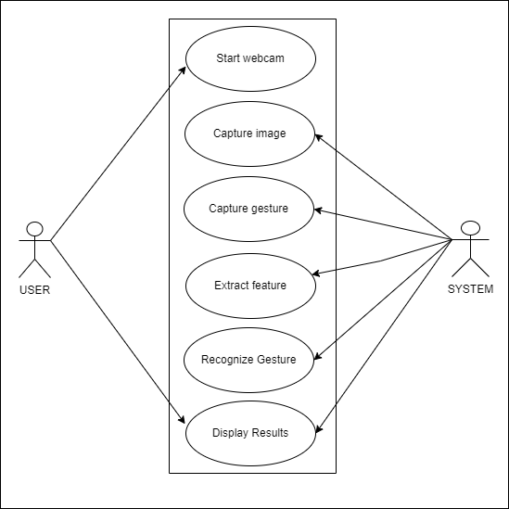

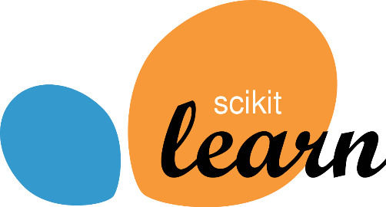
Sign Language Recognition System Muhammad Umar(VIII-C) | Tasmiyah Ali (VIII-A) FYP ID:CS-SP-21-33
Introduction
Flow Diagram
Results
Sign Language Recognition System will allow you to communicate easily with mute/deaf people..
This system will predict and show the name of the captured images. The captured image undergoes series of processing steps which include various Computer vision techniques such as the conversion to gray-scale, dilation and mask operation. Convolutional Neural Network (CNN) is used to train our model and identify the pictures.
Results
2D CNN Acc. 98% Loss 20% |  | InceptionResnetV2 VGG 89% 80% 57%
10%
Above are the Accuracy and loss percentages of three different Deep Learning models we applied on our dataset.
Problem Statement
Communicating with the person having hearing disability is always a major challenge. Normal hearing people find it difficult to understand sign language so this develops a communication barrier between normal hearing and mute/deaf people.
Discussion / Comparisons
Each frame of the video is preprocessed followed by feature extraction. A machine learning based model is trained on extracted features with labels in the data. A web based gui is designed to take input from the user, make prediction and then display the output. This Model based pipeline can then later be used for the prediction of ‘A Sign’ (in video form) by the end user.
2D CNN model was trained using black and white images of static hand gestures and it performed very well in proper lightning condition .
InceptionResnetV2 and VGG were trained on RGB images of static hand gestures.
InceptionResnetV2 performed much better than VGG.
Goals/Objectives
The aim of this project is to use the corresponding gestures to recognize words in Pakistan Sign Language.
Objectives
To remove the invisible communication barrier while communicating with mute/deaf people.
The system should be able to recognize a selected subset of a sign language .
A User could save(register) a sign to the database.
System should be Open Source and be easily accessible to wide range of potential users.
User Interface
Conclusion
A web based GUI is designed which shows live camera feed , 2 buttons, (first to start/stop the camera and second to capture the gesture) and a textbox to show the meaning of the captured gesture.
When the user will press capture button
Our Project will predict the meaning of the signs performed by the signer in front of the camera using different AI and Machine Learning techniques. We used three different multiclass classification models, 2D CNN for Black and white images, InceptionResNetV2 and VGG for RGB images.
Use Case Diagram

