Slide 1

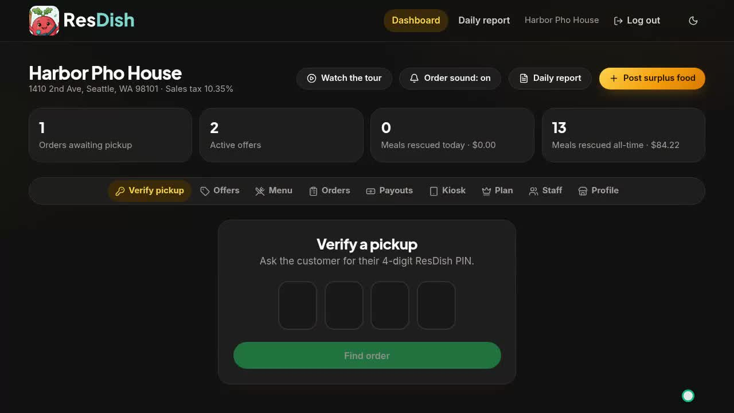
Turn your surplus food into revenue
Sell wrong orders, no-shows and end-of-day extras to customers nearby, instead of throwing them away. No commission on your food sales.
Your restaurant dashboard
🌱 First 50 restaurants: free for life
Notes:
Open with the one-line promise: ResDish turns food you already paid to make into money, instead of waste. Mention the Pioneer offer early: the first 50 approved restaurants use it free for life.

Slide 2



Every kitchen ends the day with good food it can't sell
You already paid for the ingredients and the labour. Throwing it out turns that cost into a total loss.
Wrong orders
No-shows and cancels
Closing-time extras
A dish made with the wrong ingredient, or the wrong size, that the customer sent back.
Delivery drivers who cancel, and pickup orders nobody comes for.
The last trays and portions you made too much of, when demand was lower than expected.
Notes:
Ask the owner how often each of these happens in their kitchen. Most restaurants recognise all three. The point: this food is already paid for; the only question is whether it earns anything.

Slide 3
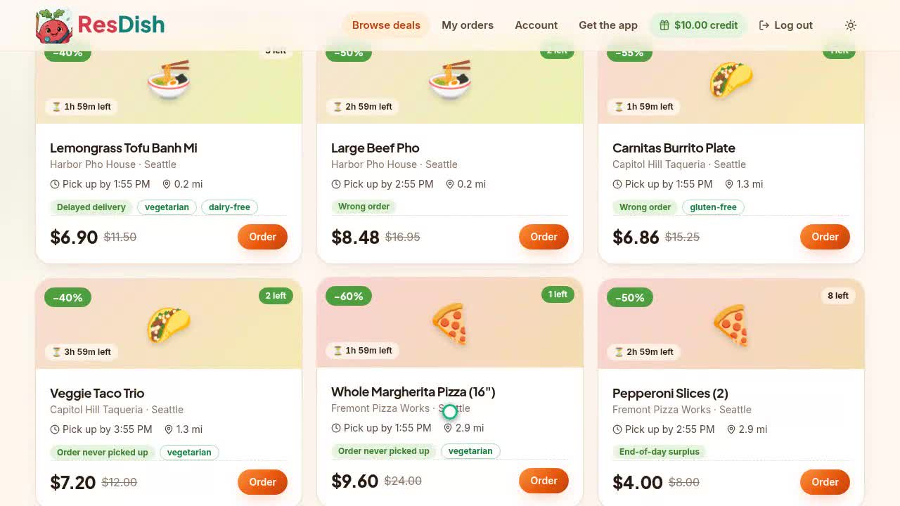



ResDish sells it to people nearby, within the hour
Recover revenue
Earn from food that would otherwise go in the bin.
Win new regulars
Customers discover you through a deal, then come back at full price.
Waste less
Every meal sold is one less in the landfill, and a story your customers like.
What customers see: live deals near them, with distance and a pickup countdown
Notes:
ResDish is a local marketplace. Restaurants post surplus dishes at a discount; customers nearby buy them on their phone and pick them up. It works in the United States and Canada, in US or Canadian dollars.

Slide 4




Four steps from extra food to money in the bank
1
2
3
4
Post it
A bell rings
Check the PIN
Get paid
Pick a dish from your menu, set the discount, quantity and a discard timer. About a minute.
A nearby customer orders. Their card is only held, not charged, for now.
At the counter, type the customer's 4-digit pickup PIN and hand over the food.
The card is charged at pickup, and your share goes to your Stripe account.
No-shows are released automatically when the discard timer ends, and the customer is not charged.
Notes:
Walk through one real order. Stress that the restaurant is never left holding an unpaid order: the card is held at ordering and charged only when your staff confirm the PIN.

Slide 5
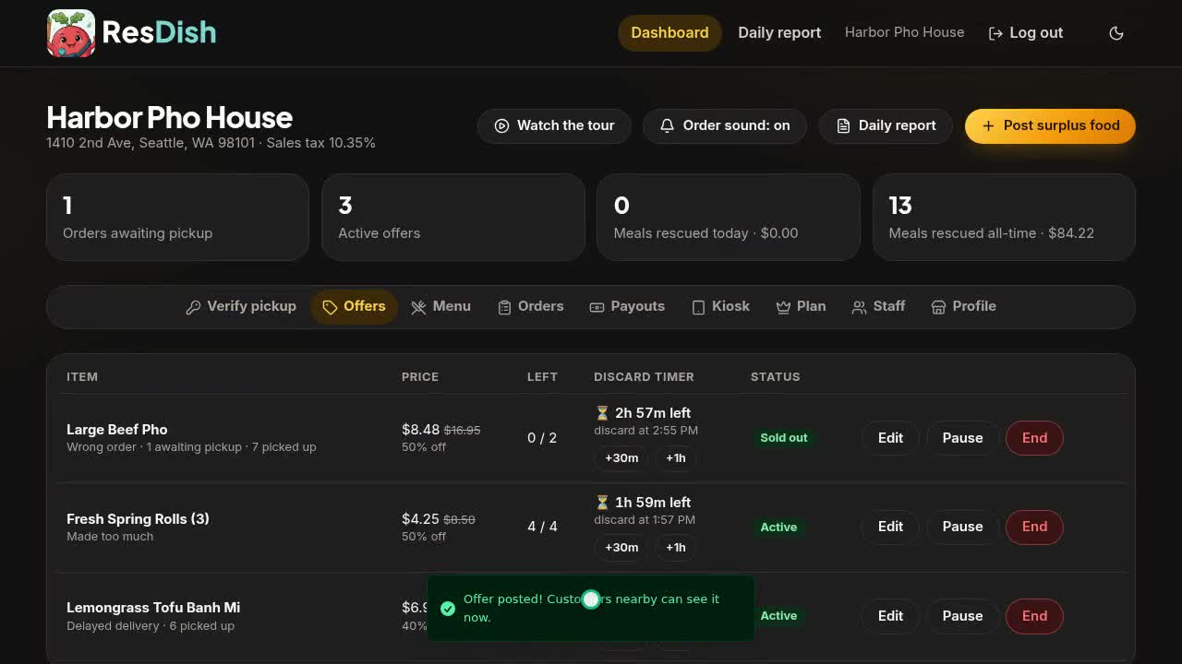

Post an offer in about a minute
Pick from your menu
Photos, dietary tags and allergen notes come with it. Import your menu from your website or a file.
Discard timers
Each offer ends when the food stops being safe to sell. Extend it with one tap.
Pause, edit or end
Stay in control of every offer, any time.
Your whole team
Add managers and supervisors with their own logins.
Notes:
Show the dashboard live if you can, or play the short restaurant video from the website. Point out the discard timer: food is only sold while it is safe.

Slide 6
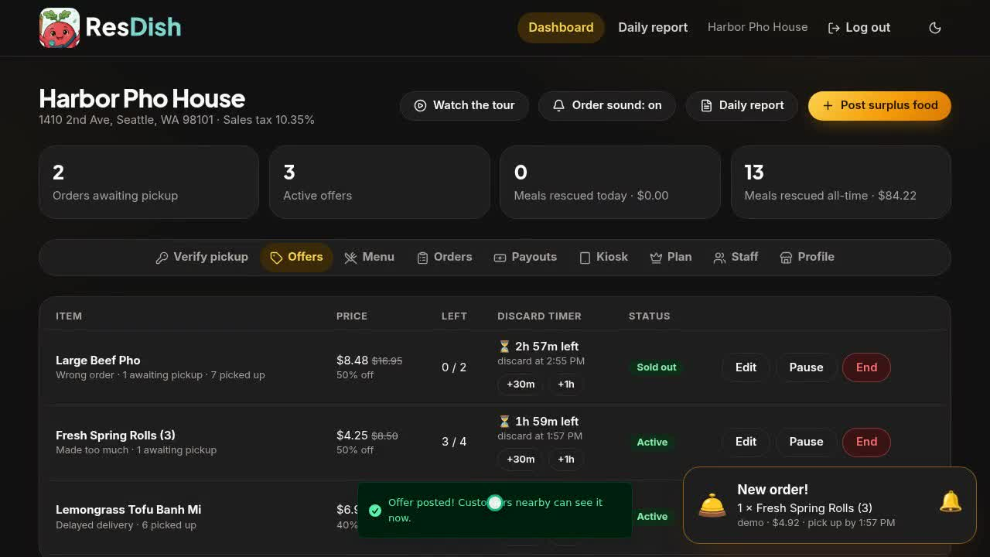
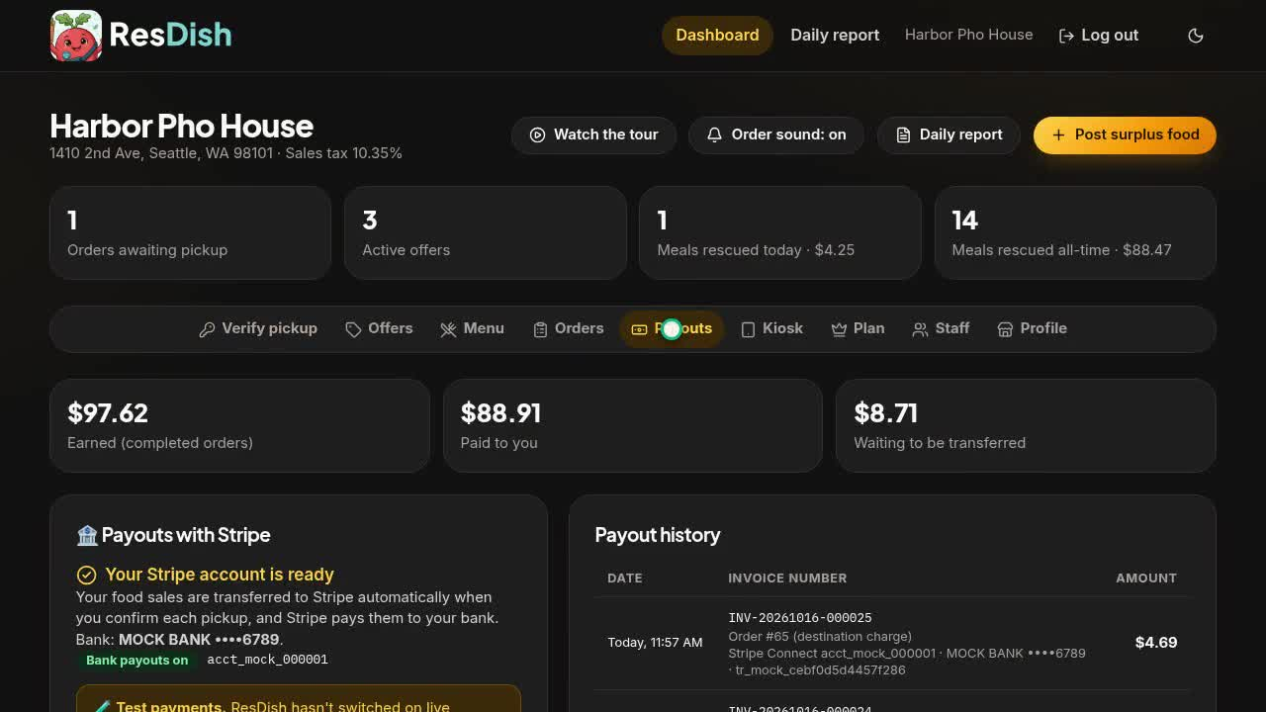
Counter kiosk on any tablet, payouts at every pickup
Counter kiosk. Open your private kiosk link on any Android tablet or iPad. New orders ring a bell; staff type the PIN. No special hardware.
Payouts and reports. Every payment with its invoice number, in US or Canadian dollars. Daily sales reports with print, PDF and CSV.
Notes:
Equipment objection: none needed. Any tablet or phone with a browser works. Bookkeeping objection: every payout has an invoice number, and the daily report exports to PDF and CSV for your accountant. Sales tax is set automatically from your address.

Slide 7
One simple plan, and no commission on your food sales
ONLY 50 SPOTS
Pioneer Member
Monthly
Annual
$0 free for life
$15 per month
$150 per year
The first 50 restaurants approved
Any approved restaurant
Any approved restaurant
No card needed
Every feature included
Spot assigned in order of approval
Charged monthly in advance
Turn off auto-renewal any time
Every feature included
Save $30 a year ($12.50/month)
Reminder a week before renewal
Every feature included
You receive the full discounted price of every meal you sell, plus its sales tax. Customers pay a separate ResDish service fee on top. ResDish promotional coupons may reduce the food price as set out in the Restaurant Partner Agreement. Plans are billed in US or Canadian dollars.
Notes:
The key message: no commission. The restaurant keeps the full discounted price of the food; ResDish earns a service fee from the customer and the plan fee. Then close on urgency: Pioneer spots are limited to the first 50 approved restaurants. Be upfront that ResDish coupons can come out of the food price, as the agreement explains.

Slide 8
Five meals a day can add up to about $1,200 a month
An illustrative example. Your numbers will differ.
5
surplus meals sold per day
$8
average discounted price
30
days open per month
Pioneer Members pay $0, so every dollar is recovered revenue. Figures are for illustration only, not a forecast or guarantee of sales.
Notes:
5 meals x $8 x 30 days = $1,200 a month back from food that would have been thrown away, against a $15 plan, or nothing for a Pioneer Member. Ask the owner to plug in their own numbers.

Slide 9






Built so you never lose out on an order
Card hold, then charge
Pickup PIN
Real customers
The card is held when the customer orders and charged at pickup.
Every order has its own 4-digit PIN, so the right food goes to the right person.
Fake and throwaway emails are refused. Repeat no-shows are suspended, then banned.
Taxes handled
We handle support
US and Canada
Sales tax is set from your address and shown on every receipt and report.
Customer questions, refunds and credit are handled by ResDish.
Customers pay in US or Canadian dollars, by the restaurant's country.
Notes:
Handle the risk objections here: unpaid orders (card hold), wrong person picking up (PIN), time-wasters (no-show suspensions and bans), tax compliance (automatic sales tax), and customer service (ResDish handles it).

Slide 10

Start selling this week
1
Sign up online
Enter your restaurant details and accept the partner agreement. A few minutes.
Become a Pioneer Member
2
Get approved
Usually within one business day. Set up your menu meanwhile.
The first 50 restaurants approved use ResDish free for life. No card, no commission, every feature.
3
Connect payouts
Link your bank account through Stripe, open the kiosk on a tablet.
www.bite-wise.org
support@bite-wise.org
4
Post your first dish
And listen for the bell.
Notes:
Close: offer to sign them up on the spot, on their phone or yours. Remind them Pioneer spots go in order of approval, so signing up today secures a free plan for life while spots remain.

