Slide 1

Chapter 1
Introduction
1.<number>
Notes:
1.#

Slide 2
1-1 DATA COMMUNICATIONS
The term telecommunication means communication at a distance and deals primarily with voice. Data communications are the exchange of data between two devices via some form of transmission medium such as a wire cable.
Data communications deals primarily with data
Subset of telecommunication.
Topics discussed in this section:
Components
Data Représentation
Data Flow
1.<number>
Notes:
1.#
The part of telecommunication related to computer systems.
They're pretty much the same thing. Telecommunication is just communication over some distance. Data communication is generally thought of as being digital. Telecommunication can be digital or analog. Thus, data communication could be thought of as a

Slide 3

Five components of data communication
1.<number>
Notes:
1.#

Slide 4

Data flow (simplex, half-duplex, and full-duplex)
1.<number>
Notes:
1.#
Data representations : audio , video , data and images

Slide 5
1-2 NETWORKS
A network is a set of devices (often referred to as nodes) connected by communication links. A node can be a computer, printer, or any other device capable of sending and/or receiving data generated by other nodes on the network.
Topics discussed in this section:
Distributed Processing
Network Criteria
Physical Structures
Network Models
Categories of Networks
Interconnection of Networks: Internetwork
1.<number>
Notes:
1.#

Slide 6
Distributed Processing
Most networks use distributed processing, in which a task is divided among multiple computers. Instead of one single large machine being responsible for all aspects of a process, separate computers (usually a personal computer or workstation) handle a subset.
1.<number>

Slide 7
Network Criteria
A network must be able to meet a certain number of criteria. The most important of these are performance, reliability, and security.
Performance
Performance can be measured in many ways, including transit time and response time.*
Transit time is the amount of time required for a message to travel from one device to another. Response time is the elapsed time between an inquiry and a response.
1.<number>
Notes:
*Performance is often evaluated by two networking metrics: throughput and delay.
We often need more throughput and less delay.
The amount of Data that enters and goes through system and machine.
1.#

Slide 8
Network Criteria
Reliability
In addition to accuracy of delivery, network reliability is measured by the frequency of failure.MTBF
Security
Network security issues include protecting data from unauthorized access, damage, and implementing policies and procedures for recovery from breaches and data losses.
1.<number>
Notes:
Mean time between failure.
1.#

Slide 9

Types of connections: point-to-point and multipoint
Two or more devices connect to a link; two or more links form a topology.
1.<number>
Notes:
1.#
Physical way of connecting the devices on to the network.

Slide 10

Categories of topology
1.<number>
Notes:
1.#

Slide 11

A fully connected mesh topology (five devices)
n(n -1) /2
In a mesh topology, every device has a dedicated point-to-point link to every other device. The term dedicated means that the link carries traffic only between the two devices it connects.
1.<number>
Notes:
1.#

Slide 12
Advantages
Each connection can carry its own data load, thus eliminating the traffic problems that can occur when links must be shared by multiple devices.
Second, a mesh topology is robust.*
-Third, there is the advantage of privacy or security. When every message travels along a dedicated line, only the intended recipient sees it.
-Finally, point-to-point links make fault identification and fault isolation easy.
1.<number>
Notes:
*Second, a mesh topology is robust. If one link becomes unusable, it does not incapacitate
the entire system.
1.#

Slide 13
Disadvantages
- The main disadvantages of a mesh are related to the amount of cabling and the number of I/O ports required.
- First, because every device must be connected to every
other device, installation and reconnection are difficult.
- Second, the bulk of the wiring can be greater than the available space (in walls, ceilings, floors) can accommodate.
Finally, the hardware required to connect each link (I/O ports and cable) can be prohibitively expensive.
For these reasons a mesh topology is usually implemented in a limited fashion.
1.<number>

Slide 14

A star topology connecting four stations
In a star topology, each device has a dedicated point-to-point link only to a central controller, usually called a hub. The devices are not directly linked to one another. Unlike a mesh topology, a star topology does not allow direct traffic between devices.
1.<number>
Notes:
1.#

Slide 15
Advantages
A star topology is less expensive than a mesh topology.
In a star, each device needs only one link and one I/O port to connect it to any number of others. This factor also
makes it easy to install and reconfigure.
-Other advantages include robustness. If one link fails, only that link is affected. All other links remain active. This factor also lends itself to easy fault identification and fault isolation.
- Less collisions and Most efficient.
1.<number>

Slide 16
Disadvantages
One big disadvantage of a star topology is the dependency of the whole topology on one single point, the hub. If the hub goes down, the whole system is dead.
Although a star requires far less cable than a mesh, each node must be linked to a central hub.
1.<number>
Notes:
The star topology is used in local-area networks (LANs)
1.#

Slide 17

A bus topology connecting three stations
Bus Topology : A bus topology, on the other hand, is multipoint. One long cable acts as a backbone to link all
the devices in a network
1.<number>
Notes:
1.#

Slide 18
Advantages and Disadvantages
-Ease of installation.
-Backbone cable can be laid along the most efficient path then connected to the nodes by drop lines of various lengths. In this way, a bus uses less cabling than mesh or star topologies.
- Disadvantages include difficult reconnection and fault isolation. A fault or break in the bus cable stops all transmission, even between devices on the same side of the problem.
Difficult to add new devices. Adding new devices may therefore require mod and downtime.
Collosion
1.<number>
Notes:
In a star, for example, four network devices in the same room require four lengths of cable reaching all the way to the hub. In a bus, this redundancy is eliminated.
1.#

Slide 19

A ring topology connecting six stations
In a ring topology, each device has a dedicated point-to-point connection with only the two devices on either side of it. A signal is passed along the ring in one direction, from device to device, until it reaches its destination. Each device in the ring incorporates a repeater. When a device receives a signal intended for another device, its repeater regenerates the bits and passes them along.*
1.<number>
Notes:
1.#
*Uses A Token To Pass Information From 1 Computer To The Other. A Token Is Attached To The Message By The Sender To Identify Which Computer Should Receive The Message. As The Message Moves Around The Ring, Each Computer Examines The token. If the computer identifies the token as its own, then it will process the information.

Slide 20
Advantages and Disadvantages
A ring is relatively easy to install and reconfigure. Each device is linked to only its immediate neighbors. To add or delete a device requires changing only two connections.
Fault isolation is simplified.
Unidirectional traffic can be a disadvantage.*
- Ring topology was IBM proprietary and introduced its local-area network Token Ring. Today, the need for higher-speed LANs has made this topology less popular.
1.<number>
Notes:
*In a simple ring, a break in the ring (such as a disabled station) can disable the entire network. IF ONE
COMPUTER IS BROKEN OR DOWN, THE MESSAGE CANNOT BE PASSED TO THE OTHER COMPUTERS
1.#

Slide 21
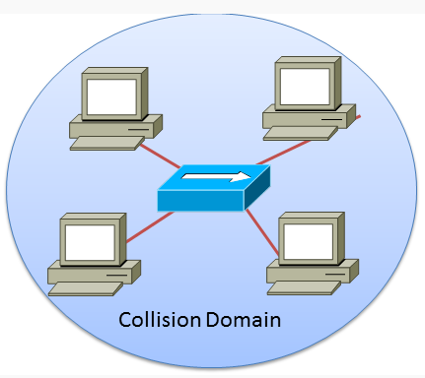
Collision Domain
A collision domain is a section of a network where data packets can collide with one another when being sent on a shared medium or through repeaters, in particular, when using early versions of Ethernet. A network collision occurs when more than one device attempts to send a packet on a network segment at the same time. Collisions are resolved using carrier sense multiple access with collision detection (CSMA/CD) in which the competing packets are discarded and re-sent one at a time. This becomes a source of inefficiency in the network.
Notes:
1.#

Slide 22

Ethernet LANs:How do they work?
Multiple workstations are connected to a “segment”
Each station has to take turns sending traffic
All stations listen to all traffic on their segment
Stations can only send data (Ethernet Frames) when no one else is sending.

Slide 23
Ethernet LANs:Unicast Frames
0000.0c12.3456
Ethernet frames contain the MAC address of the station that the frame was sent to
These are called “unicast” frames
All stations receive the Ethernet frame, but ignore the frames that are not addressed to their MAC address
Frame
To: 0000.0c12.3456
0000.1018.321a
0000.0c12.1111

Slide 24
Ethernet LANs:MAC Addresses
0000.0c12.3456
Every workstation has a Network Interface Card (NIC)
Every NIC has a unique MAC address
Stations use MAC addresses to send Ethernet Frames to a specific station
0000.1018.321a
0000.0c12.1111

Slide 25
Ethernet LANs:Broadcast Frames
0000.0c12.3456
Some Ethernet frames are sent to all stations
These are called “broadcast” frames
All stations process this frame
Frame
To: FFFF.FFFF.FFFF
0000.1018.321a
0000.0c12.1111

Slide 26
Flow Control Mechanism on Ethernet
CSMA/CD is the mechanism that regulates the segment
Each station listens for other traffic before they transmit
Frame
Packet

Slide 27
Ethernet Collisions
Collision!
Sometimes stations transmit simultaneously
Two frames on the same segment collide
Collisions require each station to wait and resend
Frame
Packet
Packet
Frame
Frame
Packet
Frame
Packet

Slide 28
Ethernet Reliability
A
B
C
D
Figure 1
A
B
C
D
Figure 2
Collision

Slide 29
Ethernet Reliability
A
B
C
D
Collision
A
B
C
D
JAM
JAM
JAM
JAM
JAM
JAM

Slide 30
CSMA/CD
CSMA/CD stands for Carrier Sense Multiple Access / Collision Detect.
It is used by all NICs in Ethernet Networking
In this method all NICs first sense whether the cable is free or not.
If it is free the request is sent otherwise it waits.

Slide 31
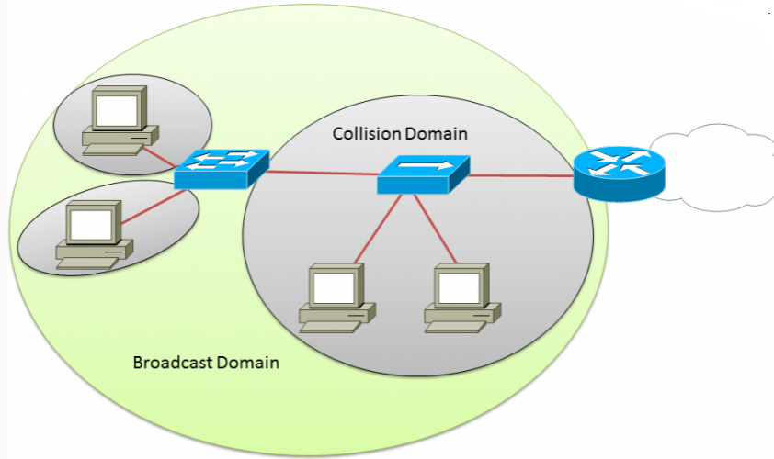
Broadcast domain
The definition of a broadcast domain is a set of devices that if one device sends a broadcast frame all other devices will receive that frame in the same broadcast domain. So if devices are in the same IP network they will be able to receive a broadcast message. Having a smaller broadcast domain can improve network performance and improve against security attacks. Remember a broadcast message goes to every PC and network device.

Slide 32
Categories of Network
LAN (Local Area Network):
  - It is a group of network components that work within small area
  - Ex.: Token Ring, FDDI, Ethernet, Fast Ethernet,..
MAN (Metropolitan Area Network):
  - It is a group of LANs that are interconnected over a small area within city like karachi . - Ex.: Metro Ethernet.
WAN (Wide Area Network):
- Cover cities, countries, and continents.
- It is a group of LANs that are interconnected within large area.
  Ex.: FR, ISDN,X.25, Analog dialup, ATM.

Slide 33
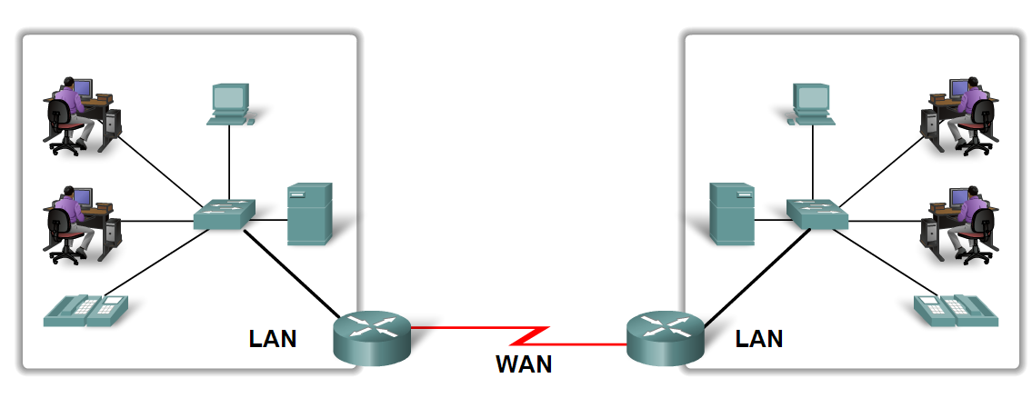
LAN and WAN

Slide 34
1-3 THE INTERNET
The Internet has revolutionized many aspects of our daily lives. It has affected the way we do business as well as the way we spend our leisure time. The Internet is a communication system that has brought a wealth of information to our fingertips and organized it for our use.
Topics discussed in this section:
A Brief History
The Internet Today (ISPs)
1.<number>
Notes:
1.#

Slide 35
Brief History
A collaboration of more than hundreds of thousands of interconnected networks(Network of networks).
In the mid-1960s, mainframe computers in research organizations were standalone Devices.
-In 1967, at an Association for Computing Machinery (ACM) meeting, ARPA presented its ideas for ARPANET, a small network of connected computers.
1.<number>
Notes:
1-Private individuals as well as various organizations such as government agencies, schools, research facilities, corporations, and libraries in more than 100 countries use the Internet. Millions of people are users. Yet this extraordinary communication system only came into being in 1969.
2-Computers from different manufacturers were unable to communicate with one another. The Advanced Research Projects Agency (ARPA) in the Department of Defense (DoD) was interested in finding a way to connect computers .
6-IP would handle datagram routing while TCP would be responsible for higher-level functions such as segmentation, reassembly, and error detection. The internetworking protocol became known as TCPIIP.
1.#

Slide 36
Brief History
-By 1969, ARPANET was a reality. Four nodes, at different universities were connected to form a network.
-In 1972, ARPANET group, worked on the Internetting Project. In 1973 they proposed paper outlined the on Transmission Control Protocol (TCP) protocols to achieve end-to-end delivery of packets
-Shortly thereafter, authorities made a decision to split TCP into two protocols: Transmission Control Protocol (TCP) and Internetworking Protocol (lP).
1.<number>

Slide 37
Internet Today
The Internet has come a long way since the 1960s. The Internet today is not a simple hierarchical structure. It is made up of many wide- and local-area networks joined by connecting devices and switching stations. It is difficult to give an accurate representation of the Internet because it is continually changing-new networks are being added, existing networks are adding addresses, and networks.
Today most end users who want Internet connection use the services of Internet service providers (lSPs). service providers, regional service providers, and local service providers.
1.<number>

Slide 38
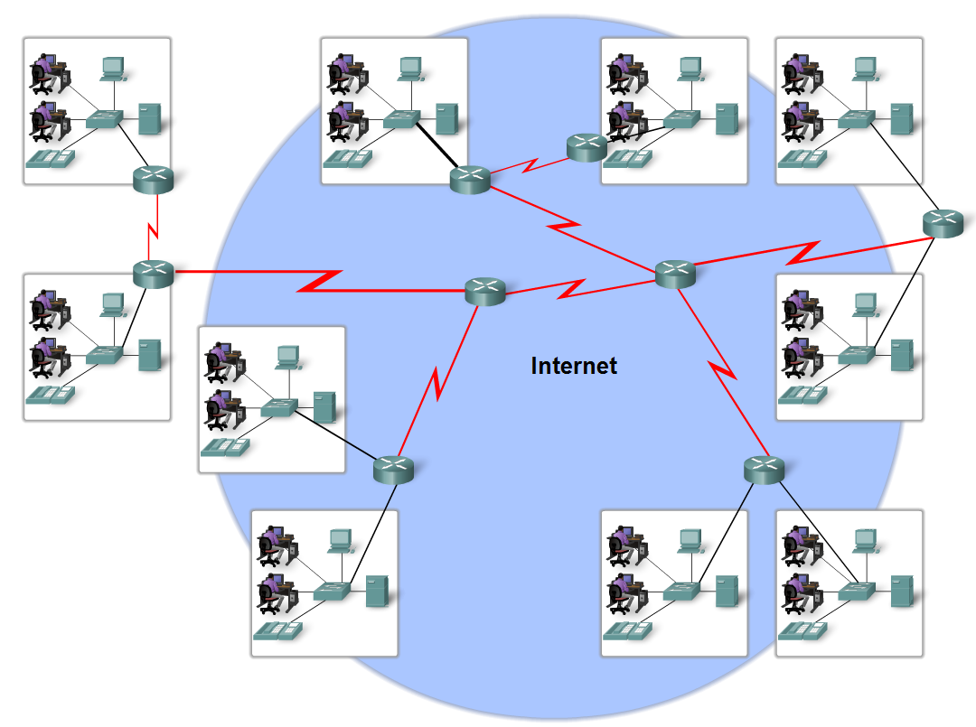
Internet Today

Slide 39
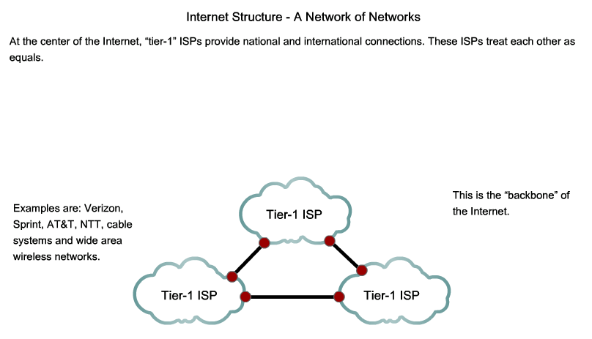
Internet Today

Slide 40
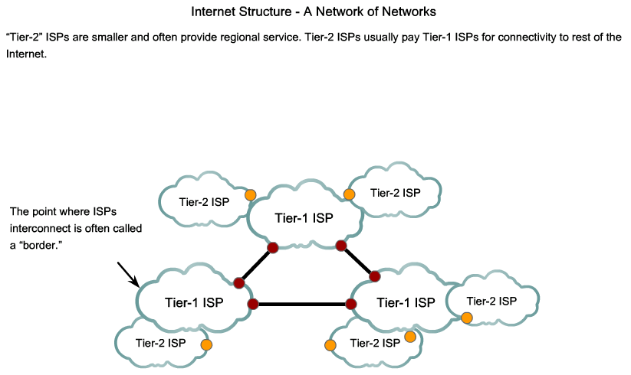
Internet Today

Slide 41
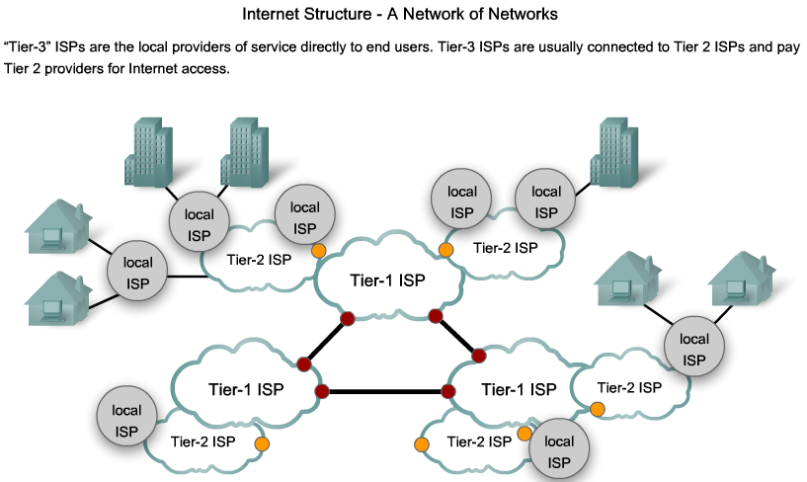
Internet Today

Slide 42
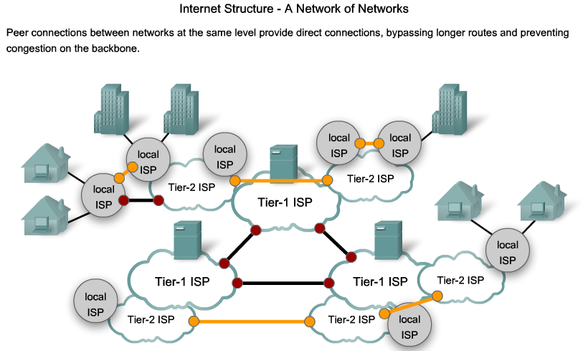
Internet Today

Slide 43
1.<number>

