Slide 1
The Information Processing Cycle

Slide 2
Introduction
There are four stages to the information processing cycle:
    Input
    Process
    Output
    Storage/Distribute

Slide 3
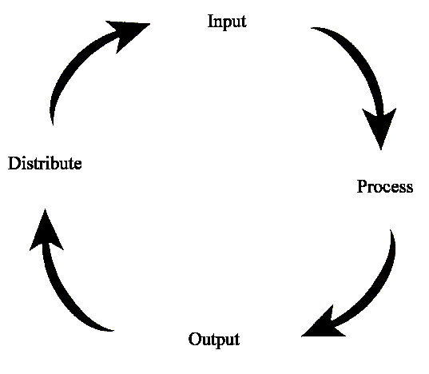
Introduction
These processes work together and repeat over and over:

Slide 4
The Four Stages

Slide 5
Stage 1: Input
“You first have to get the data in”
Our brain takes in information from our senses
Computers need “peripherals” (extra components) to get information in
  ex/ keyboards, scanners, mice

Slide 6
Stage 2: Process
Next, we need to ‘make sense of’ the data we have
Our brain compares this to what we know and decides whether it is important enough to remember or not
Computers use the CPU (the main chip inside) to make decisions, do calculations, and organize data
  ex/ Pentium-IV, Dual-Core

Slide 7
Stage 3: Output
The next step is to get the results out from the process, and present them in a useable way
Our brain makes our body respond by talking, moving, or writing
Computers need “peripherals” to do this
  ex/ monitor, printer, data projector

Slide 8
Stage 4: Storage/Distribute
Finally, the information needs to be sent elsewhere (or stored) so it can be used later
Our brain makes “memories” of the information, and we may write it down to look over later
Computers use “peripherals” to do this
  ex/ hard drive, CDs or DVDs to burn, Internet

Slide 9
…and back to Stage 1
Once the information is stored or distributed, it may be reviewed later by you or somebody else
This takes us back to Stage 1 (Input), and the cycle starts again

Slide 10
A Real-World Example

Slide 11
The Example
You are going to start a new job at an office (as a Secretary/ Receptionist). Your job includes typing letters and answering phones.
How is the Information Processing Cycle involved?

Slide 12
Stage 1: Input
“You first have to get the data in”
You see and feel the different papers you’re given to type
When you go to work, you hear the phone calls, and answer them

Slide 13
Stage 2: Process
Next, we need to ‘make sense of’ the data we have
You decide to type the most important letters first
You realize who is phoning, and decide to take a message

Slide 14
Stage 3: Output
get the results out from the process, and present them in a useable way
You print out the finished letter
You write down the phone message

Slide 15
Stage 4: Distribute
the information needs to be sent elsewhere (or stored) so it can be used later
You save the letter as a computer file and mail it
You also phone your boss and relay the message

Slide 16
…and back to Stage 1
You may need to find the file later, and update the letter
The mailed letter is read by whoever you sent it to
The phone message is heard by your boss

