Slide 1

lesson 5
  Monitors and Sound Systems

Slide 2
This lesson includes the following sections:
    Monitors
    PC Projectors
    Sound Systems

Slide 3
Monitors
Categories of Monitors
CRT Monitors
Flat-Panel Monitors
Comparing Monitors
Video Controllers

Slide 4
Monitors - Categories of Monitors
Monitors are categorized by the technology they use:
Cathode ray tube (CRT) monitors
Flat-panel displays
And by the way they display colors:
Monochrome – One color on a black background
Grayscale – Shades of gray on a white or off-white background
Color – From 16 to 16 million unique colors

Slide 5
Monitors - CRT Monitors
In CRT monitors, electrons are fired at phosphor dots on the screen.
The dots are grouped into pixels, which glow when struck by electrons.
In color CRTs, each pixel contains a red, green, and blue dot. These glow at varying intensities to produce color images.

Slide 6
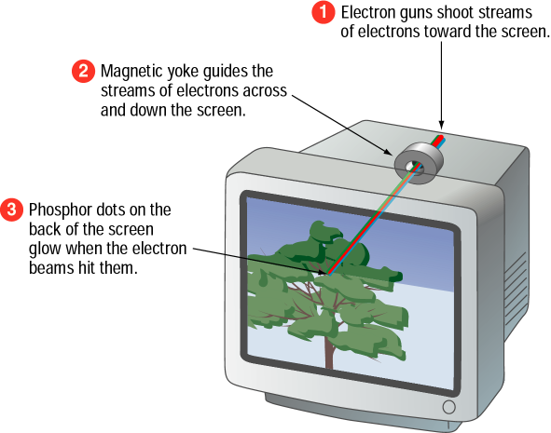

Slide 7
Monitors - Flat-Panel Monitors
Most flat-panel monitors use liquid crystal display (LCD) technology.
Passive matrix LCD uses a transistor for each row and column of pixels.
Active matrix LCD uses a transistor for each pixel on the screen.
Thin-film transistor displays use multiple transistors for each pixel.

Slide 8
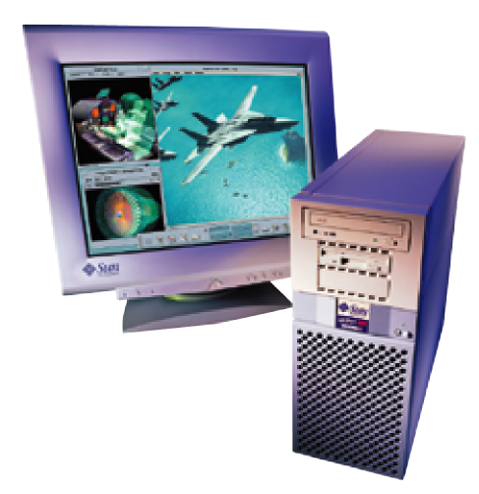
Flat-panel monitors take up less desk space.

Slide 9
Monitors - Comparing Monitors
When comparing monitors, consider four features:
Size
Resolution
Refresh rate
Dot pitch

Slide 10
Comparing Monitors - Size
A monitor's size is the diagonal measurement of its face, in inches.
For years, 15" monitors (13"viewing area) were standard.
Today, 17" monitors (15" viewing area) are common.
Larger monitors are available, but can be expensive.

Slide 11
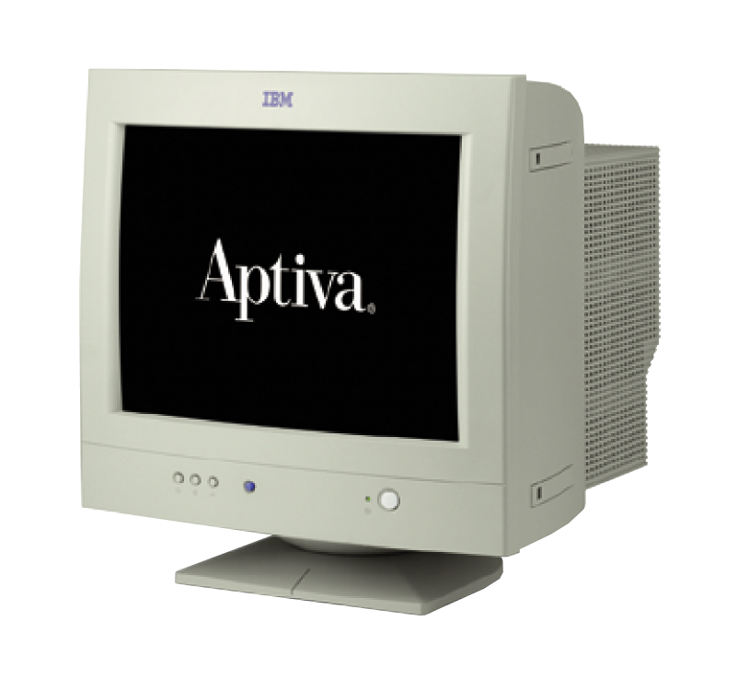
The diagonal
size (often 15”)

Slide 12
Comparing Monitors - Resolution
Resolution is the number of pixels on the screen, expressed as a matrix (such as 600x800).
A 17" monitor offers resolutions from 640x480 up to 1280x1024.
The Video Graphics Array (VGA) standard is 640x480. Super VGA (SVGA) monitors provide resolutions of 800x600, 1024x768 or higher.

Slide 13
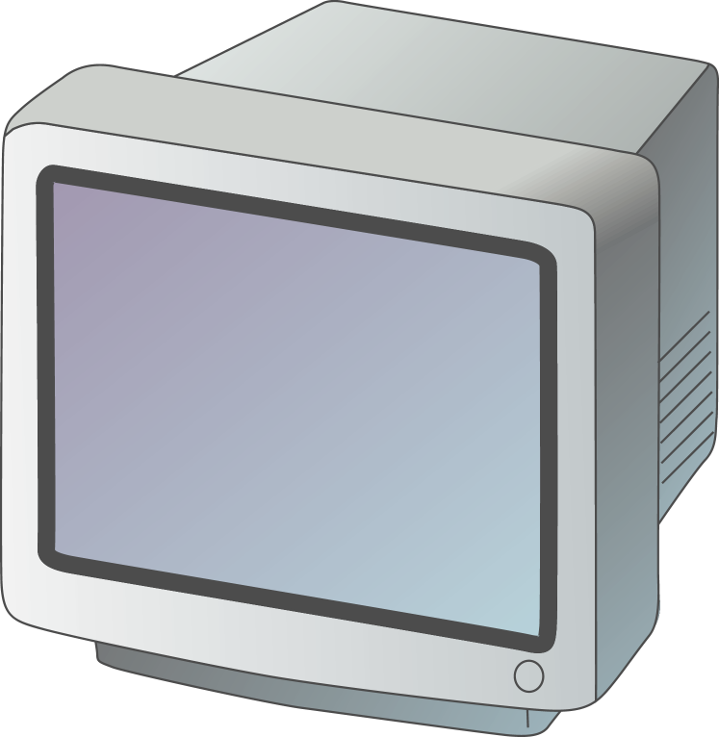

Resolution (image sharpness) is important.
  (Especially for graphics, page layout, and CAD)

Slide 14
Comparing Monitors - Refresh Rate
Refresh rate is the number of times each second that the electron guns scan the screen's pixels.
Refresh rate is measured in Hertz (Hz), or cycles per second.
Look for a refresh rate of 72 Hz or higher. A slower rate may cause eyestrain.

Slide 15
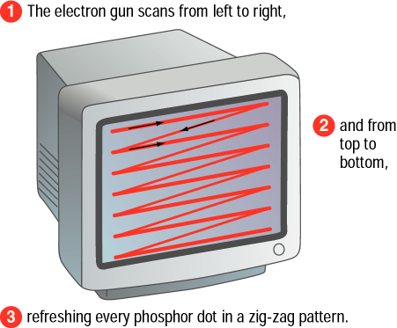
Fast scanning = Quick refresh (less flicker)

Slide 16
Comparing Monitors - Dot Pitch
Dot pitch is the distance between the phosphor dots that make up a single pixel.
In color monitors, three dots (red, green, and blue) comprise each pixel.
Look for a dot pitch no greater than .28 millimeter.

Slide 17
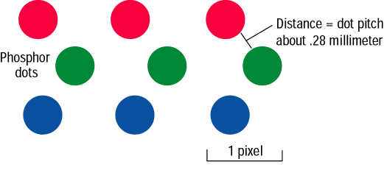
Fine dot pitch = Crisp displays

Slide 18
B + G
R + B
R + G
R + B + G
Phosphor Dot Color Mixing

Slide 19
Monitors - Video Controllers
The video controller is an interface between the monitor and the CPU.
The video controller determines many aspects of a monitor's performance, such as resolution or the number of colors displayed.
The video controller contains its own on-board processor and memory, called video RAM (VRAM).

Slide 20
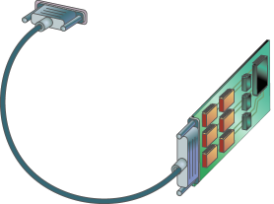
Video Control Board with Monitor Cable
VRAM
Graphic intensive applications such
as games require plenty of VRAM.

Slide 21
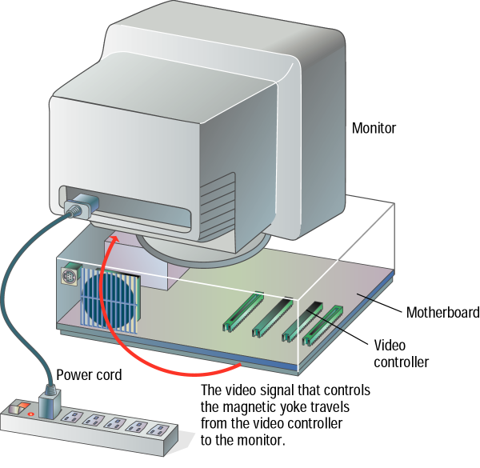

Slide 22
PC Projectors
A PC projector connects to a PC and is used to project images on a large screen.
Many PC projectors provide the same resolutions and color levels as high-quality monitors.
Digital light processing (DLP) projectors use a microchip containing tiny mirrors to produce very sharp, bright images.

Slide 23

Projected Screen

Slide 24
Sound Systems
Multimedia PCs come with a sound card, speakers, and a CD-ROM or DVD drive.
A sound card translates digital signals into analog ones that drive the speakers.
With the right software, you can use your PC to edit sounds and create special sound effects.

Slide 25
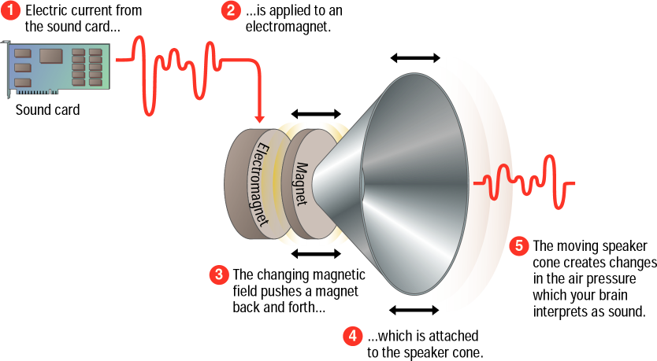

Slide 26
lesson 5 - Review
List the two most commonly used types of computer monitors.
Explain how a CRT monitor displays images.
Identify two types of flat-panel monitors and explain their differences.
List four characteristics you should consider when comparing monitors.
Explain how a computer outputs sound.

