Slide 1

    lesson 7
    Transforming Data
    into Information

Slide 2
This lesson includes the following sections:
    How Computers Represent Data
    How Computers Process Data
    Factors Affecting Processing Speed
    Extending the Processor's Power to Other Devices

Slide 3
How Computers Represent Data
Binary Numbers
The Binary Number System
Bits and Bytes
Text Codes

Slide 4
How Computers Represent Data
– Binary Numbers
Computer processing is performed by transistors, which are switches with only two possible states: on and off.
All computer data is converted to a series of binary numbers– 1 and 0. For example, you see a sentence as a collection of letters, but the computer sees each letter as a collection of 1s and 0s.
If a transistor is assigned a value of 1, it is on. If it has a value of 0, it is off. A computer's transistors can be switched on and off millions of times each second.

Slide 5
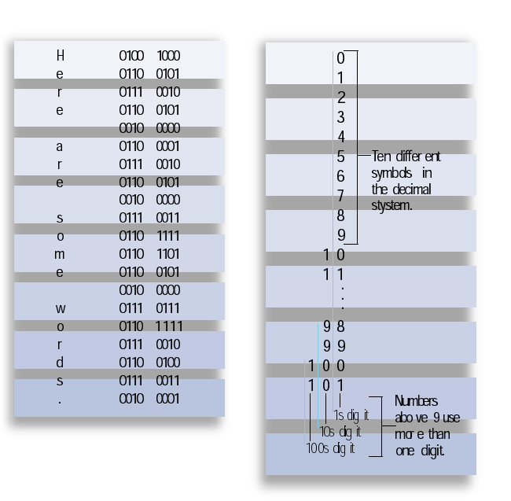
Ten different
symbols in
the decimal
system
Numbers above 9
use more than 1 digit

Slide 6
Base 10 | Base 2
0 | 0
1 | 1
2 | 10
3 | 11
4 | 100
5 | 101
6 | 110
7 | 111
8 | 1000
9 | 1001
10 | 1010
The Binary Number System
To convert data into strings of numbers, computers use the binary number system.
Humans use the decimal system (“deci” stands for “ten”).
The binary number system works the same way as the decimal system, but has only two available symbols (0 and 1) rather than ten (0, 1, 2, 3, 4, 5, 6, 7, 8, and 9).

Slide 7
How Computers Represent Data - Bits and Bytes
A single unit of data is called a bit, having a value of 1 or 0.
Computers work with collections of bits, grouping them to represent larger pieces of data, such as letters of the alphabet.
Eight bits make up one byte. A byte is the amount of memory needed to store one alphanumeric character.
With one byte, the computer can represent one of 256 different symbols or characters.
.

Slide 8
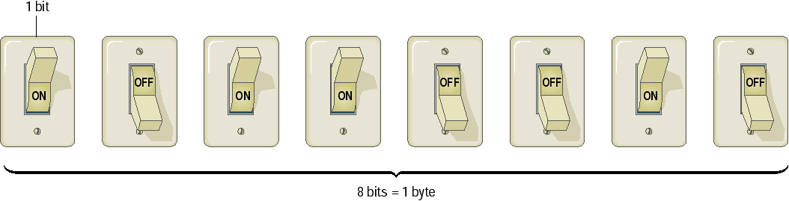
1 0 1 1 0 0 1 0
1 0 0 1 0 0 1 0
1 0 0 1 0 0 1 1
1 1 1 1 1 1 1 1

Slide 9
How Computers Represent Data - Text Codes
A text code is a system that uses binary numbers (1s and 0s) to represent characters understood by humans (letters and numerals).
An early text code system, called EBCDIC, uses eight-bit codes, but is used primarily in older mainframe systems.
In the most common text-code set, ASCII, each character consists of eight bits (one byte) of data. ASCII is used in nearly all personal computers.
In the Unicode text-code set, each character consists of 16 bits (two bytes) of data.

Slide 10
Code | Character
00110000 | 0
00110001 | 1
00110010 | 2
00110011 | 3
00110100 | 4
00110101 | 5
01000001 | A
01000010 | B
01000011 | C
01000100 | D
01000101 | E
Examples from the
ASCII Text Code

Slide 11
How Computers Process Data
Where Processing Occurs:
  The Control Unit
  The Arithmetic Logic Unit
  Machine Cycles
  The Role of Memory in Processing
  Types of RAM

Slide 12
  How Computers Process Data –
  Where Processing Occurs
  Processing takes place in the PC's central processing unit (CPU).
  The system's memory also plays a crucial role in processing data.
  Both the CPU and memory are attached to the system's motherboard, which connects all the computer's devices together, enabling them to communicate.

Slide 13
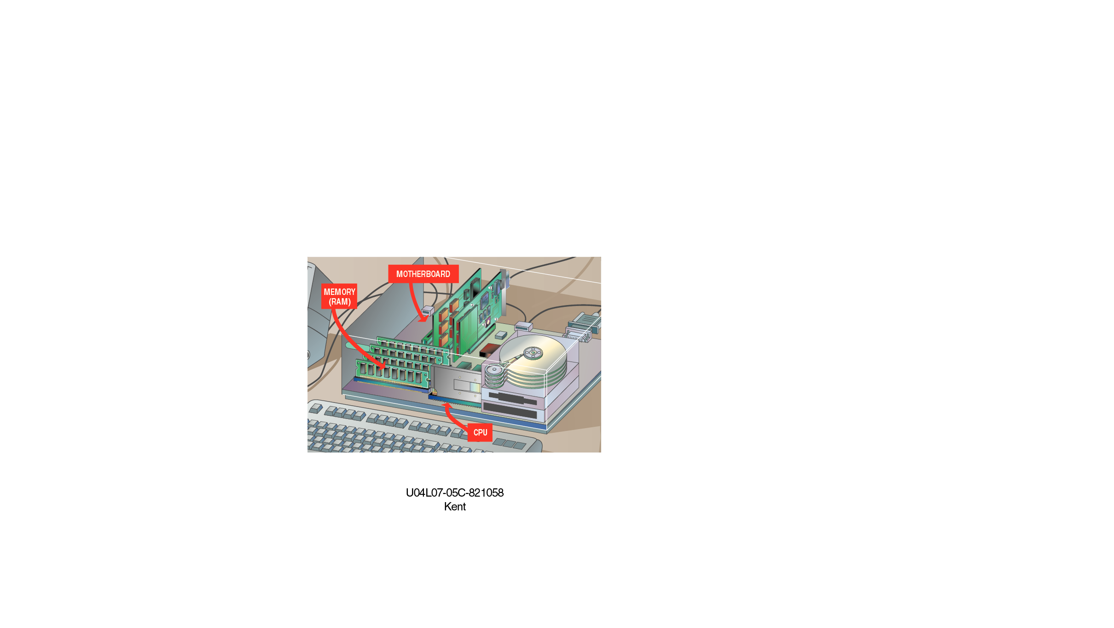

Slide 14
How Computers Process Data –
The Control Unit
The two main parts of a CPU are the control unit and the arithmetic logic unit (ALU)
  The control unit directs the flow of data through the CPU, and to and from other devices.
  The control unit stores the CPU's microcode, which contains the instructions for all the tasks the CPU can perform.

Slide 15
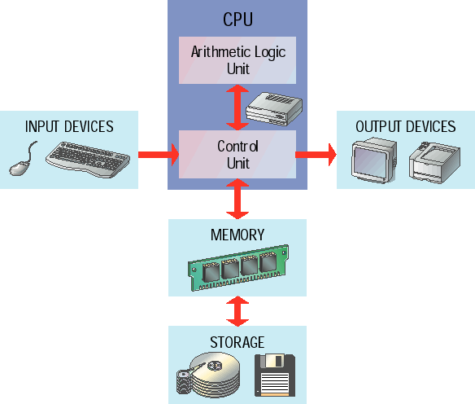

Slide 16
How Computers Process Data –
The Arithmetic Logic Unit
The actual manipulation of data takes place in the ALU.
The ALU can perform arithmetic and logic operations.
The ALU is connected to a set of registers—small memory areas in the CPU, which hold data and program instructions while they are being processed.

Slide 17
ALU Operations List
Arithmetic Operations | Logical Operations
+ Add | =, ≠ equal to, not equal to
− Subtract | >, > greater than, not greater than
x Multiply | <, < less than, not less than
÷ Divide | ≥, ≥ greater than or equal to, not greater than or equal to
^ Raise by a power | ≤, ≤ less than or equal to, not less than or equal to

Slide 18
How Computers Process Data –
Machine Cycles
    The CPU follows a set of steps-called a machine cycle-for each instruction it carries out.
    By using a technique called pipelining, many CPUs can process more than one instruction at a time.
    The machine cycle includes two smaller cycles:
      During the instruction cycle, the CPU "fetches" a command or data from memory and "decodes" it for the CPU.
      During the execution cycle, the CPU carries out the instruction, and may store the instruction's result in memory.

Slide 19
How Computers Process Data –
The Role of Memory
RAM stores data and program code needed by the CPU. The contents of RAM change rapidly and often.
Read-only memory (ROM) is nonvolatile (or permanent). It holds instructions that run the computer when the power is first turned on.
The CPU accesses each location in memory by using a unique number, called the memory address.

Slide 20
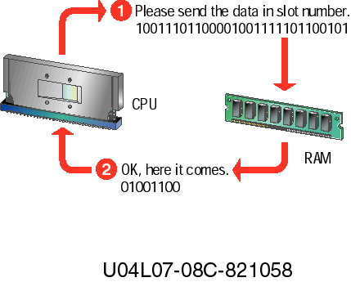

Slide 21
How Computers Process Data - Types of RAM
There are two basic types of RAM: static and dynamic
Dynamic RAM (DRAM) chips must be recharged
with electricity very frequently, or they will lose their
contents.
Static RAM (SRAM) does not need to be recharged
as often as DRAM, and can hold its contents longer.
Another type of RAM, called flash memory, can store its contents after power is turned off. Flash memory is used in digital cameras to store pictures.

Slide 22
Factors Affecting Processing Speed
Registers
RAM
The System Clock
The Bus
Cache Memory

Slide 23
Factors Affecting Processing Speed – Registers
The CPU contains a number of small memory areas, called registers, which store data and instructions while the CPU processes them.
The size of the registers (also called word size) determines the amount of data with which the computer can work at a one time.
Today, most PCs have 32-bit registers, mean the CPU can process four bytes of data at one time. Register sizes are rapidly growing to 64 bits.

Slide 24
Factors Affecting Processing Speed – RAM
The amount of RAM in a PC has a direct affect on the system's speed.
The more RAM a PC has, the more program instructions and data can be held in memory, which is faster than storage on disk.
If a PC does not have enough memory to run a program, it must move data between RAM and the hard disk frequently. This process, called swapping, can greatly slow a PC's performance.

Slide 25
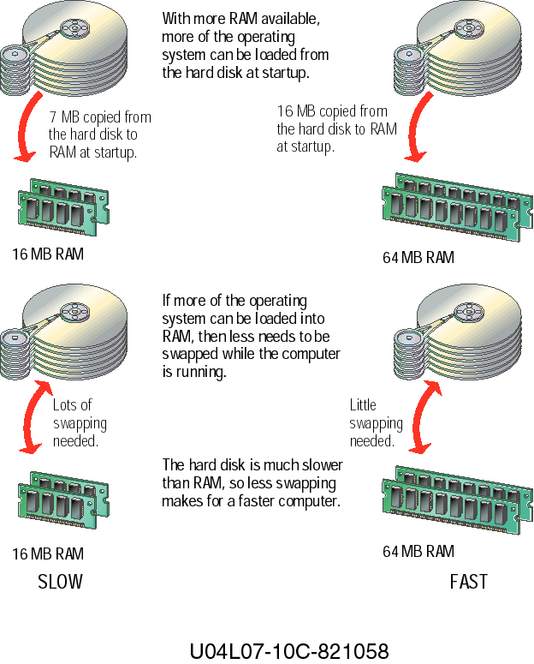

Slide 26
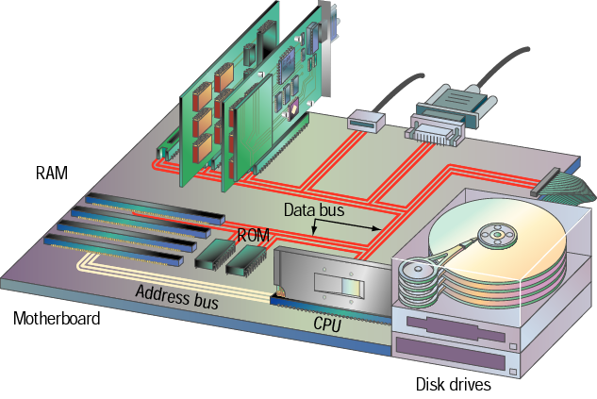

More RAM = Better Performance!

Slide 27
Factors Affecting Processing Speed –
The System Clock
The computer's system clock sets the pace for the CPU by using a vibrating quartz crystal.
A single "tick" of the clock is the time required to turn a transistor off and back on. This is called a clock cycle.
Clock cycles are measured in Hertz (Hz), a measure of cycles per second. If a computer has a clock speed of 300 MHz, then its system clock "ticks" 300 million times every second.
The faster a PC's clock runs, the more instructions the PC can execute each second.

Slide 28
Factors Affecting Processing Speed –
The Bus
A bus is a path between the components of a computer. Data and instructions travel along these paths.
The data bus' width determines how many bits can be transmitted between the CPU and other devices.
The address bus runs only between the CPU and RAM, and carries nothing but memory addresses for the CPU to use.
Peripheral devices are connected to the CPU by an expansion bus.

Slide 29
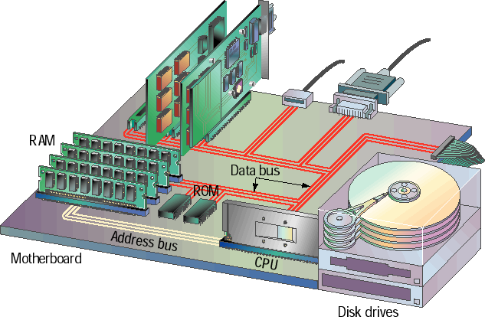

Slide 30
Factors Affecting Processing Speed –
Cache Memory
Cache memory is high-speed memory that holds the most recent data and instructions that have been loaded by the CPU.
Cache is located directly on the CPU or between the CPU and RAM, making it faster than normal RAM.
CPU-resident cache is called Level-1 (L1) cache. External cache is called Level-2 (L2) cache.
The amount of cache memory has a tremendous impact on the computer's speed.

Slide 31
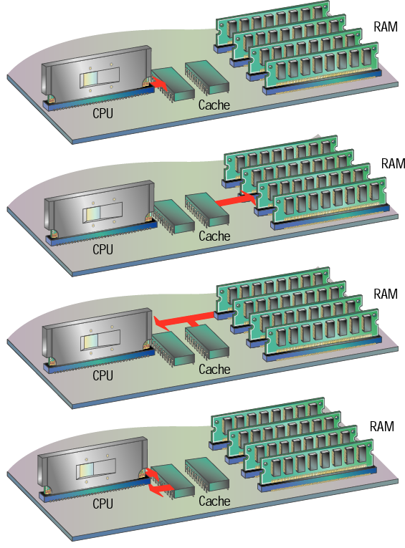

Slide 32
Extending the Processor's Power
to Other Devices
Ports
Expansion Slots and Boards

Slide 33
    Extending the Processor's Power
    to Other Devices – Ports
External devices—such as those used for input and output—are connected to the system by ports on the back of the computer.
PCs feature a number of built-in ports, which are ready to accept devices such as a printer, mouse, keyboard, phone line, microphone and speakers, and others.
Most computers come with a serial port and a parallel port. A serial port transmits one bit of data at a time; a parallel port transmits data one byte at a time.

Slide 34
Adding Other Devices –
Expansion Slots and Boards
If the PC does not have a port for an external device, you can install an expansion board into one of the empty expansion slots.
A board provides the correct port for the new device, and connects the device to the CPU by way of the computer's expansion bus.
Newer bus technologies such as Universal Serial Bus (USB) and IEEE 1394 enable many devices to be connected to one port.
Small Computer System Interface (SCSI) is an older standard for extending the bus to multiple devices through a single port.

Slide 35
lesson 7 Review
List two reasons why computers use the binary number system.
List the two main parts of the CPU and explain how they work together.
Explain the difference between RAM and ROM.
Identify two RAM technologies used in PCs.
List three hardware factors that affect processing speed.
Identify four connections used to attach devices to a PC.

