Slide 1
Design model
Presentation Subtitle

Slide 2
SDLC

Slide 3
systems development life cycle (SDLC)
The systems development life cycle (SDLC), also referred to as theapplication development life-cycle, is a term used in systems engineering,information systems and software engineering to describe a process for planning, creating, testing, and deploying an information system.The systems development life-cycle concept applies to a range of hardware and software configurations, as a system can be composed of hardware only, software only, or a combination of both

Slide 4
Like anything that is manufactured on an assembly line, an SDLC aims to produce high quality systems that meet or exceed customer expectations, based on customer requirements, by delivering systems which move through each clearly defined phase, within scheduled time-frames and cost estimates
To manage this level of complexity, a number of SDLC models or methodologies have been created, such as "waterfall"; "spiral"; "Agile software development"; "rapid prototyping"; "incremental"; and "synchronize and stabilize"

Slide 5
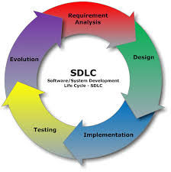
How it looks

Slide 6
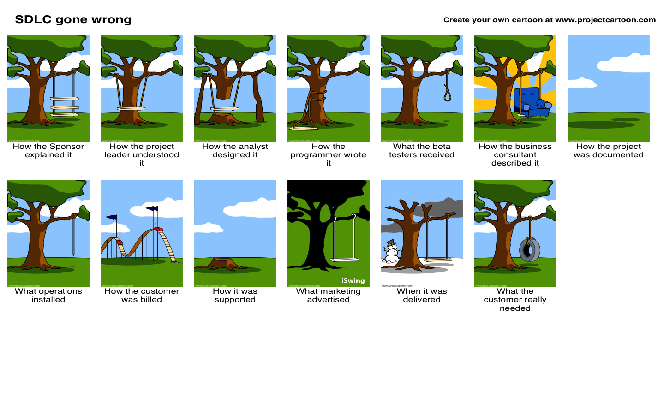

Slide 7
Requirement gathering and analysis: Business requirements are gathered in this phase. This phase is the main focus of the project managers and stake holders. Meetings with managers, stake holders and users are held in order to determine the requirements like; Who is going to use the system? How will they use the system? What data should be input into the system? What data should be output by the system? These are general questions that get answered during a requirements gathering phase. After requirement gathering these requirements are analyzed for their validity and the possibility of incorporating the requirements in the system to be development is also studied.
Finally, a Requirement Specification document is created which serves the purpose of guideline for the next phase of the model.

Slide 8
Design: In this phase the system and software design is prepared from the requirement specifications which were studied in the first phase. System Design helps in specifying hardware and system requirements and also helps in defining overall system architecture. The system design specifications serve as input for the next phase of the model.
Implementation / Coding: On receiving system design documents, the work is divided in modules/units and actual coding is started. Since, in this phase the code is produced so it is the main focus for the developer. This is the longest phase of the software development life cycle.

Slide 9
Testing: After the code is developed it is tested against the requirements to make sure that the product is actually solving the needs addressed and gathered during the requirements phase. During this phase all types of functional testing like unit testing, integration testing, system testing, acceptance testing are done as well as non-functional testing are also done.

Slide 10
Deployment: After successful testing the product is delivered / deployed to the customer for their use.
Maintenance: Once when the customers starts using the developed system then the actual problems comes up and needs to be solved from time to time. This process where the care is taken for the developed product is known as maintenance.

Slide 11
Requirement gathering and analysis: Business requirements are gathered in this phase. This phase is the main focus of the project managers and stake holders. Meetings with managers, stake holders and users are held in order to determine the requirements like; Who is going to use the system? How will they use the system? What data should be input into the system? What data should be output by the system? These are general questions that get answered during a requirements gathering phase. After requirement gathering these requirements are analyzed for their validity and the possibility of incorporating the requirements in the system to be development is also studied.
Finally, a Requirement Specification document is created which serves the purpose of guideline for the next phase of the model.

Slide 12
Requirement gathering and analysis: Business requirements are gathered in this phase. This phase is the main focus of the project managers and stake holders. Meetings with managers, stake holders and users are held in order to determine the requirements like; Who is going to use the system? How will they use the system? What data should be input into the system? What data should be output by the system? These are general questions that get answered during a requirements gathering phase. After requirement gathering these requirements are analyzed for their validity and the possibility of incorporating the requirements in the system to be development is also studied.
Finally, a Requirement Specification document is created which serves the purpose of guideline for the next phase of the model.

Slide 13

Project Completed

