Slide 1
E-R Data Model

Slide 2
Topics
Entity-Relationship Intro
Entity
Attribute
Concept of Keys
Relationships

Slide 3
E-R Data Model
Is a semantic data model, that is a data model that provides you more constructs more tools to fit in different situations, the advantage is when you draw, when you make a deigns using E-R data model it is more explanatory, it clearer to understand, it portrays, it models more information to the design.

Slide 4
E-R Data Model
It is a semantic data model that is used for the graphical representation of the conceptual database design.

Slide 5
Components of E-R Data Model
The E-R data model supports following major constructs:
Entity
Attribute
Relationship
We are going to discuss each one of them in detail.

Slide 6
The Entity
Entity is basic building block of the E-R data model. The term entity is used in three different meanings or for three different terms and that are:
Entity type
Entity instance
Entity set
In this course we will be using the precise term most of the time. However after knowing the meanings of these three terms it will not be difficult to judge from the context which particular meaning the term entity is being used in.

Slide 7
Entity Type
The entity type can be defined as a name/label assigned to items/objects that exist in an environment and that have similar properties.
It could be person, place, event or even concept, that is, an entity type can be defined for physical as well as not-physical things.
An entity type is distinguishable from other entity types on the basis of properties and the same thing provides the basis for the identification of an entity type.

Slide 8
Entity Type
We can identify or associate certain properties with each of the existing in that environment.
Now the things that have common or similar properties are candidates of belonging to same group, if we assign a name to that group then we say that we have identified an entity type.

Slide 9
Entity Type
However, many times the grouping of things in an environment is dictated by the specific interest of the organization or system that may supersede the natural classification of entity types.
For example, in an organization, entity types may be identified as donated items, purchased items, manufactured items; then the items of varying nature may belong to these entity types, like air conditioners, tables, frying pan, shoes, car; all these items are quite different from each other by their respective nature, still they may be considered the instances of the same entity type since they are all donated or purchased or manufactured.

Slide 10
Entity Type
Analyzing user environment
Abstraction process (thinking ability)
Experience
can help you to identifying an entity type.

Slide 11
Entity Instance
A particular object belonging to a particular entity type and how does an item becomes an instance of or belongs to an entity type?
By possessing the defining properties associated with an entity type.
Each entity instance possesses certain values against the properties with the entity type to which it belongs.

Slide 12
Entity Instance
Each record in the table is an instance of a Car, like Ford Mustang.
Quaid-e-Azam is an instance of a Person.
Apple is an instance of a Fruit.

Slide 13
Entity Set
A group of entity instances of a particular entity type is called an entity set.

Slide 14
Entity Type : Student
Entity Instance: M. Ahmer
Entity Set : All Students

Slide 15
Entity Examples
Person: EMPLOYEE, STUDENT, PATIENT
Place: CITY, DEPARTMENT
Object: MACHINE, BUILDING, AUTOMOBILE
Event: CUSTOMER_ORDER, INVENTORY_RENEWAL
Concept: ACCOUNT, COURSE, WORK_CENTER

Slide 16
Classification of entity types
Weak Entity Types
Strong Entity Type

Slide 17
Weak Entity Types
An entity type whose instances cannot exist without being linked with instances of some other entity type, i.e., they cannot exist independently.

Slide 18
Example
For example, in an organization we want to maintain data about the vehicles owned by the employees.
Now a particular vehicle can exist in this organization only if the owner already exists there as employee.
Similarly, if employee leaves the job and the organization decides to delete the record of the employee then the record of the vehicle will also be deleted since it cannot exist without being linked to an instance of employee.

Slide 19
Examples
Dependants of an employee
Order history

Slide 20
Strong Entity Type
An entity type whose instances can exist independently, that is, without being linked to the instances of any other entity type is called strong entity type.

Slide 21
Naming Entity Types
Singular noun recommended, but still plurals can also be used
Organization specific names, like customer, client, anything will work
Write in capitals, yes, this is something that is generally followed, otherwise will also work.
Abbreviations can be used, be consistent. Avoid using confusing abbreviations, if they are confusing for others today, tomorrow they will confuse you too.

Slide 22
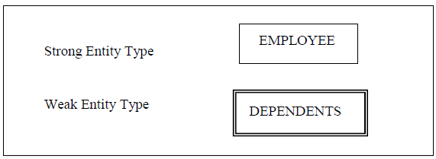
Symbols for Entity Types

Slide 23
BOOK
BOOK
BOOKCOPY

Slide 24
Attribute
An attribute of an entity type is a defining property or quality of the instances of that entity type.
However, values of these attributes may be same or different. For example, all instances of the entity type STUDENT may have the attributes name, father name, age; but the values against each of these attributes for each instance may be different.

Slide 25
Attribute
The thing to remember at this stage is that attributes are associated with an entity type and those attributes then become applicable /valid for all the instances of that entity type and instances have values against these attributes.

Slide 26
Domain of an Attribute
Domain is the set of possible values that an attribute can have, that is, we specify a set of values either in the form of a range or some discrete values, and then attribute can have value out of those values. Domain is a form of a check or a constraint on attribute that it cannot have a value outside this set.

Slide 27
Domain of an Attribute
For example, if we define a salary attribute of EMPLOYEE entity type to hold the salary of employees, the value assigned to this attribute should be numeric, it should not be assigned a value like ‘Amir’, or ‘10/10/2004’.
even if we have declared it as numeric it will have numeric values, but about a value like 10000000000. This is a numeric value, but is it a legal salary value within an organization? You have to ask them.
It means not only you will specify that the value of salary will be numeric but also associate a range, a lower and upper limit. It reduces the chances of mistake.

Slide 28

Symbols of Attributes
Each represented as an oval, linked with an ET symbol.

Slide 29
Types of Attributes
Attributes may be of different types. They may be:
Simple or Composite
Single valued or multi-valued
Stored or Derived

Slide 30
Simple Attributes
An attribute that is a single whole is a simple attribute. The value of a simple attribute is considered as a whole, not as comprising of other attributes or components.
For example, attributes stName, stFatherName, stDateOfBorth of an entity type STUDENT are example of simple attributes.

Slide 31
Composite Attributes
On the other hand if an attribute consists of collection of other simple or composite attributes then it is called a composite attributes.
For example, stAdres attribute may comprise of houseNo, streetNo, areaCode, city etc. In this case stAdres will be a composite attribute.

Slide 32
Examples
Simple {Salary}
Composite { Name (FirstName, LastName), }

Slide 33
Single valued
Some attribute have single value at a time, For example designation are generally single valued attributes.

Slide 34
Multi-valued
For example, hobby attribute of STUDENT or skills attribute of EMPLOYEE, since a student may have multiple hobbies, likewise an employee may have multiple skills so they are multi-valued attributes.

Slide 35
Examples
Single { Age, City, Name, CustomerID
}
Multivalue { MultiPhoneNumbers, Qualifications
}

Slide 36
Stored
Normally attributes are stored attributes, that is, their values are stored and accessed as such from the database.
For example, we may store the name, father name, address of employees

Slide 37
Derived
However, sometimes attributes’ values are not stored as such, rather they are computed or derived based on some other value. This other value may be stored in the database or obtained some other way.
Age can be computed from date of birth.

Slide 38
Examples
Stored {DOB, Bonus, HireDate }
Derived {Age, GrossSalary, Experience }

Slide 39
Attributes
How a particular attribute is stored or defined, it is decided first by the environment and then it has to be designer’s decision; your decision.
Because, the organization or system will not object rather they will not even know the form in which you have defined an attribute.
You have to make sure that the system works properly, it fulfills the requirement; after that you do it as per your convenience and in an efficient way.

Slide 40
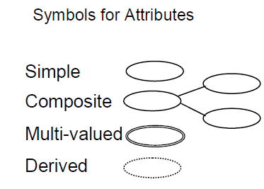

Slide 41
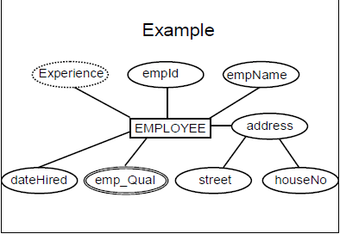

Slide 42
The Keys
A key is a set of attributes that can be used to identify or access a particular entity instance of an entity type (or out of an entity set).
The concept of key is beautiful and very useful; why and how.
An entity type may have many instances, from a few to several thousands and even more. Now out of many instances, when and if we want to pick a particular/single instance, and many times we do need it, then key is the solution.

Slide 43
Concept of Key
For example, think of whole population of Pakistan, the data of all Pakistanis lying at one place, say with NADRA people. Now if at sometime we need to identify a particular person out of all this data, how can we do that?
Can we use name for that? like Mirza Zahir.
Another option is the combination of name and father name. Mirza Amjad s/o Mirza Zahir.

Slide 44
Concept of Key
If you think about National ID Card number, then no matter whatever is the population of Pakistan, you will always be able to pick precisely a single person.
That is the key.

Slide 45
Concept of Key
While defining an entity type we also generally define the key of that entity type.
How do we select the key, from the study of the real-world system.
Key attribute(s) already exist there, sometimes they don’t then the designer has to define one.
A key can be simple, that is, consisting of single attribute, or it could be composite which consists of two or more attributes.

Slide 46
Types Of Keys
Following are the major types of keys:
Super Key
Candidate Key
Primary Key
Alternate Key
Secondary Key
Foreign Key

Slide 47
Simple or Composite key
A key consisting of single attribute is called simple key, e.g, StudID, PoroductNo
A key consisting of more than one attribute is known as composite key, like
{Program_Code, Course_Code}

Slide 48
Simple or Composite Key
Program_Code | Course_Code | Marks_Allocated | Credit_hours
MCS | DS | 100 | 3
BCS | DBS | 100 | 3
BCS | IT | 100 | 3
MCS | DBS | 100 | 3
BBA | IT | 100 | 3

Slide 49
Super Key
A super key is a set of one or more attributes which taken collectively, allow us to identify uniquely a entity instance in the entity set.
For example, consider the entity type STUDENT with attributes registration number, name, father name, address, phone, class, admission date. Now which attribute can we use that can uniquely identify any instance of STUDENT entity type. Of course, none of the name, father name, address, phone number, class, admission date can be used for this purpose.

Slide 50
Super Key
Once specific characteristic with super key is that, as per its definition any combination of attributes with the super key is also a super key.
Like, in the example just discussed where we have identified regNo as super key, now if we consider any combination of regNo with any other attribute of STUDENT entity type, the combination will also be a super key.
For example, “regNo, name”, “regNo, fName, address”, “name, fName, regNo” and many others, all are super keys.

Slide 51
Example
StdId | StdName | Address | ClName | CurSem
S1020 | Kamran | Latifabad #2 | MCS | 3
S1028 | Shoaib | Latifabad #4 | BCS | 3
S1022 | Vikram | Saddar | MCS | 4
S1054 | Ali | Kohsaar | BIT | 2
S1056 | Rehan | Qasimabad | BCS | 1

Slide 52
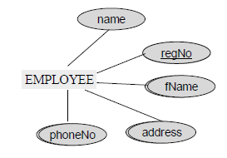

Slide 53
Candidate Key
A super key for which no subset is a super key is called a candidate key, or the minimal super key is the candidate key.
A candidate key is the super key that does not contain extra attributes. It might have more than one attributes that uniquely identifies an entity. e.g (name, address}.

Slide 54
Candidate Key
If super key is single attribute than it is a super key.

Slide 55
Primary key
A candidate key chosen by the database designer to act as key is the primary key.
An entity type may have more than one candidate keys, in that case the database designer has to designate one of them as primary key, since there is always only a single primary key in an entity type.

Slide 56
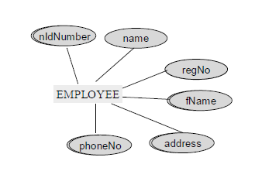
Examples
STUDENT with an additional attribute nIdNumber (national ID card Number), with RegNo.

Slide 57
Which one to select as Primary Key?
Use less attribute candidate key.
Easy to remember Or with small value.
Popular among organization, easy to remember.

Slide 58
Characteristics of Primary key
It cannot be duplicated.
it cannot have the NULL value.
If PK is a composite, then none of the attributes included in the PK can have the NULL.

Slide 59
Alternate key
Candidate keys which are not chosen as the primary key are known as alternate keys.
For example, we have two candidate keys of STUDENT in figure, regNo and nIdNumber, if we select regNo as PK then the nIdNumber will be alternate key.

Slide 60
Foreign Key
It is constraint that always parent’s PK serve as FK in child entity.
FK are used to combine two entities.

Slide 61
Relationships
After two or more entities are identified and defined with attributes, the participants determine if a relationship exists between the entities.
A relationship is any association, linkage, or connection between the entities of interest to the business.

Slide 62
Relationships
It is a two-directional.
Each relationship has a name, an optionality (optional or mandatory), and a degree (how many).
A relationship is described in real terms.

Slide 63
Relationships
Assigning a name, optionality, and a degree to a relationship helps confirm the validity of that relationship.
If you cannot give a relationship all these things, then perhaps there really is no relationship at all.

Slide 64
Relationships
Employees are assigned to projects
Projects have subtasks
Departments manage one or more projects
Departments hires employee
Customer orders products
People votes to candidate
Owner owns Car

Slide 65
Naming Relationships
If there is no proper name of the association in the system then participants’ names of abbreviations are used. STUDENT and CLASS have ENROLL relationship. However, it can also be named as STD_CLS.

Slide 66
Sybmols
DEPT
EMP
STD
BOOK

Slide 67
Relationships
A relationship type is an abstraction of a relationship i.e. a set of relationships instances sharing common attributes.
Entities enrolled in a relationship are called its participants.

Slide 68
Types of Relationships
Unary Relationship
Binary relationship
Ternary Relationship
N-ary Relationship

Slide 69
Unary Relationship
An ENTITY TYPE linked with itself, also called recursive relationship.
Example Roommate, where STUDENT is linked with STUDENT.
Roomate
Student

Slide 70
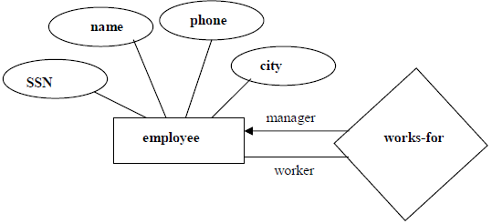

Slide 71
Binary Relationship
A Binary relationship is the one that links two entities sets e.g. STUDENT-CLASS.
Relationships can be formally described in an ordered pair form.

Slide 72
STD
COURSE
DEPT
EMP
STD
BOOK

Slide 73
Attributes of Relationship
The Key
The relationship can have their descriptive attributes
Grade
STUDENT
Course

Slide 74
Ternary Relationship
A Ternary relationship is the one that involves three entities e.g. STUDENT-CLASS-FACULTY.
STUDENT
Course
Faculty

Slide 75
PROJECT
EMPLOYEE
Faculty

Slide 76
N-ary Relationship
Most relationships in data model are binary or at most ternary but we could define a relationship set linking any number of entity sets i.e. n-ary relationship.

Slide 77
Relationship Cardinality
Number of instances of one entity type that can possibly be related to instances of other entity type.

Slide 78
One to One
One to Many
Many to one
Many to Many

Slide 79
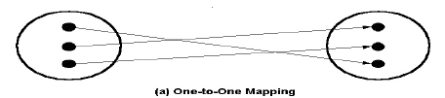
One-to-One mapping
A mapping R from X to Y is one-to-one if each entity in X is associated with at most one entity in Y and vice versa.

Slide 80
Examples
DEPT
CHAIR PERSON

Slide 81
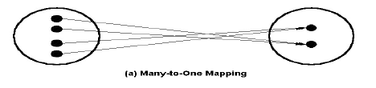
Many-to-One mapping
A mapping R from X to Y is many-to-one if each entity in X is associated with at most one entity in Y but each entity in Y is associated with many entities in X.

Slide 82
Examples
BRANCH
EMP

Slide 83
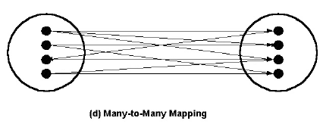
Many-to-Many mapping
A mapping R from X to Y is many-to-many if each entity from X is associated with many entities in Y and one entity in Y is associated with many entities in X.

Slide 84
Examples
PRODCUT
CUSTOMER

Slide 85
Expression of Relationship in ER Data Model
Minimum Cardinality
The minimum cardinality show us that how many instance of one entity can be placed in another relation at least.
In simple words it can be said that the minimum cardinality tells that whether the link between two relations is optional or compulsory.

Slide 86
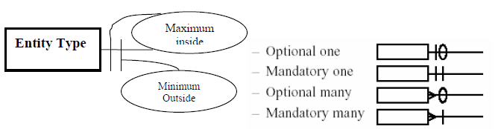
Expression of Relationship in ER Data Model

Slide 87
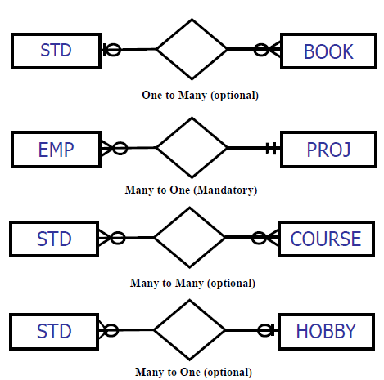

Slide 88
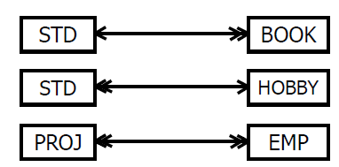

Slide 89
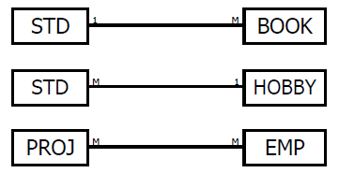

Slide 90
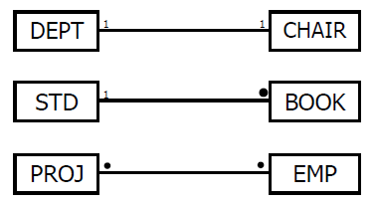

Slide 91
Roles in Relationships
Two situations to mention the role explicitly
Recursive Relationship
Multiple Relationships

Slide 92

Recursive Relationship
This is the situation when any attribute of one entity is associated with another attribute of the same entity.

Slide 93
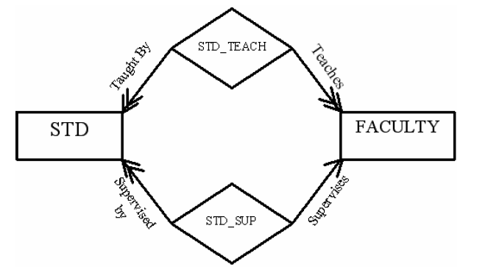
Multiple Relationships
This is the second situation which needs the role to be mentioned on the relationship link when there is more than one relationship.

Slide 94
Exercise

Slide 95
Person – NIC
Person – Passport
Person – Thumb Impression

Slide 96
Mother – Child
Author – Book
Employee – Phone
Customer – Order
Account Holder – Account

Slide 97
Student – Course
Employee – Skill
Student – Teacher
Person - Address

