Slide 1
GIT
By:Umer Farooq

Slide 2
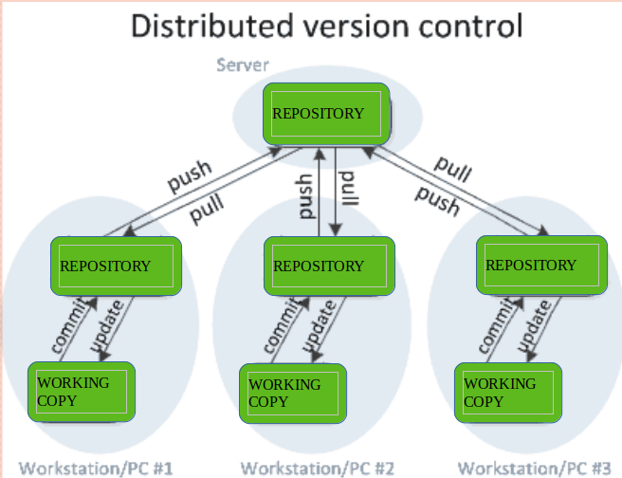
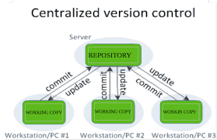
Version Control Types
Local Version Control Systems. Centralized Version Control Systems. Distributed Version Control Systems

Slide 3
GIT
Git is a free and open source distributed version control system designed to handle everything from small to very large projects with speed and efficiency.

Slide 4
What is repository
Repo=repository
Usually used to organize a single project
Repos can contain folders and files, images, videos, spreadsheet, and data sets – anything your project needs

Slide 5
Git Setup in system
Download Git from git scm
  https://git-scm.com/
Create account on github

Slide 6
commands
Open cmd with folder
  Git init
    Show folder
  Git status
    How many files track and un track
  Git add .
    It will add all files
    Chk status again
  Git commit –m “message”
    But if you are not login so login first
  Create repo on github after login
    There are 2 types of repo
      Public
      Private
  git remote add origin << repo link >>
    To connect folder and github repo
  git push -u origin master
    Code upload on github repo
  gh-pages
    Click on create
    For hosting
  Go on setting
    Click on check it out here
    Click on link

