Slide 1

Bank Customer Segmentation
Name : Umesh Rachanna
Batch : 514

Slide 2
About me
B-Tech CSE from Aurora’s Technological &Research Institute
I developed an interest in working with data and understanding how insights can help in better decision making. That’s why I choose to learn Data Analytics
LinkedIn : www.linkedin.com/in/umesh-rachanna/
GitHub : https://github.com/umesh-897

Slide 3
Agenda
Business Problem
Problem Statement
Introduction
Objective of the Project
Bank Customer Segmentation – Tables Overview
Data Cleaning
Dashboard Overview
Final business insights
Business Recommendations
Conclusion
Q&A
Thank You

Slide 4
Business Problem
Banks collect a large amount of customer and transaction data every day through deposits, withdrawals, online banking, ATM usage, and digital payments. However, collecting data alone is not enough. Without proper analysis, it is difficult to identify valuable customers, understand customer spending patterns, and detect potential financial risks.
As the number of customers increases, manual analysis becomes inefficient and time-consuming. By using a data-driven approach, banks can turn raw data into meaningful insights, helping them improve customer retention, personalize services, optimize marketing strategies, and make better business decisions.

Slide 5
Problem Statement
The primary challenge is to analyse customer demographic and transaction data to understand customer behaviour and identify different customer segments based on their value and activity.
This project aims to answer key business questions such as:
Who are the bank's most valuable (loyal) customers?
Which customers are at risk of becoming inactive?
Which customer segments generate the highest revenue?
How do customer demographics influence transaction behaviour?
Which customers require additional risk monitoring?

Slide 6
Introduction
Customer segmentation is an important technique used by banks to group customers based on characteristics such as age, account balance, transaction behaviour, and spending patterns.
In this project, Power BI is used to analyse a bank customer dataset by cleaning, transforming, and visualizing the data. Interactive dashboards provide insights into customer demographics, transaction behaviour, customer segments, profitability and risk factors. The dashboard includes KPIs, charts, tables, and slicers that help users explore the data easily and support better business decisions.

Slide 7
Objective
Understand customer demographics.
Analyze transaction trends.
Perform customer segmentation.
Identify high-value and high-risk customers.
Support business decision-making.

Slide 8
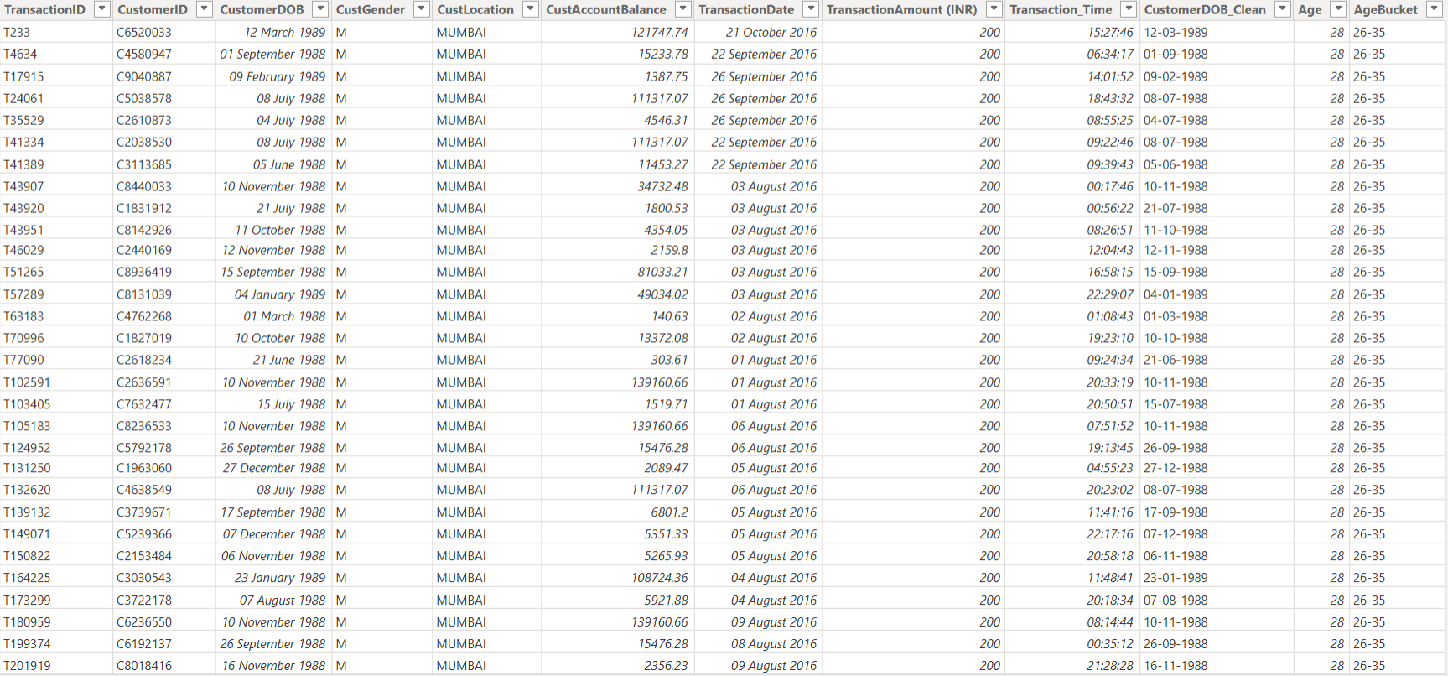
Table Overview

Slide 9
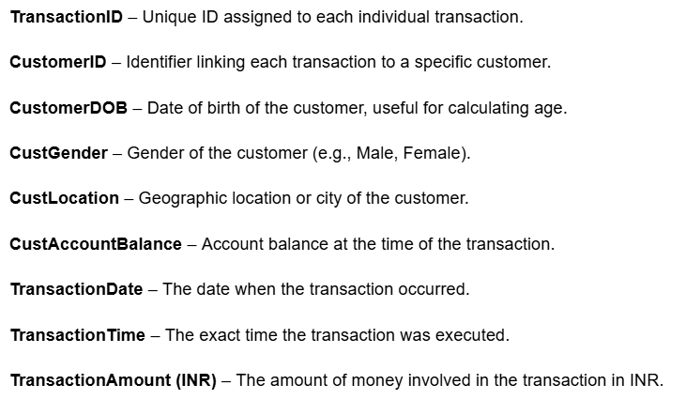
Column Description

Slide 10
Data Cleaning
Handled missing and duplicate records.
Converted data types (dates, numbers, time).
Created Age and Age Group columns.
Validated transaction amounts and balances.
Built calculated columns and DAX measures.

Slide 11
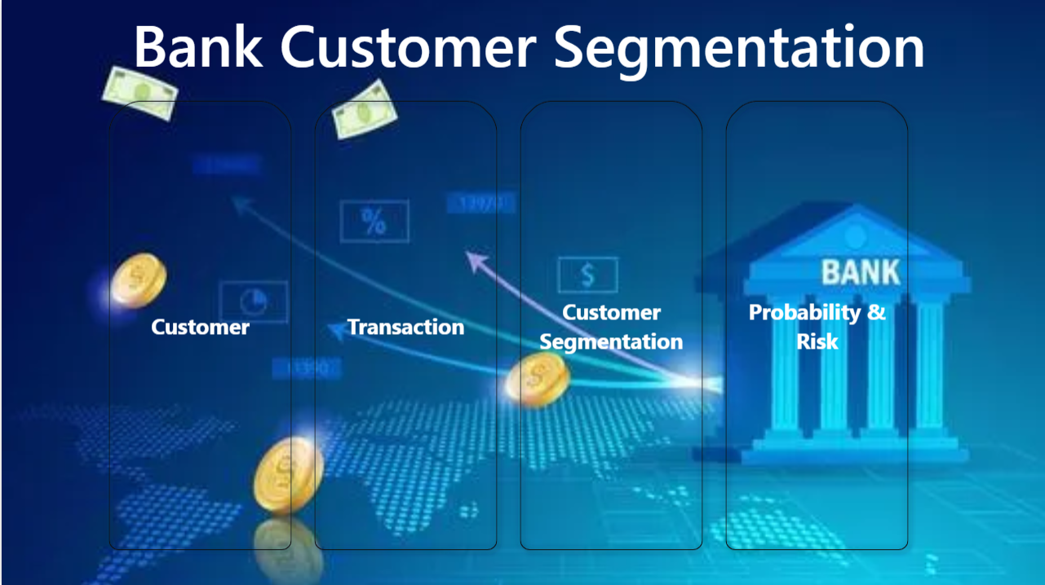
Dashboard Overview

Slide 12
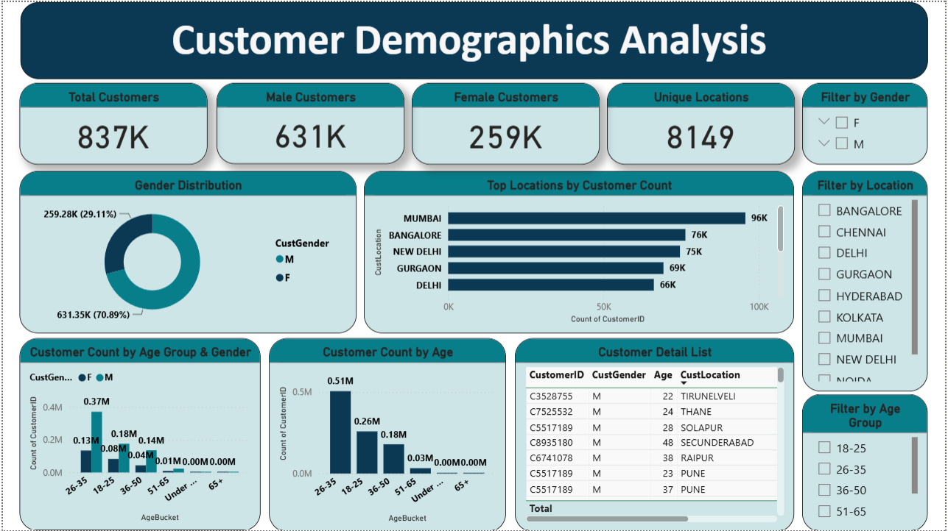

Slide 13
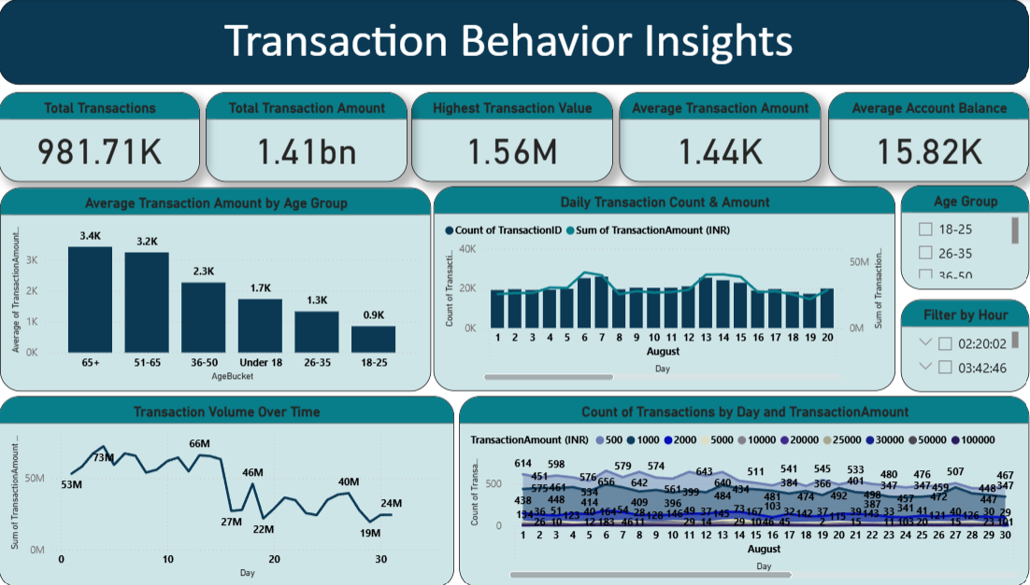

Slide 14
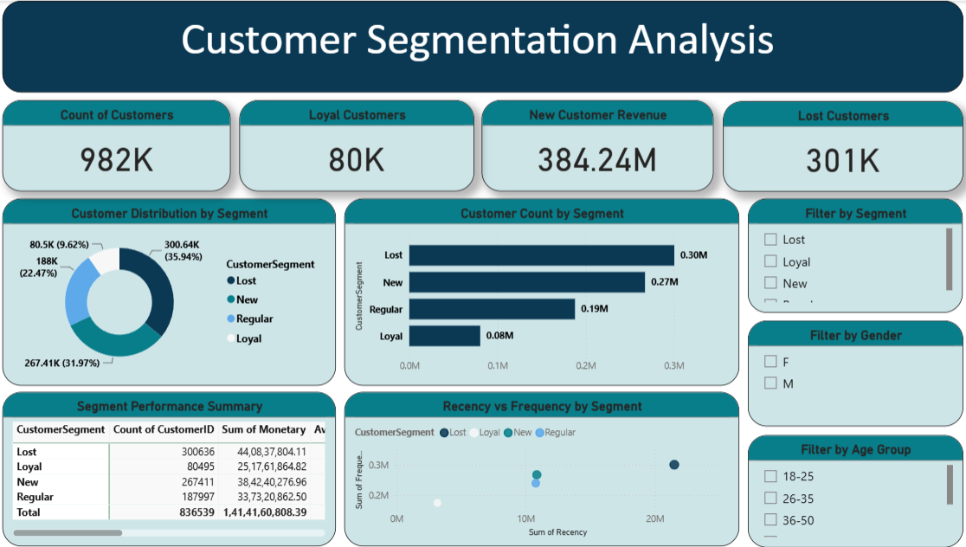

Slide 15
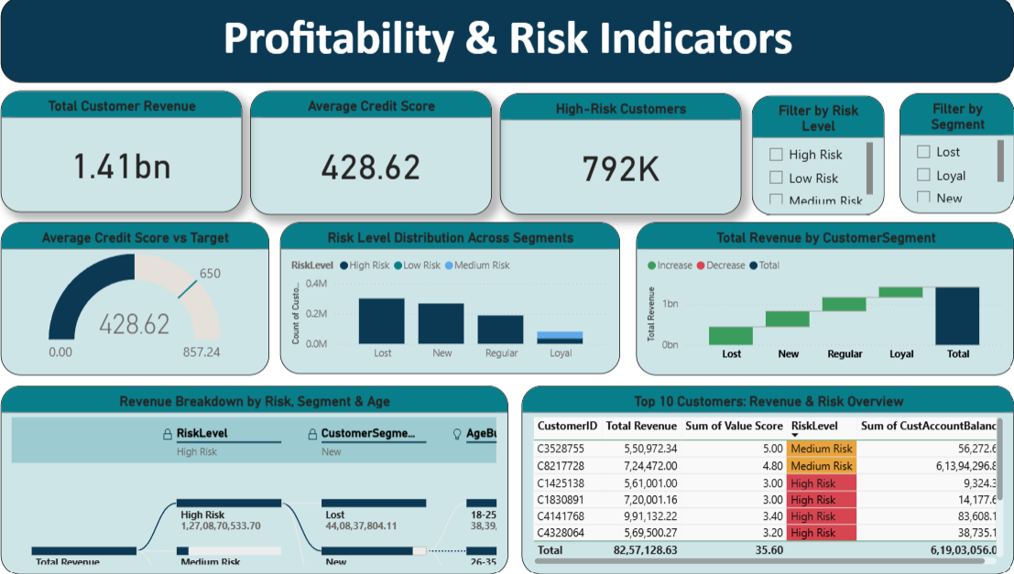

Slide 16
Final Business Insights
Loyal customers generate the most revenue per person, but there are very few of them.
Lost is your biggest segment by count (0.30M) but contributes the least revenue.
Transaction activity is remarkably stable day-to-day.
Customer base is dominated by young adults
Customer Segmentation Improves Decision-Making
Mumbai city has the highest customer count.

Slide 17
Business Recommendations
Reward loyal customers with personalized offers.
Target new customers with onboarding campaigns.
Re-engage lost customers using promotional campaigns.
Strengthen monitoring for high-risk customers.
Use segmentation for targeted marketing.

Slide 18
Conclusion
Customer segmentation helps banks better understand different customer groups based on their demographics and transaction behaviour.
The Power BI dashboard converts raw banking data into meaningful insights through interactive visualizations and KPIs.
Data analysis helps identify high-value customers, inactive customers, and potential risk segments, enabling targeted business strategies.
Interactive dashboards support faster data-driven decision-making and improve operational efficiency.
The insights gained from this project can help banks enhance customer satisfaction, improve retention, optimize marketing efforts, and drive business growth.

Slide 19
Q/A

Slide 20

THANK YOU

