Slide 1

Review prediction classifier model

Slide 2
introduction
Nowadays, a massive number of reviews is available online. Besides offering a valuable source of information, these informational contents generated by users, also called User Generated Contents (UGC) strongly impact the purchase decision of customers. As a matter of fact, a recent survey (Hinckley, 2015) revealed that 67.7% of consumers are effectively influenced by online reviews when making their purchase decisions. More precisely, 54.7% recognized that these reviews were either fairly, very or absolutely important in their purchase decision making. Relying on online reviews has thus become a second nature for consumer’s comment.

Slide 3
objective
The objective of comment classifier model is:-
We have a client who has a website where people write different reviews for technical products. Now they are adding a new feature to their website i.e. The reviewer will have to add stars(rating) as well with the review. The rating is out 5 stars and it only has 5 options available 1 star, 2 stars, 3 stars, 4 stars, 5 stars. Now they want to predict ratings for the reviews which were written in the past and they don’t have rating. So, we have to build a model which can predict the rating by seeing the review.

Slide 4
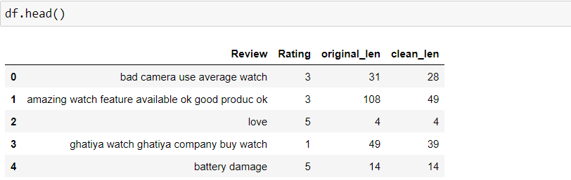
Dataset description
I have used Flipkart website to extract reviews from ['laptops', 'Phones', 'Headphones', 'smart watches', 'Professional Cameras', 'Printers', 'monitors', 'Home theatre', 'router']. There are in total 25544 rows and 2 columns of ratings and reviews are present in our dataset:-
Ratings: It is the Label column, which includes ratings in the form of integers from 1 to 5.
Full review: It contains text data on the basis of which we have to build a model to predict ratings.

Slide 5

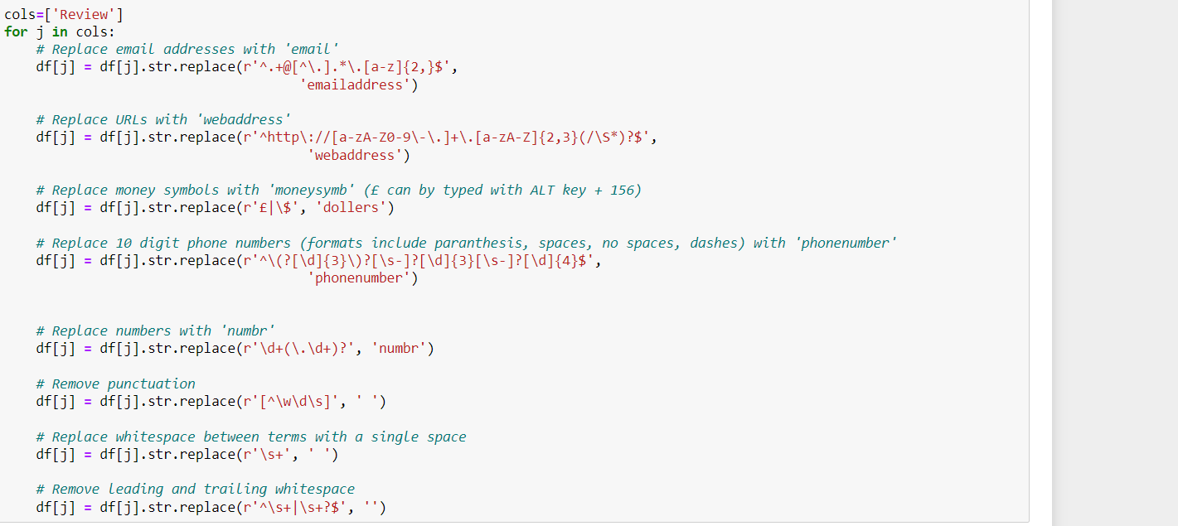
Data pre-processing
Converting lower case to upper case:
Text normalisation: it includes removing punctuation and symbols.

Slide 6

Stop words & lemmatisation
Stop words : Stop words are those words that are frequently used in both written and verbal communication and thereby do not have either a positive/negative impact on our statement.
Lemmatisation: lemmatisation is the process of grouping together of different inflated form words so they can be analysed as a single item.

Slide 7
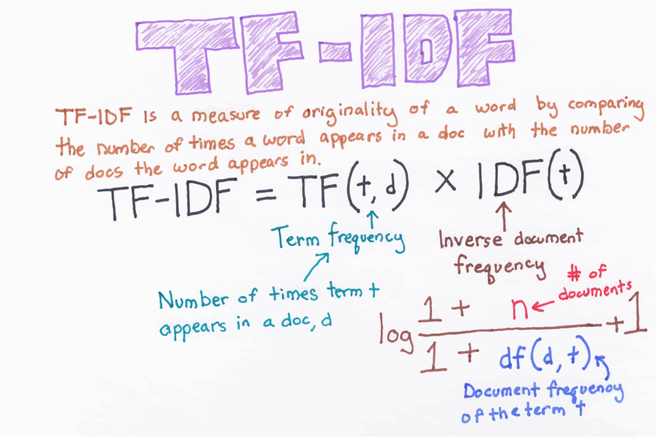
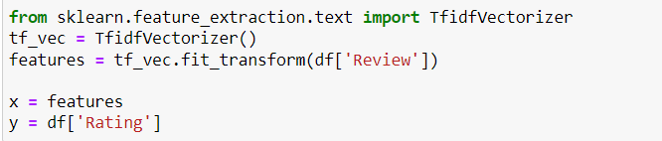
vectorisation
Tf-idf vectorisation :

Slide 8
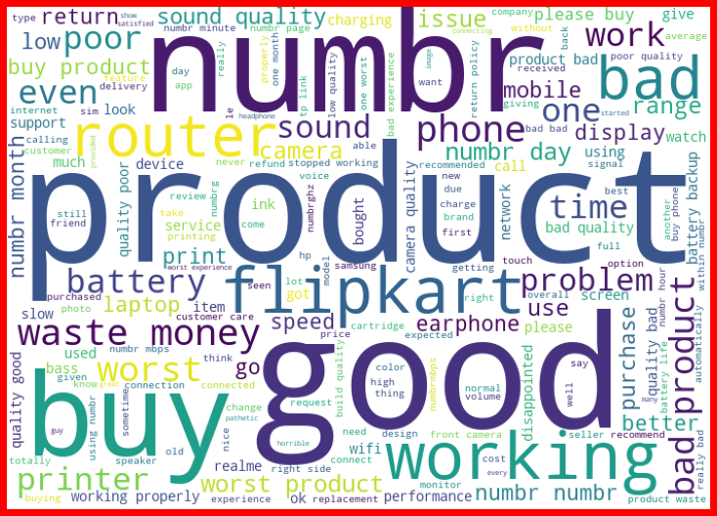
visualisation
Word cloud:Word Cloud is a data visualization technique used for representing text data in which the size of each word indicates its frequency or importance. Significant textual data points can be highlighted using a word cloud. Word clouds are widely used for analyzing data from social network websites.

Slide 9
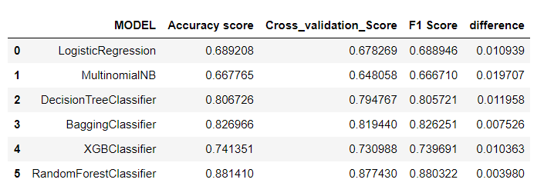
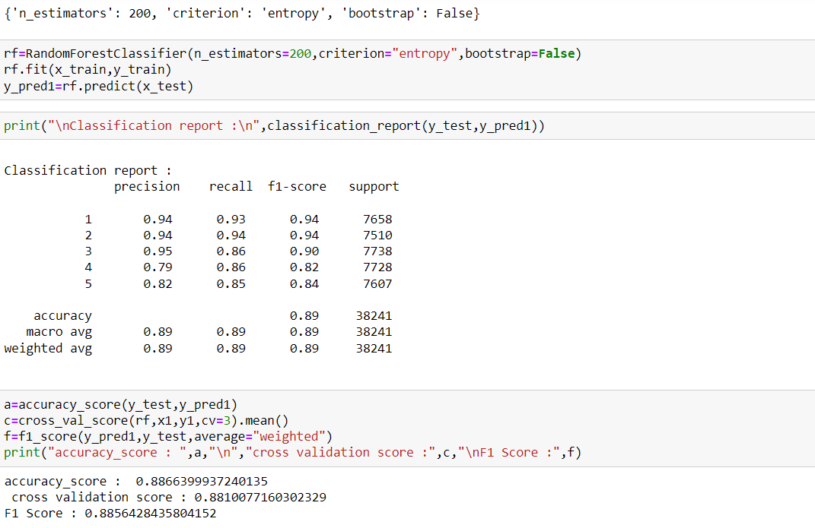
Model building
Best model
Random forest Classifier

Slide 10
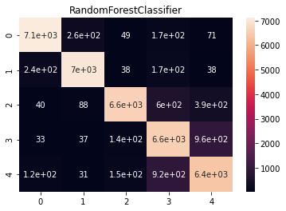
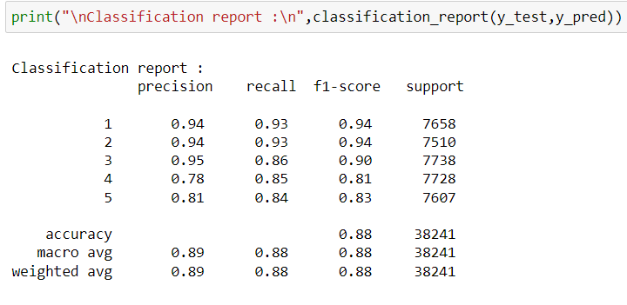
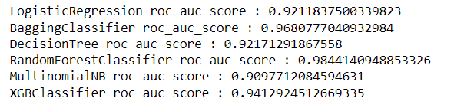
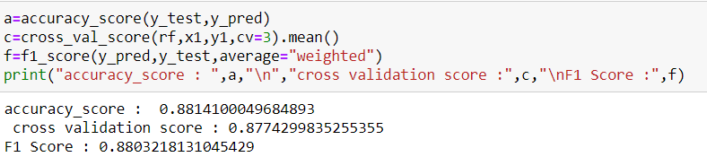
Metrics
Accuracy score
Confusion matrix
Recall
Precision
Auc roc Score

Slide 11
conclusion
In this project we have tried to detect the Ratings in commercial websites on a scale of 1 to 5 on the basis of the reviews given by the users. We made use of natural language processing and machine learning algorithms in order to do so. We interpreted that Random Forest classifier model is giving us best results. Through this project we were able to learn various Natural language processing techniques like lemmatization, stemming, removal of stop words. This project has demonstrated the importance of sampling effectively, modelling and predicting data. Through different powerful tools of visualization, we were able to analyze and interpret different hidden insights about the data. The few challenges while working on this project where: -
• Imbalanced dataset
• Lots of text data
The dataset was highly imbalanced so we balanced the dataset using smote technique. We converted text data into vectors with the help of tfidf vectorizer.

