Slide 1


E-commerce Furniture Dataset 2024
Project Report Summary
Internship ID: UMIP281177

Slide 2


1. Objective
Analyze and predict the number of furniture items sold.
Use productTitle, originalPrice, price, and tagText as features.

Slide 3
2. Tools Used
Python (Pandas, Seaborn, Scikit-learn)
SQL for querying insights
Excel for dashboards

Slide 4
3. Dataset Overview
2,000 entries from AliExpress
Columns: productTitle, originalPrice, price, sold, tagText

Slide 5
4. Steps Followed
Data Collection and Cleaning
EDA and Visualizations
Feature Engineering (Discount %, TF-IDF)
Model Training (Linear Regression, Random Forest)
SQL Integration & Excel Dashboard

Slide 6
5. Model Results
Linear Regression:
- R²: -0.4151, MSE: 194,750.99
Random Forest Regressor:
- R²: 0.2526, MSE: 102,857.73

Slide 7
6. Conclusion
Random Forest outperformed Linear Regression.
Discounts and shipping strongly influence sales.
Project shows end-to-end data science workflow.

Slide 8

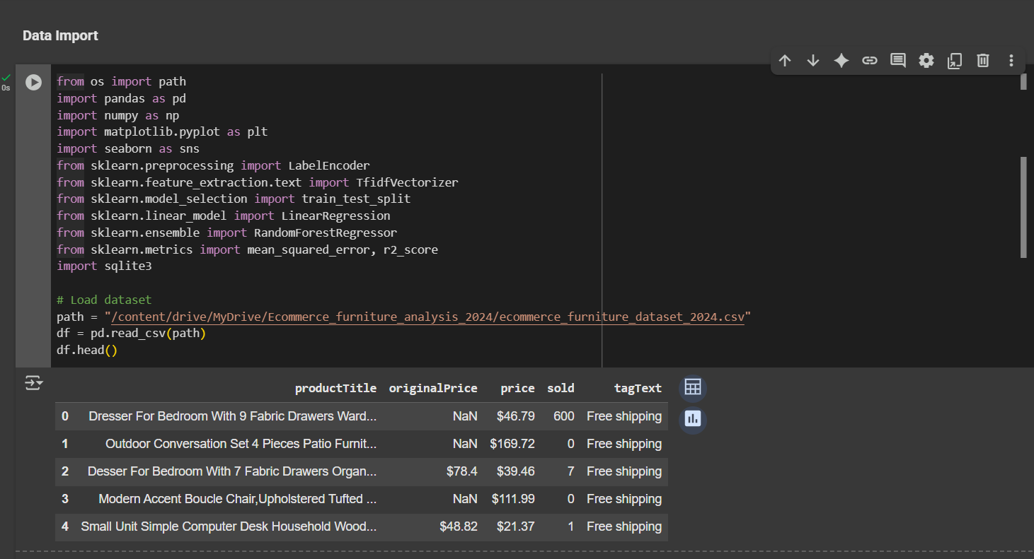
Code With Outputs

Slide 9
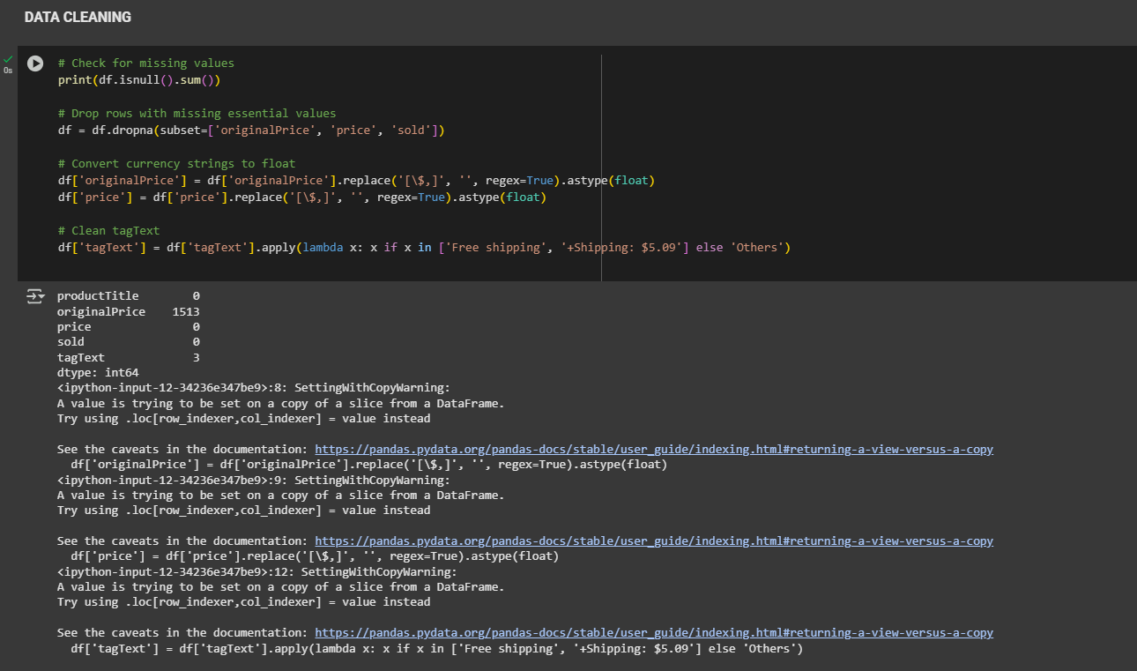
Data Cleaning

Slide 10
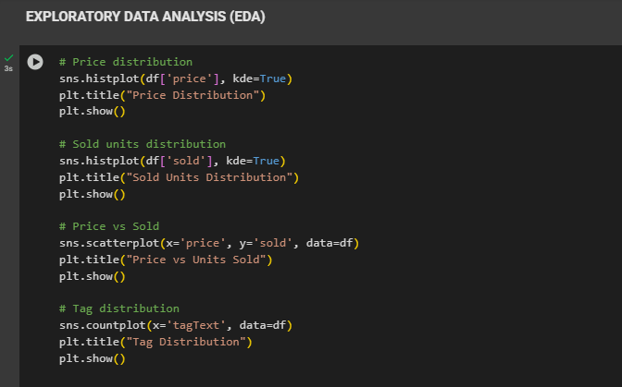
EDA

Slide 11
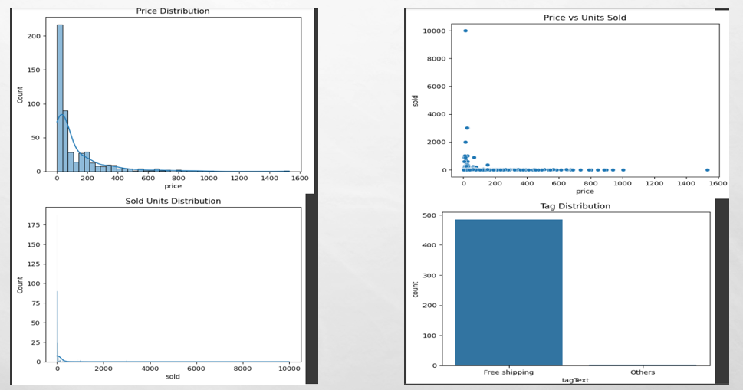
EDA Output

Slide 12
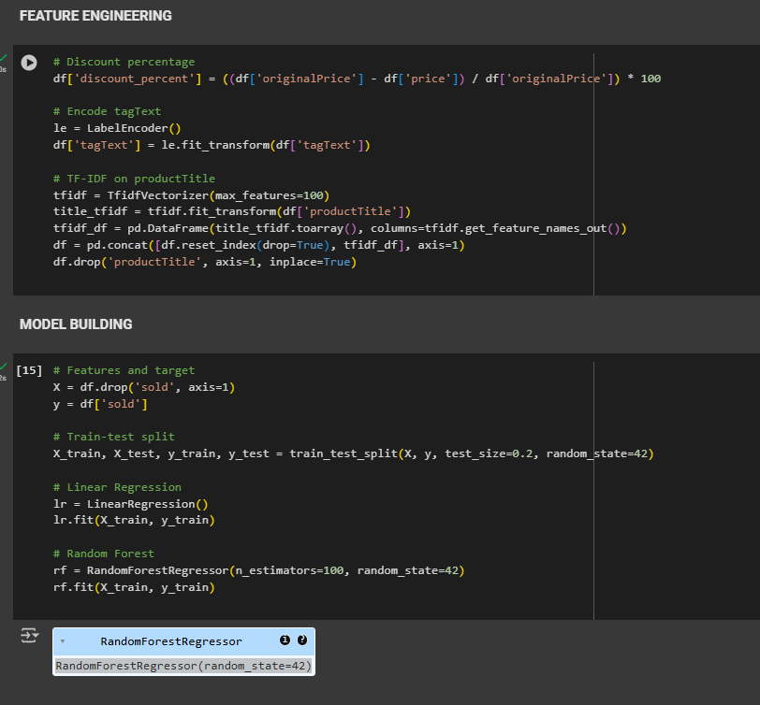
Features and Model Building

Slide 13
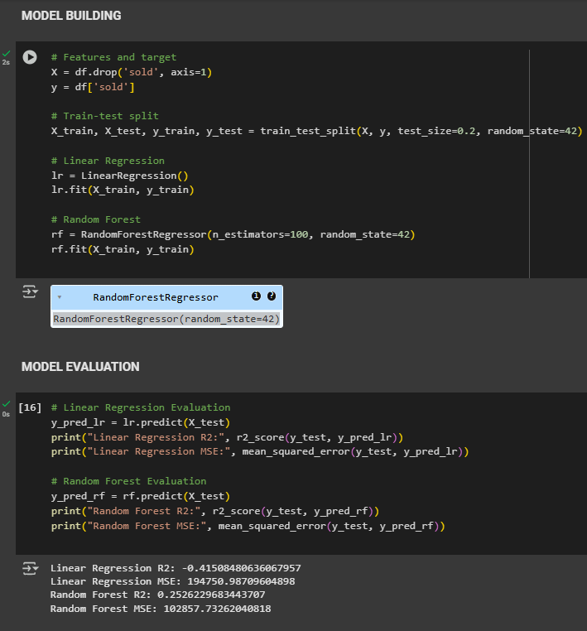
Model(Building and Evaluation)

Slide 14
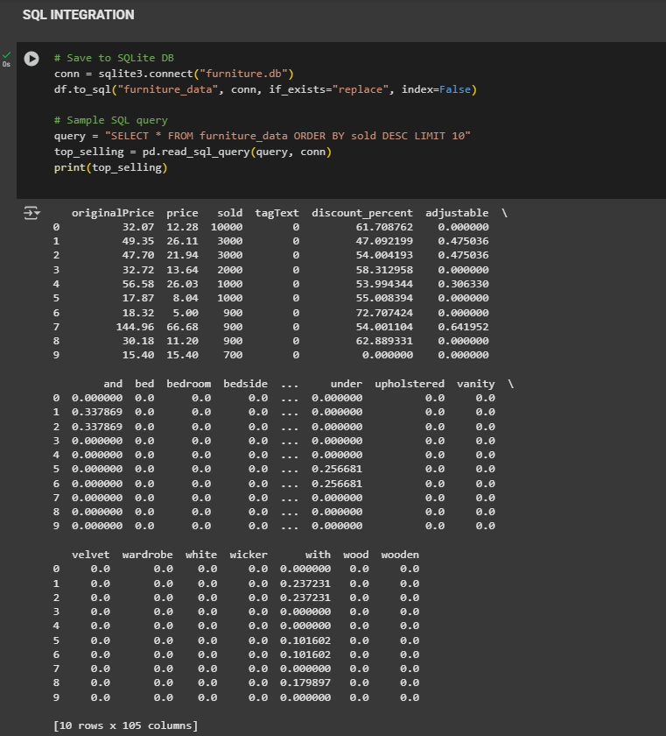
SQL Integration

Slide 15
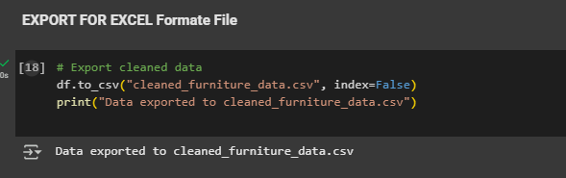
Export For Excel

Slide 16

Thank YOU

