Slide 1


Stock Market Analysis Dashboard
Built Using Power BI with Advanced Visuals
Internship ID: UMIP281177

Slide 2


Project Overview
Objective: To analyze stock trends, calculate volatility, and create an interactive dashboard.
Technologies Used:
- Power BI for Data Visualization
- Python API (Optional, for fetching data)

Slide 3

Data Collection & Preprocessing
Source: CSV / API Link
Description of data fields:
- Date, Open, High, Low, Close, Volume, etc.
Data Cleaning:
- Removed null values
- Corrected data types

Slide 4

Key Metrics & KPIs
- Highest Dividend Stock
- Most Volatile Stock
- Stock-wise Average Daily Trading Volume
- Highest & Lowest of 52 Weeks

Slide 5

Dashboard Layout Design
Dashboard Includes:
- Line Chart for Price Trends
- Bar Chart for Daily Trading Volume
- Pie/Donut Chart for Market Cap
- Stock Comparison & Volatility Analysis

Slide 6

Advanced Visuals & Charts
Explained:
KPI Cards
Interactive Slicers
Min/Max Analysis for 52-Week Data
Trend Analysis with Moving Averages

Slide 7

DAX Formulas & Calculations
- Calculating Volatility
- Moving Average
- Highest/Lowest Price Calculations

Slide 8

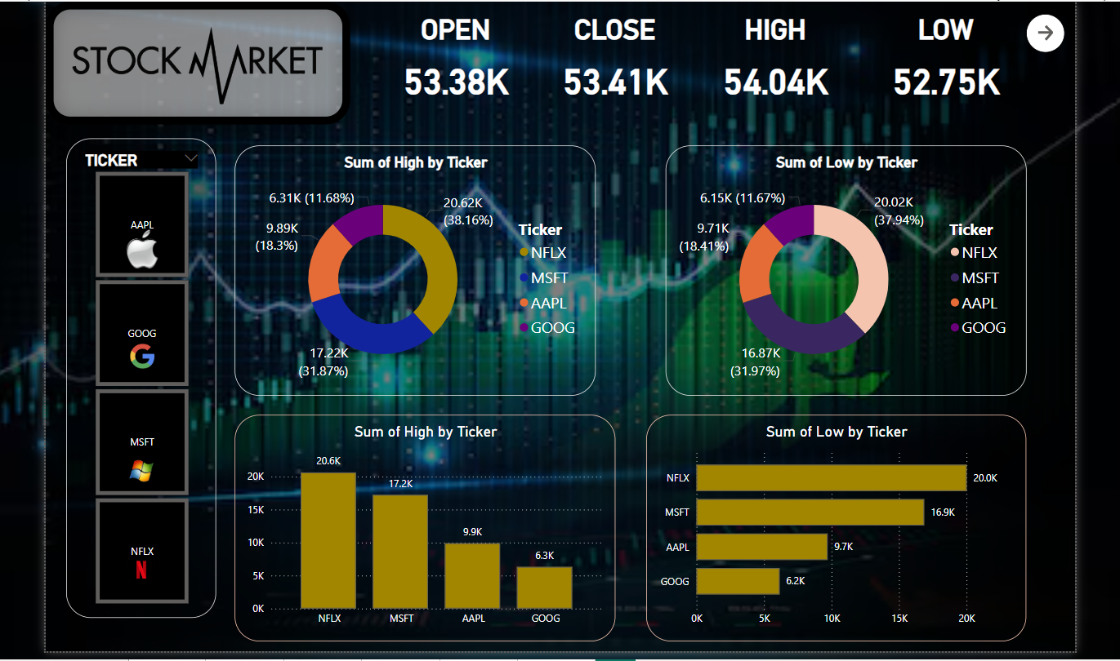
Dashboard Preview
Main page

Slide 9
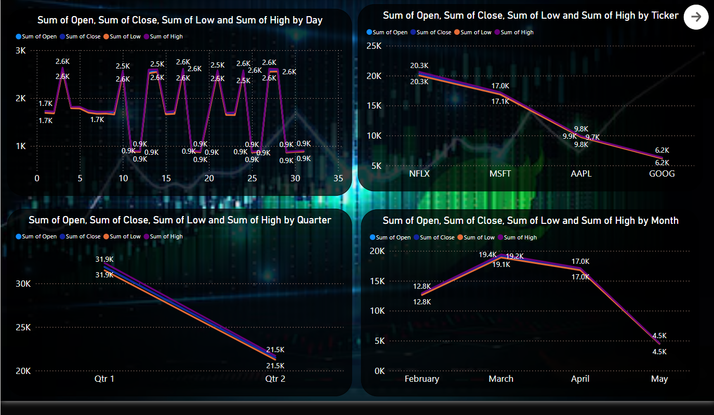
Second Page

Slide 10
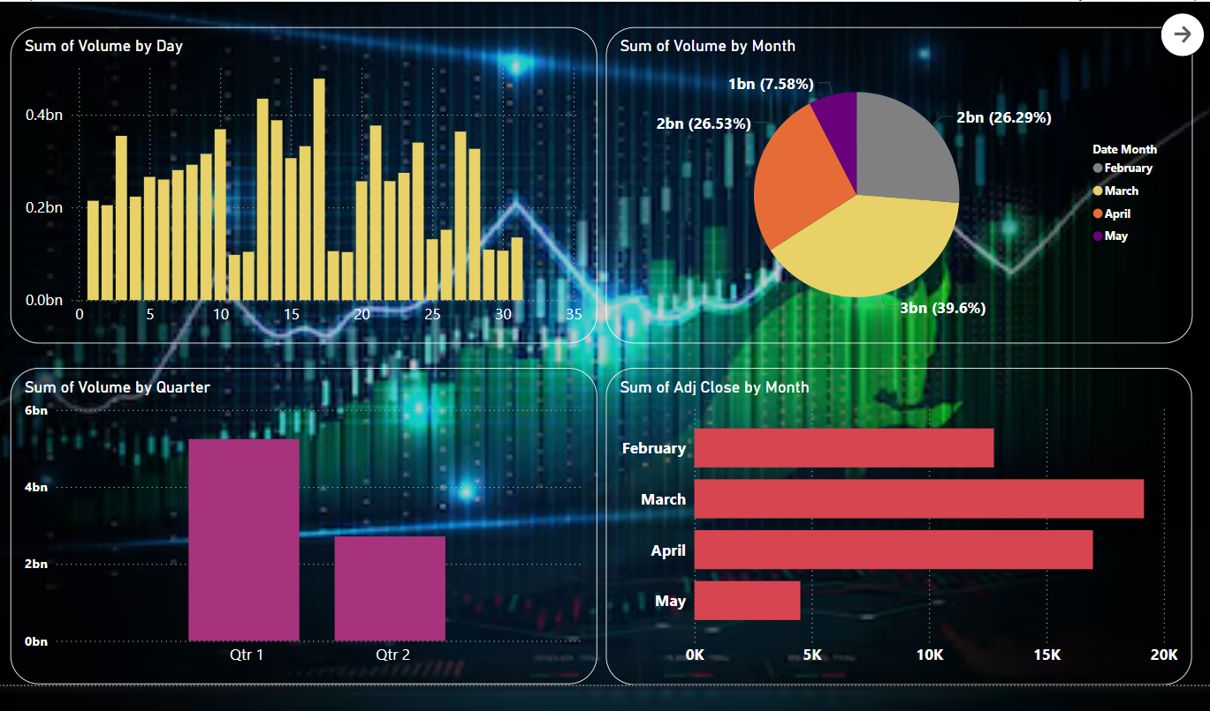
Third Page

Slide 11
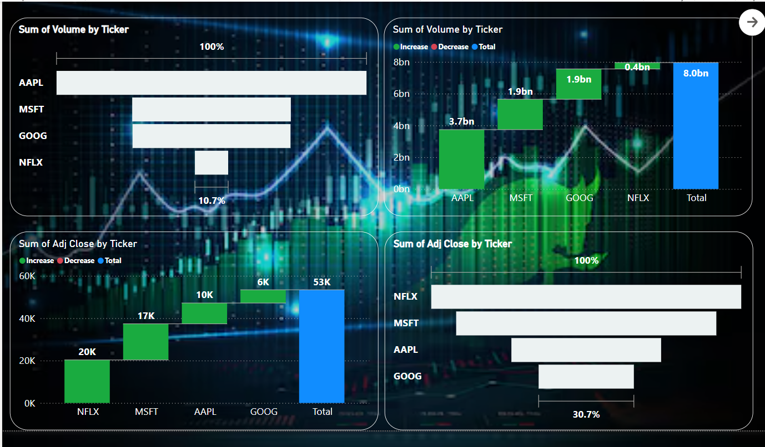
Fourth Page

Slide 12
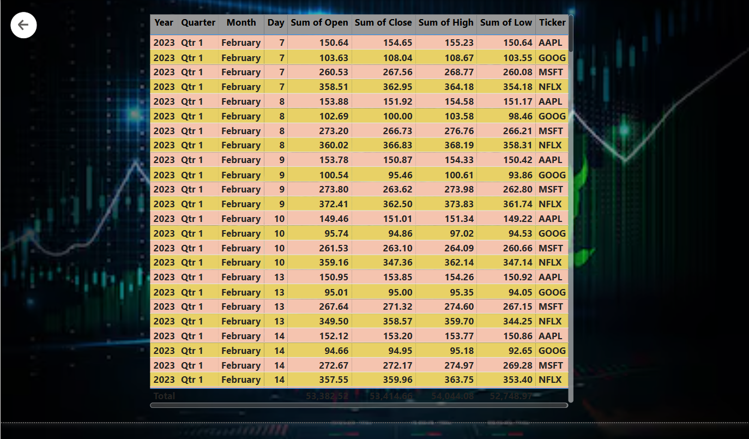
Final Page

Slide 13
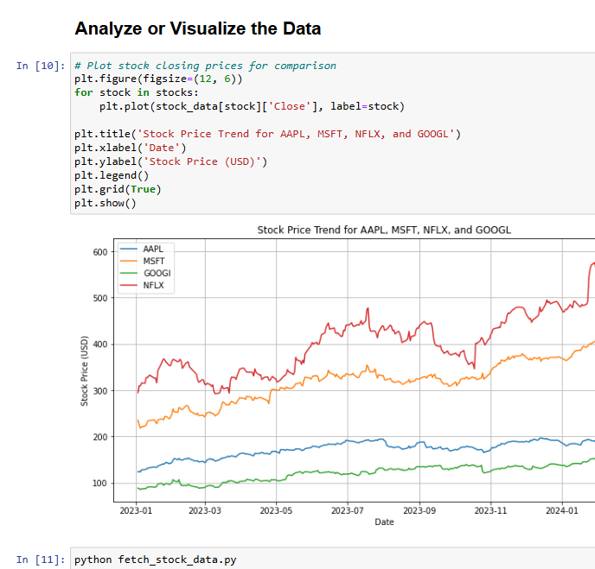
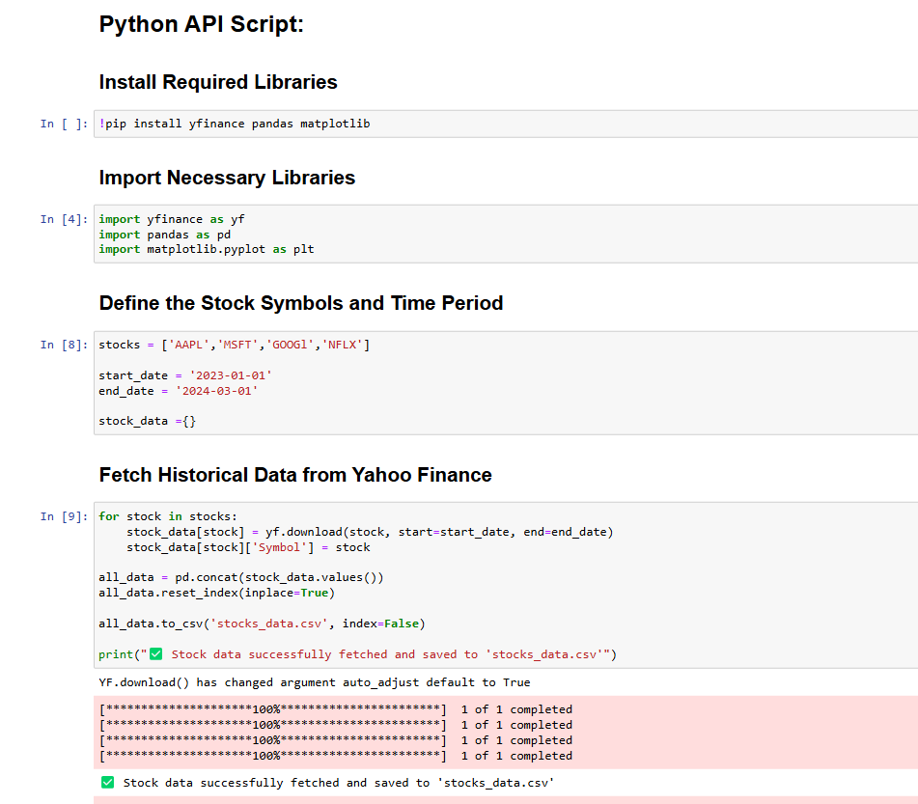
Python API Script:

Slide 14
Challenges & Solutions
- Issues with Data Transformation
- Challenges in DAX Calculations
- Fixed Aggregation Errors & Data Types

Slide 15
Conclusion & Future Scope
Summary of project outcomes:
- Successfully built an interactive Power BI dashboard.
- Possible improvements:
- Add real-time stock updates.
- Create predictive models for trend forecasting.

Slide 16


Thank You
Questions & Feedback

