Slide 2
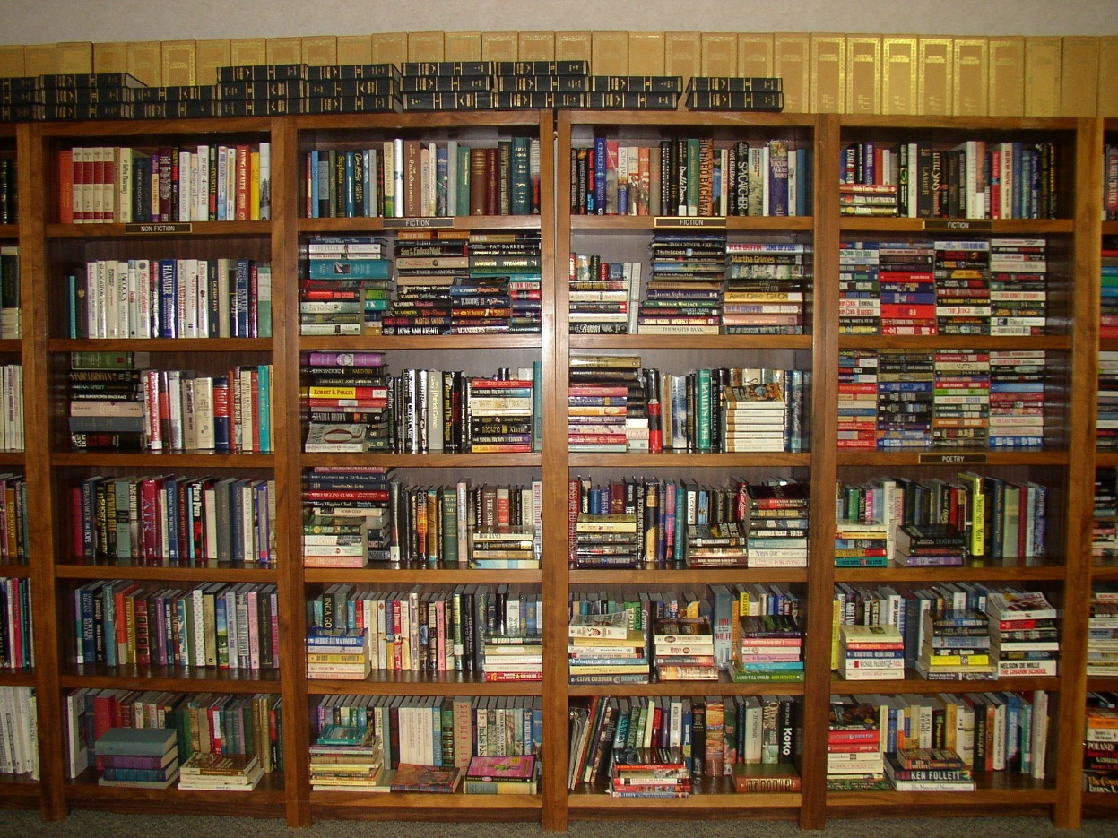
Library management system
Members
Umesh Raj Joshi
Yubaraj Karki
Prince Chaudhary

Slide 3

Library management system
Objective
To solve the management issues of library by digital way.
To keep data safe and secure.
To Save library operation cost and save time of staffs of library.

Slide 4
Library management system
Scope
The scope of library management system are listed below:
This system is used in a library where librarian and other staff of library are used this system for managing a library.
Keep data secure to using a specific password and username to operate this system.
This system will provide an efficient and effective method for managing book record, transactions of books like issues and returning book, and any other confidential information.
Addition, deletion, searching and viewing of books information are recorded by authorized administrators.

Slide 5
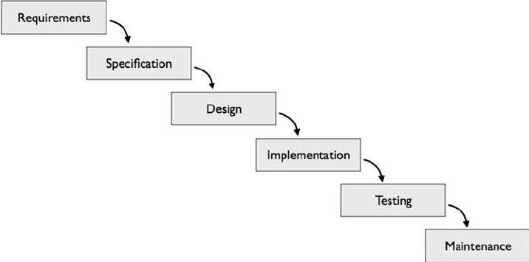
SDLC model
Library management system
Waterfall model.

Slide 6
Library management system
Feasibility analysis
Technical feasible.
Operational Feasibility.
Legal Feasibility.
Economic Feasibility.
Scheduling Feasibility.

Slide 7
Start
Enter 1 for LMS
Exit
Welcome
Opt 1
Read username and password
No
Yes
Welcome to library management system
No
n=1
Yes
Opt 2
Display menu
Issues book
Return book
Search book
Update book
Setting
Exit
Login
Program terminated
Welcome user
Opt 1
Yes
No
Issues book

Slide 8
Enter book name, student name, giving date, return date
Display menu
Add book
Delete book
See book list
Exit
Opt=1
Yes
Opt 2
Yes
Return book
No
Add book
No
No
Enter book name, student name
Enter book name, publication name
Opt 3
Yes
Search book
Opt=2
Yes
No
Enter book name or book no
Delete book
No
Enter book name
Opt 4
Yes
Update book

Slide 9
Opt=3
Yes
No
See book list
Opt 2
Change username
Opt=4
Exit
Opt 5
Display menu
Enter 1 for change password
Enter 2 for change username
Enter 3 for exit.
Opt 3
Exit
Yes
Exit
Read opt
Opt 1
Yes
Change password
No

Slide 10
Gantt chart
Library management system
 | Week 1&2 | Week 3,4&5 | Week 6&7 | Week 8,9&10 | Week 11&12 | Week 13,14&15
Title selecting and project study
Planning and research
Product requirement analysis
System degining
Coding and testing
Documentation

Slide 11
Expected outcome
Library management system
User Authentication and Authorization
Analysis material
Transaction Processing
Security and Compliance
User Interface and Experience

Slide 12
Conclusion
Library management system
We are going to make a library management system using a c programming by waterfall SDLC model.
This project aim is develop a computerized library management system which provide a easy interface for librarian to manage a library.
We cannot able to use high level graphics in this system because of using c programming.

Slide 13
Reference
Library management system
[1] Abir roy and anindita mridha (2024). Programming in Dev C++ C(datim.org.np).BCA student
[2] Prabhakar kumar and Rahul (2018). Using c programming language (ACADEMIA). Computer engineering student of Cohin University of science and technology.[accessed march 17]
[3]GLEVIN STANISLAUS GAGA(2021). Using c programming language to developed this system. BIT student of university of Mumbai.
[4] MRS Swaroop (2017). Using c language to develop this system. Msc computer student of “ university of east london”.

Slide 14


