Slide 1

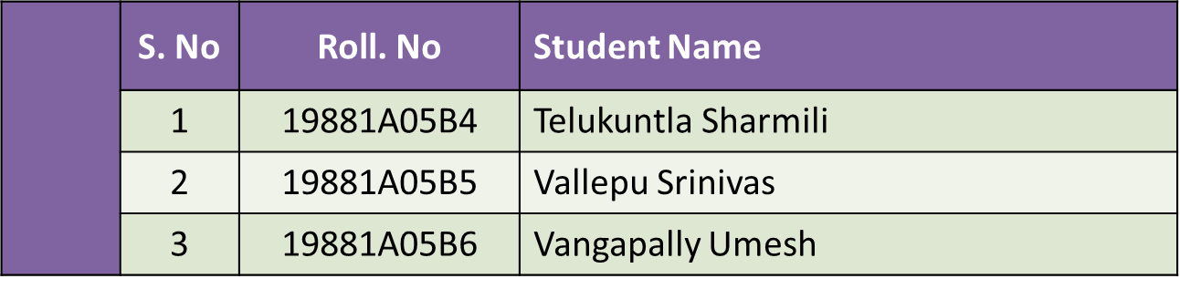
VARDHAMAN COLLEGE OF ENGINEERING, HYDERABAD
Autonomous institute affiliated to JNTUH
DEPARTMENT OF COMPUTER SCIENCE & ENGINEERING
Title: Eyeball Cursor Moment Using Deep Learning
BATCH ID : 19CSPW-B8
FINAL REVIEW
Guide Details
Dr G. Surya Narayana
Associate Professor
Department of CSE

Slide 2
Project Work Review Outlines
Main idea of the Project
Existing System Vs Proposed
Proposed Project Objectives
Proposed Project Outcomes
Software and Hardware Requirements
Process Model
Design Phase
  Architectural Diagram [Modified]
  [UML Diagrams or Data Flow Diagrams] and ER-Diagrams ; It should be detailed diagrams
Proposed Method s and Algorithms [ With example]
Test Cases
Output Screens
Conclusion
Future Scope
References
Paper Acceptance/ Published Paper Journal / Conference Name
DEPARTMENT OF CSE PROJECT WORK REVIEW

Slide 3
Main idea of the Project
Medically disabled people cannot access the computer like a normal person.
We are proposing a system which makes operating a computer easier.
We can be able to use computer using our eyeball moment.
Our eyeballs will be used as a cursor for controlling the system.
To create a system through which the computer can be controlled using eye ball moment.
DEPARTMENT OF CSE PROJECT WORK REVIEW

Slide 4
Existing System Vs Proposed
Existing system only detects the position of the eyeball as a cursor but does not prefer any mapping to the cursor moment and click operations .
Our project detects the eyeball moment and also deals with the click operations .
In the proposed system, we have included the eye detection, eye tracking, interpretation of a sequence of eye blinks in real time for controlling a human computer interface.
DEPARTMENT OF CSE PROJECT WORK REVIEW

Slide 5
Proposed Project objectives
To make use of computer vision to capture and record human actions.
To develop a Deep Learning model to identify eyeball moment.
To create a user friendly environment through which communication becomes easy with computer using eye ball moment.
DEPARTMENT OF CSE PROJECT WORK REVIEW

Slide 6
Proposed Project Outcomes
We are creating a deep learning model which detects the pupil moment of a user.
The moment of the eye will be triggered as the cursor moment.
Operating the cursor with eye ball moment will be achieved.
While the tracking in process it will detect which eye is blinking and will map it to the corresponding mouse click event.
DEPARTMENT OF CSE PROJECT WORK REVIEW

Slide 7
Software and Hardware requirements
Software Requirements:
Jupyter Notebook
Anaconda Navigator
Browser
Hardware Requirements:
8GB or higher RAM
Windows OS
Web camera
DEPARTMENT OF CSE PROJECT WORK REVIEW

Slide 8
Process model
In this project at first we are generating a dataset which will be combination of both the eyes when we are looking at a particular pixel value on the screen.
The eye detection will be done using the haar cascade classifier.
Those pixel values are stored as the file name of the picture.
Once the dataset is created model will be trained.
DEPARTMENT OF CSE PROJECT WORK REVIEW

Slide 9
Process model
Now when we try to implement this project the web cam will be taking the pictures frame by frame.
Haar cascade classifier will detect the eyes.
Now the output from the model will be X and Y values which are the screen pixel values.
The cursor will be mapped to the desired pixel value.
Now using the face land marks we will be calculating the Eye aspect ratio(EAR) through which we can decide weather the eye is open or close.
Then the corresponding click event is generated using pyautoGUI.
DEPARTMENT OF CSE PROJECT WORK REVIEW

Slide 10
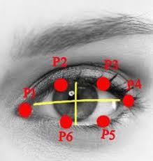
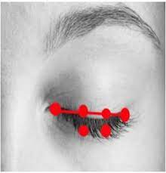
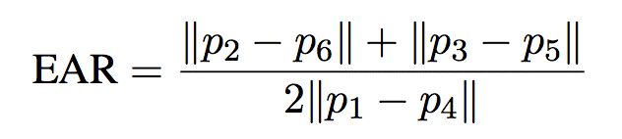
Process model
DEPARTMENT OF CSE PROJECT WORK REVIEW

Slide 11
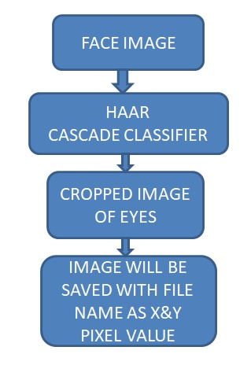
Design Phase
Dataset creation :
DEPARTMENT OF CSE PROJECT WORK REVIEW

Slide 12
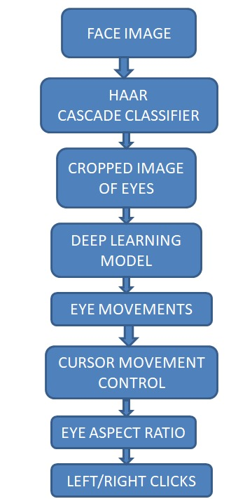
Design Phase
Process Flow chart:
DEPARTMENT OF CSE PROJECT WORK REVIEW

Slide 13
Proposed Methods and Agorithms
In the proposed method we have used the following algorithms and methods.
Haar cascade
Sequential model of deepLearning
OpenCV
StreamLit
PyautoGUI
Eye Aspect Ratio (EAR)
DEPARTMENT OF CSE PROJECT WORK REVIEW

Slide 14
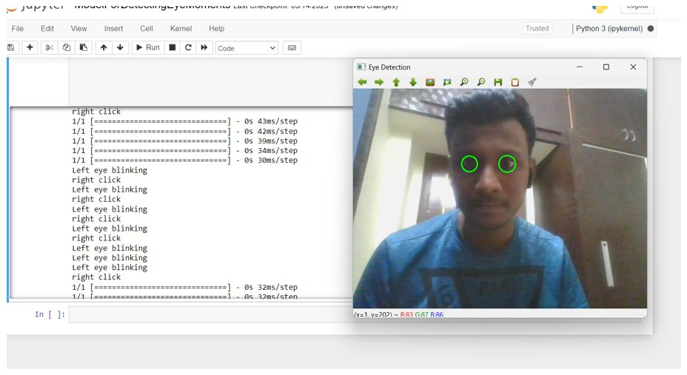
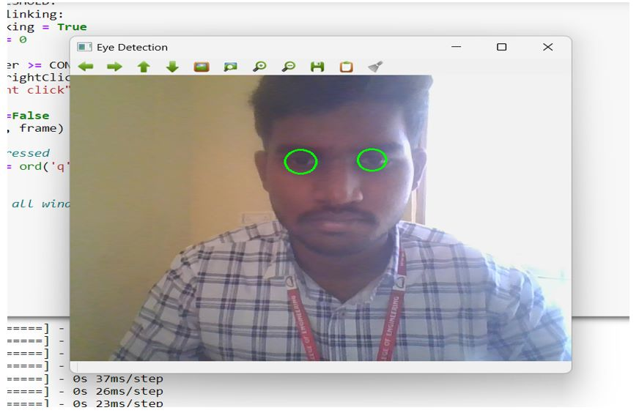
Output Screens
DEPARTMENT OF CSE PROJECT WORK REVIEW

Slide 15
Conclusions
Ultimately, we were able to detect the eyeballs using our application, and then the pointer was moved on the screen in response to the eyeball detection.
Even in our application, employing EAR, clicking operations are carried out (Eye Aspect Ratio).
We finally conclude that handicapped persons can effortlessly operate their systems by using our programme.
DEPARTMENT OF CSE PROJECT WORK REVIEW

Slide 16
Future Scope
We are looking forward to generalize the cursor control to the remote controlling of televisions or any other software.
For this we need an hardware device which will do the whole thing at once and perform the task at ease. A specs or As or aim is to control computer with eyes.
We are looking to implement few other operations which can be done by mouse. Other than click operations there are scrolling operation, selection of text and typing.
For typing we are trying to invoke a virtual keyboard and the letters that are clicked will be displayed on the notepad or other blank screen.
something with a camera inbuilt and the whole process running can make the daily life easier and interesting.
DEPARTMENT OF CSE PROJECT WORK REVIEW

Slide 17
References
Khare, Vandana, S. Gopala Krishna, and Sai Kalyan Sanisetty. "Cursor Control Using Eye Ball Movement." In 2019 Fifth International Conference on Science Technology Engineering and Mathematics (ICONSTEM), vol. 1, pp. 232-235. IEEE, 2019.
Sharafi, Zohreh, Timothy Shaffer, and Bonita Sharif. "Eye-Tracking Metrics in Software Engineering." In 2015 AsiaPacific Software Engineering Conference (APSEC), pp. 96-103. IEEE, 2015.
Chandra, S., Sharma, G., Malhotra, S., Jha, D. and Mittal, A.P., 2015, December. Eye tracking based human computer interaction: Applications and their uses. In 2015 International Conference on Man and Machine Interfacing (MAMI) (pp. 1-5). IEEE..
Bozomitu, R.G., P˘as˘aric˘a, A., Cehan, V., Lupu, R.G., Rotariu, C. and Coca, E., 2015, November. Implementation of eye-tracking system based on circular Hough transform algorithm. In E-Health and Bioengineering Confer_x0002_ence (EHB), 2015 (pp. 1-4). IEEE.
RamshaFatima,AtiyaUsmani(2016) Eye movement based human computer interaction, IEEE.
Venugopal, B. K., and Dilson D’souza. ”Real Time Implementation of Eye Tracking System Using Arduino Uno Based Hardware Interface.”in 2016.
DEPARTMENT OF CSE PROJECT WORK REVIEW

Slide 18

Paper acceptance from IJRASET
DEPARTMENT OF CSE PROJECT WORK REVIEW

Slide 19
Thank You
DEPARTMENT OF CSE PROJECT WORK REVIEW

