Slide 1
strata
Relational tables → Apache Iceberg, the same code locally and on AWS.
Architecture & high-level requirements
at-least-once delivery · idempotent commits · same code on laptop and in AWS

Slide 2
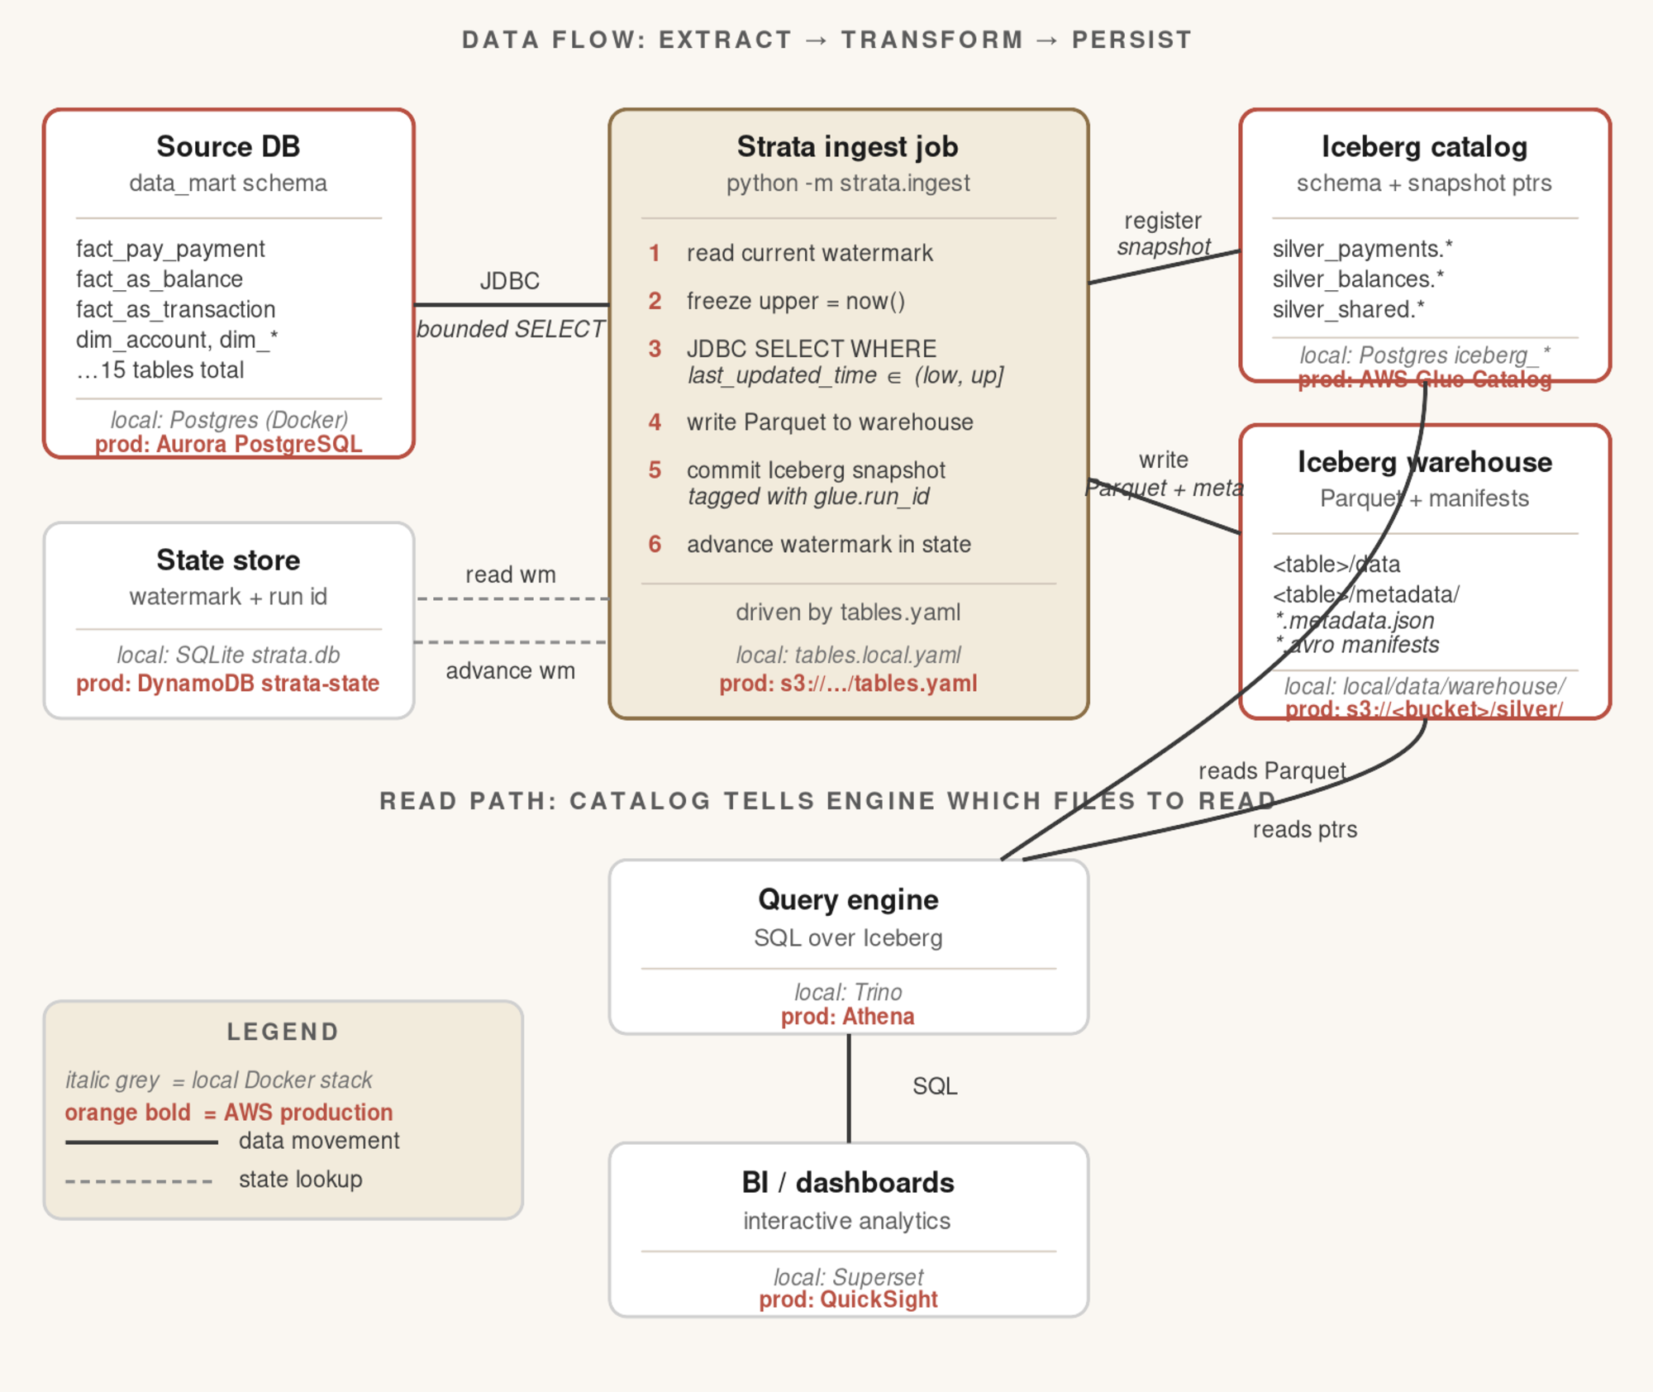
Data flow
source DB → ingest job → Iceberg catalog + warehouse → SQL → BI
Three storage tiers
Source DB · Iceberg (catalog + warehouse) · state. All three must stay in sync — seed.sh --wipe-state resets them atomically.
Catalog ≠ warehouse
Catalog answers "which tables exist?" Warehouse holds the Parquet bytes. Glue + S3 in prod; Postgres + local dir locally.
Same code, different backends
Local Docker stack mirrors AWS 1:1. A Trino query you write locally runs verbatim in Athena.
strata · architecture & high-level requirements
2 / 5

Slide 3
Functional requirements
what strata must do
01
Source replication
02
Incremental + full-refresh
Extract from relational sources (Postgres, Oracle, MySQL) via JDBC into Iceberg silver tables.
Watermark-bounded SELECT on last_updated_time for routine runs; --full-refresh mode for backfill.
03
Multi-table orchestration
04
Schema evolution
15+ tables driven from a single parameterised PySpark job — no per-table Python.
Auto-handle additive columns and safe type widening. SchemaDriftError on breaking changes — operator decides.
05
Atomic snapshot commits
06
YAML-driven extensibility
Each commit tagged with glue.run_id, glue.watermark_*. Retry with same run_id is an idempotent skip.
Adding a new table = a tables.yaml edit + run-all.sh append. ddl_to_yaml.py drafts most of it.
strata · architecture & high-level requirements
3 / 5

Slide 4
Non-functional requirements
what strata must guarantee
01
At-least-once + idempotent
02
Consistency via snapshots
Recovery from any failure point with no data loss and no duplicates. The linchpin invariant.
Iceberg snapshots are authoritative for committed data; state is a cache. Conditional state updates only.
03
Serverless-first cost model
04
Observability
Glue, S3, DynamoDB on-demand, Athena. No always-on services. Per-customer footprint scales to zero.
Structured EVENT= logs, CloudWatch metrics, queryable snapshot history (run_id, row_count, bounds).
05
Local↔prod parity
06
Tenant isolation + security
Same src/strata/ code; only the catalog and storage backends differ. Docker mirrors AWS 1:1.
Per-customer Terraform stamp creates isolated S3, Glue, DynamoDB, IAM. Secrets in Secrets Manager.
strata · architecture & high-level requirements
4 / 5

Slide 5
Storage tiers — local ↔ production
every box in the diagram lives in a different service per environment
Component | Local (Docker) | AWS production
Source DB schema + data | Postgres in Docker — data_mart.* | Aurora PostgreSQL
Iceberg catalog (table metadata) | Postgres tables public.iceberg_* | AWS Glue Data Catalog
Iceberg warehouse (Parquet + manifests) | local/data/warehouse/ | s3://<bucket>/silver/
Watermark state | SQLite at local/data/state/strata.db | DynamoDB strata-state
Source-DB credentials | local/secrets/db.local.json | AWS Secrets Manager
Table config (tables.yaml) | local/config/tables.local.yaml | s3://<bucket>/config/tables.yaml
Query engine | Trino | Athena
BI / dashboards | Superset | QuickSight
Same Python (src/strata/) reads/writes both. The substitution happens at the runtime-glue layer — local_ingest.py vs ingest.py.
strata · architecture & high-level requirements
5 / 5

