Slide 1
“ski_data” Analysis
Problem Statement:
1. Build a predictive model for ticket price based on a number of facilities, or properties, boasted by resorts (at the resorts).
2. Provide guidance for Big Mountain's pricing and future facility investment plans using the above data model.

Slide 2
Key findings
1. Weekend prices being higher than weekday prices seem restricted to sub $100 resorts.
2. “fastQuads”, “Runs” and “Snow Making_ac” appear as features of importance.
3. Visitors value more guaranteed snow.
4. Of the new features,”resort_night_skiing_state_ratio” seems the most correlated with ticket price.
5. “Runs”, “total_chairs” is quite well correlated with ticket price.
6. People seem to put more value in guaranteed snow cover rather than more variable terrain area.
7. The vertical drop seems to be a selling point that raises ticket prices as well.

Slide 3
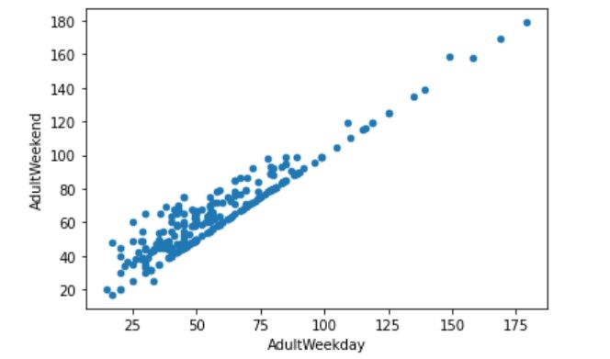
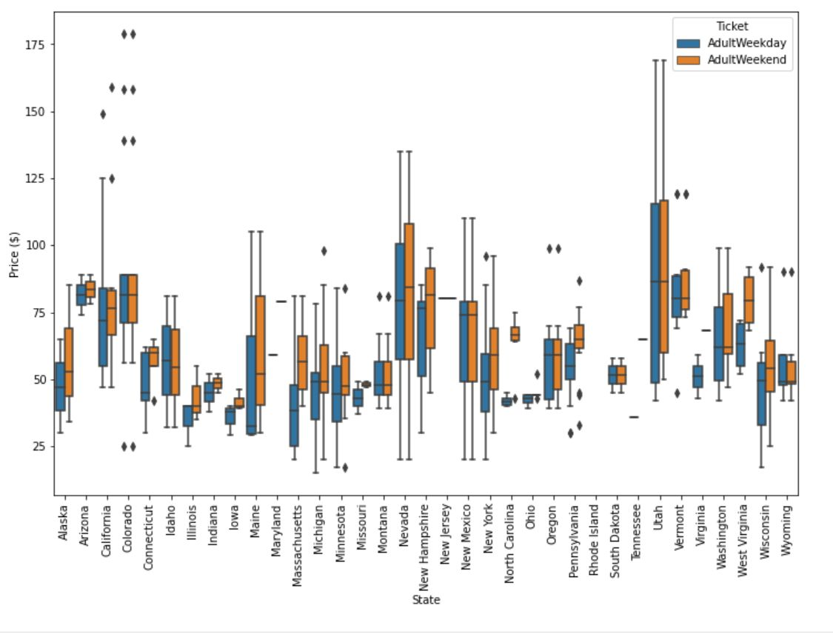
Analysis
A couple of observations can be made.
Firstly, there is a clear line where weekend and weekday prices are equal.
Weekend prices being higher than weekday prices seem restricted to sub $100 resorts.
From the boxplot, the distribution for weekday and weekend prices in Montana seemed equal.

Slide 4
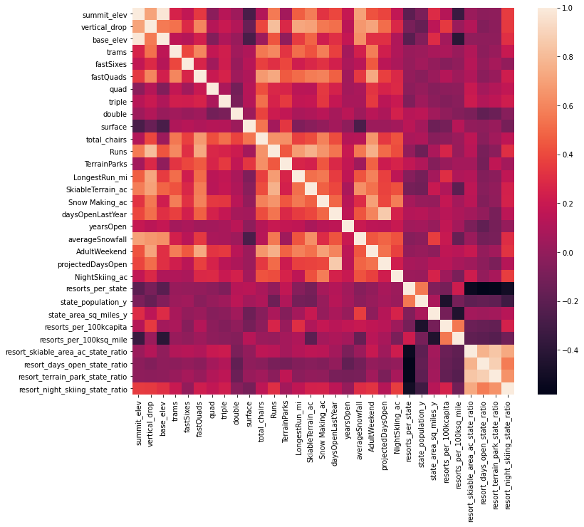
Analysis
Ticket price analysis: “fastQuads”, “Runs” and “Snow Making_ac” appear as features of importance. Visitors value more guaranteed snow.
Of the new features,”resort_night_skiing_state_ratio” seems the most correlated with ticket price. If this is true, then perhaps seizing a greater share of night skiing capacity is positive for the price a resort can charge.
“Runs”, “total_chairs” is quite well correlated with ticket price. People seem to put more value in guaranteed snow cover rather than more variable terrain area.The vertical drop seems to be a selling point that raises ticket prices as well.
Heat map showing relationship between the features in the ski_data. Color level is the ticket price.

Slide 5
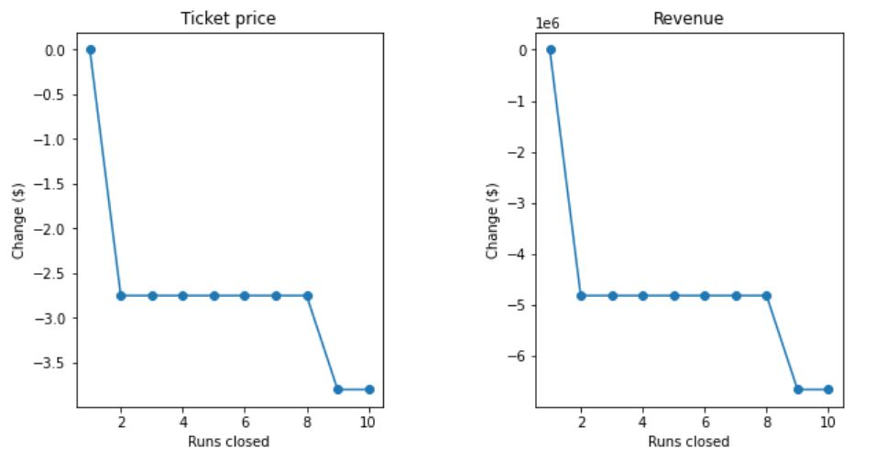
Model Analysis
The business shortlisted some options:
1. Permanently closing down up to 10 of the least used runs. This doesn't impact any other resort statistics.
1. The model says closing one run makes no difference.
2. Closing 2 and 3 successively reduces support for ticket price and so revenue.
3. If Big Mountain closes down 3 runs, it seems they may as well close down 4 or 5 as there's no further loss
in ticket price.
4. Increasing the closures down to 6 or more leads to a large drop.

Slide 6
Model Analysis
The business shortlisted some options:
2. Increase the vertical drop by adding a run to a point 150 feet lower down but requiring the installation of an additional chair lift to bring skiers back up, without additional snow making coverage
1. This scenario increases support for ticket price by $8.05
2. Over the season, this could be expected to amount to $14087500

Slide 7
Model Analysis
The business shortlisted some options:
3. Further adding 2 acres of snow making cover
1. Such a small increase in the snow making area makes no difference!
2. An increase by 10 acres, would bring the ticket price to $10.20 (~25% increase)
and revenue to $ 17850000 (~25% increase)

Slide 8
Model Analysis
The business shortlisted some options:
4. Increase the longest run by 0.2 mile to boast 3.5 miles length, requiring an additional snow making coverage of 4 acres
1. Based on Random Forest Modeling, no difference whatsoever if we add just 0.2 miles.
2. A 25% increase can be achieved by adding 1.0 miles

