Slide 1

KICKSTARTER PROJECT SUCCESS PREDICTION
Umesh Bodhwani
Sahil Chutani
Anunay Sanganal
Harsh Mehta
^{Data Analytics}

Slide 2
INTRODUCTION
Kickstarter – crowdfunding platform – aims to bring creative projects to life
174618 successfully funded projects so far – $4.7 billion pledged amount
Pebble Time – smartwatch – raised $1 million in 49 minutes – $20.4 million dollars raised in total by 78000 backers
Numerous such success stories through the world’s largest crowdfunding platform
^{Data Analytics}

Slide 3


Do you have an idea you want to implement?
^{Data Analytics}

Slide 4



ideas
People have countless ideas that go unimplemented – Why?
We all want to be a part of the next “billion-dollar idea”
Do you have an album that you produced and want to get it out in the world?
Do you have an idea for a board game that people can play?
Or maybe a new recipe for a cheesecake?
^{Data Analytics}

Slide 5
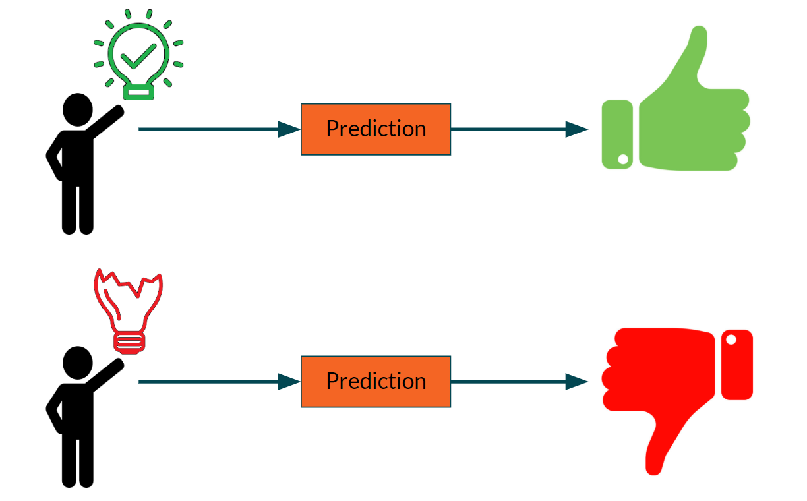
What are we trying to do?
Our aim – predict whether a project on Kickstarter will get funded or not
^{Data Analytics}

Slide 6





OUR stakeholders
Our stakeholders – the creators of the project and the backers who pledge money to the project
CREATOR
BACKERS
^{Data Analytics}
Notes:
Through our analysis – aimed to raise the odds of success of a project
Backers – use our models to judiciously pledge money to projects

Slide 7
Implementation
Kickstarter launched in 2009 – massive amount of data
Scraped last 3 months data for analysis
Data exploration and cleaning – approximately 200000 data points and 46 attributes
Data visualization
Feature engineering – extracting important features
Building different models and comparing their performance
Gaining valuable insights – generating targeted recommendations for live projects
^{Data Analytics}

Slide 8
Eda and feature engineering
Extracting useful features – using EDA and data manipulation
Goal – amount of money to be raised by the creator
Deadline – deadline set by the creator for raising the goal
Category – 15 categories
Location – location of the creator
Project launch day – day of week when the project is launched
Description length – number of words in the description
Staff pick – whether the project is starred by Kickstarter
Let’s see some visualizations to get a sense of the data
^{Data Analytics}

Slide 9
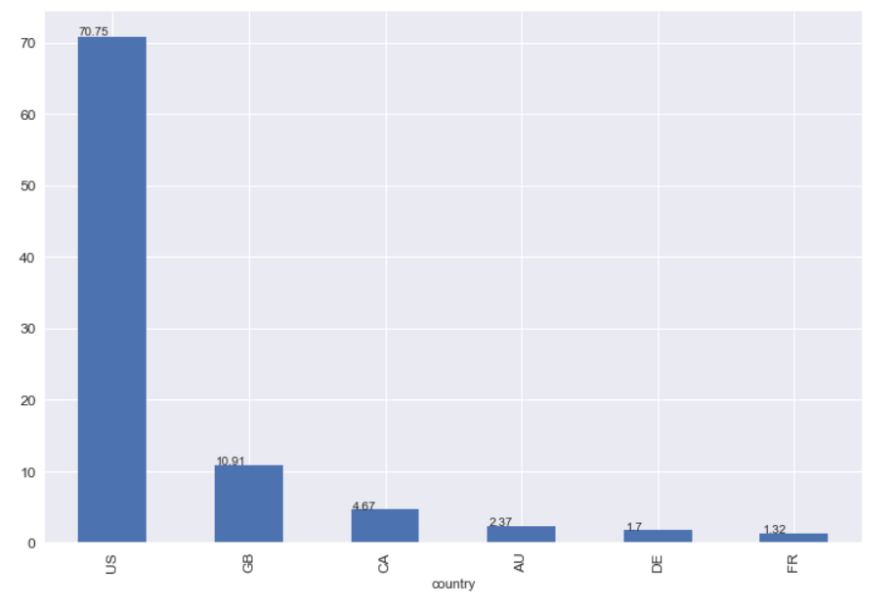
Percentage of projects by country
^{Data Analytics}

Slide 10
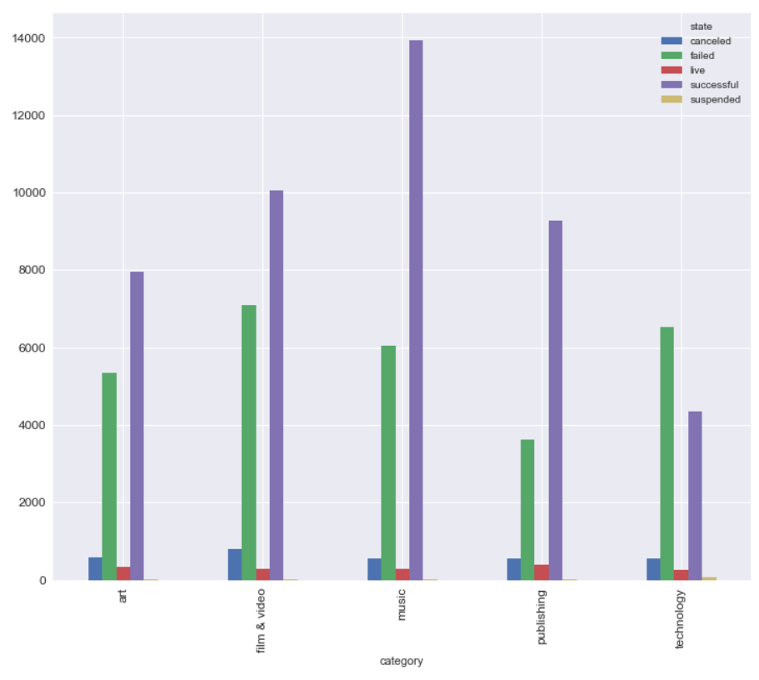
COUNT of project state by category
^{Data Analytics}

Slide 11
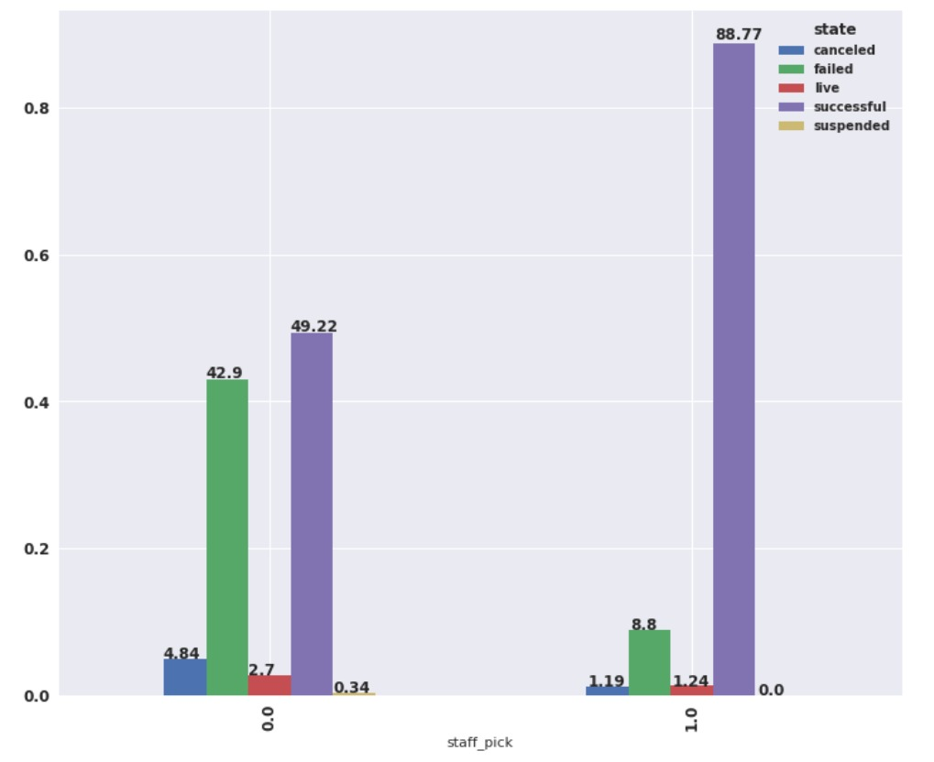
Projects picked by Kickstarter
^{Data Analytics}

Slide 12
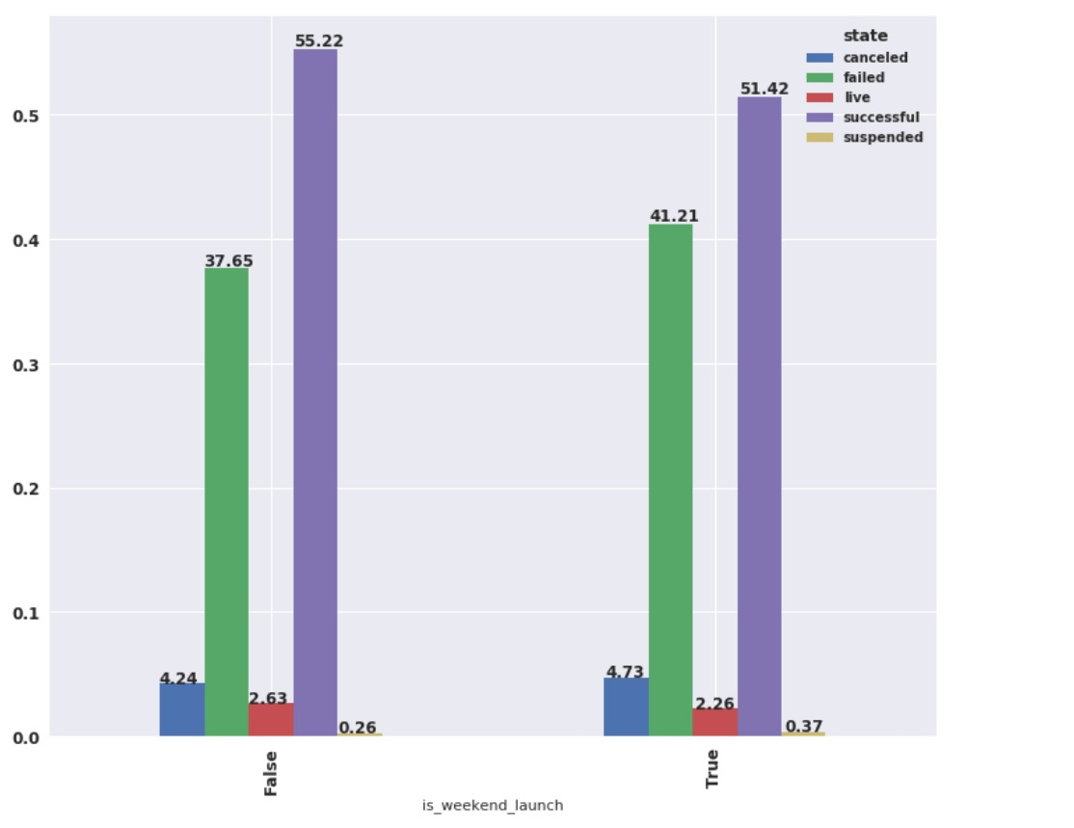
Projects launched on weekend
^{Data Analytics}

Slide 13
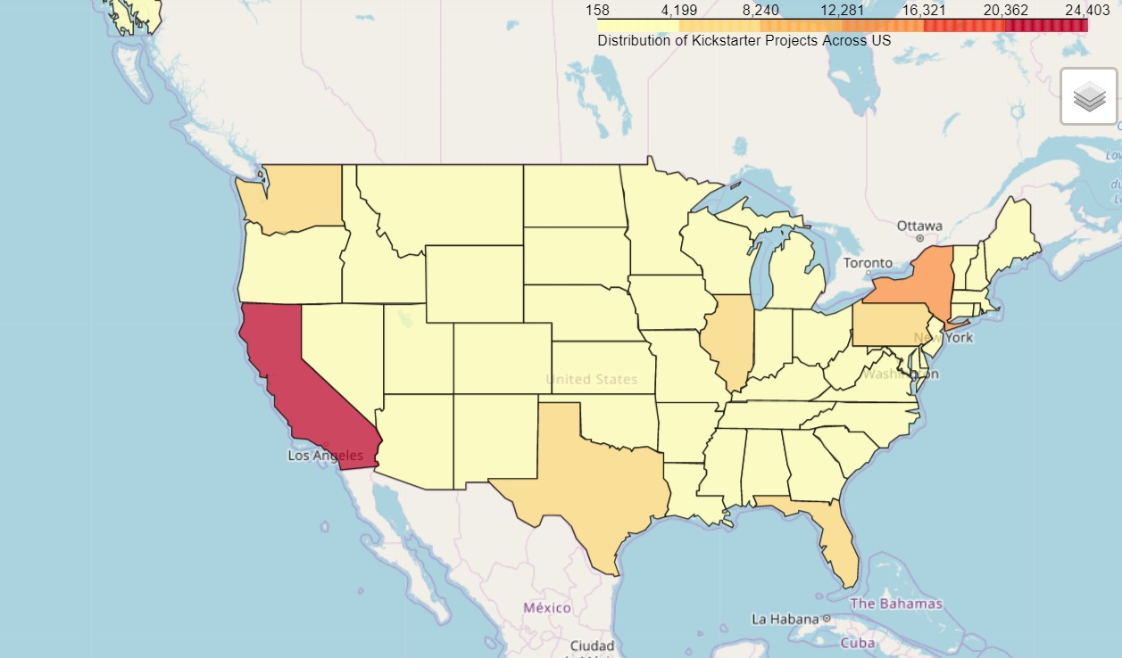
Projects by location in USa
^{Data Analytics}

Slide 14
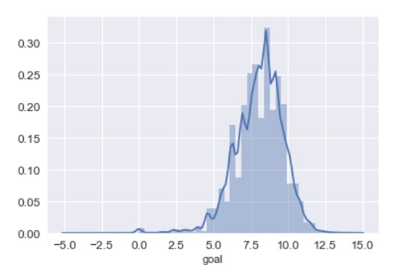
Distribution plot of the Goal
^{Data Analytics}

Slide 15
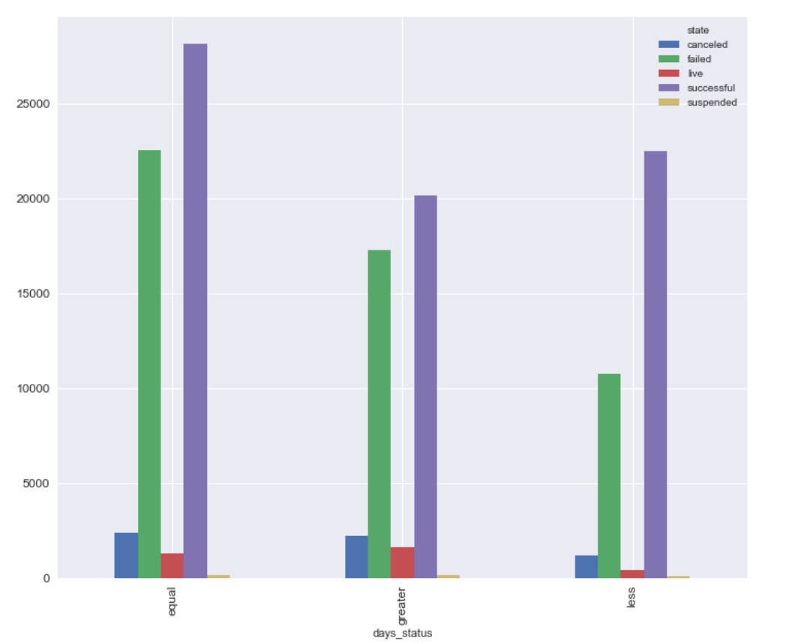
Distribution plot of days to deadline
^{Data Analytics}

Slide 16
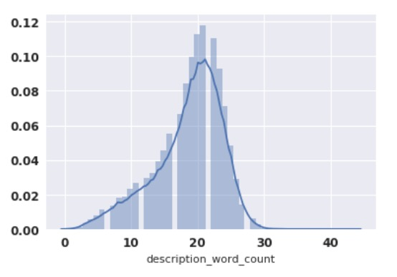
Distribution plot of the description length
^{Data Analytics}

Slide 17
MODEL COMAPRISON
Model | Train Accuracy | Test Accuracy
Logistic Regression | 76% (ROC) | 76% (ROC)
Decision Tree | 68.20% | 67.87%
Random Forest | 72.35% | 70.01%
Neural Networks | 55% | 46%
^{Data Analytics}

Slide 18
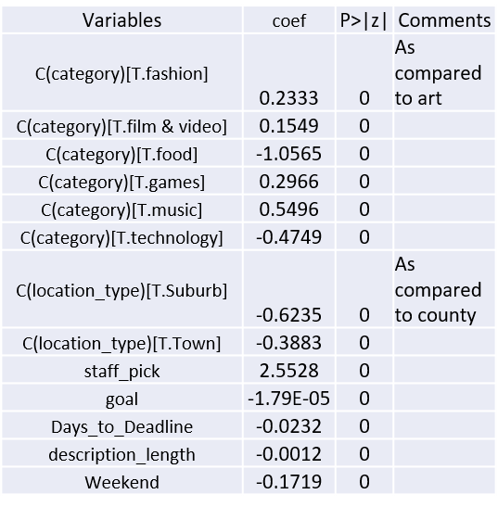
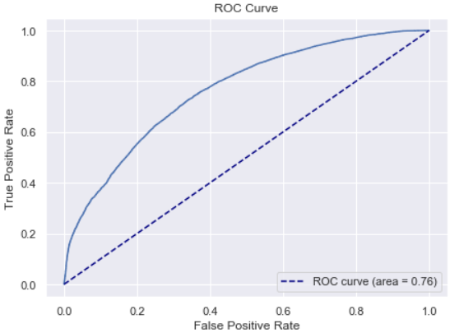
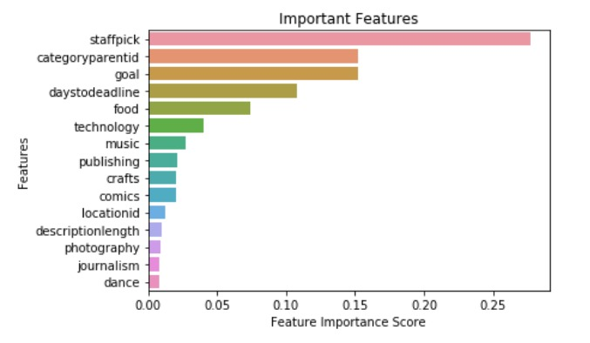
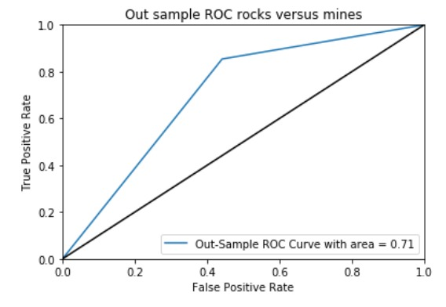
model statistics
^{Data Analytics}

Slide 19
INSIGHTS
For the creators:
Goal
Deadline – realistic deadline as compared to goal
Description length – 140 characters
Category – overlapping categories – choose more funded category
Launch on weekdays
Description – requesting in nature – tone needs to be set accordingly
For the backers:
See if the project is “staff picked”
Observe the creator’s profile over time
Location can be a big factor
^{Data Analytics}

Slide 20
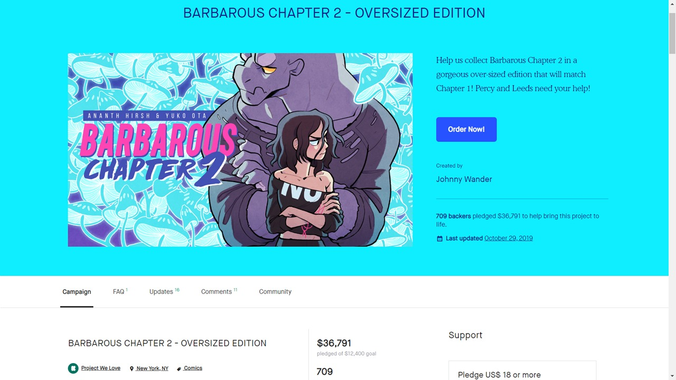
Project analysis - 1
Description length is appropriate
Requesting tone
Staff picked
Location – NY
Category – Publishing
Optimal amount – more likely to get funded
^{Data Analytics}

Slide 21
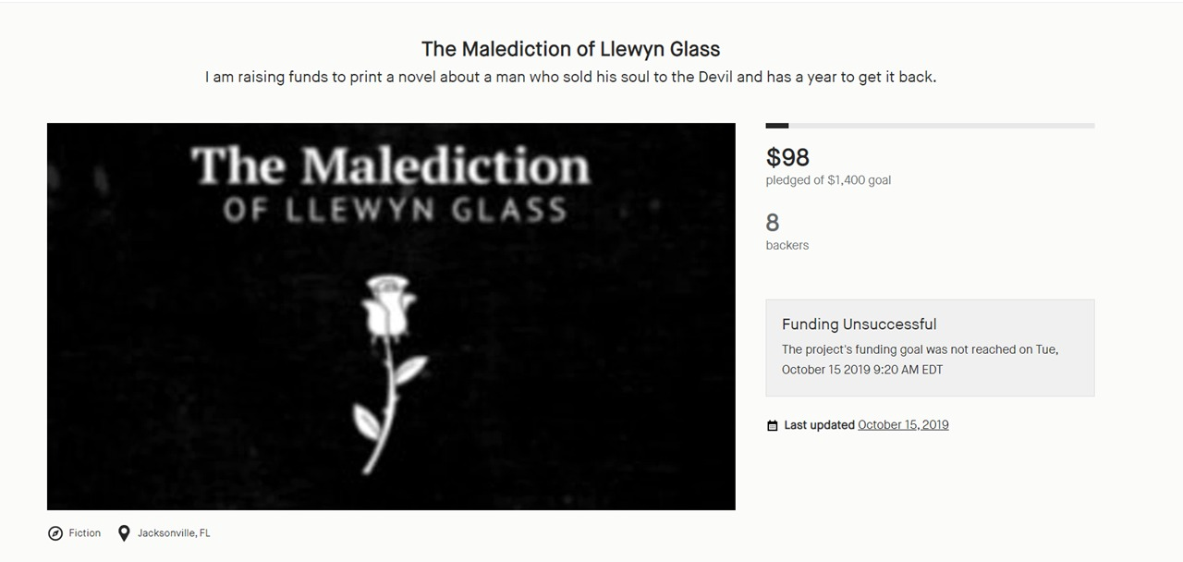
Project analysis - 2
Vague description
Not a requesting tone
Deadline was 60 days even when the goal was only $1400
Weekend launch
^{Data Analytics}

Slide 22
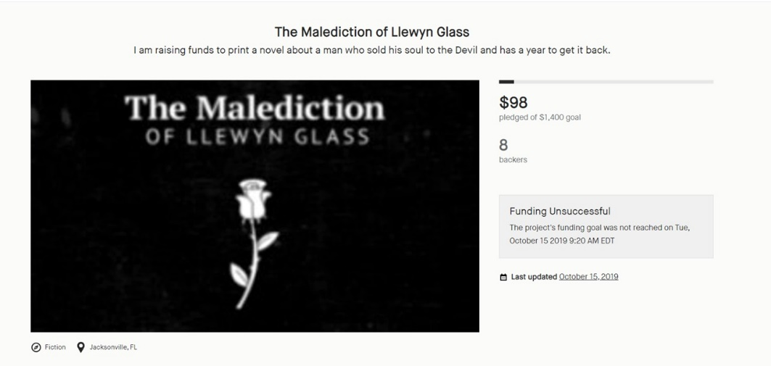
Project analysis - 2
Deadline – 30 days
Description length – 140
Launched on weekday
Description text tone changed
Changes
MODEL
MODEL
31%
42%
Success probability
Success probability
^{Data Analytics}

Slide 23
conclusion
Uncovered secrets behind success on Kickstarter
US is the biggest market – California, New York and Texas lead the other states in terms of origin of projects
Creators can use our models – generate recommendations to improve their odds of success
Backers can use our models to make data-driven investments
Features like moderate goal, realistic deadlines, launch day, description and staff pick– significant factors
Future scope
Incorporate Twitter and Facebook data about the projects to predict their success
Improve the accuracy of models by taking into account more features
^{Data Analytics}

Slide 24
Thank you
^{Data Analytics}

