Slide 1
SwiftPOS: an online Point of Sales Application
Presented By:
Anmol Raj Pant

Slide 2
Agenda
Introduction
Functionality of the system
System Architecture
Live Demonstration

Slide 3
Introduction
SwiftPOS is an online POS application for small mini-marts
Developed on Ruby on Rails framework
MVC architect
Can be operated on server or in localhost

Slide 4
Functionality of the system
Inventory Management System
Billing (Sales)
Report Generation
Activity Log

Slide 5
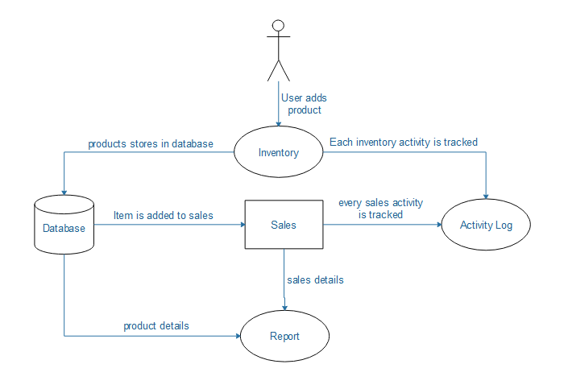
System Architect

Slide 6
System Demonstration

