Slide 1

WORKING with HASHICORP VAULT

Slide 2
Download And Install Hashicorp vault
https://developer.hashicorp.com/vault/install
https://releases.hashicorp.com/vault/1.16.2/vault_1.16.2_windows_386.zip
Installation:
Create a data folder in same directory where vault.exe exist
Create config.hcl file with following content
disable_mlock = true
ui = true
listener "tcp" {
address = "127.0.0.1:8200"
tls_disable = "true"
}
storage "file" {
path = "C:\\workspace\\software\\vault\\vault_1.16.0_windows_386\\data"
}
Start vault using command
vault.exe server -config=config.hcl

Slide 3
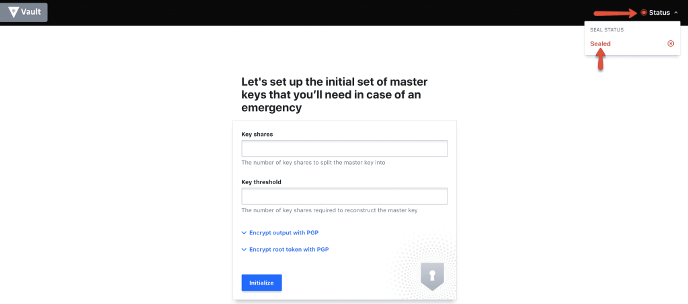
Create secret in Vault – store root keys
Open http://127.0.0.1:8200/ui

Slide 4
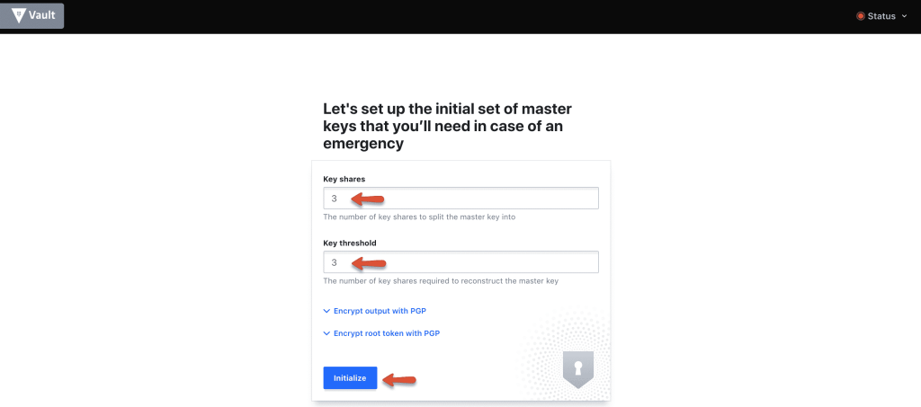
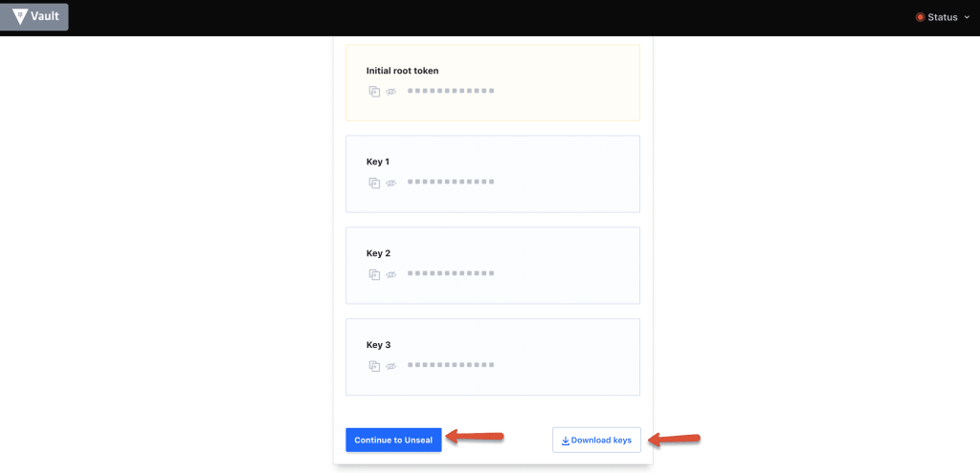
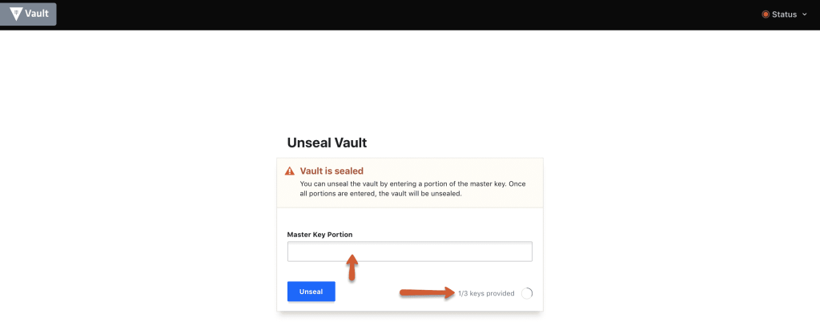
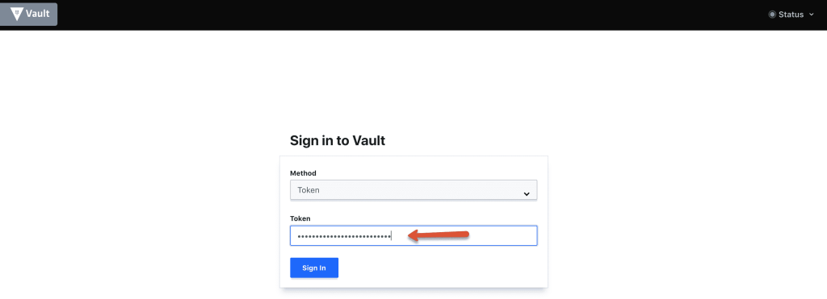
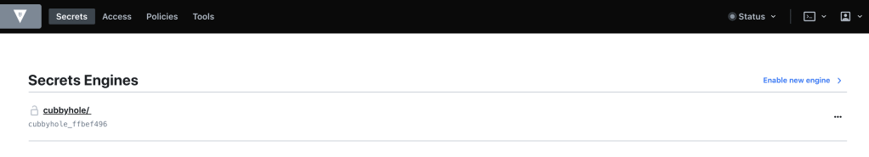
Create secret in Vault – store root keys
Initialise the vault using the initialise button with 3 key shares.
Dowload the keys using the “Download Keys” button and click the “Continue to unseal” button.
Note: The key files are very important and you should keep them safe. For any reason, if you restart the server or vault service, the vault gets locked. You will need these keys to unlock it.
Step 10: Enter three keys one by one from the downloaded key file to unseal vault.
Step 11: Once unsealed, log to the vault with the root_token from the downloaded key file.
Thats it! You will be logging in to the vault server with all default settings.

Slide 5
Create secret in Vault – store root keys
Enter three keys one by one from the downloaded key file to unseal vault.
Once unsealed, log to the vault with the root_token from the downloaded key file.

Slide 6
Create secret in Vault – store root keys
Open http://127.0.0.1:8200/ui
You will be logging in to the vault server with all default settings.

Slide 7
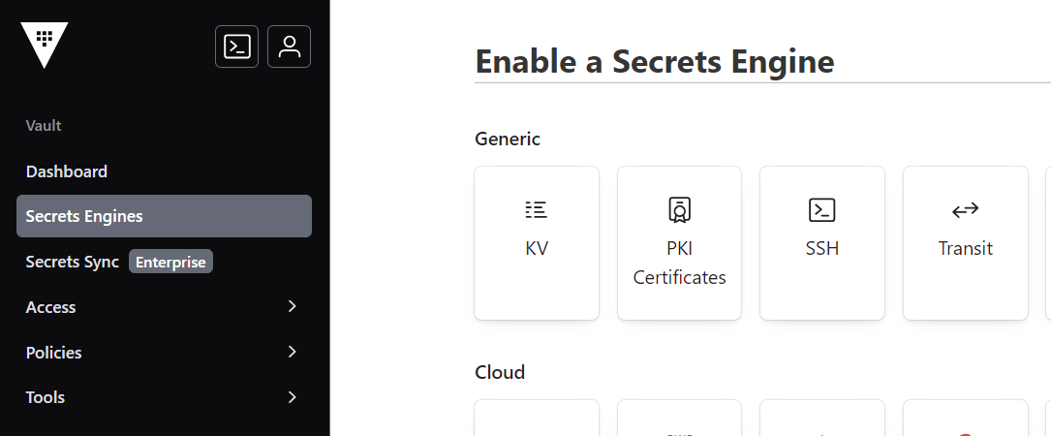
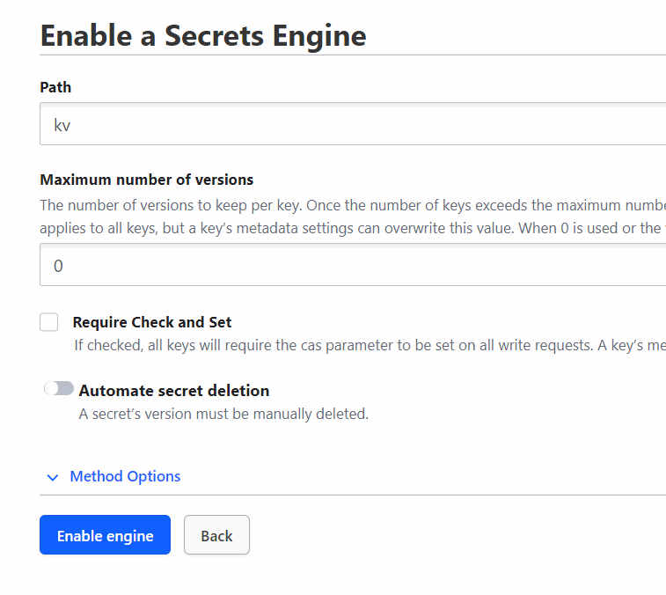
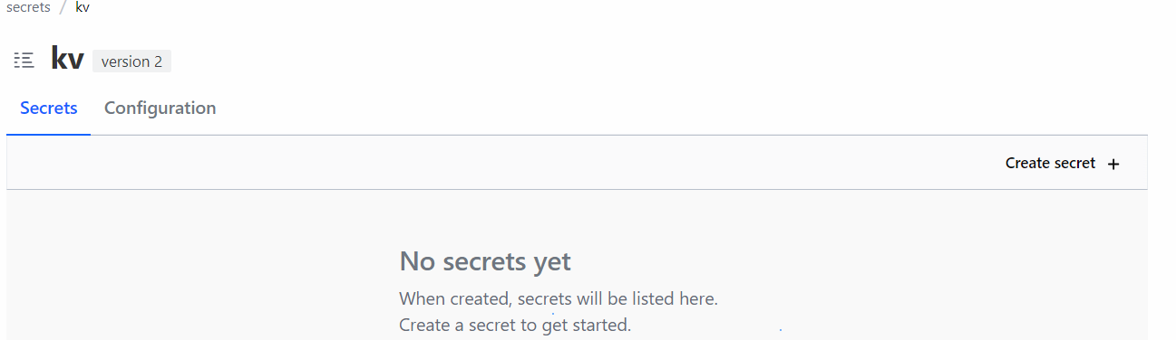
Create secret in Vault – Enable a secret engine

Slide 8
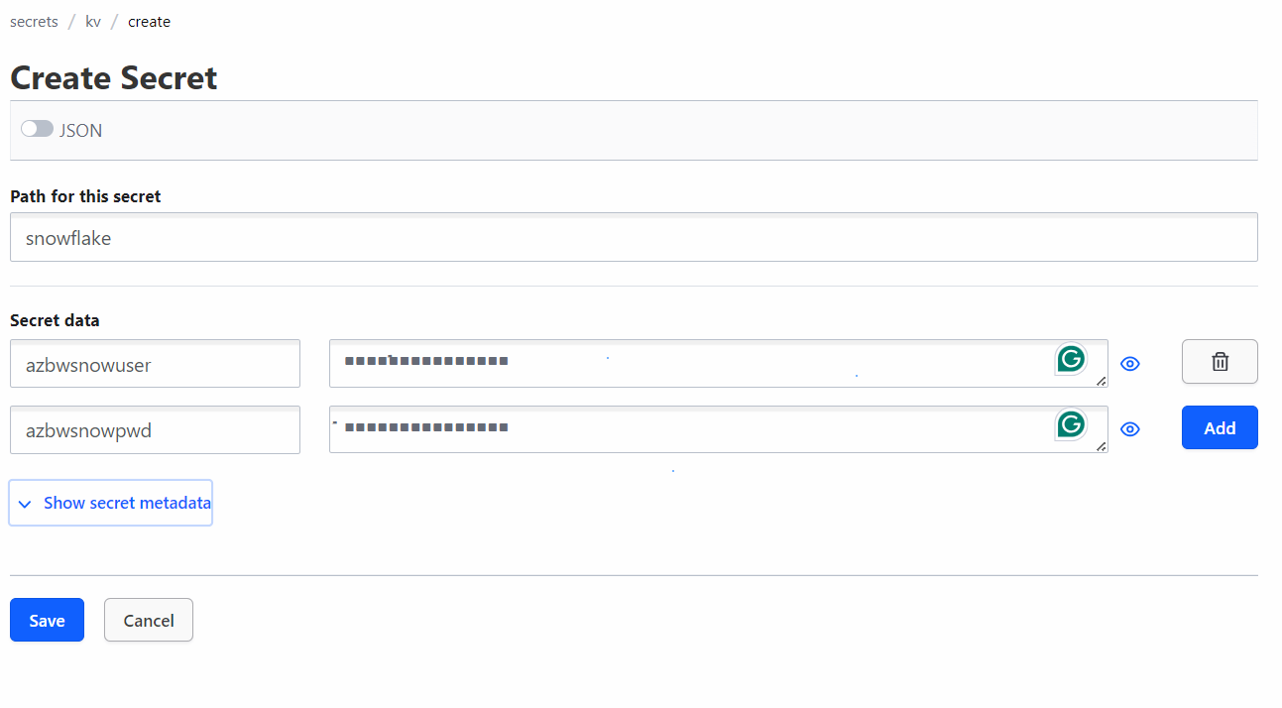
Create secret in Vault – Enable a secret engine

Slide 9
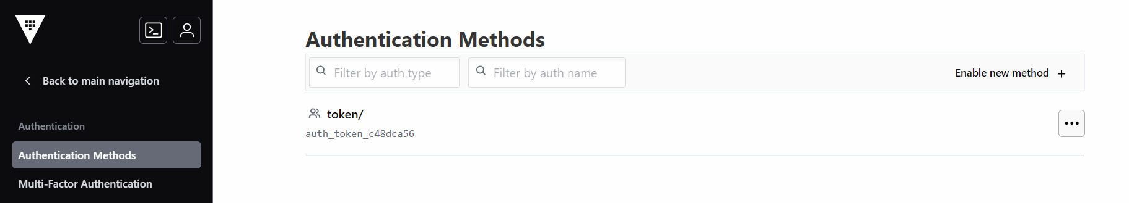
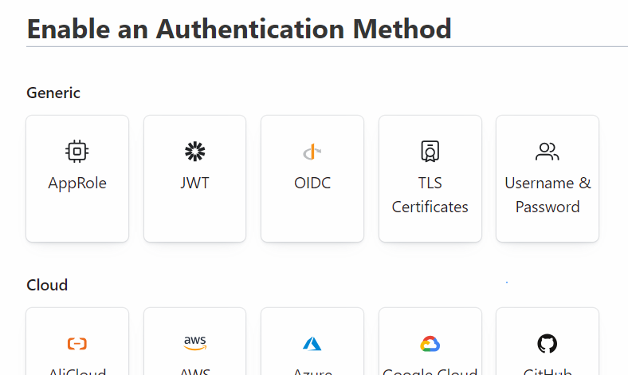
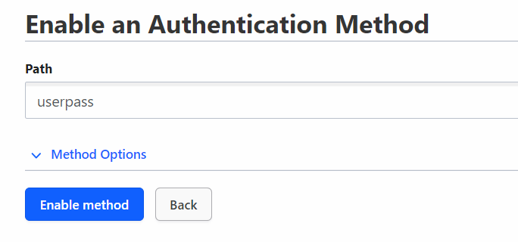
Create user

Slide 10
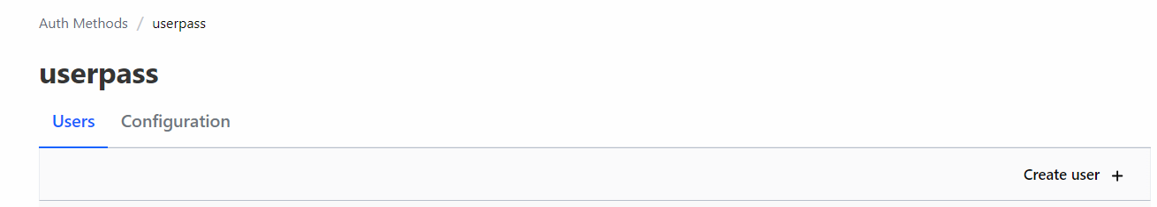
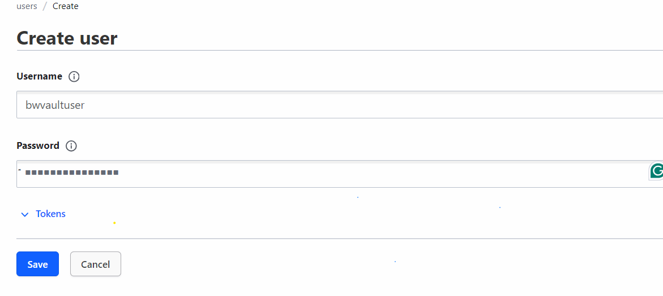
Add user

