Slide 1

Snowflake course content

Slide 2
Snowflake course content
Snowflake Overview and Architecture
Architecture
Connectivity
Getting started with snowflake
Virtual warehouse
Databases, Tables, views, data types
Data Loading and Unloading
Snowflake Queries
Data Sharing and collaboration
Alert notifications
Snowflake Security
Data Governance
Snowflake account management
Data Recovery
Performance optimization
Cost and Billing

Slide 3
Snowflake Overview and Architecture

Slide 4
WHAT is snowflakE?
Snowflake’s Data Cloud is powered by an advanced data platform provided as a self-managed service. Snowflake enables data storage, processing, and analytic solutions that are faster, easier to use, and far more flexible than traditional offerings.
The Snowflake data platform is not built on any existing database technology or “big data” software platforms such as Hadoop.
Instead, Snowflake combines a completely new SQL query engine with an innovative architecture natively designed for the cloud. To the user, Snowflake provides all of the functionality of an enterprise analytic database, along with many additional special features and unique capabilities.
Snowflake is a true self-managed service, meaning:
There is no hardware (virtual or physical) to select, install, configure, or manage.
There is virtually no software to install, configure, or manage.
Ongoing maintenance, management, upgrades, and tuning are handled by Snowflake.
Snowflake runs completely on cloud infrastructure. All components of Snowflake’s service (other than optional command line clients, drivers, and connectors), run in public cloud infrastructures.
Snowflake uses virtual compute instances for its compute needs and a storage service for persistent storage of data. Snowflake cannot be run on private cloud infrastructures (on-premises or hosted).
Snowflake is not a packaged software offering that can be installed by a user. Snowflake manages all aspects of software installation and updates.

Slide 5
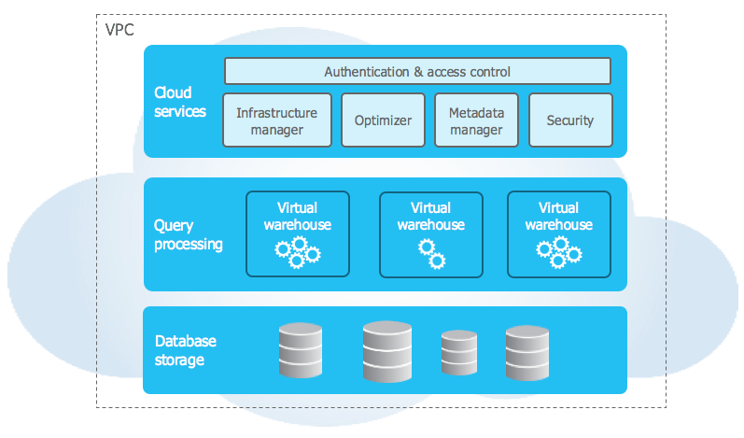
Snowflake ARCHITECTURE
Snowflake’s architecture is a hybrid of traditional
shared-disk and
shared-nothing database architectures.
Similar to shared-disk architectures, Snowflake uses a central data repository for persisted data that is accessible from all compute nodes in the platform.
But similar to shared-nothing architectures, Snowflake processes queries using MPP (massively parallel processing) compute clusters where each node in the cluster stores a portion of the entire data set locally.
This approach offers the data management simplicity of a shared-disk architecture, but with the performance and scale-out benefits of a shared-nothing architecture.

Slide 6
Snowflake ARCHITECTURE
Database Storage
When data is loaded into Snowflake, Snowflake reorganizes that data into its internal optimized, compressed, columnar format. Snowflake stores this optimized data in cloud storage.
Snowflake manages all aspects of how this data is stored — the organization, file size, structure, compression, metadata, statistics, and other aspects of data storage are handled by Snowflake. The data objects stored by Snowflake are not directly visible nor accessible by customers; they are only accessible through SQL query operations run using Snowflake.
Query Processing
Query execution is performed in the processing layer. Snowflake processes queries using “virtual warehouses”. Each virtual warehouse is an MPP compute cluster composed of multiple compute nodes allocated by Snowflake from a cloud provider.
Each virtual warehouse is an independent compute cluster that does not share compute resources with other virtual warehouses. As a result, each virtual warehouse has no impact on the performance of other virtual warehouses.
Cloud Services
The cloud services layer is a collection of services that coordinate activities across Snowflake. These services tie together all of the different components of Snowflake in order to process user requests, from login to query dispatch. The cloud services layer also runs on compute instances provisioned by Snowflake from the cloud provider.
Services managed in this layer include:
Authentication
Infrastructure management
Metadata management
Query parsing and optimization
Access control

Slide 7
Supported Cloud Platforms
Snowflake is provided as a self-managed service that runs completely on cloud infrastructure. This means that all three layers of Snowflake’s architecture (storage, compute, and cloud services) are deployed and managed entirely on a selected cloud platform.
A Snowflake account can be hosted on any of the following cloud platforms:
Amazon Web Services (AWS)
Google Cloud Platform (GCP)
Microsoft Azure (Azure)

Slide 8
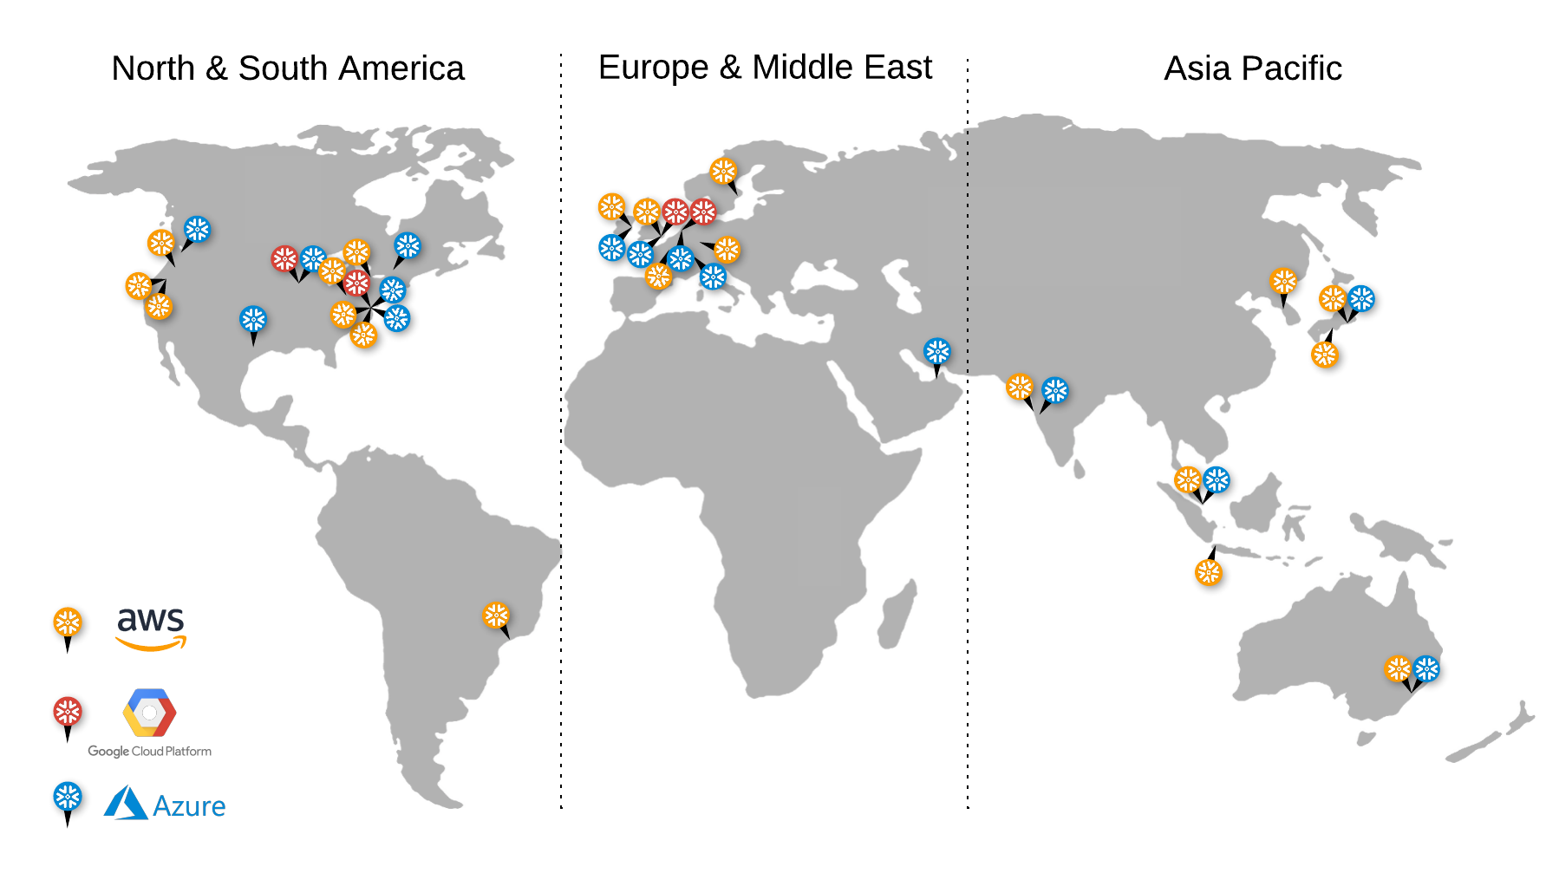
snowflake REGIONS

Slide 9
SNOWFLAKE EDITIONS
Standard Edition
Standard Edition is our introductory level offering, providing full, unlimited access to all of Snowflake’s standard features. It provides a strong balance between features, level of support, and cost.
Enterprise Edition
Enterprise Edition provides all the features and services of Standard Edition, with additional features designed specifically for the needs of large-scale enterprises and organizations.
Business Critical Edition
Business Critical Edition, formerly known as Enterprise for Sensitive Data (ESD), offers even higher levels of data protection to support the needs of organizations with extremely sensitive data, particularly PHI data that must comply with HIPAA and HITRUST CSF regulations.
It includes all the features and services of Enterprise Edition, with the addition of enhanced security and data protection. In addition, database failover/failback adds support for business continuity and disaster recovery.
Virtual Private Snowflake (VPS)
Virtual Private Snowflake offers our highest level of security for organizations that have the strictest requirements, such as financial institutions and any other large enterprises that collect, analyze, and share highly sensitive data.
It includes all the features and services of Business Critical Edition, but in a completely separate Snowflake environment, isolated from all other Snowflake accounts (i.e. VPS accounts do not share any resources with accounts outside the VPS). However, you may choose to enable data sharing with non-VPS customers.

Slide 10
Connecting to Snowflake
Snowflake supports multiple ways of connecting to the service:
A web-based user interface from which all aspects of managing and using Snowflake can be accessed.
Command line clients (e.g. SnowSQL) which can also access all aspects of managing and using Snowflake.
ODBC and JDBC drivers that can be used by other applications (e.g. Tableau) to connect to Snowflake.
Native connectors (e.g. Python, Spark) that can be used to develop applications for connecting to Snowflake.
Third-party connectors that can be used to connect applications such as ETL tools (e.g. Informatica) and BI tools (e.g. ThoughtSpot) to Snowflake.

Slide 11
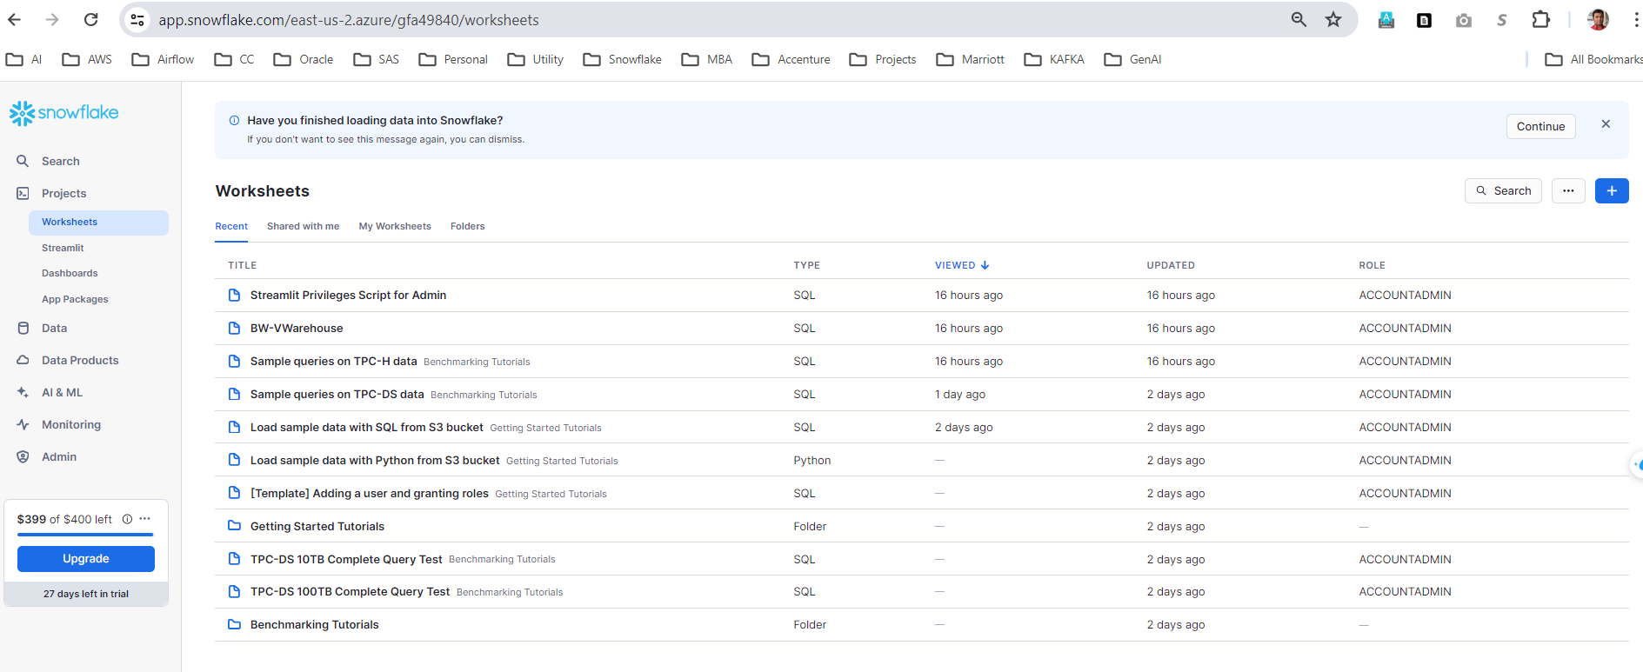
Connecting to Snowflake – Snowsight - webaccess

Slide 12
Connecting to Snowflake – SnowsQL
You can download SNOWSQL from https://developers.snowflake.com/snowsql/
Once you download you can configure snowsql
Windows - %USERPROFILE%\.snowsql\
Linux - ~/.snowsql/
Connect using snowsql
Named connection – e.g.
[connections.bwcon]
accountname = RAAGLJS-ZZA75076
username = AZUREBRAINWORKS2023
password = xxxxxxxxxxxxxxxxxxxx
dbname = SNOWFLAKE_SAMPLE_DATA
schemaname = TPCH_SF1
warehousename = COMPUTE_WH
Run command - $ snowsql –c bwcon
Using key-pair authentication and key-pair rotation
Step -1 Generate private key - openssl genrsa 2048 | openssl pkcs8 -topk8 -v2 des3 -inform PEM -out rsa_key.p8
Step -2 Generate public key - openssl rsa -in rsa_key.p8 -pubout -out rsa_key.pub
Step -3 Assign public key to snowflake user
ALTER USER jsmith SET RSA_PUBLIC_KEY='MIIBIjANBgkqh...';
Run command - snowsql -a RAAGLJS-ZZA75076 -u AZUREBRAINWORKS2023 --private-key-path <path>/rsa_key.p8
Using Proxy server – we can use proxy server to connect to snowflake. We will have to set proxy variables.
Using a SSO-
Snowsql command to connect
snowsql -a RAAGLJS-ZZA75076 -u AZUREBRAINWORKS2023 -d SNOWFLAKE_SAMPLE_DATA -s TPCH_SF1 -r SYSADMIN -w COMPUTE_WH

Slide 13
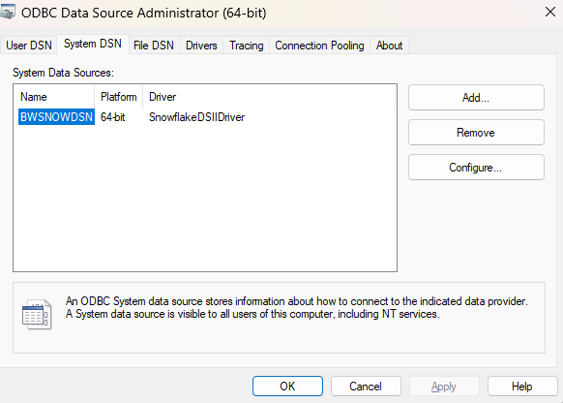
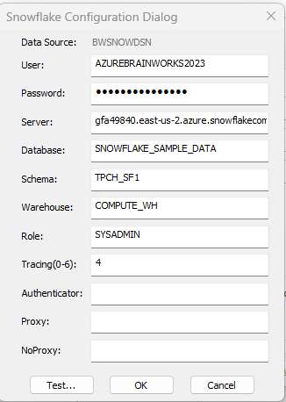
Connecting to Snowflake – ODBC/JDBC Driver
You can download ODBC/JDBC driver from https://docs.snowflake.com/en/developer-guide/odbc/odbc-download
Install ODBC Driver
Configure ODBC driver
Open ODBC data source administrator window
Click add DSN(Data Source Name)
Provide configuration details, and test connection
Reference – to provide password in connection setting - https://community.snowflake.com/s/article/Error-Snowflake-DSI-20032-Required-setting-PWD-is-not-present-in-the-connection-settings-20032-with-windows-ODBC-snowflake-driver

Slide 14
Connecting to Snowflake – Using Python
Installing python connector:
pip install snowflake-connector-python
Write a python program:

Slide 15
GETTING STARTED with Snowflake

Slide 16
Virtual Warehouse
Virtual warehouse is a cluster of compute resources in Snowflake. A virtual warehouse is available in two types:
Standard
Snowpark-optimized
A warehouse provides the required resources, such as CPU, memory, and temporary storage, to perform the following operations in a Snowflake session:
Executing SQL SELECT statements that require compute resources (e.g. retrieving rows from tables and views).
Performing DML operations, such as:
Updating rows in tables (DELETE , INSERT , UPDATE).
Loading data into tables (COPY INTO <table>).
Unloading data from tables (COPY INTO <location>).
Properties of virtual warehouse
Multi cluster
Auto-scale
Scaling policy
Auto Terminate and Resume
Monitoring Virtual warehouse

Slide 17
Databases, Tables and Views - Overview
All data in Snowflake is maintained in databases. Each database consists of one or more schemas, which are logical groupings of database objects, such as tables and views. Snowflake does not place any hard limits on the number of databases, schemas (within a database), or objects (within a schema) you can create.
Micro-partitions & Data Clustering
All data in Snowflake tables is automatically divided into micro-partitions, which are contiguous units of storage. Each micro-partition contains between 50 MB and 500 MB of uncompressed data (note that the actual size in Snowflake is smaller because data is always stored compressed). Groups of rows in tables are mapped into individual micro-partitions, organized in a columnar fashion. This size and structure allows for extremely granular pruning of very large tables, which can be comprised of millions, or even hundreds of millions, of micro-partitions.
Snowflake stores metadata about all rows stored in a micro-partition, including:
The range of values for each of the columns in the micro-partition.
The number of distinct values.
Additional properties used for both optimization and efficient query processing.

Slide 18
Databases, Tables and Views - Overview
Benefits of Micro-partitions
In contrast to traditional static partitioning, Snowflake micro-partitions are derived automatically; they don’t need to be explicitly defined up-front or maintained by users.
As the name suggests, micro-partitions are small in size (50 to 500 MB, before compression), which enables extremely efficient DML and fine-grained pruning for faster queries.
Micro-partitions can overlap in their range of values, which, combined with their uniformly small size, helps prevent skew.
Columns are stored independently within micro-partitions, often referred to as columnar storage. This enables efficient scanning of individual columns; only the columns referenced by a query are scanned.
Columns are also compressed individually within micro-partitions. Snowflake automatically determines the most efficient compression algorithm for the columns in each micro-partition.

Slide 19
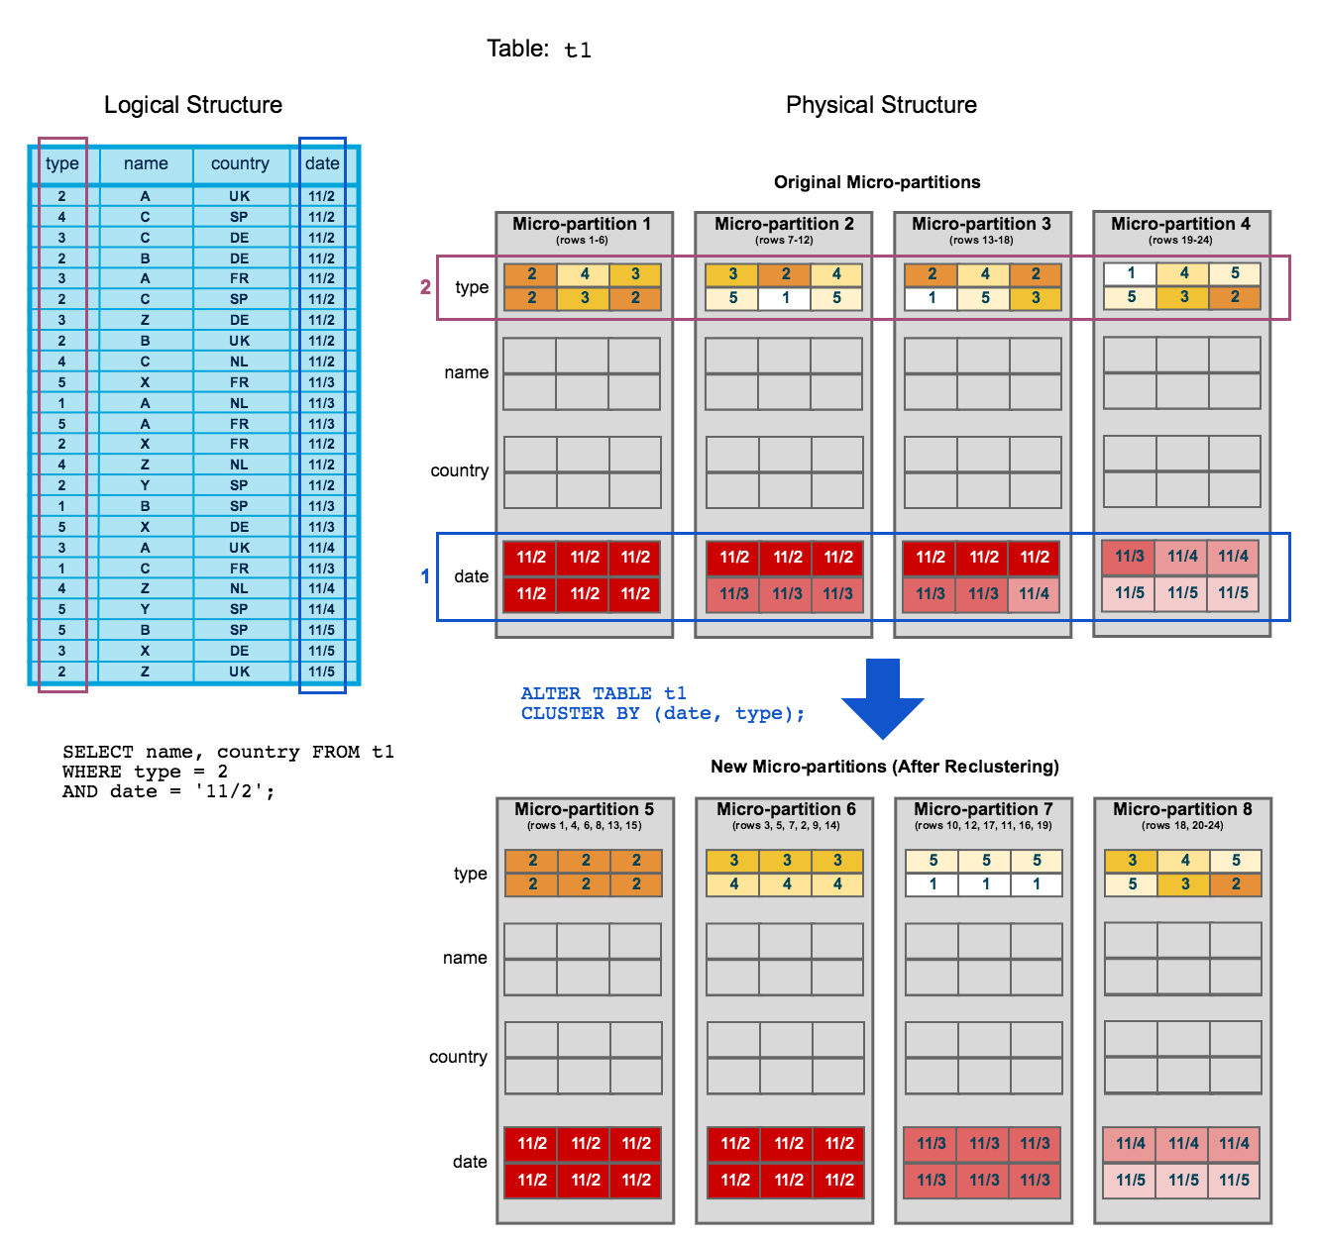
Clustering Key- Overview

Slide 20
Types of tables
Temporary Tables: Snowflake supports creating temporary tables for storing non-permanent, transitory data (e.g. ETL data, session-specific data). Temporary tables only exist within the session in which they were created and persist only for the remainder of the session. As such, they are not visible to other users or sessions. Once the session ends, data stored in the table is purged completely from the system and, therefore, is not recoverable, either by the user who created the table or Snowflake.
After creation, temporary tables cannot be converted to any other table type.
CREATE TEMPORARY TABLE mytemptable (id NUMBER, creation_date DATE);
Transient Table: Snowflake supports creating transient tables that persist until explicitly dropped and are available to all users with the appropriate privileges. Transient tables are similar to permanent tables with the key difference that they do not have a Fail-safe period. As a result, transient tables are specifically designed for transitory data that needs to be maintained beyond each session (in contrast to temporary tables), but does not need the same level of data protection and recovery provided by permanent tables.
CREATE TRANSIENT TABLE mytranstable (id NUMBER, creation_date DATE);

Slide 21
Snowflake table comparison
Type | Persistence | Cloning (source type => target type) | Time Travel Retention Period (Days) | Fail-safe Period (Days)
Temporary | Remainder of session | Temporary => Temporary Temporary => Transient | 0 or 1 (default is 1) | 0
Transient | Until explicitly dropped | Transient => Temporary Transient => Transient | 0 or 1 (default is 1) | 0
Permanent (Standard Edition) | Until explicitly dropped | Permanent => Temporary Permanent => Transient Permanent => Permanent | 0 or 1 (default is 1) | 7
Permanent (Enterprise Edition and higher) | Until explicitly dropped | Permanent => Temporary Permanent => Transient Permanent => Permanent | 0 to 90 (default is configurable) | 7

Slide 22
Snowflake View
Types of Views
Non-materialized views (usually simply referred to as “views”)
Materialized views.
Non-materialized Views
Any query expression that returns a valid result can be used to create a non-materialized view, such as:
Selecting some (or all) columns in a table.
Selecting a specific range of data in table columns.
Joining data from two or more tables.
Materialized Views
A materialized view’s results are stored, almost as though the results were a table. This allows faster access, but requires storage space and active maintenance, both of which incur additional costs.
Secure Views
Secure views have advantages over standard views, including improved data privacy and data sharing; however, they also have some performance impacts to take into consideration.

Slide 23
Views – Materialized views
Materialized views require Enterprise Edition.
A materialized view is a pre-computed data set derived from a query specification (the SELECT in the view definition) and stored for later use. Because the data is pre-computed, querying a materialized view is faster than executing a query against the base table of the view.
This performance difference can be significant when a query is run frequently or is sufficiently complex. As a result, materialized views can speed up expensive aggregation, projection, and selection operations, especially those that run frequently and that run on large data sets.
Materialized views are particularly useful when:
Query results contain a small number of rows and/or columns relative to the base table (the table on which the view is defined).
Query results contain results that require significant processing, including:
Analysis of semi-structured data.
Aggregates that take a long time to calculate.
The query is on an external table (i.e. data sets stored in files in an external stage), which might have slower performance compared to querying native database tables.
The view’s base table does not change frequently.

Slide 24
Performance comparison of view
 | Performance Benefits | Security Benefits | Simplifies Query Logic | Supports Clustering | Uses Storage | Uses Credits for Maintenance | Notes
Regular table |  |  |  | ✔ | ✔
Regular view |  | ✔ | ✔
Cached query result | ✔ |  |  |  |  |  | Used only if data has not changed and if query only uses deterministic functions (e.g. not CURRENT_DATE).
Materialized view | ✔ | ✔ | ✔ | ✔ | ✔ | ✔ | Storage and maintenance requirements typically result in increased costs.
External table |  |  |  |  |  |  | Data is maintained outside Snowflake and, therefore, does not incur any storage charges within Snowflake.
create materialized view mv4 as
select column_1, column_2, sum(column_3) from table1 group by column_1, column_2;

Slide 25
Secure view

Slide 26
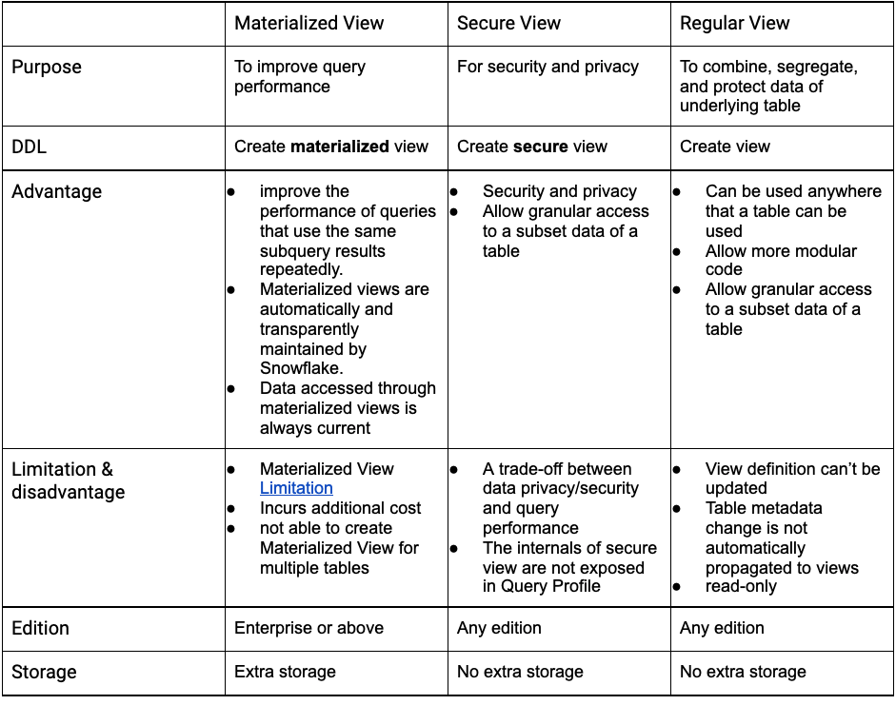
View types

Slide 27
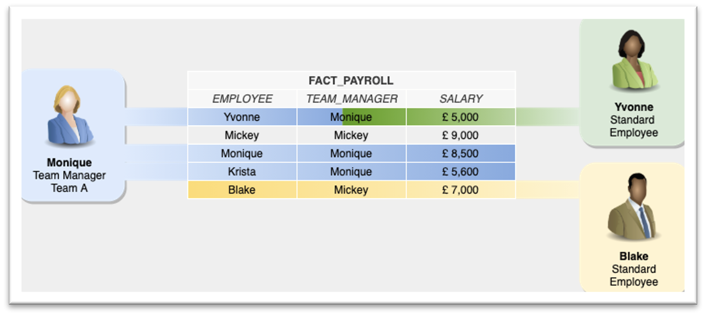
Secured View – Row level security

Slide 28
Example of secure view
create table fact_payroll(employee varchar(100),team_manager varchar(100),salary number)insert into fact_payroll(employee, team_manager, salary)values('Yvonne','Monique',5000), ('Mickey','Mickey',9000)('Monique','Monique',8500)('Krista','Monique',560)('Balke','Mickey',7000)
create or replace secure view my_team asselect * from BWDATABASE.BWSCHEMA.FACT_PAYROLLwhere upper(employee) = current_user() or upper(team_manager)= current_user()

Slide 29
Data Types
Category | Type | Notes
 | Numeric Data Types | NUMBER
 | DECIMAL, NUMERIC | Synonymous with NUMBER.
 | INT, INTEGER, BIGINT, SMALLINT, TINYINT, BYTEINT | Synonymous with NUMBER except precision and scale cannot be specified.
 | FLOAT, FLOAT4, FLOAT8 | ^{[1]}
DOUBLE, DOUBLE PRECISION, REAL | Synonymous with FLOAT. ^{[1]}
 | String & Binary Data Types | VARCHAR
 | CHAR, CHARACTER | Synonymous with VARCHAR except default length is VARCHAR(1).
 | STRING | Synonymous with VARCHAR.
 | TEXT | Synonymous with VARCHAR.
 | BINARY
VARBINARY | Synonymous with BINARY.
Logical Data Types | BOOLEAN | Currently only supported for accounts provisioned after January 25, 2016.
 | Date & Time Data Types | DATE
 | DATETIME | Alias for TIMESTAMP_NTZ
 | TIME
 | TIMESTAMP | Alias for one of the TIMESTAMP variations (TIMESTAMP_NTZ by default).
 | TIMESTAMP_LTZ | TIMESTAMP with local time zone; time zone, if provided, is not stored.
 | TIMESTAMP_NTZ | TIMESTAMP with no time zone; time zone, if provided, is not stored.
TIMESTAMP_TZ | TIMESTAMP with time zone.
 | Semi-structured Data Types | VARIANT
 | OBJECT
ARRAY
 | Geospatial Data Types | GEOGRAPHY
GEOMETRY
Vector Data Types | VECTOR

Slide 30
Snowflake Datatypes
Data Type Category | Data Type | Description | Example
Numeric Data Types | NUMBER (NUMERIC) | Variable precision numeric values | NUMBER(10, 2) for values like 12345.67
 | INTEGER | Whole numbers | INTEGER for values like 42
 | FLOAT (DOUBLE) | Floating-point numbers | FLOAT for values like 3.14159
String & Binary Data Types | STRING (VARCHAR) | Variable-length character strings | VARCHAR(255) for values like 'Hello, World!'
 | CHAR (CHARACTER) | Fixed-length character strings | CHAR(10) for values like 'ABCDEFGHIJ'
 | BINARY | Variable-length binary strings | BINARY(100) for binary data up to 100 bytes
Logical Data Types | BOOLEAN | True/False values | BOOLEAN for values like TRUE or FALSE
Date & Time Data Types | DATE | Calendar dates | DATE for values like '2023-05-18'
 | TIME | Time of day | TIME for values like '13:45:30'
 | TIMESTAMP | Date and time | TIMESTAMP for values like '2023-05-18 13:45:30'
 | TIMESTAMP_LTZ | Timestamp with local time zone | TIMESTAMP_LTZ for values like '2023-05-18 13:45:30'
 | TIMESTAMP_NTZ | Timestamp without time zone | TIMESTAMP_NTZ for values like '2023-05-18 13:45:30'
 | TIMESTAMP_TZ | Timestamp with specified time zone | TIMESTAMP_TZ for values like '2023-05-18 13:45:30+01:00'
Data Type Category | Data Type | Description | Example
Semi-structured Data Types | VARIANT | Flexible data type for semi-structured data | VARIANT for JSON data like {"name": "John", "age": 30}
 | OBJECT | Collection of key-value pairs | OBJECT for values like {"key1": "value1", "key2": "value2"}
 | ARRAY | Ordered list of elements | ARRAY for values like [1, 2, 3, 4]
Structured Data Types | STRUCT | Group of related fields (emulated using nested objects) | STRUCT for values like STRUCT<name STRING, age INTEGER>
Geospatial Data Types | GEOGRAPHY | Represents geospatial data | GEOGRAPHY for values like POINT(-122.35 37.55)
Vector Data Types | VECTOR | Array of numeric values (emulated using ARRAY) | VECTOR for values like [1.0, 2.0, 3.0]
Unsupported Data Types | XML | Not natively supported, can be stored as VARIANT | VARIANT for XML data
 | CLOB | Not natively supported, can be stored as STRING | STRING for large text
 | BLOB | Not natively supported, can be stored as BINARY | BINARY for binary large objects
Data Type Conversion | CAST, CONVERT | Convert data from one type to another | CAST('123' AS INTEGER)
 | TO_CHAR, TO_DATE, TO_NUMBER | Functions to convert between data types | TO_DATE('2023-05-18', 'YYYY-MM-DD')

Slide 31
Snowflake Data Load
Bulk Load

Slide 32
Data Loading to snowflake
Bulk load:
External stages
Internal Stages
User stage
Table stage
Named Stage
Continuous load:
Snowpipe
Snowpipe Streaming

Slide 33
Feature | Supported | Notes
Location of files | Local environment | Files are first copied (“staged”) to an internal (Snowflake) stage, then loaded into a table.
 | Amazon S3 | Files can be loaded directly from any user-supplied bucket.
 | Google Cloud Storage | Files can be loaded directly from any user-supplied bucket.
 | Microsoft Azure cloud storage Blob storage Data Lake Storage Gen2 General-purpose v1 General-purpose v2 | Files can be loaded directly from any user-supplied container.
File formats | Delimited files (CSV, TSV, etc.) | Any valid delimiter is supported; default is comma (i.e. CSV).
 | Semi-structured formats JSON Avro , ORC Parquet , XML (supported as a preview feature)
 | Unstructured formats
File encoding | File format-specific | For delimited files (CSV, TSV, etc.), the default character set is UTF-8
 |  | For semi-structured file formats (JSON, Avro, etc.), the only supported character set is UTF-8.

Slide 34
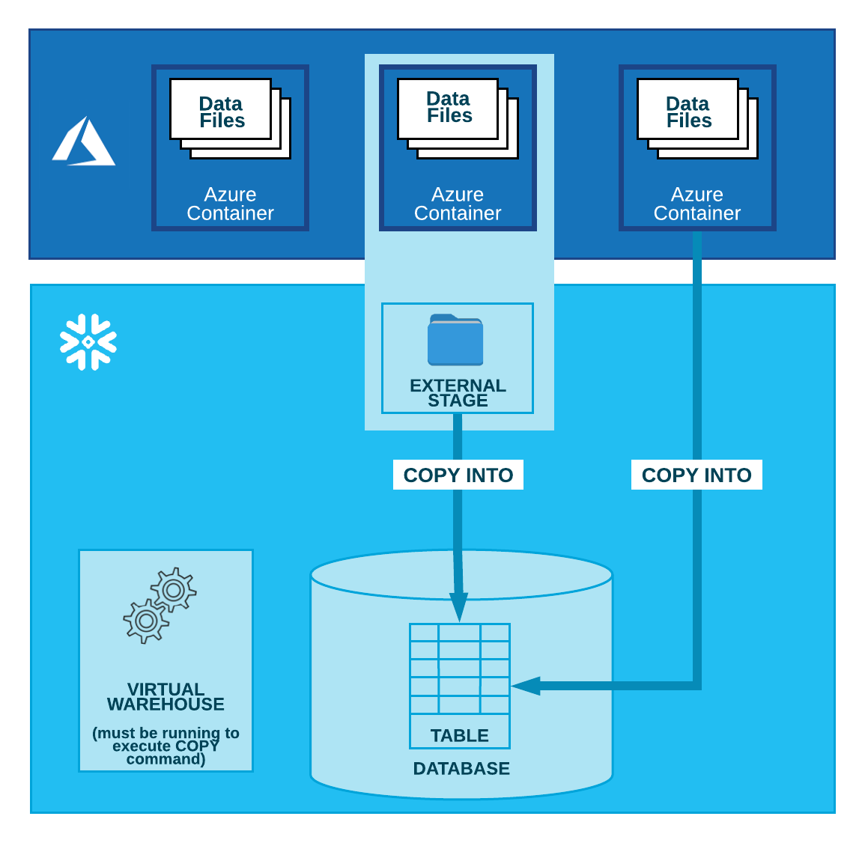
Bulk loading from Microsoft Azure

Slide 35
Configuring an Azure container for loading data
Configure a storage integration:
Step 1: Create a Cloud Storage Integration in Snowflake
Step 2: Grant Snowflake Access to the Storage Locations
Step 3: Create an external stage
Generate a shared access signature (SAS) token
Step 1: Generate the SAS token
Step 2: Create an external stage

Slide 36
Create storage integration
Configure a storage integration:
Step 1: Create a Cloud Storage Integration in Snowflake
CREATE STORAGE INTEGRATION <integration_name>
TYPE = EXTERNAL_STAGE
STORAGE_PROVIDER = 'AZURE'
ENABLED = TRUE
AZURE_TENANT_ID = '<tenant_id>'
STORAGE_ALLOWED_LOCATIONS = ('azure://<account>.blob.core.windows.net/<container>/<path>/', 'azure://<account>.blob.core.windows.net/<container>/<path>/')
[ STORAGE_BLOCKED_LOCATIONS = ('azure://<account>.blob.core.windows.net/<container>/<path>/', 'azure://<account>.blob.core.windows.net/<container>/<path>/’) ]
Actual code:
CREATE STORAGE INTEGRATION azure_int TYPE = EXTERNAL_STAGE STORAGE_PROVIDER = 'AZURE' ENABLED = TRUE AZURE_TENANT_ID = 'e5b37e62-c6cc-42ca-bd74-05b3ddd02784' STORAGE_ALLOWED_LOCATIONS = ('azure://bw2023snowflakedata.blob.core.windows.net/bw2023snowflakedatacontainer/') -- [ STORAGE_BLOCKED_LOCATIONS = ('azure://<account>.blob.core.windows.net/<container>/<path>/', 'azure://<account>.blob.core.windows.net/<container>/<path>/') ] ;

Slide 37
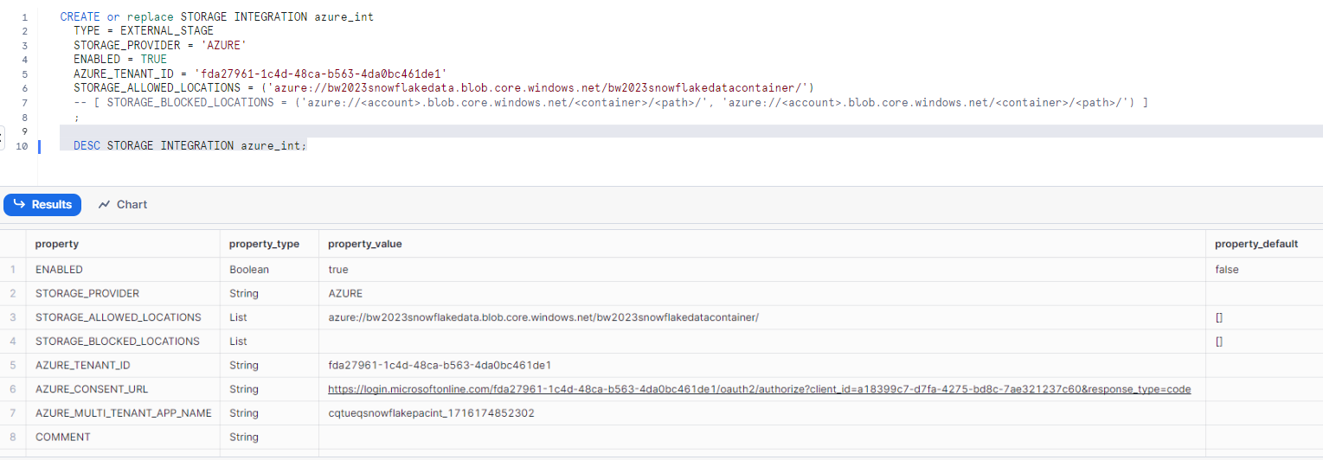
Create storage integration
Step 2: Grant Snowflake Access to the Storage Locations

Slide 38
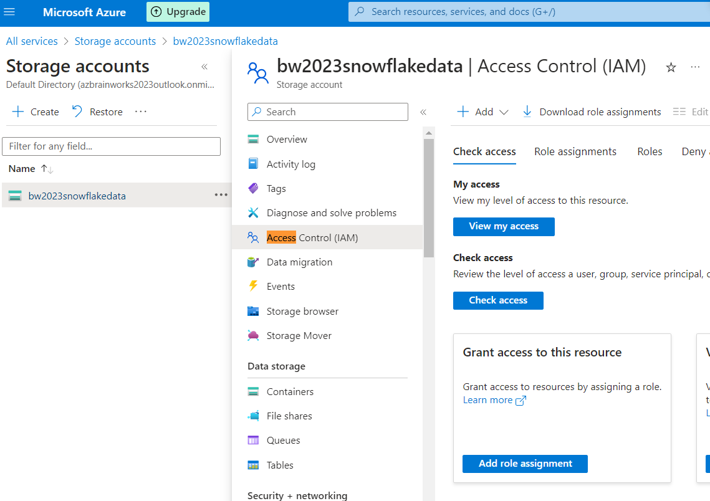
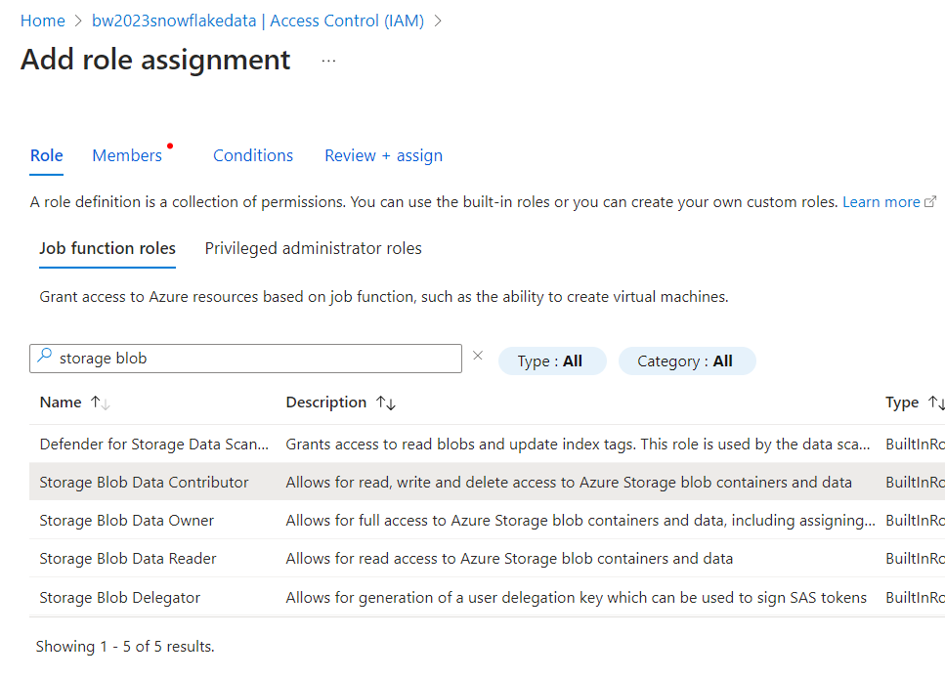
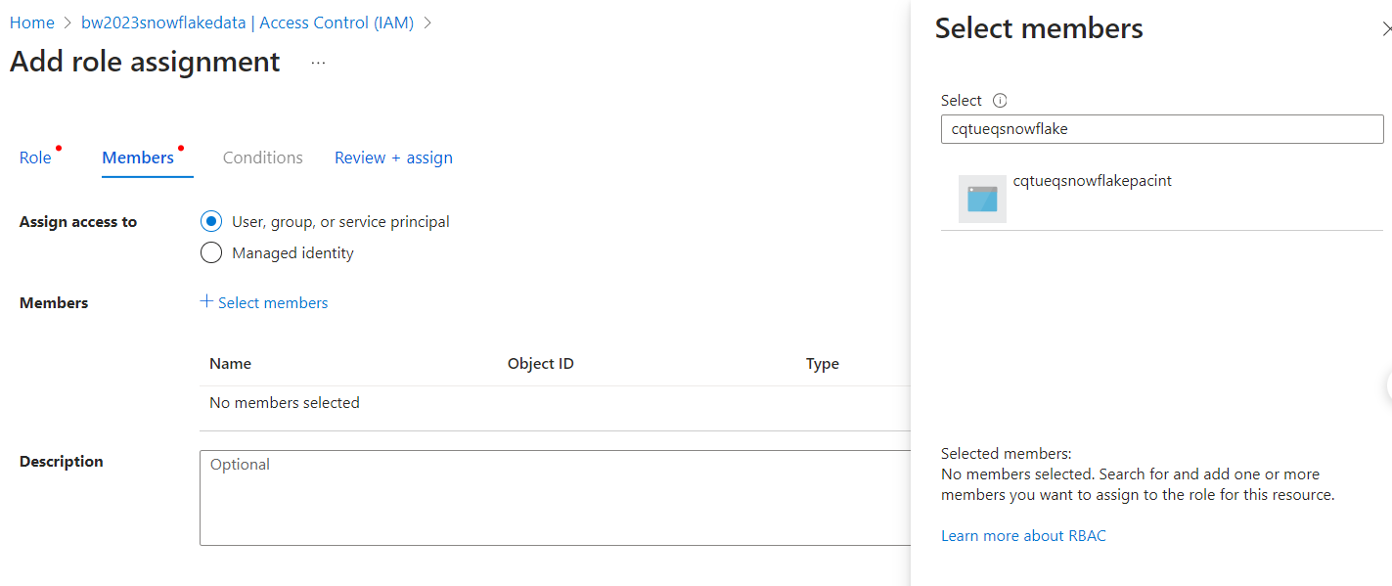
Create storage integration
Step 2: Grant Snowflake Access to the Storage Locations

Slide 39
Create storage integration
Step 2: Grant Snowflake Access to the Storage Locations

Slide 40
Create storage integration
GRANT CREATE STAGE ON SCHEMA BWSCHEMA TO ROLE ACCOUNTADMIN;
GRANT USAGE ON INTEGRATION azure_int TO ROLE ACCOUNTADMIN;
create or replace file format csv_superstore
TYPE=CSV SKIP_HEADER=1 FIELD_DELIMITER=',’
TRIM_SPACE=FALSE FIELD_OPTIONALLY_ENCLOSED_BY='"'
REPLACE_INVALID_CHARACTERS=TRUE DATE_FORMAT=AUTO
TIME_FORMAT=AUTO TIMESTAMP_FORMAT=AUTO;
create replace stage az_stg_superstore
storage_integration = azure_int
URL = 'azure://bw2023snowflakedata.blob.core.windows.net/bw2023snowflakedatacontainer/’
file_format = csv_superstore;
list @az_stg_superstore;
select $1,$2,$3 from @az_stg_superstore (file_format=>'csv_superstore’)
create or replace TABLE BWDATABASE.BWSCHEMA.SUPERSTORE_NEW (
ROWID NUMBER(38,0),
ORDERID VARCHAR(16777216),
ORDERDATE DATE, SHIPDATE DATE,
SHIPMODE VARCHAR(16777216),
CUSTOMERID VARCHAR(16777216),
CUSTOMERNAME VARCHAR(16777216),
SEGMENT VARCHAR(16777216),
COUNTRYREGION VARCHAR(16777216),
CITY VARCHAR(16777216),
STATE VARCHAR(16777216),
POSTALCODE NUMBER(38,0),
REGION VARCHAR(16777216),
PRODUCTID VARCHAR(16777216),
CATEGORY VARCHAR(16777216),
SUBCATEGORY VARCHAR(16777216),
PRODUCTNAME VARCHAR(16777216),
SALES NUMBER(38,4),
QUANTITY NUMBER(38,0),
DISCOUNT NUMBER(38,2),
PROFIT NUMBER(38,4));
COPY INTO superstore_new from @az_stg_superstore;list @az_stg_superstore

Slide 41
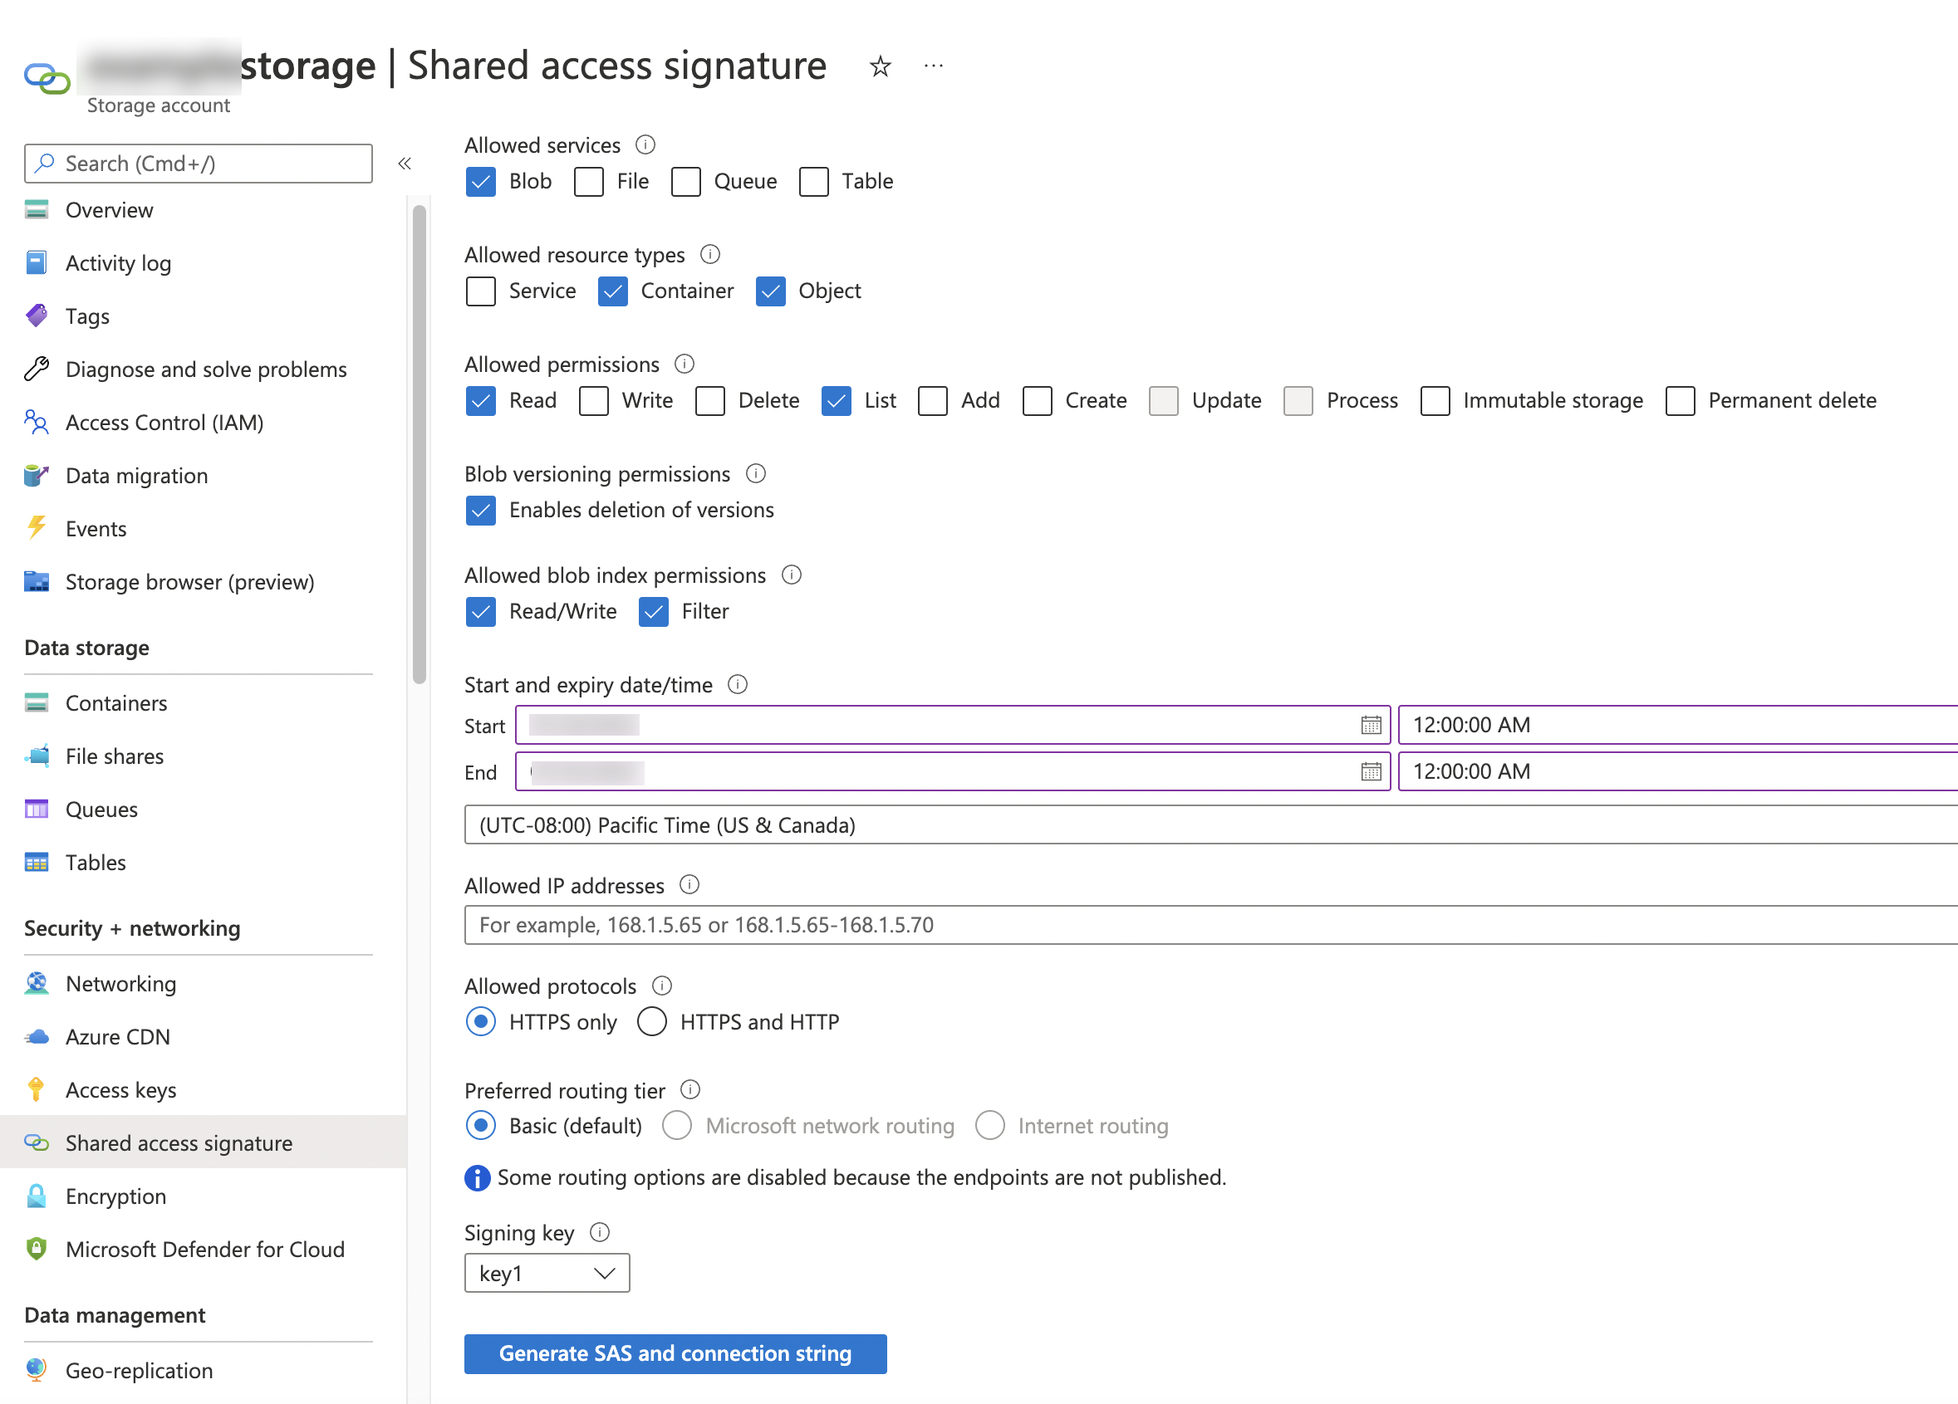
Create storage integration
Generate a shared access signature (SAS) token
Step 1: Generate the SAS token
Step 2: Create an external stage

Slide 42
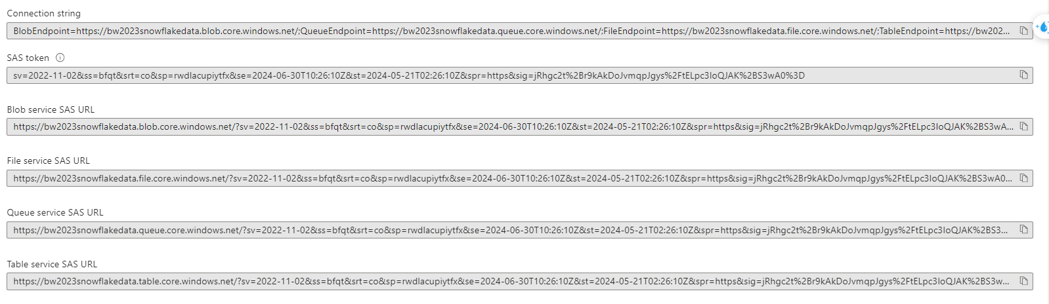
shared access signature (SAS) token
Generate a shared access signature (SAS) token
Step 1: Generate the SAS token
Step 2: Create an external stage

Slide 43
shared access signature (SAS) token
CREATE OR REPLACE STAGE bw_azure_stage_sas URL='azure://bw2023snowflakedata.blob.core.windows.net/bw2023snowflakedatacontainer/' CREDENTIALS=(AZURE_SAS_TOKEN='sv=2022-11-02&ss=bfqt&srt=co&sp=rwdlacupiytfx&se=2024-06-30T10:26:10Z&st=2024-05-21T02:26:10Z&spr=https&sig=jRhgc2t%2Br9kAkDoJvmqpJgys%2FtELpc3IoQJAK%2BS3wA0%3D') ENCRYPTION=(TYPE='NONE') FILE_FORMAT = csv_superstore;
list @bw_azure_stage_sas
delete from superstore_new
create table superstore_new_sas as select * from superstore_new
COPY INTO superstore_new_sas from @bw_azure_stage_sas;

Slide 44
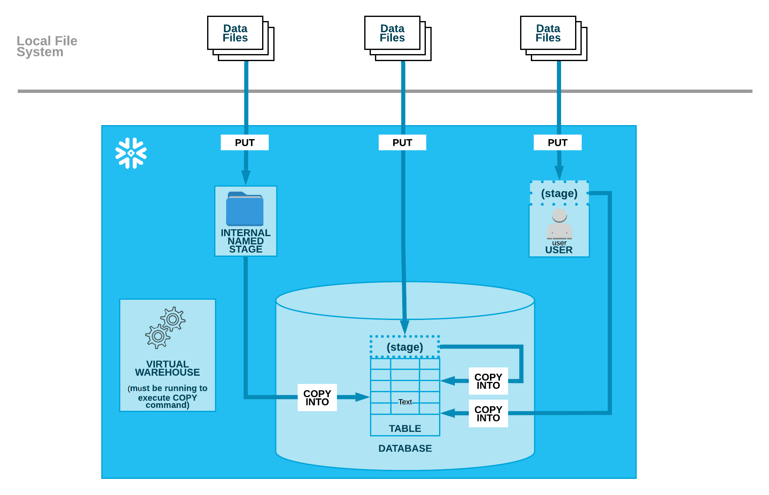
Loading data from local file system

Slide 45
Creating Internal Stages – USER STAGE
Staging the Data Files
User Stage
User stages are referenced using @~; e.g. use LIST @~ to list the files in a user stage.
Unlike named stages, user stages cannot be altered or dropped.
User stages do not support setting file format options. Instead, you must specify file format and copy options as part of the COPY INTO <table> command.
E.g. PUT file://C:\data\data.csv @~/staged;
LIST @~;
COPY INTO mytable from @~/staged FILE_FORMAT = (FORMAT_NAME = 'my_csv_format');

Slide 46
Creating Internal Stages – TABLE STAGE
Staging the Data Files
Table Stage
Table stages have the same name as the table; e.g. a table named mytable has a stage referenced as @%mytable.
Unlike named stages, table stages cannot be altered or dropped.
Table stages do not support transforming data while loading it (i.e. using a query as the source for the COPY command).
E.g. PUT file://C:\data\data.csv @%mytable;
LIST @%mytable;
COPY INTO mytable FILE_FORMAT = (TYPE = CSV FIELD_DELIMITER = '|' SKIP_HEADER = 1);

Slide 47
Creating Internal Stages – NAMED STAGE
Staging the Data Files
Named Stage
Users with the appropriate privileges on the stage can load data into any table.
Because the stage is a database object, the security/access rules that apply to all objects apply. The privileges to use a stage can be granted or revoked from roles. In addition, ownership of the stage can be transferred to another role.
E.g. PUT file://C:\data\data.csv @my_stage;
LIST @my_stage;
COPY INTO mytable from @my_stage;

Slide 48
Removing Internal staged Files
Files that were loaded successfully can be deleted from the stage during a load by specifying the PURGE copy option in the COPY INTO <table> command.
Load files from a table’s stage into the table and purge files after loading. By default, COPY does not purge loaded files from the location. To purge the files after loading:
that all files successfully loaded into the table a Set PURGE=TRUE for the table to specify re purged after loading:
ALTER TABLE mytable SET STAGE_COPY_OPTIONS = (PURGE = TRUE);
COPY INTO mytable;
You can also override any of the copy options directly in the COPY command:
COPY INTO mytable PURGE = TRUE;
After the load completes, use the REMOVE command to remove the files in the stage.
REMOVE @mystage/path1/subpath2;
REMOVE @%orders;
RM @~ pattern='.*jun.*';

Slide 49
DIRECTORY TABLES
A directory table is an implicit object layered on a stage (not a separate database object) and is conceptually similar to an external table because it stores file-level metadata about the data files in the stage. A directory table has no grantable privileges of its own.
This example retrieves all metadata columns in a directory table for a stage named mystage:
SELECT * FROM DIRECTORY(@mystage);

Slide 50
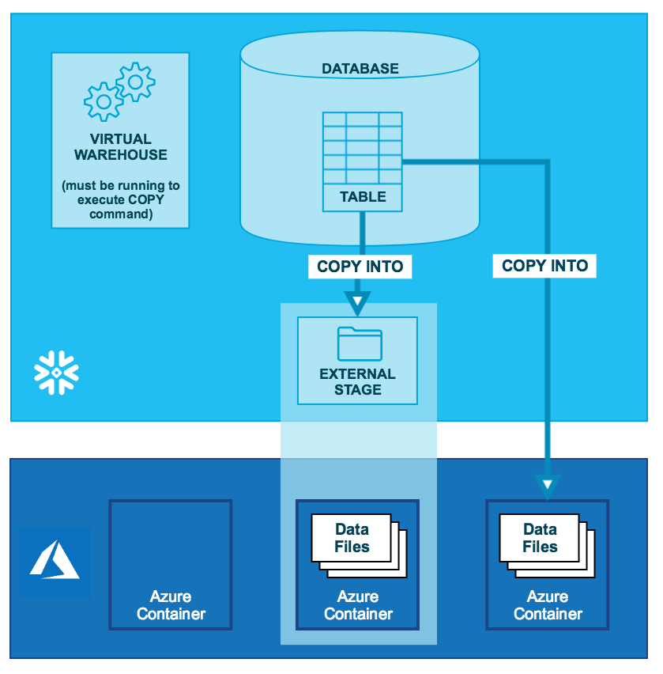
DATA unloading – External Stage AZURE

Slide 51
DATA unloading – External Stage - AZURE
Unload using Storage integration:
Unload using stage storage:
Create storage integration
CREATE or replace STORAGE INTEGRATION azure_int TYPE = EXTERNAL_STAGE STORAGE_PROVIDER = 'AZURE' ENABLED = TRUE AZURE_TENANT_ID = 'fda27961-1c4d-48ca-b563-4da0bc461de1' STORAGE_ALLOWED_LOCATIONS = ('azure://bw2023snowflakedata.blob.core.windows.net/bw2023snowflakedatacontainer/')
Create stage
CREATE OR REPLACE STAGE az_ext_unload_stage_superstore URL='azure://bw2023snowflakedata.blob.core.windows.net/bw2023snowflakedatacontainer/snowoutput/' STORAGE_INTEGRATION = azure_int FILE_FORMAT = csv_superstore;
Copy data
COPY INTO @az_ext_unload_stage_superstore from SUPERSTORE_FRMUSERSTG;
Unload without using stage:
Create storage integration
CREATE or replace STORAGE INTEGRATION azure_int TYPE = EXTERNAL_STAGE STORAGE_PROVIDER = 'AZURE' ENABLED = TRUE AZURE_TENANT_ID = 'fda27961-1c4d-48ca-b563-4da0bc461de1' STORAGE_ALLOWED_LOCATIONS = ('azure://bw2023snowflakedata.blob.core.windows.net/bw2023snowflakedatacontainer/')
Copy data
COPY INTO 'azure://bw2023snowflakedata.blob.core.windows.net/bw2023snowflakedatacontainer/snowoutput/d1/' from SUPERSTORE_FRMUSERSTG storage_integration = azure_int;
Unload using SAS token
Create SAS token – as shown in previous slide
Create stage –
CREATE OR REPLACE STAGE bw_azure_stage_sas
URL='azure://bw2023snowflakedata.blob.core.windows.net/bw2023snowflakedatacontainer/'
CREDENTIALS=(AZURE_SAS_TOKEN='sv=2022-11-02&ss=bfqt&srt=co&sp=rwdlacupiytfx&se=2024-06-30T10:26:10Z&st=2024-05- 21T02:26:10Z&spr=https&sig=jRhgc2t%2Br9kAkDoJvmqpJgys%2FtELpc3IoQJAK%2BS3wA0%3D')
ENCRYPTION=(TYPE='NONE')
FILE_FORMAT = csv_superstore;
Copy data
COPY INTO @ bw_azure_stage_sas from SUPERSTORE_FRMUSERSTG;

Slide 52
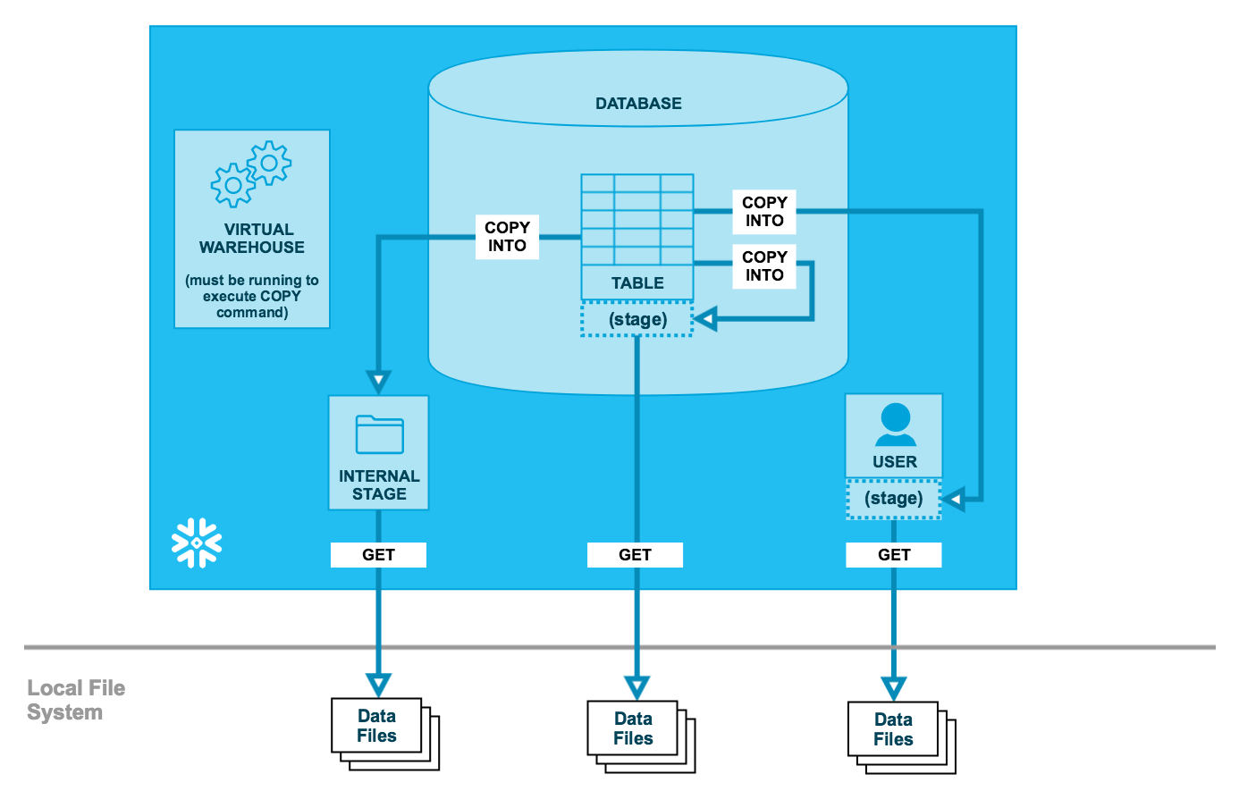
DATA Unloading – Via internal Stage

Slide 53
DATA Unloading – Via internal Stage
Unloading Data to a Named Internal Stage
CREATE OR REPLACE STAGE SUPERSTORE_FRMUSERSTG_UNLD_NMED
FILE_FORMAT = csv_superstore_new;
COPY INTO @SUPERSTORE_FRMUSERSTG_UNLD_NMED/unload/ from SUPERSTORE;
GET @SUPERSTORE_FRMUSERSTG_UNLD_NMED/unload/data_0_0_0.csv.gz file://C:\data\unload;
Unloading data via table stage
COPY INTO @%mytable/unload/ from mytable FILE_FORMAT = (FORMAT_NAME = 'my_csv_unload_format' COMPRESSION = NONE);
GET @%mytable/unload/data_0_0_0.csv file://C:\data\unload;
Unloading Data to Your User Stage
COPY INTO @~/unload/ from SUPERSTORE_FRMUSERSTG FILE_FORMAT = (FORMAT_NAME = 'csv_superstore' COMPRESSION = NONE);
GET @~/unload/data_0_0_0.csv file://~/;

Slide 54
SNOWPIPE
Snowpipe enables loading data from files as soon as they’re available in a stage. This means you can load data from files in micro-batches, making it available to users within minutes, rather than manually executing COPY statements on a schedule to load larger batches.
Different mechanisms for detecting the staged files are available:
Automating Snowpipe using cloud messaging
Calling Snowpipe REST endpoints

Slide 55
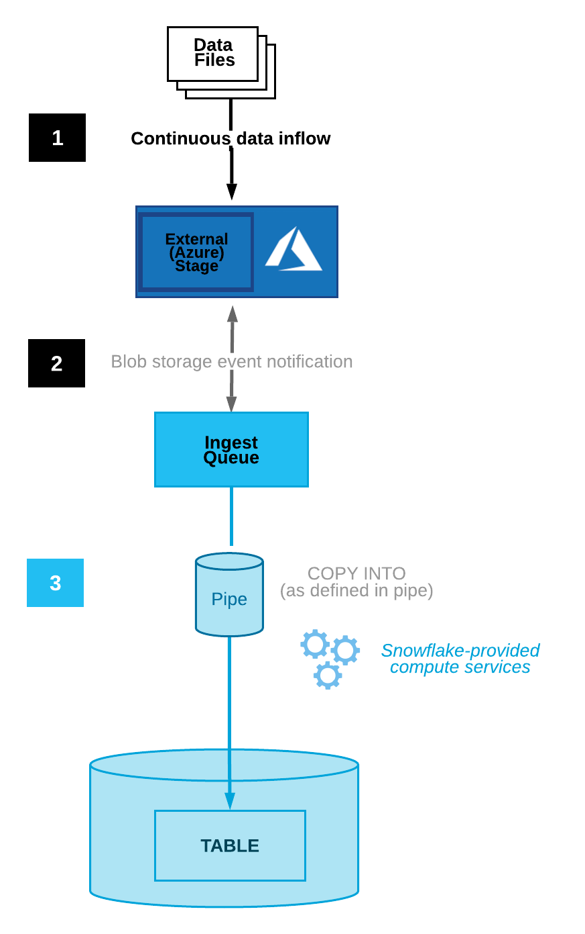
SNowpipe

Slide 56
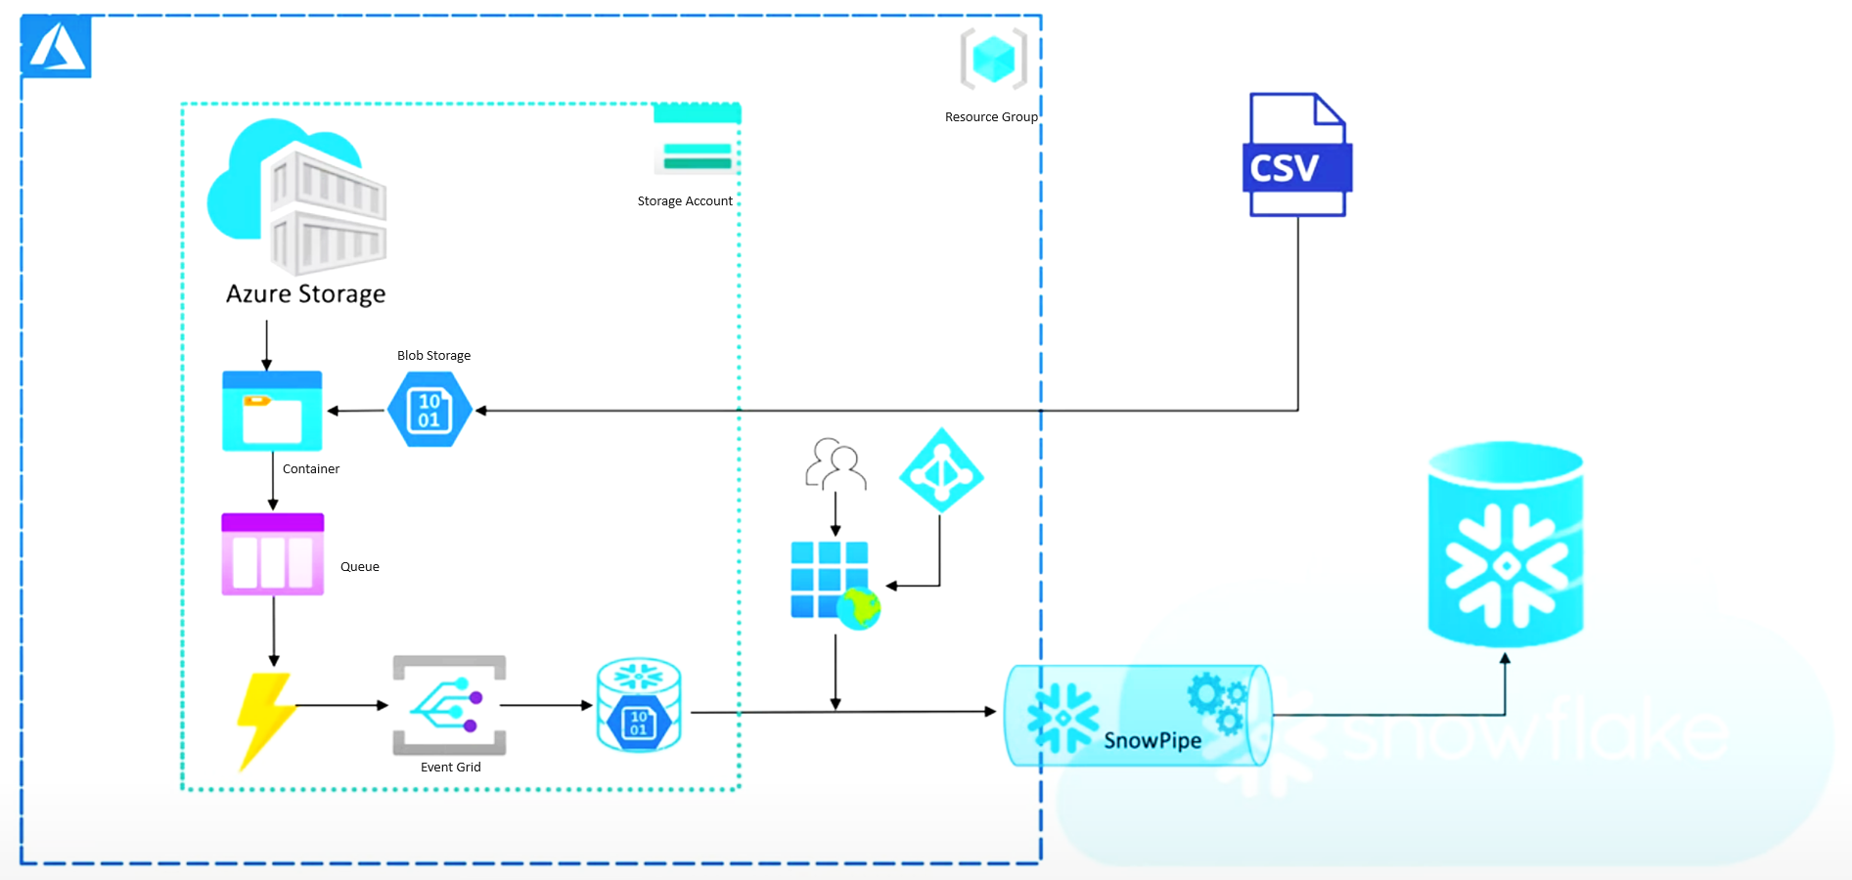
SNowpipe

Slide 57
SNowpipe
-- Step -1 create storage integration CREATE or replace STORAGE INTEGRATION azure_int_new TYPE = EXTERNAL_STAGE STORAGE_PROVIDER = 'AZURE' ENABLED = TRUE AZURE_TENANT_ID = 'fda27961-1c4d-48ca-b563-4da0bc461de1' STORAGE_ALLOWED_LOCATIONS = ('azure://bw2023snowflakedata.blob.core.windows.net/bw2023snowflakedatacontainer/');DESC STORAGE INTEGRATION azure_int_new; GRANT CREATE STAGE ON SCHEMA BWSCHEMA TO ROLE ACCOUNTADMIN;GRANT USAGE ON INTEGRATION azure_int_new TO ROLE ACCOUNTADMIN;-- Step -2 Create file formatcreate or replace file format csv_superstore TYPE=CSV SKIP_HEADER=1 FIELD_DELIMITER=',' TRIM_SPACE=FALSE FIELD_OPTIONALLY_ENCLOSED_BY='"' REPLACE_INVALID_CHARACTERS=TRUE DATE_FORMAT=AUTO TIME_FORMAT=AUTO TIMESTAMP_FORMAT=AUTO;-- Step -3 Create table structurecreate or replace TABLE BWDATABASE.BWSCHEMA.SUPERSTORE_fromsnowpipe ( ROWID NUMBER(38,0), ORDERID VARCHAR(16777216), ORDERDATE DATE, SHIPDATE DATE, SHIPMODE VARCHAR(16777216), CUSTOMERID VARCHAR(16777216), CUSTOMERNAME VARCHAR(16777216), SEGMENT VARCHAR(16777216), COUNTRYREGION VARCHAR(16777216), CITY VARCHAR(16777216), STATE VARCHAR(16777216), POSTALCODE NUMBER(38,0), REGION VARCHAR(16777216), PRODUCTID VARCHAR(16777216), CATEGORY VARCHAR(16777216), SUBCATEGORY VARCHAR(16777216), PRODUCTNAME VARCHAR(16777216), SALES NUMBER(38,4), QUANTITY NUMBER(38,0), DISCOUNT NUMBER(38,2), PROFIT NUMBER(38,4));-- Step -4 Create stagecreate or replace stage az_stg_superstore_snowpipestorage_integration = azure_int_new file_format = csv_superstore; list @az_stg_superstore_snowpipe; drop NOTIFICATION INTEGRATION AZ_NOTIFICATION_INT; CREATE or replace NOTIFICATION INTEGRATION AZ_NOTIFICATION_INT ENABLED =TRUE TYPE =QUEUE NOTIFICATION_PROVIDER=AZURE_STORAGE_QUEUE AZURE_STORAGE_QUEUE_PRIMARY_URI = 'https://bw2023snowflakedata.queue.core.windows.net/storagequeues' AZURE_TENANT_ID = 'fda27961-1c4d-48ca-b563-4da0bc461de1'; desc NOTIFICATION INTEGRATION AZ_NOTIFICATION_INT; CREATE OR REPLACE STAGE bw_azure_stage_sas URL='azure://bw2023snowflakedata.blob.core.windows.net/bw2023snowflakedatacontainer/' CREDENTIALS=(AZURE_SAS_TOKEN='sv=2022-11-02&ss=bfqt&srt=co&sp=rwlaciytfx&se=2024-06-29T12:39:17Z&st=2024-05-26T04:39:17Z&spr=https&sig=7JreCeW87wEVBmZdQrcNAJ%2FR9fV%2FJ64L3sV7SYaI5M8%3D') ENCRYPTION=(TYPE='NONE') FILE_FORMAT = csv_superstore; -- Step -5 Create snowpipecreate pipe az_superstore_snowpipe_new auto_ingest = TRUE integration = 'AZ_NOTIFICATION_INT' as copy into SUPERSTORE_fromsnowpipe from @bw_azure_stage_sas; -- Step -6 select count(*) from SUPERSTORE_fromsnowpipe;

Slide 58
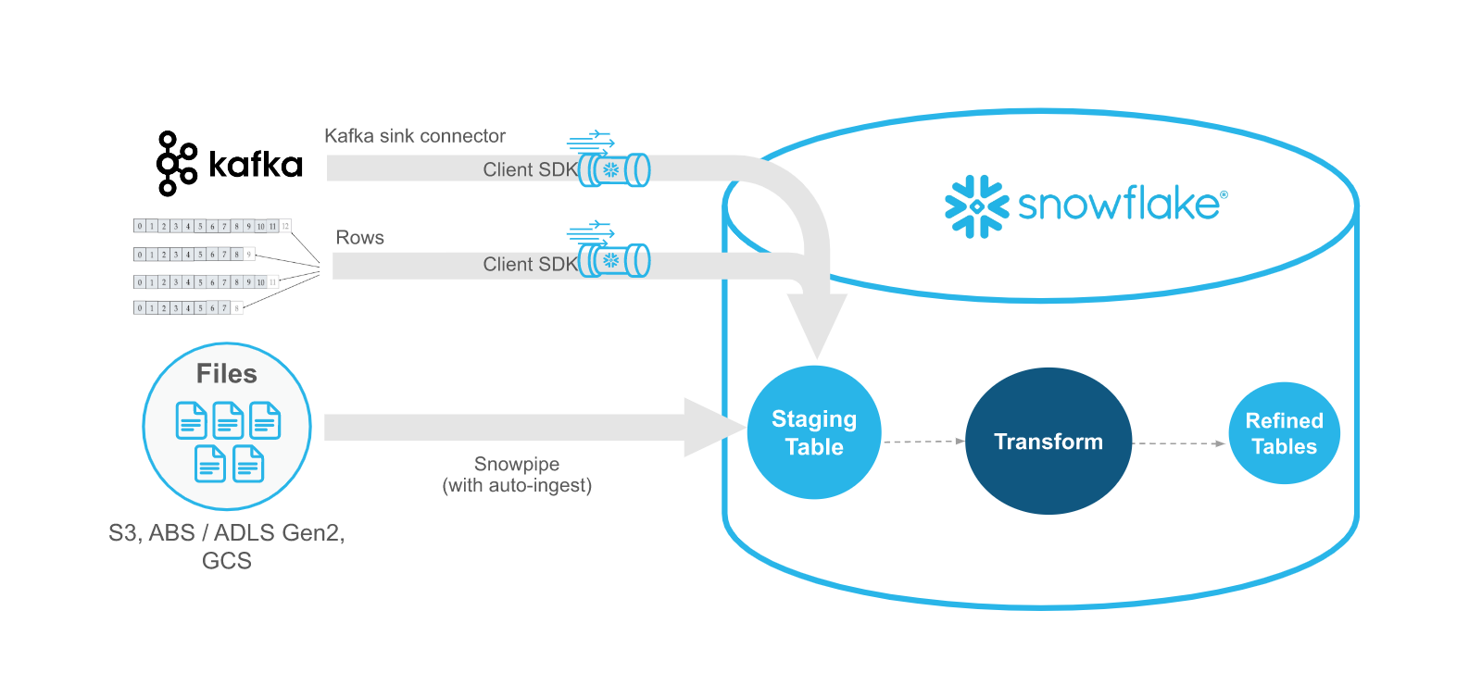
Snowpipe - Streaming

Slide 59
Working with semi structure data
Semi-structured Data Types:
The following Snowflake data types can contain Semi-structure data:
VARIANT (can contain any other data type). E.g. {“key1” : “value1”, “key2”: “value2”}
ARRAY (can directly contain VARIANT, and thus indirectly contain any other data type, including itself). E.g. [1,2,3]
OBJECT (can directly contain VARIANT, and thus indirectly contain any other data type, including itself). E.g.
{
"outer_key1": {
"inner_key1A": "1a",
"inner_key1B": "1b“
},
"outer_key2": {
"inner_key2": 2
}
}
Querying Semi-structured Data:
Snowflake supports operators for:
Accessing an element in an array.
Retrieving a specified value from a key-value pair in an OBJECT.
Traversing the levels of a hierarchy stored in a VARIANT.

Slide 60
Working with semi structure data
Querying Semi-structured Data:
Snowflake supports operators for:
Accessing an element in an array.
select my_array_column[2] from my_table;
select my_array_column[0][0] from my_table;
select array_slice(my_array_column, 5, 10) from my_table;
Inserting data in arrary datatype
INSERT INTO array_example (array_column)
SELECT ARRAY_CONSTRUCT(12, 'twelve', NULL);
Retrieving a specified value from a key-value pair in an OBJECT.
select my_variant_column['key1'] from my_table;
Inserting data to object
INSERT INTO object_example (object_column)
SELECT OBJECT_CONSTRUCT('thirteen', 13::VARIANT, 'zero', 0::VARIANT);
Traversing the levels of a hierarchy stored in a VARIANT.

Slide 61
Working with semi structure data
Querying Semi-structured Data:
Snowflake supports operators for:
Traversing the levels of a hierarchy stored in a VARIANT.
Using : (colon)
Using Dot Notation
Using Bracket notation
Retrieving single instance of repeating element
Explicitly casting values
Using FLATTEN function
Data inserted using PARSE_JSON

Slide 62
Snowflake data sharing and collaboration

Slide 63
data sharing and collaboration
Secure Data Sharing lets you share selected objects in a database in your account with other Snowflake accounts. You can share the following Snowflake objects:
Databases
Tables
Dynamic tables
External tables
Iceberg tables
Secure views
Secure materialized views
Secure user-defined functions (UDFs)
Important: All database objects shared between accounts are read-only (i.e. the objects cannot be modified or deleted, including adding or modifying table data).

Slide 64
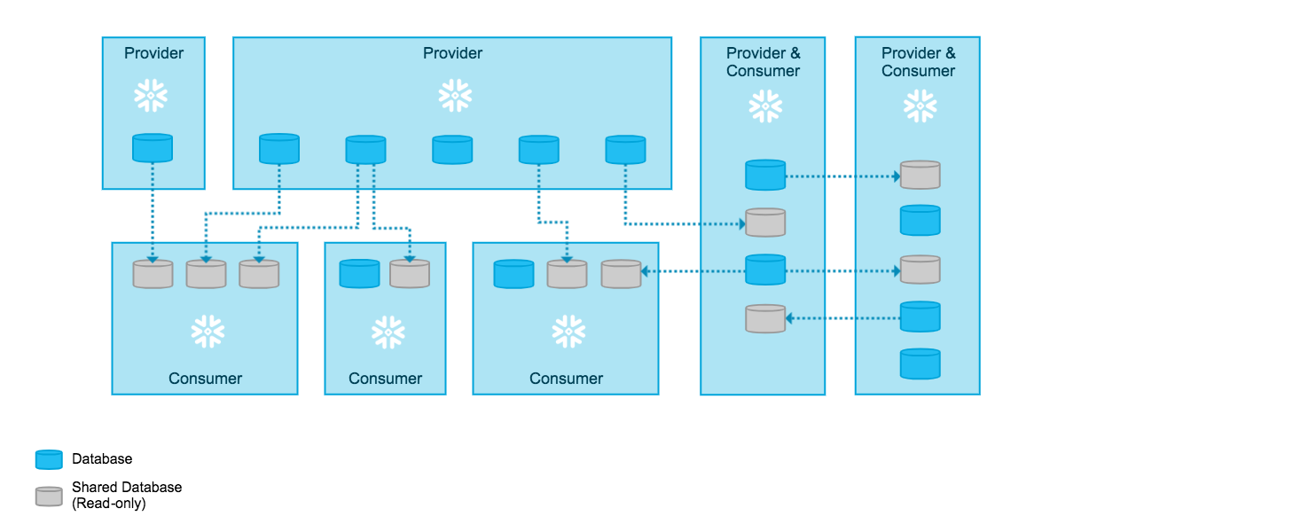
data sharing and collaboration

Slide 65
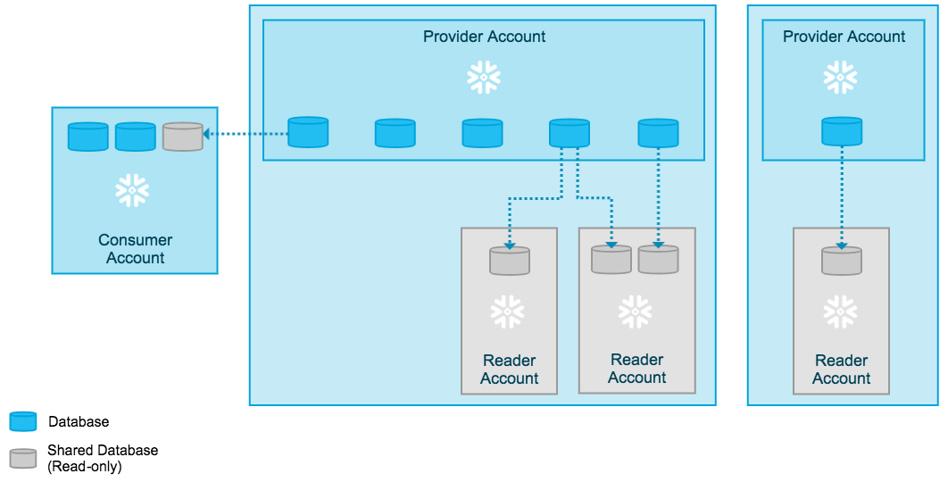
Reader accounts for third-party access
Data sharing is only supported between Snowflake accounts. As a data provider, you might want to share data with a consumer who does not already have a Snowflake account or is not ready to become a licensed Snowflake customer.
To facilitate sharing data with these consumers, you can create reader accounts. Reader accounts (formerly known as “read-only accounts”) provide a quick, easy, and cost-effective way to share data without requiring the consumer to become a Snowflake customer.
Each reader account belongs to the provider account that created it. As a provider, you use shares to share databases with reader accounts; however, a reader account can only consume data from the provider account that created it. Refer to the following diagram:

Slide 66
data sharing and collaboration

Slide 67
AWS

Slide 68
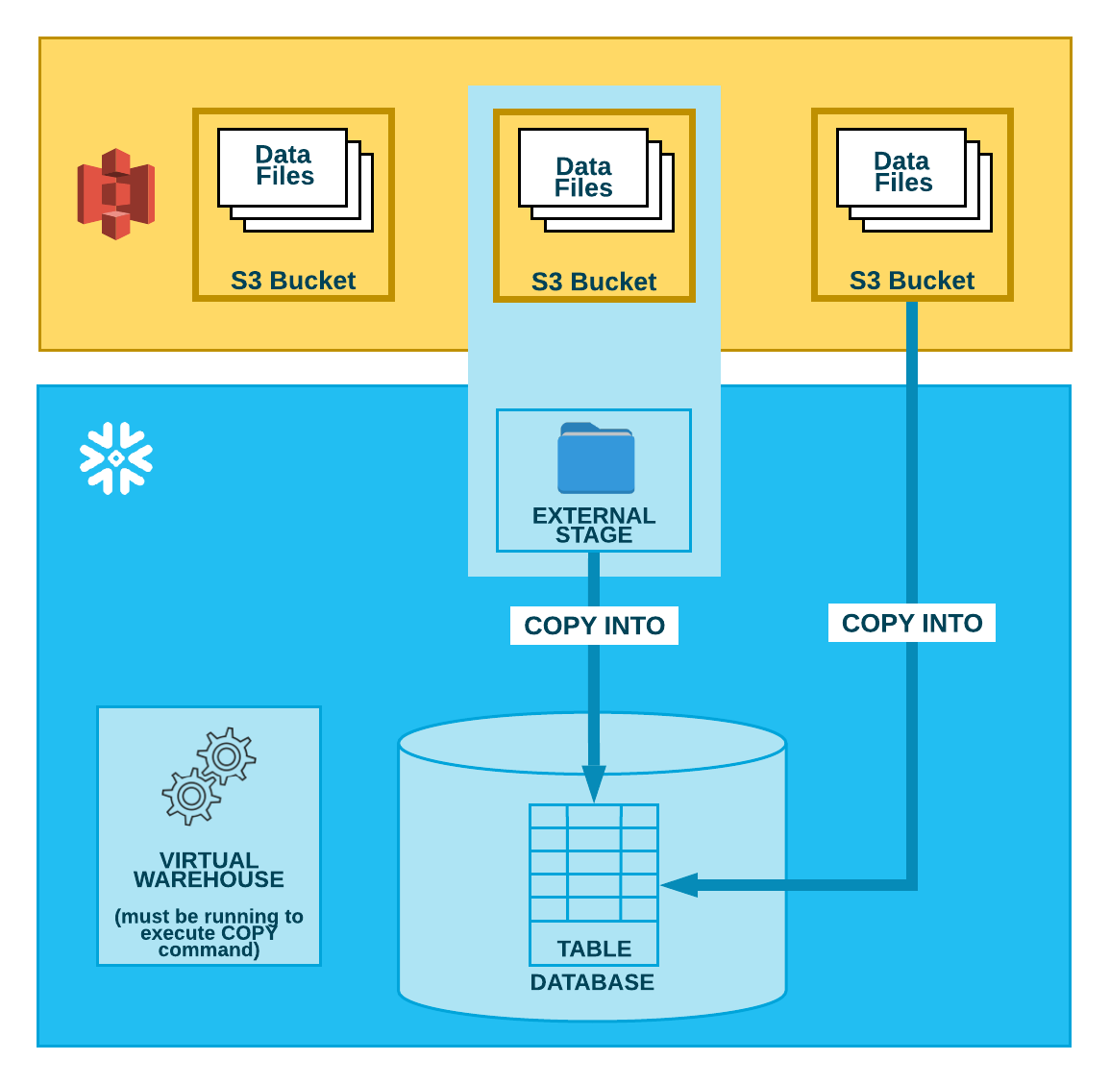
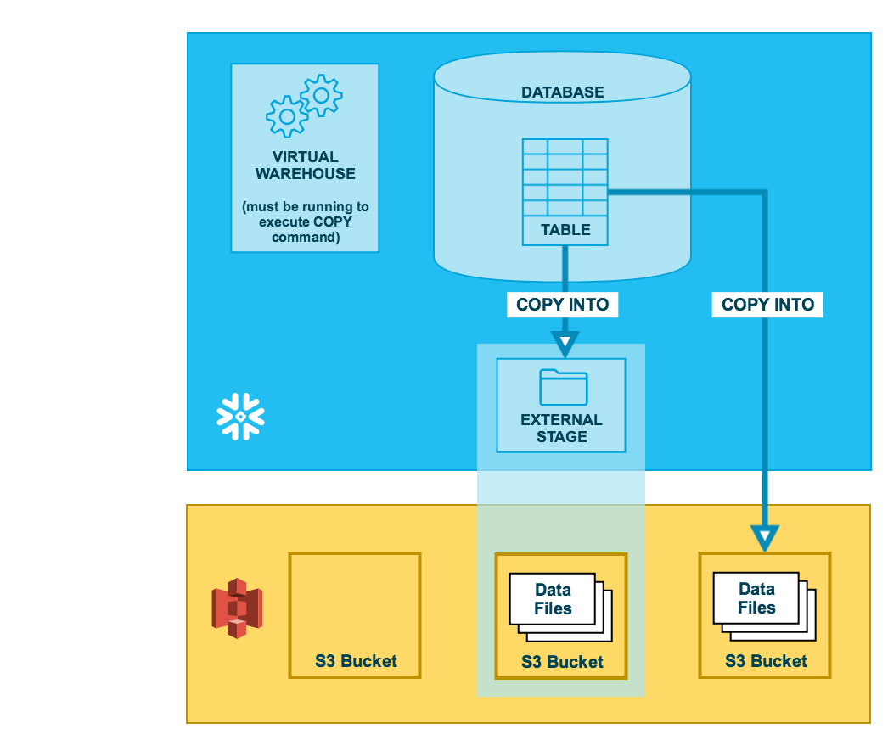
DATA unloading – External Stage AWS

Slide 69
DATA unloading – External Stage - AZURE
COPY via named stage:
CREATE OR REPLACE STAGE my_ext_unload_stage URL='s3://unload/files/'
STORAGE_INTEGRATION = s3_int
FILE_FORMAT = my_csv_unload_format;
COPY INTO @my_ext_unload_stage/d1 from mytable;
Unloading Data Directly into an S3 Bucket
COPY INTO s3://mybucket/unload/ from mytable storage_integration = s3_int;

Slide 70
DATA unloading – External Stage
COPY via named stage:
CREATE OR REPLACE STAGE my_ext_unload_stage URL='s3://unload/files/'
STORAGE_INTEGRATION = s3_int
FILE_FORMAT = my_csv_unload_format;
COPY INTO @my_ext_unload_stage/d1 from mytable;
Unloading Data Directly into an S3 Bucket
COPY INTO s3://mybucket/unload/ from mytable storage_integration = s3_int;

Slide 71
DATA Unloading – Via internal Stage

Slide 72
DATA Unloading – Via internal Stage
Unloading Data to a Named Internal Stage
CREATE OR REPLACE STAGE my_unload_stage
FILE_FORMAT = my_csv_unload_format;
COPY INTO @mystage/unload/ from mytable;
GET @mystage/unload/data_0_0_0.csv.gz file://C:\data\unload;
Unloading data via table stage
COPY INTO @%mytable/unload/ from mytable FILE_FORMAT = (FORMAT_NAME = 'my_csv_unload_format' COMPRESSION = NONE);
GET @%mytable/unload/data_0_0_0.csv file://C:\data\unload;
Unloading Data to Your User Stage
COPY INTO @~/unload/ from mytable FILE_FORMAT = (FORMAT_NAME = 'my_csv_unload_format' COMPRESSION = NONE);
GET @~/unload/data_0_0_0.csv file://C:\data\unload;

Slide 73
SNOWPIPE
Snowpipe enables loading data from files as soon as they’re available in a stage. This means you can load data from files in micro-batches, making it available to users within minutes, rather than manually executing COPY statements on a schedule to load larger batches.
Different mechanisms for detecting the staged files are available:
Automating Snowpipe using cloud messaging
Calling Snowpipe REST endpoints

Slide 74
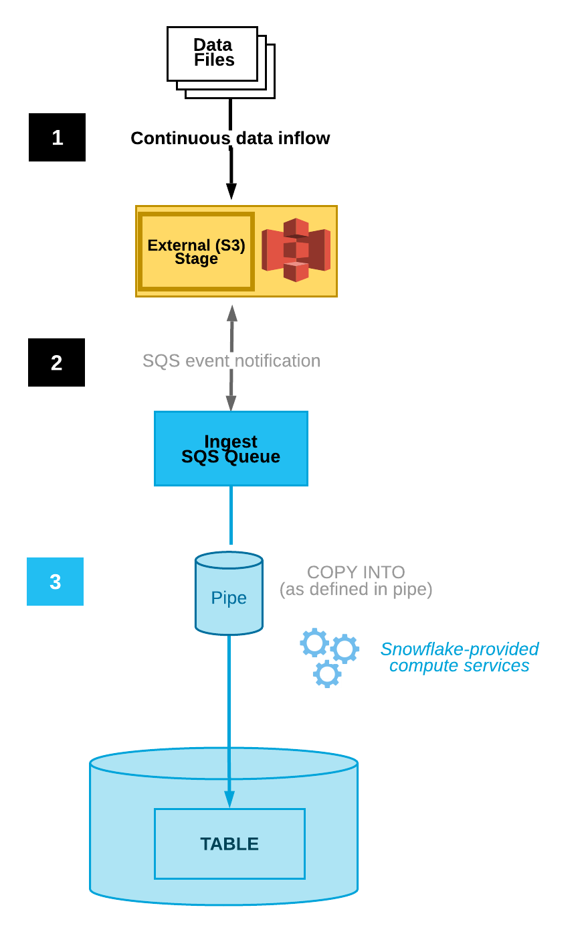
SNowpipe

Slide 75
Snowpipe - Streaming

